Slide 1
DEEP-TECH EDUCATION · DRESDEN
PhysicsMind
A personal science tutor for every student who doesn’t have one.
A great teacher can’t be there 24×7 — so learning stays passive.
PhysicsMind is always on — learning that’s active and proactive, never passive.
Pradeep Nagapuri — Graduate, Dresden International University (2026)
Deep-tech education startup · built in Dresden, Germany
APPLYING FOR EXIST-GRÜNDERSTIPENDIUM
PhysicsMind
1 / 9
Notes:
Say: “I just finished my degree at Dresden International University. I'm building a deep-tech education company — an always-on AI tutor that makes students learn actively and proactively, not just watch passively — and I'd like to understand whether and how EXIST can support it.”

Slide 2
THE PROBLEM
Understanding science shouldn’t depend on affording a great teacher.
◆ A great tutor is the biggest advantage in learning — and never available 24×7
◆ Video and text are passive — students watch, they don’t do
◆ Students memorise formulas; misconceptions go uncorrected
◆ 1-to-1 tutoring is expensive and doesn’t scale
PhysicsMind
2 / 9
Notes:
Say: “The real gap isn't content — it's access to a teacher who makes it click and corrects how you think.”

Slide 3
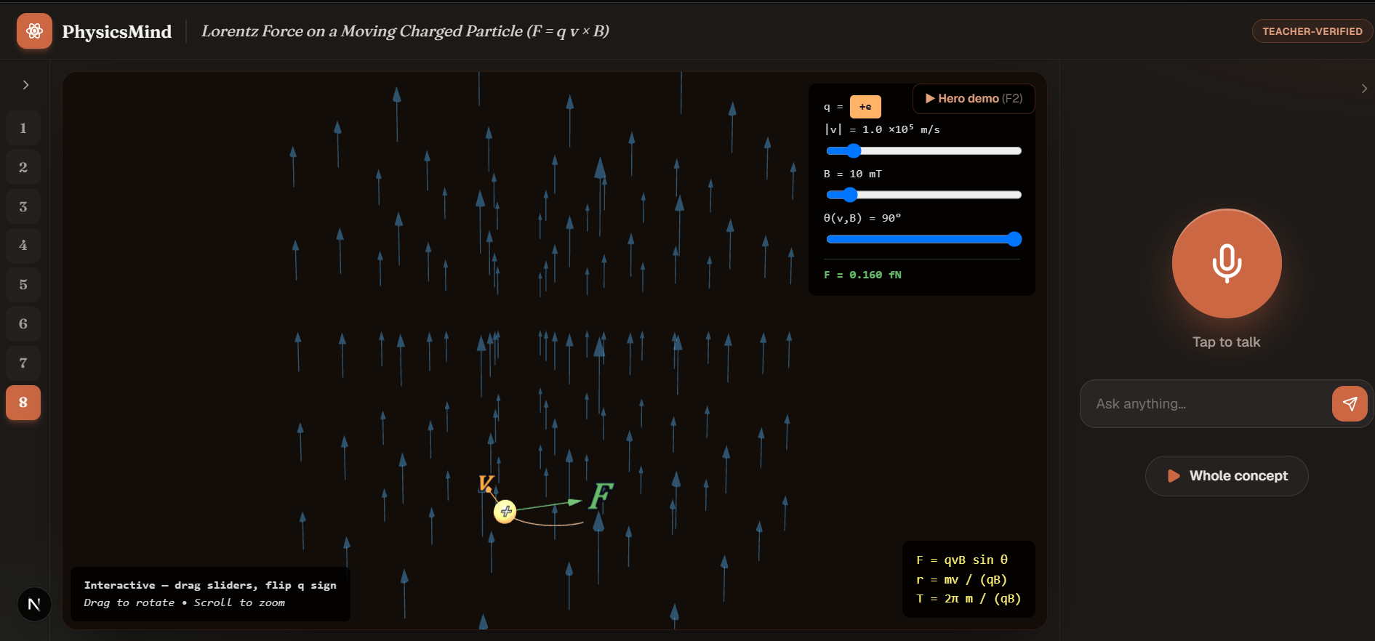
THE SOLUTION
We make the concept move.
◆ Physics-accurate, interactive simulations — learn by doing
◆ An AI professor that explains & drives the sim live, by voice
◆ Always on — 24×7 doubt-solving, no waiting for a teacher
◆ “ChatGPT tells you — PhysicsMind shows you”
Live product — Lorentz force, with the voice AI professor
PhysicsMind
3 / 9
Notes:
Say: open the real simulation on your laptop. The moving, correct physics does more than any slide — and it's always on, so the student learns actively the moment they're stuck. Tap the mic and ask a 'what if' to show the AI professor driving it.

Slide 4
WHY IT’S DIFFERENT
Not another tutoring app — a deep-tech engine.
◆ Physics engines compute everything; the AI writes only configuration, never the physics → always accurate
◆ A curriculum-specific simulation library — our core IP
◆ A proprietary data flywheel: every student doubt improves the next explanation
Defensible technology + knowledge — not a feature a competitor can copy.
PhysicsMind
4 / 9
Notes:
Say: “The innovation is the architecture and the data — that's what makes it defensible, not a feature anyone can clone.” This is the EXIST-critical slide.

Slide 5
PRODUCT · B2C
Direct-to-student subscription.
◆ Students subscribe directly — web app + AI voice professor
◆ Tiered: simulations → AI doubt-solving → voice professor
◆ Concept clarity first; exam depth grows with the student
No dependence on schools or institutions.
PhysicsMind
5 / 9
Notes:
Say: “We sell directly to students. We're not dependent on schools or institutions.”

Slide 6
MARKET & GO-TO-MARKET
A focused entry into a global market.
◆ Global STEM learning — underserved by simulation-first products
◆ Build on the Indian curriculum (deepest → ports to AP / A-level / IB)
◆ First revenue: UAE diaspora — same curriculum, high willingness to pay
◆ Year 2: India scale + Western curricula
PhysicsMind
6 / 9
Notes:
Say: “One curriculum, sequenced markets. We build where our expertise is, monetize first where families pay, expand deliberately.”

Slide 7
TRACTION & FEASIBILITY
Already building. Already validated by a teacher.
◆ Gold-standard simulations built — magnetism & electrostatics
◆ Working AI authoring pipeline + AI voice-professor prototype
◆ A teacher co-development partner reviewing real lessons
◆ Built solo, from Germany, with AI-assisted development
✓ TEACHER-VERIFIED
Pre-revenue today — a teacher-supervised student pilot is the next step.
PhysicsMind
7 / 9
Notes:
Say honestly: “Pre-revenue today — the next step is a teacher-supervised student pilot. That's exactly what the EXIST year would fund.”

Slide 8
THE VISION
A great teacher for every student — always on, in every subject.
◆ Every concept in science becomes an interactive, physics-accurate simulation
◆ An AI professor that teaches, adapts, and answers by voice — 24×7
◆ Physics first → chemistry, mathematics
◆ Indian curriculum → AP · A-level · IB → students everywhere
◆ Eventually create a personalize teacher.
ALWAYS ON · ACTIVE · PROACTIVE
From “who can afford a great teacher” to “every student has one.”
PhysicsMind
8 / 9
Notes:
Say: “This is where it goes. The same engine that teaches Lorentz force today teaches every concept in science tomorrow — one AI professor, always on, for every student, in every curriculum. That's the company I want to build with EXIST.”

Slide 9
EXIST · THE ASK
What the stipend makes possible.
THE 12-MONTH PLAN
THE 12-MONTH PLAN
MY QUESTIONS FOR YOU
◆ Build the concept library to depth
◆ Run a teacher + student pilot
◆ Reach first paying users
◆ Build a German-based deep-tech company
◆ Eligibility (DIU graduate, 2026)
◆ Team requirement — do I need co-founders?
◆ Professor / mentor — can you help me find one?
◆ Visa pathway (§20 → §21)
◆ Next steps & timeline
PhysicsMind
9 / 9
Notes:
Say: “I'd love your guidance on these — that's really why I'm here.” Let the conversation open up after this slide.

