Slide 1
Design Credit Project
(MEN1010)
Laminar Burning Speed Estimation using Machine Learning
Mentor
Presenter
Dr. Sudipto Mukhopadhyay
Khushal Sonawat(B19ME037)
Rohit Nagar(B19ME069)
Department of Mechanical Engineering,
Indian Institute of Technology Jodhpur

Slide 2
Aim & Approach
Accurate computation of the Laminar Burning Speed (S_{L}) for better design of SI engines
Due to dependency of S_{L} on 6 parameters we chose ML Algorithms.
Python instead of Matlab is selected.
Collection of Dataset and Performing EDA
Regression Task instead of Classification Task
RMSE module for correction

Slide 3

Algorithm
Create an instance of the required model
Extract Features
Tune the necessary hyperparameters
Learn the underlying distribution
Optimize the parameters to achieve satisfactory performance.

Slide 4
Results (I) Training Samples & Accuracies
After training of the models, we found that different models predicted S_{L} values with different accuracies. Below is the accuracy percentages of each of the selected models.
For example: For the values of parameters Ф, Pressure, Temperature, %EGR ,%CH₄, %H₂ respectively as1, 189.39 , 800 K, 0, 0.75 & 0.15, the values of S_{L} predicted by various models for S_{L} of 0.57 is.
Model Name | LR Model | Support Vector Machine | Regression Trees | Neural Network
Accuracy(in %) | 94.2 | 92.5 | 92.4 | 91.5
LR Model | SVM | Regression Trees | Neural Network
0.54 | 0.33 | 0.71 | 0.28

Slide 5
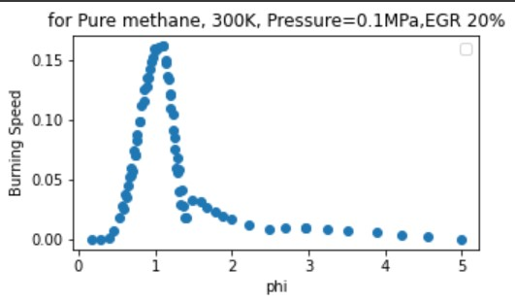
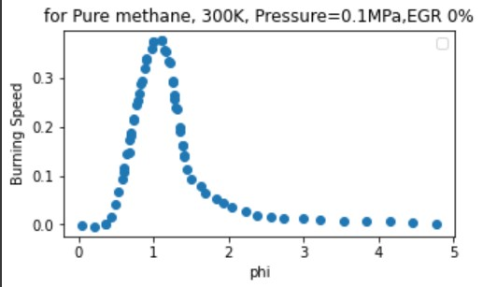
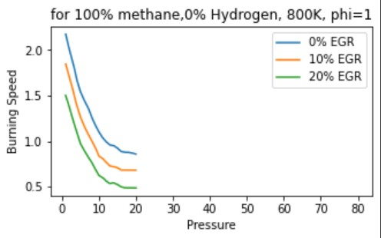
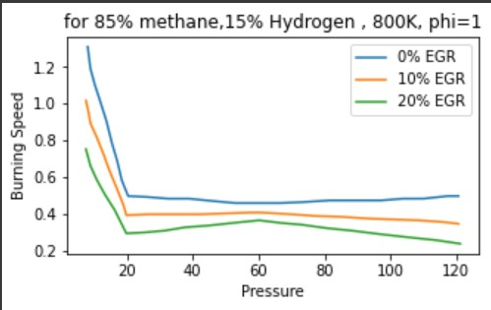
(II)Analysis
Charts for visual understanding

Slide 6
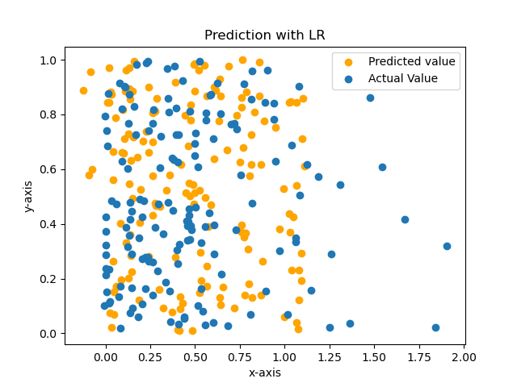
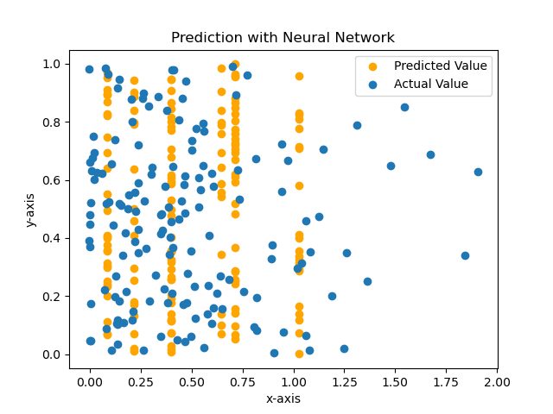
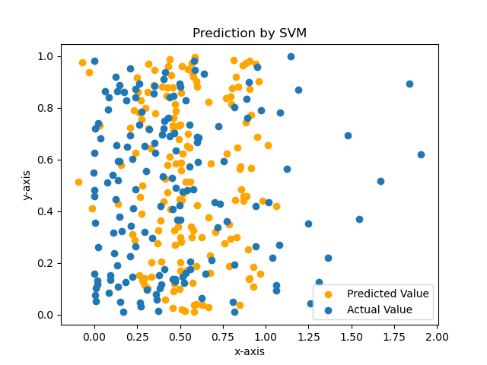
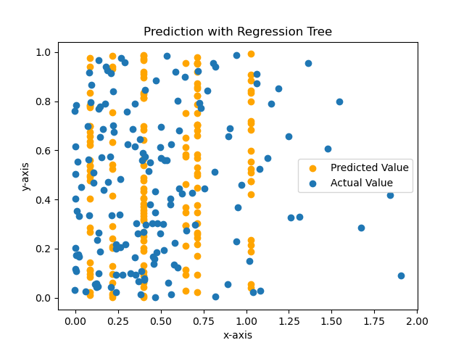
(III) Comparison between Model
Linear Regression
Neural Network
Support Vector Machine
Regression Tree

Slide 7
CONCLUSION
Prediction of Laminar Burning Speed involved taking note of various parameters and involved testing of Multiple Machine Learning Models
Models such as Linear Regression, Multi-Level Perceptron(Neural Networks), Support Vector Machines were tested to get the best suited model.
Compared the predicted data with actual data by varying pressure, unburned gas temperature, fuel-air equivalence ratio, EGR rate, methane and hydrogen concentration in mixture.
The Linear Regression model turned out to be the best for the purpose of prediction with 5% inaccuracy

