Slide 1


Smart Prenatal Health Care Monitoring System For Pregnancy Women In Rural Areas Using IOT
Bapuji Institute Of Engineering And Technology Davanagere Department of Computer Science & Engineering Phase 2 Presentation
Guided by:
Prof. Naseer R
HOD CS&E:
Dr. NIRMALA C R
PROJECT CO-ORDINATOR:
Dr. ROOPA G M
PRESENTED BY:
Gagandeep B 4BD18CS023
Nagaraja S Aralikatti 4BD19CS402
Narendra B O 4BD19CS403
Sachin M N 4BD19CS408

Slide 2
Introduction
Literature Survey
Existing System
Problem Statement
Proposed Solution
Proposed Objectives
System Methodology
System Requirements
Implementation
Result and Discussion
Conclusion
References
CONTENTS

Slide 3
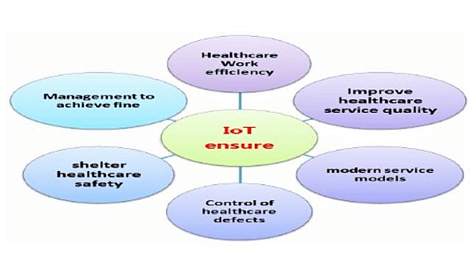
INTRODUCTION
Human resources is the backbone of developing and under developed nations.
Due to the unavailability of hospitals In rural areas and longer distance required to travel,people are not really concious about their health,for small injuries and routine checkups.
In the developing countries most of the peoples are lived in the rural areas and medical systems are not amalgamated for sharing information.
The pregnant women’s are unable to do their normal checkups at the starting time of pregnancy time and this cause higher death count in case of newborn and parental in the rural areas as well as in urban also.
Due to this situation, the women’s are facing an immense medical issues. Accelerometer sensor is designed to measure the count of kicks/force by unborn child and it is transfer into the ARDUINO UNO controller.

Slide 4
Motion of the foetal and some important parameters such as Blood pressure, Heartbeat rate, count of unborn child’s kicks and temperature for the women’s are measured using various types of sensors.
Every day, approximately 800 women die from preventable causes related to pregnancy and childbirth. 99% of all maternal deaths occur in developing countries.
A quarter of world's neonatal deaths (one million) each year take place in India, mostly at home (65.4% of all births and 75.3% of births in rural areas occur at home).
Issues of availability and accessibility of maternal and child health care and nutritional programs are important in this context.
Though India has made an appreciable progress in improving the overall health status of its population but it is far from satisfaction.
The pace of decline of infant and child mortality on one hand and maternal mortality on the other hand has been quite low.
Improved utilization and access of health care facilities are often interrelated with distance, socioeconomic condition and literacy levels of women.
Awareness of and access to a health care center, equipped with modern maternity facilities has a significant positive impact on the health-seeking behavior and pregnancy outcome of rural women. Lack of knowledge thus is a cause of high maternal mortality rate among the women.

Slide 5
LITERATURE SURVEY
SI NO | TITLE | CONTRIBUTION | REMARKS
1 | IOT based Health Care Monitoring System for Rural Pregnant Women | Analysing of detail Survey on Pregnant Women Health Monitoring. | It gives multiple information about IOT technology
2 | Security channel noise management in cognitive radio networks. | We can monitor the pregnant women health from rural areas using IOT technology | The proposed smart health care system for pregnant women
3 | Supervised machine learning techniques in cognitive radio networks during cooperative spectrum land overs. | They discovered that app related for featal care and the mother has become a valuable source of knowledge. | With the help of the apps problems recognition becomes easy.
4 | Pilot evaluation of the test4baby mobile health program. | This system is proposed to monitor the movement of the foetus inside womb of the mother. | This technique is used for early detection of foetal health and mother.
“IoT Based Health Care Monitoring System for Rural Pregnant Women” by S.ShinyAmalaandDr.S.Mythili: In this proposed system analyze about detail survey on pregnant women health monitoring. They give multiple information about IOT technology.[1]
“Security and channel noise management in cognitive radio networks” by A. Haldorai and A. Ramu: In this papers related to monitoring the Pregnant women health from rural areas by using iot technology. The sensors that sensed like heartbeat, temperature and blood pressure with the help of microcontroller and output of the sensors are viewed on smart phone through iot interface. They proposed smart health care monitoring for pregnant women. [2]
“Canonical Correlation Analysis Based Hyper Basis Feed forward Neural Network Classification for Urban Sustainability” by A. Haldorai and A. Ramu : In this proposed system they use IOT CGM based technology which helps to collect the information about the diabetes. It is commonly known as diabetes mellitus. The glucose levels can be measured with the help of CGM. Then it viewed on health application. [3]
“Efficient Diagnosis of Liver Disease using Support Vector Machine Optimized with Crows Search Algorithm” by D. Devikanniga, A. Ramu, and A. Haldorai : They suggested a baby application text. Their policy involves sending a message to pregnant women in order to encourage health and disease prevention within the target audience. They discovered that the application has potential. Heartbeat and temperature sensors for remote monitoring are managed using Arduino and a processing unit in this paper. Bluetooth is used for contact and tracking of mobile apps. These assist us in keeping track of our vital signs such as body temperature, blood pressure, and heart rate. [4]

Slide 6
EXISTING SYSTEM
In the existing method ultrasound scan of the pregnant women is performed and along with that some vital signs is measured. The main drawback of the existing system is that the ultrasound scanning is expensive. In order to overcome this an accelerometer sensor is used to measure the kick count of the fetus and the vital parameters such as temperature and heart beat is measured and the aim is to develop a compact assist device for rural pregnant women in order to access the vital signs of maternal and fetus with low cost using recent sensors and internet of things for personalized care.

Slide 7
PROBLEM STATEMENT
In rural areas there is lack of smart health monitoring system for pregnant women and due to this regular checkups of the pregnant women is difficult and there are lot of deaths happening especially in rural areas.
PROPOSED SOLUTION
In this system the Arduino is used to attach with three sensors namely temperature sensor , memes sensor and heart beat sensor. This acts akin to a microcontroller which collects and reads values from the sensor through the physical connection of input and output pins of the board. WiFi module are attached in this system thus it helps to take reading and display on your mobile.

Slide 8
PROPOSED OBJECTIVES
To Develop the hardware model for detection of health problems in pregnancy women.
To develop the apparatus required for and connecting for cloud.
To use the android based UI for interaction with cloud.

Slide 9

Methodology diagram
CLOUD
HEART RATE
SENSOR
TEMPERATURE
SENSOR
USER INTERFACE
ARDUINO
ACCELEROMETER SENSOR
Fig3.1 Methodology diagram

Slide 10
Software Requirements Specification
Hardware Stack
ACCELEROMETER SENSOR
HEART BEAT SENSOR
TEMPERATURE SENSOR
ARDUINO UNO
WIFI MODULE
Software Stack
ARDUINO IDE
PYTHON
VISUAL STUDIO CODE
JAVA SCRIPT

Slide 11
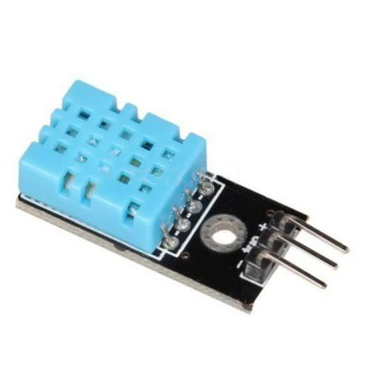
Temperature sensor
DHT -11
Working voltage 3.3-5 volts
Analog and digital reading
Temperature reading
Accuracy (+/-) 2-3⁰c

Slide 12
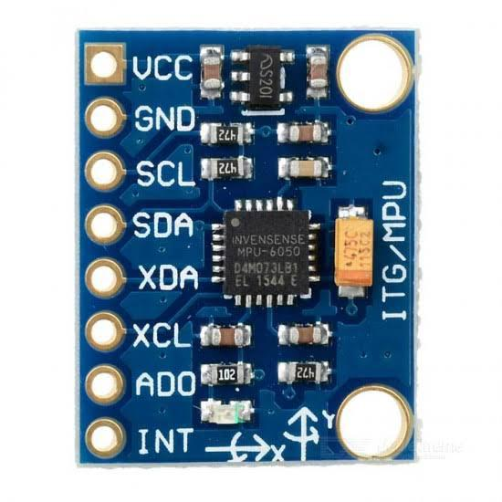
Accelerometer sensor
MPU 6050
Working voltage 3.3-5 volts
Communication Protocol I2C with controller
Reading through X and Y axis movement

Slide 13
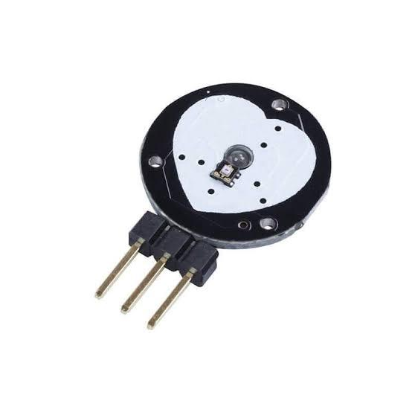
Heart beat sensor
Working voltage 3.3-5 volts
Analog and digital protocol
Measure pulse rate and heart rate
BMP

Slide 14
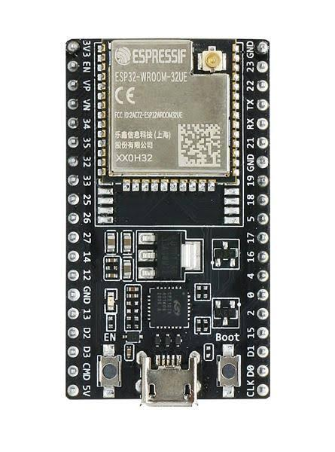
Arduino Board

Slide 15
IMPLEMENTATION
Once the app starts working the device will starts debugging the code, then the device is going to search for a open WiFi with the pre mentioned credentials.
After connecting with the WiFi it will start to read the data from the sensor and it will collect the data from sensor and send it to the cloud .
Once the data is sent to the cloud operations are done on the data received and also the data pre-processing take place.
After the data is processed in the cloud along with all the calculations the process data is sent to the app.
Then the app will display the processed data.

Slide 16
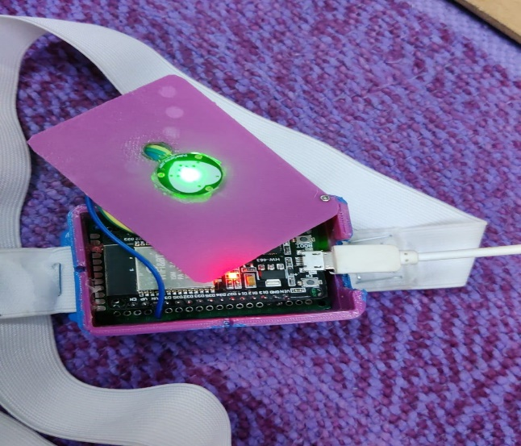
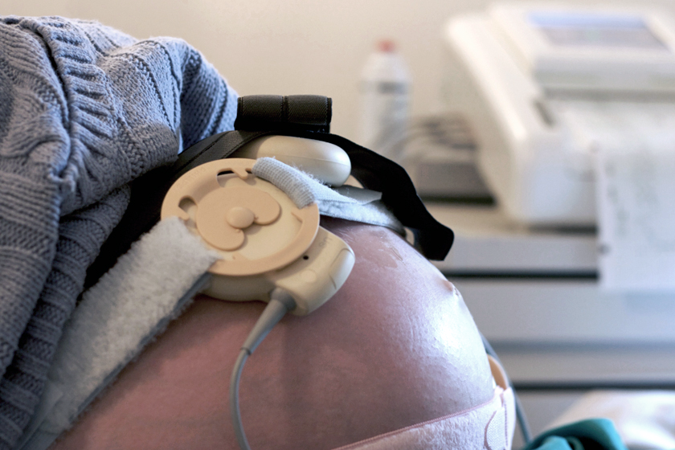
RESULT AND DISCUSSION
Fig: Prototype model containing sensors Fig: Pregnanat women wearing the belt containing sensors

Slide 17
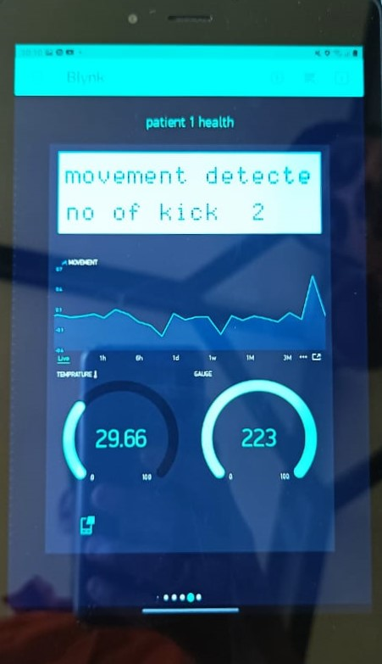
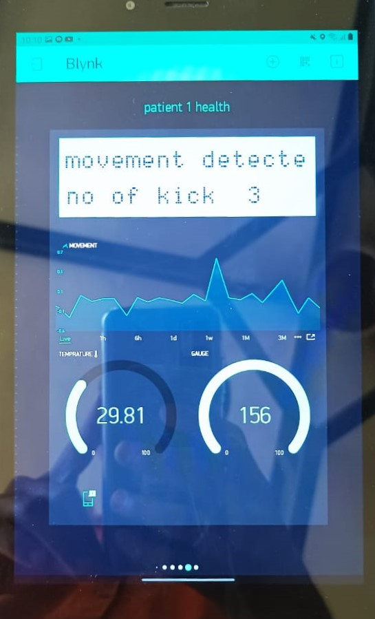
Fig : Tested result
Fig : Tested result

Slide 18
CONCLUSION
In the above model the results obtained from the different sensors devices will be compared and analysed in detail the values are recorded using the sensors and processed using the microcontroller for emergency send the message to the doctor.
The system is low cost ,self-monitoring device and can be used in remote areas efficiently.
A new architecture of IOT health monitring which provides security at the communication link as well as by providing user authentication.

Slide 19
REFERENCES
References of Papers :
S.ShinyAmalaandDr.S.Mythili “IoT Based Health Care Monitoring System for Rural Pregnant Women “International Journal of Pure and Applied Mathematics Volume 119 No. 152018.
A. Haldorai and A. Ramu, “Security and channel noise management in cognitive radio networks,” Computers & Electrical Engineering, vol. 87, p. 106784, Oct. 2020. doi:10.1016/j.compeleceng.2020.106784
A. Haldorai and A. Ramu, “Canonical Correlation Analysis Based Hyper Basis Feedforward Neural Network Classification for Urban Sustainability,” Neural Processing Letters, Aug. 2020. doi:10.1007/ s11063-020-10327-3
D. Devikanniga, A. Ramu, and A. Haldorai, “Efficient Diagnosis of Liver Disease using Support Vector Machine Optimized with Crows Search Algorithm,” EAI Endorsed Transactions on Energy Web, p. 164177, Jul. 2018. doi:10.4108/eai.13-7-2018.164177
Survey on IoT Based Pregnant Women Health Monitoring SystemRajkumar Ettiyan 2020 3rd International Conference on Intelligent Sustainable Systems (ICISS), 1207-1213,2020

Slide 20
Anandakumar and K. Umamaheswari, “Supervised machine learning techniques in cognitive radio networks during cooperative spectrum handovers,” Cluster Computing, vol. 20, no. 2, pp. 1505- 1515, Mar. 2017
H. Anandakumar and K. Umamaheswari, “A bio-inspired swarm intelligence technique for social aware cognitive radio handovers,” Computers & Electrical Engineering, vol. 71, pp. 925-937, Oct. 2018. doi:10.1016/j.compeleceng.2017.09.016
R. Arulmurugan and H. Anandakumar, “Early Detection of Lung Cancer Using Wavelet Feature Descriptor and Feed Forward Back Propagation Neural Networks Classifier,” Lecture Notes in Computational Vision and Biomechanics, pp. 103-110, 2018. doi:10.1007/978-3-319-71767-8_9
Design of a fog computing, blockchain and IoT- based continuous glucose monitoring system for crowdsourcing mHealth Tiago M Fernández- Caramés, Paula Fraga- Lamas Multidisciplinary Digital Publishing Institute Proceedings 4 (1), 37,2018.
Human vital physiological parameters monitoring: A wireless body area technology based Internet of thingsAliyu Ahmed, Ajao Adewale Lukman, Agajo James, Olaniy Olayemi Mikail, Buhari Ugbede Umar, Emmanuel SamuelJurnal Teknologi dan Sistem Komputer 6 (3), 115-121,2018
.

Slide 21
THANK YOU….!

