Slide 1
Introduction to Apex

Slide 2
Agenda
What is Apex?
Apex Is
When Should I Use Apex?
How Does Apex Work?
Developing Code in the Cloud

Slide 3
What is Apex ?
Apex is a proprietary language which has been developed by Salesforce.com.
Apex is a strongly typed, object-oriented programming language
Executes flow and transaction control statements on the Force.com platform server in conjunction with calls to the Force.com API.
Apex enables developers to add business logic to most system events, including button clicks, related record updates, and Visualforce pages.
Apex code can be initiated by Web service requests and from triggers on objects.

Slide 4
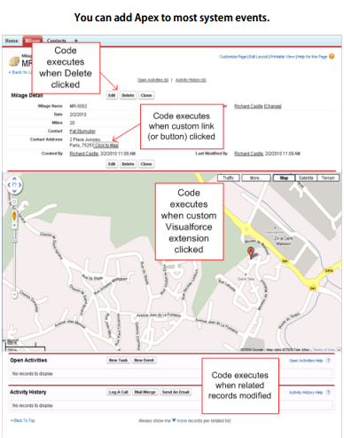
What is Apex ?
Apex can be added to most of system events as

Slide 5
Apex is
Integrated :
Apex provides built-in support for common Force.com platform idioms, including:
Data manipulation language (DML) calls, such as INSERT, UPDATE, and DELETE, that include built-in DmlException handling
Inline Salesforce Object Query Language (SOQL) and Salesforce Object Search Language (SOSL) queries that return lists of sObject records
Looping that allows for bulk processing of multiple records at a time
Locking syntax that prevents record update conflicts
Custom public Force.com API calls that can be built from stored Apex methods
Warnings and errors issued when a user tries to edit or delete a custom object or field that is referenced by Apex.

Slide 6
Apex is
Easy to use :
Apex is based on familiar Java idioms, such as variable and expression syntax, block and conditional statement syntax, loop syntax, object and array notation, and so on.
Syntax and semantics that are easy to understand and encourage efficient use of the Force.com platform.
Data focused :
Apex is designed to thread together multiple query and DML statements into a single unit of work on the Force.com platform server, much as developers use database stored procedures to thread together multiple transaction statements on a database server.

Slide 7
Apex is
Rigorous :
Apex is a strongly-typed language that uses direct references to schema objects such as object and field names.
It fails quickly at compile time if any references are invalid, and stores all custom field, object, and class dependencies in metadata to ensure they are not deleted while required by active Apex code.
Hosted :
Apex is interpreted, executed, and controlled entirely by the Force.com platform.
Multitenant aware :
Apex runs in a multitenant environment.
The apex runtime engine is designed to guard closely against runaway code, preventing it from monopolizing shared resources. Any code that violates limits fails with easy-to-understand error messages.

Slide 8
Apex is
Automatically upgradeable :
Apex never needs to be rewritten when other parts of the Force.com platform are upgraded.
Because compiled code is stored as metadata in the platform, Apex is upgraded as part of Salesforce releases
Easy to test :
Apex provides built-in support for unit test creation and execution.
Test results that indicate how much code is covered, and which parts of your code could be more efficient.
Salesforce ensures that all custom Apex code works as expected by executing all unit tests prior to any platform upgrades.
Versioned :
You can save your Apex code against different versions of the Force.com API. This enables you to maintain behavior. Apex is included in Performance Edition, Unlimited Edition, Developer Edition, Enterprise Edition, and Database.com.

Slide 9
When Should I Use Apex?
To create Web services.
To create email services.
To perform complex validation over multiple objects.
To create complex business processes that are not supported by workflow.
To create custom transactional logic (logic that occurs over the entire transaction, not just with a single record or object).
To attach custom logic to another operation, such as saving a record, so that it occurs whenever the operation is executed, regardless of whether it originates in the user interface, a Visualforce page, or from SOAP API.

Slide 10
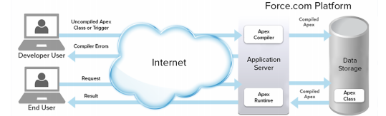
How Does Apex Work?
All Apex runs entirely on-demand on the Force.com platform, as shown in the following architecture diagram:
When a developer writes and saves Apex code to the platform, the platform application server first compiles the code into an abstract set of instructions that can be understood by the Apex runtime interpreter, and then saves those instructions as metadata.
When an end-user triggers the execution of Apex, perhaps by clicking a button or accessing a Visualforce page, the platform application server retrieves the compiled instructions from the metadata and sends them through the runtime interpreter before returning the result.
The end-user observes no differences in execution time from standard platform requests.

Slide 11
Developing Code in the Cloud
The Apex programming language is saved and runs in the cloud—the Force.com multitenant platform. which is a shared resource used by all other organizations.
Apex is tailored for data access and data manipulation on the platform, and it enables you to add custom business logic to system events.
Apex cannot be used to:
Render elements in the user interface other than error messages
Change standard functionality—Apex can only prevent the functionality from happening, or add additional functionality
Create temporary files
Spawn threads

Slide 12
Developing Code in the Cloud
To guarantee consistent performance and scalability, the execution of Apex is bound by governor limits that ensure no single Apex execution impacts the overall service of Salesforce.
This means all Apex code is limited by the number of operations (such as DML or SOQL) that it can perform within one process.
All Apex requests return a collection that contains from 1 to 50,000 records. You cannot assume that your code only works on a single record at a time.
Therefore, you must implement programming patterns that take bulk processing into account. If you don’t, you may run into the governor limits.

Slide 13
Thank-you!..

