Slide 1
sObject Relationships

Slide 2
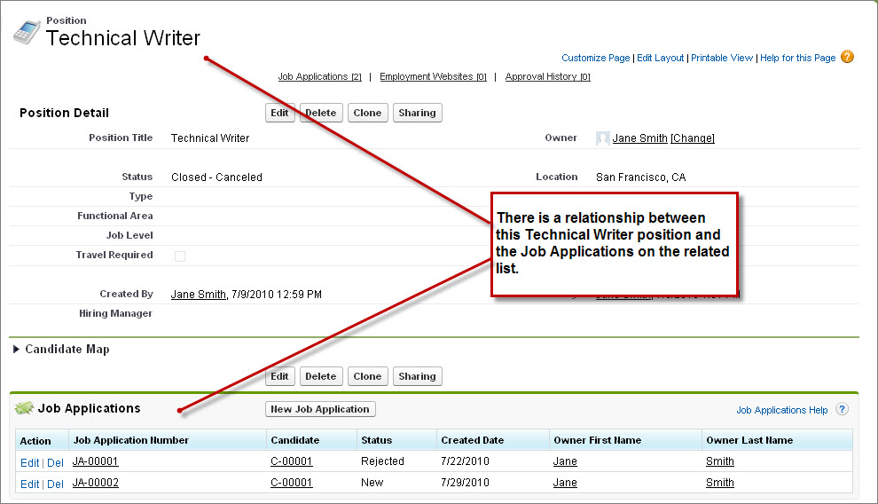
Object Relationships
The Force.com database differs from relational databases in the way that record relationships are implemented. Instead of defining relationships through primary keys and foreign keys, the database uses relationship fields. A relationship field is a custom field on an object record that contains a link to another record.

Slide 3
Object Relationships
For example, suppose you’re building a recruiting app that contains custom objects for Position and Job Application. If you define a relationship between the Position and Job Application objects, each position record can have a related list of all the job applications for candidates who have applied for the position. Then a job application record can have a link to each position for which that candidate is applying.

Slide 4
Types of Object Relationships
Master Detail
Lookup
The relationship field allows you to navigate from records in one object to the related records in another object (both visually and programmatically). Lookup relationships can be used to create one-to-one and one-to-many relationships.
This type of relationship closely links objects together such that the master record controls certain behaviors of the detail and subdetail record. In a master-detail relationship, the ownership and sharing of detail records are determined by the master record, and when you delete the master record, all of its detail records are automatically deleted along with it.

Slide 5
The master object in a master-detail relationship can also contain rollup summary fields. These fields store values aggregated from the child records in the relationship. For example, you can use these fields to count the number of child records, sum values in field of a child record, or determine the maximum/minimum of a field in a filtered set of child record.

Slide 6
Differences Between Lookup and Master-Detail Relationships
Master-detail
Lookup relationships
You can’t create a detail record without a master record.
When you delete a master record, all its detail records are automatically deleted.
The detail record inherits sharing rules from the master record.
The number of master-detail relationships you can use are limited, depending on your edition and license.
You can’t set profile object permissions for a detail record. The detail record inherits permissions from the master record.
To reference commonly shared data, such as reference data.
To relate multiple parent records to the child record.
To link two objects together when you don't want the behavior of the master-detail relationship, such as sharing rules, profile permissions and cascade delete.
If the detail object has its own tab, then you probably want to use a lookup, and not a master-detail, relationship.

Slide 7
Create a Lookup Relationship
Let’s say you want to put a Hiring Manager field on the Position object. Create a many-to-one relationship between the Position object and the standard User object that comes with every org. This relationship reflects that a hiring manager can be responsible for several positions at a time.
To create the lookup relationship fields:
From Setup, enter Objects in the Quick Find box, then select Objects.
Click Position.
In the Custom Fields & Relationships related list, click New.
Select Lookup Relationship, and click Next.
In the Related To drop-down list, choose User, and click Next.
In the Field Label text box, enter Hiring Manager. Once you move your cursor, the Field Name text box is automatically populated with Hiring_Manager.
Click Next.
Accept the defaults in the remaining two steps of the wizard.
Click Save.

Slide 8
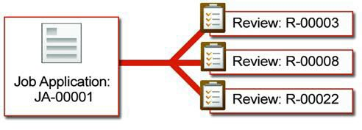
Create a Master-Detail Relationship
The Review object has a many-to-one relationship with the Job Application object because one job application can have one or more reviews associated with it. A related list on the job application record shows the associated reviews, representing the “many” side of the relationship.

Slide 9
Create a Master-Detail Relationship
To create the master-detail relationship field to relate the Review object with the Job Application object:
From Setup, enter Objects in the Quick Find box, then select Objects.
Click Review.
In the Custom Fields & Relationships related list, click New.
Select Master-Detail Relationship, and click Next.
In the Related To drop-down list, choose Job Application, and click Next.
Click in the Field Name text box and enter the field name Job_Application.
Select the Read/Write radio button.
Check Child records can be reparented to other parent records after they are created if you want to be able to change the relationship field’s value. If you leave this box unchecked, you can’t change the value in the future.
Click Next.
Accept the defaults in the remaining three steps of the wizard.
Click Save.

Slide 10
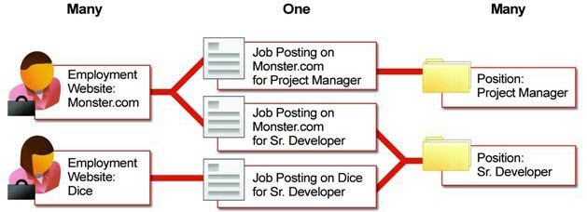
Create a Many-to-Many Relationship
So, to define a many-to-many relationship between the Position and Employment Website objects, you’d create a Job Posting object with the following fields:
A Position master-detail relationship
A Website master-detail relationship

Slide 11
Create the Junction Object
From Setup, enter Objects in the Quick Find box, then select Objects.
Click New Custom Object.
In the custom object wizard, consider these tips specifically for junction objects:
Name the object with a label that indicates its purpose, such as JobPosting.
For the Record Name field, we recommend using the auto-number data type.
Leave the “Launch New Custom Tab Wizard after saving this custom object” box unchecked before clicking Save. Junction objects don’t need tabs.
-Create the Two Master-Detail Relationships

Slide 12
Questions

