Slide 1
SOSL Queries
Learning Objectives
Describe the differences between SOSL and SOQL.
Search for fields across multiple objects using SOSL queries.

Slide 2
SOSL Queries
Salesforce Object Search Language (SOSL) is a Salesforce search language that is used to perform text searches in records.
Use SOSL to search fields across multiple standard and custom object records in Salesforce. SOSL is similar to Apache Lucene.
Differences and Similarities Between SOQL and SOSL
Like SOQL, SOSL allows you to search your organization’s records for specific information. Unlike SOQL, which can only query one standard or custom object at a time, a single SOSL query can search all objects.
Another difference is that SOSL matches fields based on a word match while SOQL performs an exact match by default (when not using wildcards). For example, searching for 'Digital' in SOSL returns records whose field values are 'Digital' or 'The Digital Company', but SOQL returns only records with field values of 'Digital'.
SOQL and SOSL are two separate languages with different syntax. Each language has a distinct use case:
Use SOQL to retrieve records for a single object.
Use SOSL to search fields across multiple objects. SOSL queries can search most text
fields on an object.

Slide 3
Basic SOSL Syntax
SOSL allows you to specify the following search criteria:
Text expression (single word or a phrase) to search for
Scope of fields to search
List of objects and fields to retrieve
Conditions for selecting rows in the source objects
This is the syntax of a basic SOSL query:
SearchQuery is the text to search for (a single word or a phrase).
Text searches are case-insensitive. For example, searching for Customer, customer,
or CUSTOMER all return the same results.
SearchGroup is optional. It is the scope of the fields to search. If not specified, the default search scope is all fields. SearchGroup can take one of the following values.
ALL FIELDS
NAME FIELDS
EMAIL FIELDS
PHONE FIELDS
SIDEBAR FIELDS

Slide 4
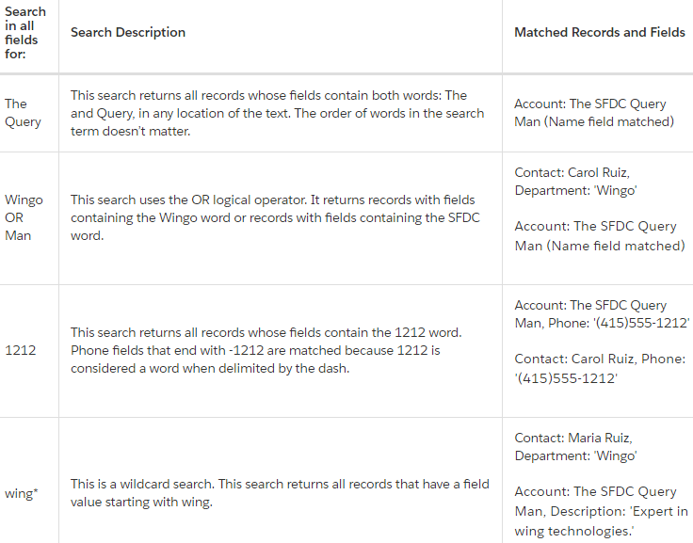
Search Examples
This table lists various example search strings and the SOSL search results.

Slide 5
ObjectsAndFields is optional. It is the information to return in the search result—a list of one or more sObjects and, within each sObject, list of one or more fields, with optional values to filter against. If not specified, the search results contain the IDs of all objects found.
You can filter, reorder, and limit the returned results of a SOSL query. Because SOSL queries can return multiple sObjects, those filters are applied within each sObject inside the RETURNING clause.
You can filter SOSL results by adding conditions in the WHERE clause for an object. For example, this results in only accounts whose industry is Apparel to be returned: RETURNING Account(Name, Industry WHERE Industry='Apparel')
Likewise, ordering results for one sObject is supported by adding ORDER BY for an object. For example this causes the returned accounts to be ordered by the Name field: RETURNING Account(Name, Industry ORDER BY Name).
The number of returned records can be limited to a subset of records. This example limits the returned accounts to 10 only: RETURNING Account(Name, Industry LIMIT 10)

Slide 6
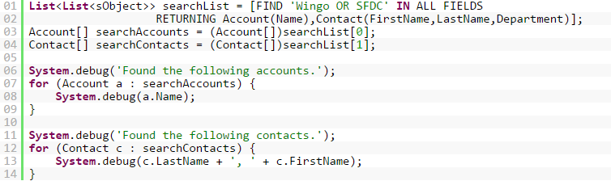
SOSL Apex Example
This example shows how to run a SOSL query in Apex. This SOSL query combines two search terms by using the OR logical operator—it searches for Wingo or SFDC in any field. This example returns all the sample accounts because they each have a field containing one of the words. The SOSL search results are returned in a list of lists. Each list contains an array of the returned records. In this case, the list has two elements. At index 0, the list contains the array of accounts. At index 1, the list contains the array of contacts.
Execute this snippet in the Execute Anonymous window of the Developer Console. Next, inspect the debug log to verify that all records are returned.

Slide 7
Hands-On
Create an Apex class that returns both contacts and leads based on a parameter.
With SOSL you can search against different object types that may have similar data, such as contacts and leads. To pass this challenge, create an Apex class that returns both contacts and leads that have first or last name matching the incoming parameter.
The Apex class must be called 'ContactAndLeadSearch' and be in the public scope.
The Apex class must have a public static method called 'searchContactsAndLeads'.
Because SOSL indexes data for searching, you must create a Contact record and Lead record before checking this challenge. Both records must have the last name 'Smith'. The challenge uses these records for the SOSL search.
The return type for 'searchContactsAndLeads' must be 'List<List< SObject>>'
The 'searchContactsAndLeads' method must accept an incoming string as a parameter, find any contact or lead that matches the string as part of either the first or last name and then return those records.

