Slide 1
PROJECT TITLE
CAPSTONE PROJECT
Presented By:
1. Student Name-Y.NagaraniCollege Name - JYOTHISHMATHI INSTITUTE OF TECHNOLOGY AND SCIENCE Department - CSE

Slide 2
OUTLINE
Problem Statement smart study planner projrct:- problem statement:- students often face challenges in organizing study schedules and tracking academic taasks .this planner helps users create,view,and manage study goals with remainders and visual timelines . The goal is to boost productivity and time management .Tasks and progress can be saved locally Tools
System Development Approach
Algorithm & Deployment (Step by Step Procedure)
Result
Conclusion
Future Scope(Optional)
References

Slide 3
Problem Statement
Students struggle to organize study schedules effectively.
Difficulty in tracking academic tasks and deadlines.
Lack of reminders for upcoming tasks reduces productivity.
Absence of visual timelines makes progress tracking harder.
Need for a simple, browser-based tool to manage study goals.
Tasks and progress should

Slide 4
System Approach
HTML5 → Structure of the web application
CSS3 → Styling, layout, and responsive design
JavaScript → Dynamic interactivity & localStorage for saving tasks
Design Approach
Simple and user-friendly interface
Visual timelines for tracking upcoming tasks
Reminders for better time management
Mobile-responsive design for accessibility
Lightweight (runs fully in browser, no server needed)

Slide 5
Algorithm & Deployment
Task Creation – User inputs task details (title, description, due date, priority, reminder).
Data Storage – Tasks are stored and retrieved using browser localStorage.
Task Management – Users can edit, delete, and mark tasks as completed.
Reminder System – Alerts/notifications are triggered before the due time.
Timeline & Progress Tracking – Visual timelines display upcoming tasks and overall progress.
Filtering & Sorting – Tasks can be filtered (active/done) and sorted (due date/priority).
Deployment
Host the project on GitHub Pages or Netlify for free access.
Runs fully in the browser (no backend required).
Works across devices with responsive design.
Easy sharing by just providing the project link.

Slide 6
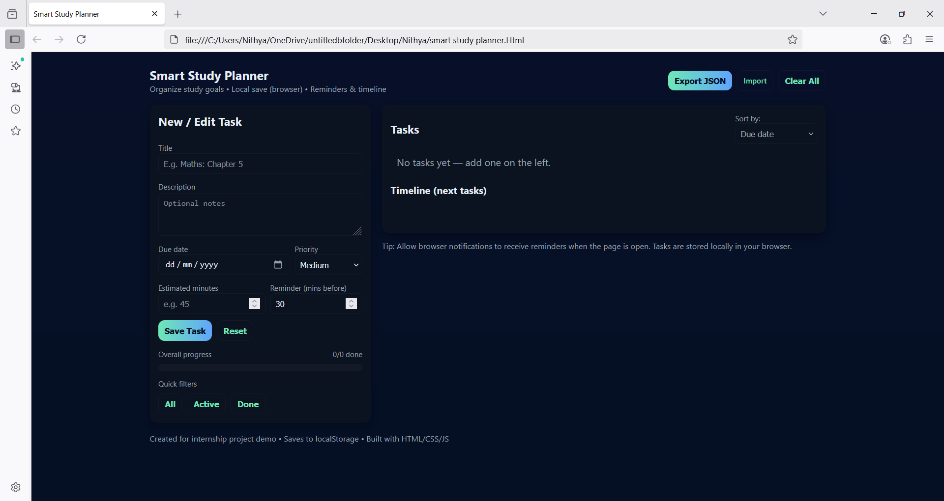
Result

Slide 7
Conclusion
The Smart Study Planner project provides a simple yet effective solution for students to organize their study schedules, track academic tasks, and manage their time efficiently. By using HTML, CSS, and JavaScript, the planner offers a responsive and interactive interface where users can add, view, and manage tasks in real-time without requiring external dependencies.
This project enhances productivity, time management, and self-discipline by allowing students to set reminders, monitor progress, and visualize study goals. It demonstrates the practical application of front-end web technologies in solving real-life problems and can be further extended with features like cloud storage, notifications, or AI-based suggestions.
In short, the Smart Study Planner is not only a useful academic tool but also a valuable learning project for web development skills.

Slide 10
References
List and cite relevant sources, research papers, and articles that were instrumental in developing the proposed solution.
NanthiniMoha/TNSDC-FWD-DIGITAL_PORTFOLIO
Get started with Bootstrap · Bootstrap v5.3

Slide 11
THANK YOU

