Slide 1
Social-Network Authentication
Angular

Slide 2
Social Network Authentication
(Login to my Application with your Social Network Account)

Slide 3
Social Network Authentication
Almost every website which contains a log in option, also contains ways to log in through different social networks, like
Google
Facebook
Twitter
Instagram
Linked In, etc.

Slide 4
Google Authentication
(Login to Website through Google Account)

Slide 5
Google Authentication
We are going to authenticate to Google using Firebase. Follow the steps:
Step 1: Enable the Google authentication in your firebase project.
Step 2: Copy the configuration of your firebase project in environments folder.
Step 3: In app.module.ts add the following imports
import { AngularFireAuthModule } from '@angular/fire/auth';
import { AngularFireModule } from '@angular/fire'
import { environment } from 'src/environments/environment'; @NgModule({
declarations: [
AppComponent,
GoogleComponent
],
imports: [
BrowserModule,
AngularFireModule.initializeApp(environment.firebase,'angular-fs'),
AngularFireAuthModule
],
providers: [],
bootstrap: [AppComponent]
})

Slide 6
Google Authentication
Step 4: Create the service file to send and get response from google server. Write the following code to login
import { Injectable } from '@angular/core';
import * as firebase from 'firebase';
import { AngularFireAuth } from '@angular/fire/auth';
import { Observable } from 'rxjs';
@Injectable({
providedIn: 'root'
})
export class GoogleAuthService {
user$: Observable<firebase.User>; constructor(private afAuth:AngularFireAuth) {
this.user$ = afAuth.authState;
} login() {
return this.afAuth.auth.signInWithRedirect(new firebase.auth.GoogleAuthProvider());
} }

Slide 7
Google Authentication
Step 5: Inject the service in the component and call the login method and get the user details.
import * as firebase from 'firebase';
import { AngularFireAuth } from '@angular/fire/auth';
import { GoogleAuthService } from '../services/google-auth.service';
@Component({…})
export class GoogleComponent implements OnInit {
user;
constructor(private gService:GoogleAuthService) {
} ngOnInit() {
this.gService.user$.subscribe(user=> {
this.user = user;
});
}
loginGoogle() {
this.gService.login()
} }

Slide 8
Google Authentication
Logout from Google:
In service write this code:
logout() {
this.afAuth.auth.signOut();
}
In component call the method:
logout() {
this.gService.logout();
}
Enabling and disabling the button:
<button class="btn btn-primary" (click)="loginGoogle()" *ngIf="!user">
Login With Google
</button>
<button class="btn btn-danger" (click)="logout()" *ngIf="user">
Logout
</button>

Slide 9
Facebook Authentication
(Login to Website through Facebook Account)

Slide 10
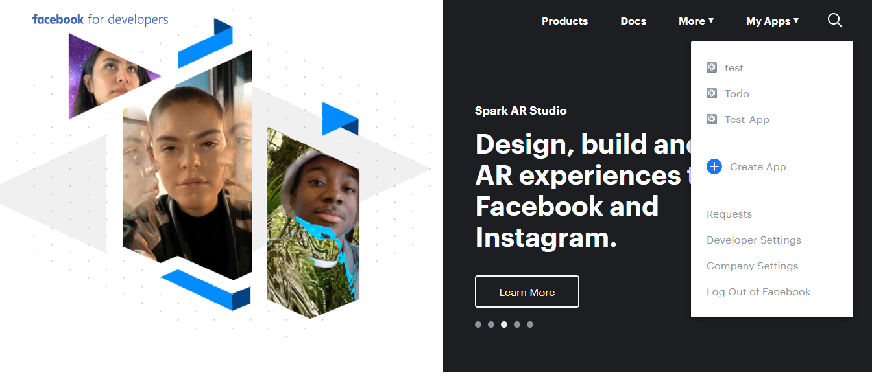
Facebook Authentication
We are going to authenticate to Facebook using Firebase. Follow the steps:
Step 1: Open the Facebook Developer Page and login with your facebook account
Step 2: Once the login is successful, go to myApps as shown in the screenshot and click on create App

Slide 11
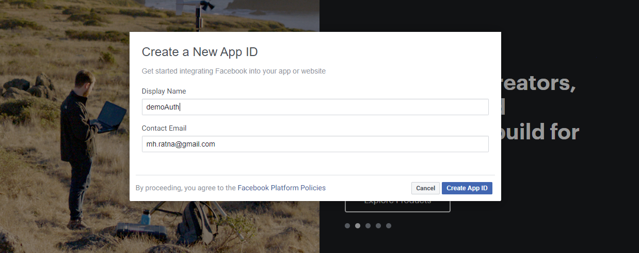
Facebook Authentication
Step 3: Give a name to your app as shown in the screenshot and create App Id:

Slide 12
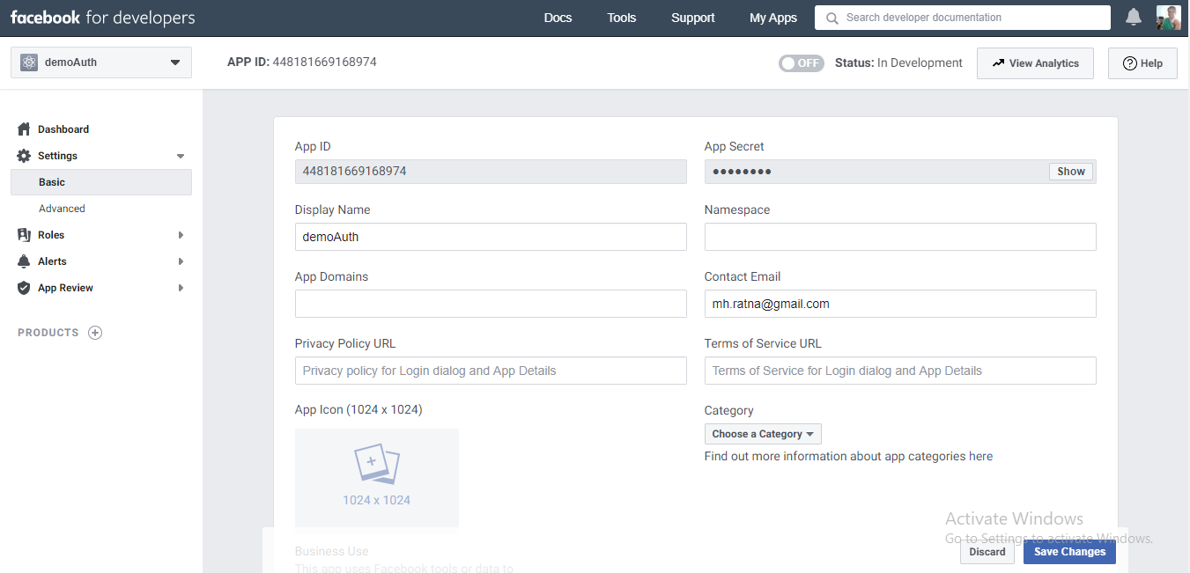
Facebook Authentication
Step 4: Copy App Id and Secret key which you can find in the basic setting of app.

Slide 13
Facebook Authentication
Step 5: Copy App Id and Secret key which you can find in the basic setting of app.

Slide 14
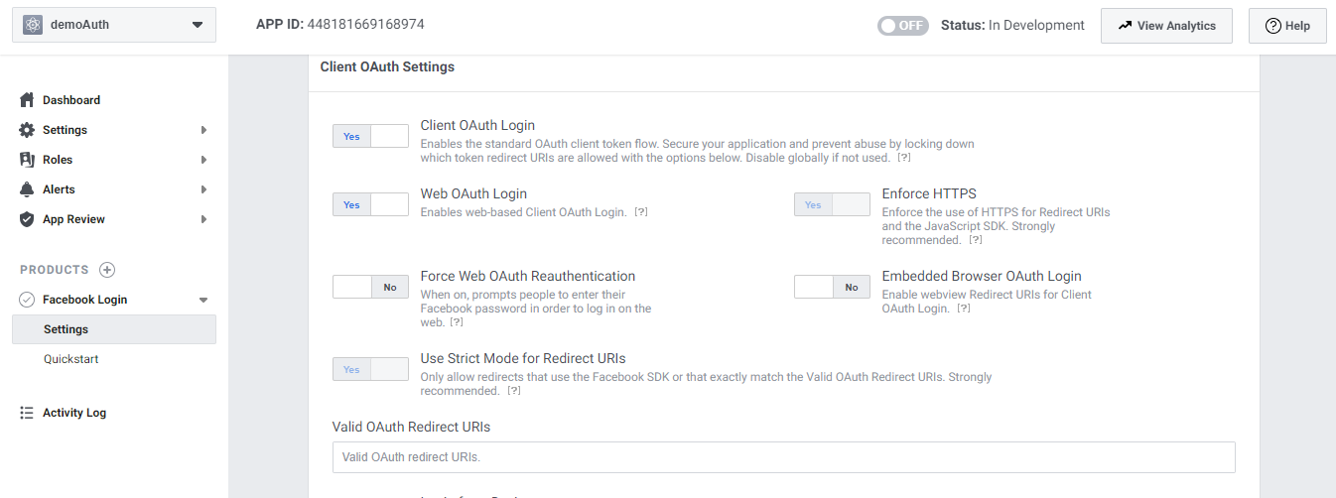
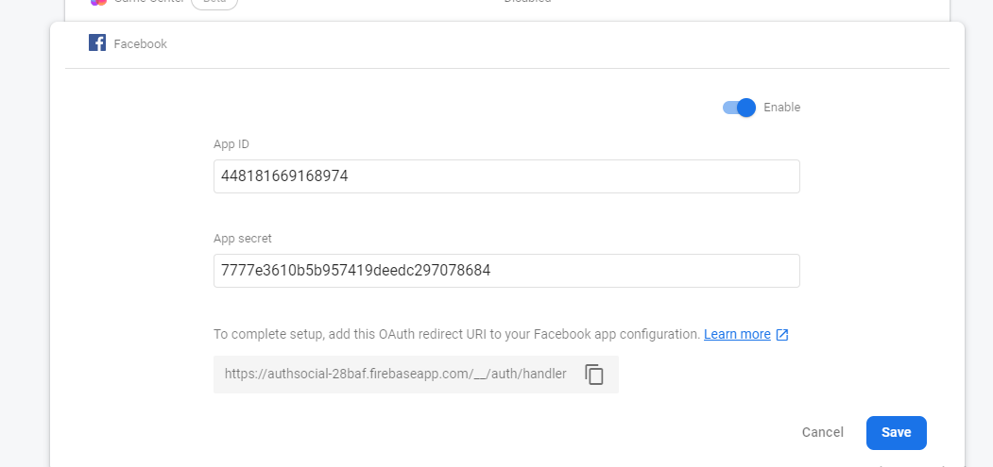
Facebook Authentication
Step 6: Paste app id and secret code in your firebase authentication option

Slide 15
Facebook Authentication
Step 7: Copy URI of firebase project and paste in the facebook developer’s OAuth setting in product

Slide 16
Facebook Authentication
Step 8: All the settings are completely done now. Next implement the login of Facebook by using the firebase API, similar to Google.
………… login() {
return this.afAuth.auth.signInWithRedirect(new firebase.auth.FacebookAuthProvider());
} }

