Slide 1
Deployment
Angular

Slide 2
Deployment
(Host your application)

Slide 3
Deployment
Deployment is an activity that makes a software system or application available for use.
There are so many hosting website which allow you to host your website using their platform.
Examples are,
GitHub
Heroku
Firebase, etc.
In this module, we are going to learn how you can deploy the project using above mentioned platforms.

Slide 4
Firebase Deployment
(Host your application in Firebase)

Slide 5
Firebase Deployment
Follow the following steps to host your application in firebase:
Step 1: Add your firebase project configuration in the environments.prod.ts file.
Step 2: In your project folder execute the following commands:
a. npm install -g firebase-tools (For installing firebase CLI)
b. firebase login (And provide user-name, password)
Step 3: Run the following command to build your project
a. ng build --prod (Create a build)
b. Once build is successful, Angular will give you a dist folder where you can find your built
project folder.

Slide 6
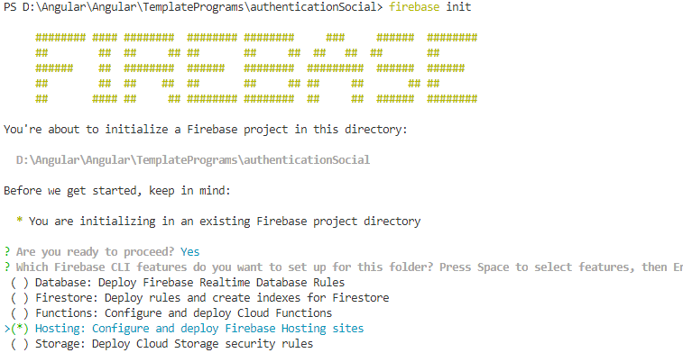
Firebase Deployment
Follow the following steps to host your application in firebase:
Step 4: Type the next command in your angular project CLI:
firebase init : Select Hosting option with spacebar and press enter

Slide 7
Firebase Deployment
Chose the firebase project which you are going to use for hosting your application in firebase
Step 5: Type your dist/project name for the next step
Step 6: Say yes for the next question
Step 7: At last deploy your project to firebase by running the following command in your project:
firebase deploy
Note down the URL of your project generated by the firebase, which you can share it to others for use.

Slide 8
GitHub Deployment
(Host your application in GitHub)

Slide 9
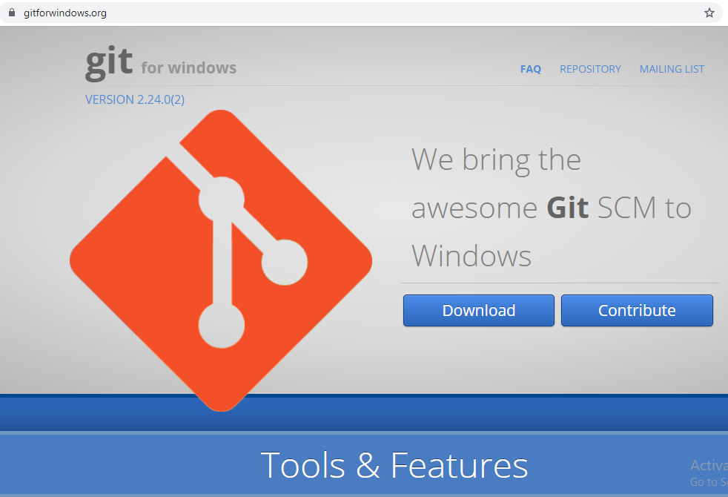
GitHub Deployment
GitHub is a code hosting platform for version control and collaboration. It lets you and others work together on projects from anywhere.
Install the github in your system. Visit http://www.gitforwindows.org to download.

Slide 10
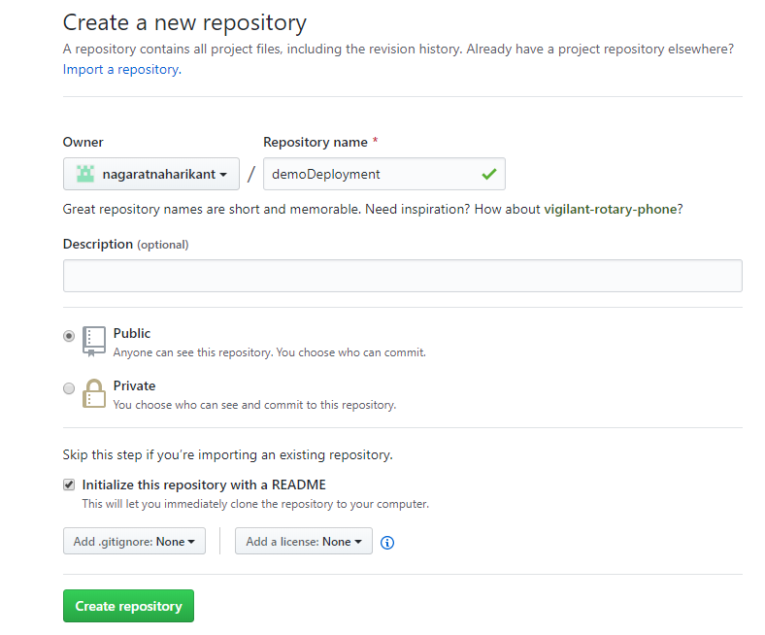
GitHub Deployment
Once github is installed in your system, login to github and create a repository to deploy your project.

Slide 11
GitHub Deployment
Follow the following step to deploy the project:
1. git init
//Copy url of the repository and run following command
2. git remote add origin "Repository URL"
//For first time it will ask for the username and password
//Provide GIT username & password
//Install github pages to deploy the project
3. npm i -g angular-cli-ghpages
//Build the project by following command
4. ng build --prod --base-href https://usernameofgit.github.io/repositoryname/
// Deploy the project in github
5. ngh --dir dist/folder-name --no-silent

Slide 12
Heroku Deployment
(Host your application in Heroku)

Slide 13
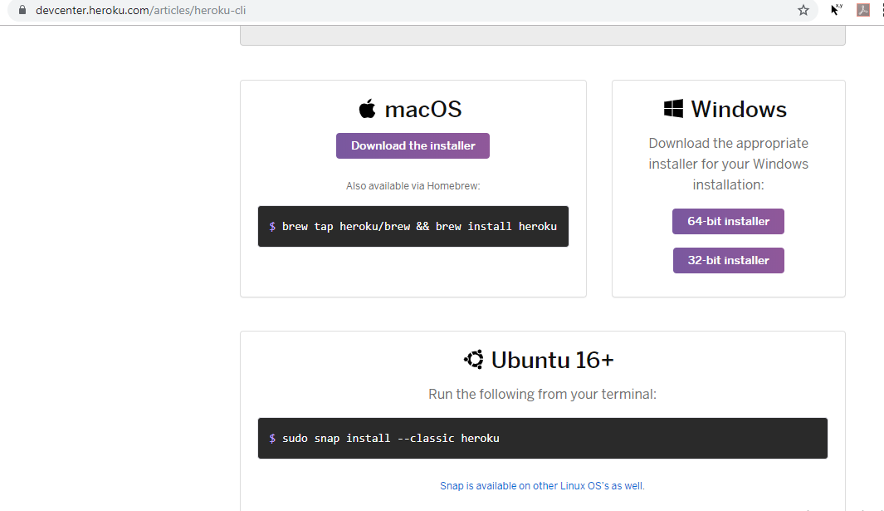
Heroku Deployment
Follow the following step to deploy the project in Heroku:
1. Goto heroku.com and create an account (Email & Password)
2. Install the heroku depending on which OS you are using as shown below

Slide 14
Heroku Deployment
Follow the following step to deploy the project in Heroku:
3. heroku --version (Check if the tool is installed properly)
4. heroku login (Provide your login credentials)
5. heroku create (It will automatically a project name). Check the URL.
6. In the package.json make the following changes:
a. Move @angular/compiler-cli, @angular/cli and typscript into Dependencies (From DevDependencies)
b. Under the scripts section add
"postinstall": "ng build --prod"
"start": "node server.js"

Slide 15
Heroku Deployment
Follow the following step to deploy the project in Heroku:
7. Create a file in your main project project with – server.js and paste the following in the file:
const express = require('express');
const app = express();
app.use(express.static(__dirname + '/dist/project-name'));
app.all('*', (req, res) => {
res.status(200).sendFile(__dirname + '/dist/project-name/index.html');
});
app.listen(process.env.PORT || 8080);

Slide 16
Heroku Deployment
Follow the following step to deploy the project in Heroku:
8. Install Express (npm install express --save)
9. git add .
10. git commit -m "Some comment"
11. git remote
12. git push heroku master
13. Once the deployment is complete heroku will give you an URL which is your official project Host URL.

