Slide 1



Vehicle Classification Technology Using AI
2nd International Conference on Data Analytics, Smart Computing and Networks (IDASCN-2023)
Paper ID: IDASCN228
Presented By:
Dr.C.Siva Kumar
N Venkatesh
P Lokesh
R Devarshini
P Nandini
Organized by

Slide 2
AGENDA
ABSTRACT
OBJECTIVES
METHODOLOGY
DATA ANALYSIS
CONCLUSION
REFERENCES

Slide 3
Cont..
ABSTRACT
Gathering traffic volume and vehicle classification counts is a crucial component of transportation engineering. For proper future highway and roadway design, including determining pavement qualities, mitigating traffic congestion, safety assessments, and improving road safety, accurate traffic volume and vehicle classification count data is crucial. For the purpose of completing this time-consuming task, numerous automated systems have been created in the past. This study examined two potential vehicle classification systems, the AI-based Inductive Loop Signature Detection System and the AI-based Video Detection System, to assess the accuracy of their vehicle classification data. While AI-based Inductive Loop Signature Detection System uses a single loop per lane to detect the classification of cars, AI-based Video Detection System uses video surveillance to do so. The two systems were installed on I-93 in Concord, New Hampshire, between Main and Manchester St. The investigation was conducted under two different conditions of traffic flow: free flow and crowded. On May 10, 2022, from 6:00 AM to 8:00 AM, statistics regarding the free flow situation were gathered at I-93 Northbound. Data regarding the crowded status was gathered on July 1, 2022, between 4:00 and 5:00 PM.

Slide 4
ABSTRACT
The ground truth provided by the New Hampshire Department of Transportation (NHDOT) was used to compare the classification data from both systems. The accuracy of both systems was greater than 90%. Occlusion, off-center vehicles, lane-changing vehicles, and floating wheels were some difficulties the study noted. Another investigation will be conducted on the upcoming winter under a bad weather scenario because New Hampshire has difficult winters. The study will help other state agencies evaluate the precision of two capable technologies and make decisions in light of that information.
Keywords: Traffic, Vehicles, Detection, Artificial Intelligence, Classification, New Hampshire Department of Transportation.

Slide 5
OBJECTIVES
Evaluate the accuracy of vehicle classification data from Leetron.
Evaluate the accuracy of vehicle classification data from VSign.
Compare the vehicle classification data from Leetron and VSign.
Compare the total counts over the evaluation period.

Slide 6
METHODOLOGY
Here we use comparision based methodology among two popular vehicle classification technologies in terms of speed,vehicle count and classification accuracy.Here we consider the data related to New Hampshire Town presented by Department of Transportation.
Popular Vehicle classification Technologies are:
INDUCTIVE LOOP SIGNATURE TECHNOLOGY(VSIGN)
LEETRON VEHICLE CLASSIFICATION TECHNOLOGY USING AI

Slide 7
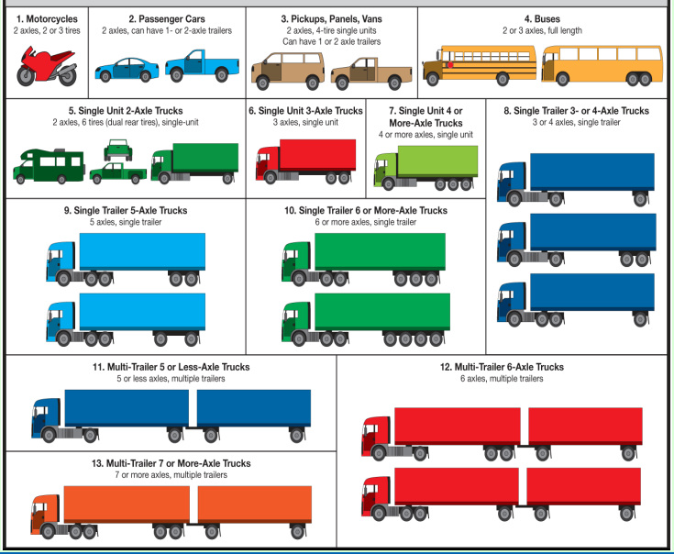
METHODOLOGY
CONT..
CLASSIFICATION OF VEHICLES

Slide 8
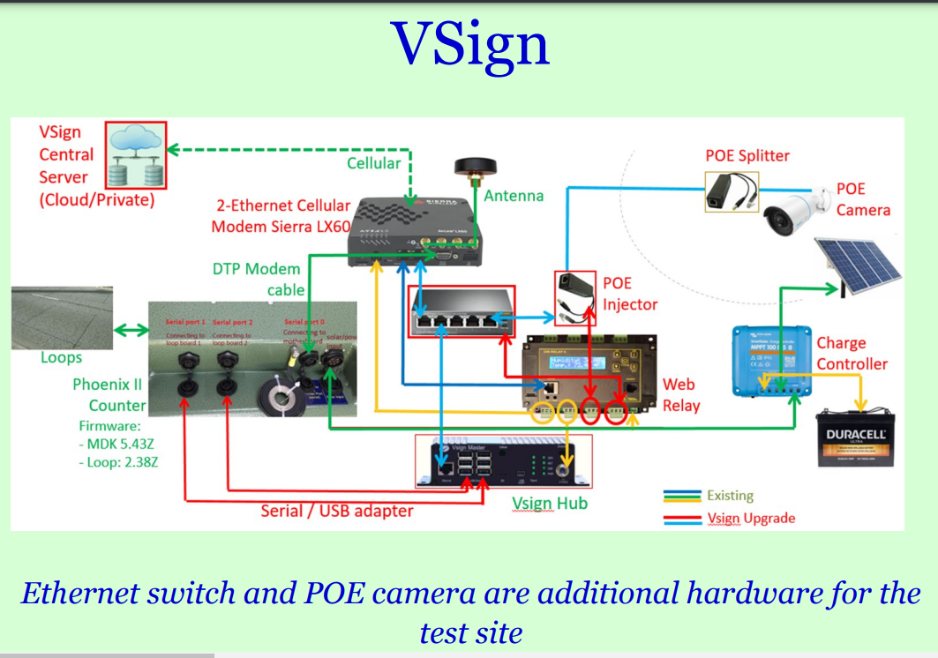
METHODOLOGY
CONT..
INDUCTIVE LOOP SIGNATURE TECHNOLOGY(VSIGN)

Slide 9
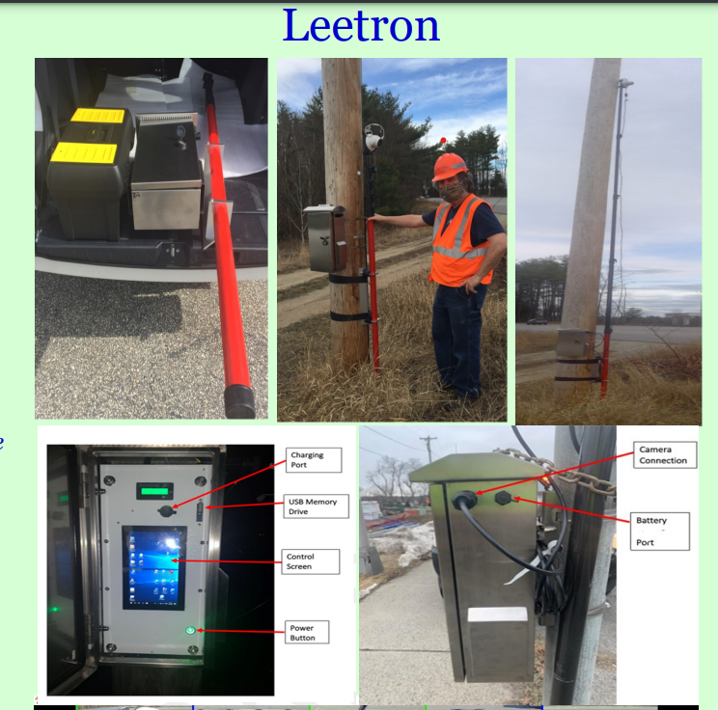
CONT..
METHODOLOGY
LEETRON VEHICLE CLASSIFICATION TECHNOLOGY AI

Slide 10
DATA ANALYSIS
DATA ANALYSIS APPROACH
Free Flow Condition:
2-hr detailed classification comparison with ground-truth data
Peak-hour selected: 6 AM -8 AM
Congested Flow Condition:
1-hr detailed classification comparison with ground-truth data
Peak-hour selected: 4 PM –5 PM
Extreme Weather Condition:
1-hr detailed classification comparison with ground-truth data
Peak-hour selected: 8 AM –9 AM

Slide 11
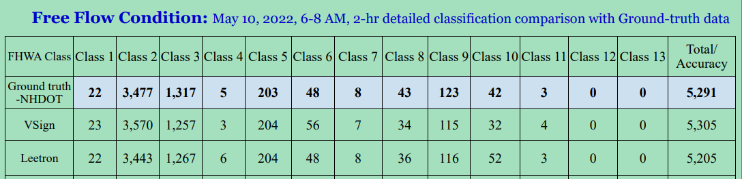
DATA ANALYSIS
CONT..
FREE FLOW CONDITION

Slide 12
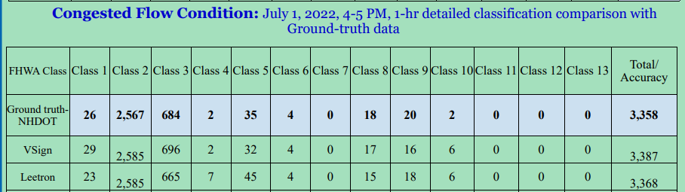
CONT..
DATA ANALYSIS
CONGESTED FLOWCONDITION

Slide 13
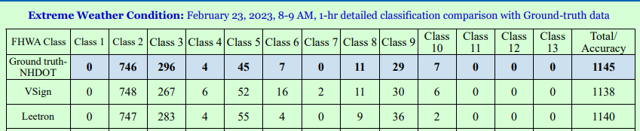
DATA ANALYSIS
CONT..
EXTREME WEATHERCONDITIONS

Slide 14
CONCLUSION
The congested condition was decided based on the speed of the vehicles. The speed range table showed that from 1:00 PM to 2:00 PM and 4:00 PM to 5:00 PM had high number of vehicles. But 4:00 PM to 5:00 PM had more vehicles on the road that had lower speed range. As such, 4:00 PM to 5:00 PM was chosen as congestion study hour.
The extreme weather condition (snow storm) hour was decided based on the speed of the vehicles and snow fall intensity. The speed range table showed that from 7:00 AM to 8:00 AM and 8:00 AM to 9:00 AM had high number of vehicles. But 8:00 AM to 9:00 AM had more vehicles on the road that had lower speed range and the intensity of the snow fall was higher than other hours. As such, 8:00 AM to 9:00 AM was chosen as extreme weather condition study hour.

Slide 15
CONT..
CONCLUSION
The comparisons shows that both VSign and Leetron vehicle classification is more than 90% accurate for all the study conditions.
Both technologies count and classify vehicles reasonably accurately. Based on the needs, states can decide when to use which technology. If existing infrastructure (loop) is available, VSign can be installed permanently and can be used as a classification count station. If safety is a concern to install tube due to heavy traffic, Leetron can be installed on the roadside (temporarily) to do the classification counts.

Slide 16
REFERENCES
Gordon Thompson, PE Traffic Research Engineer, New Hampshire Department of Transportation
Dr. Salma Sultana ,Traffic Analysis Engineer ,New Hampshire Department of Transportation
A New Hampshire Comparative Study of Vehicle Classification Technology poster(2023)

Slide 17


