Slide 1
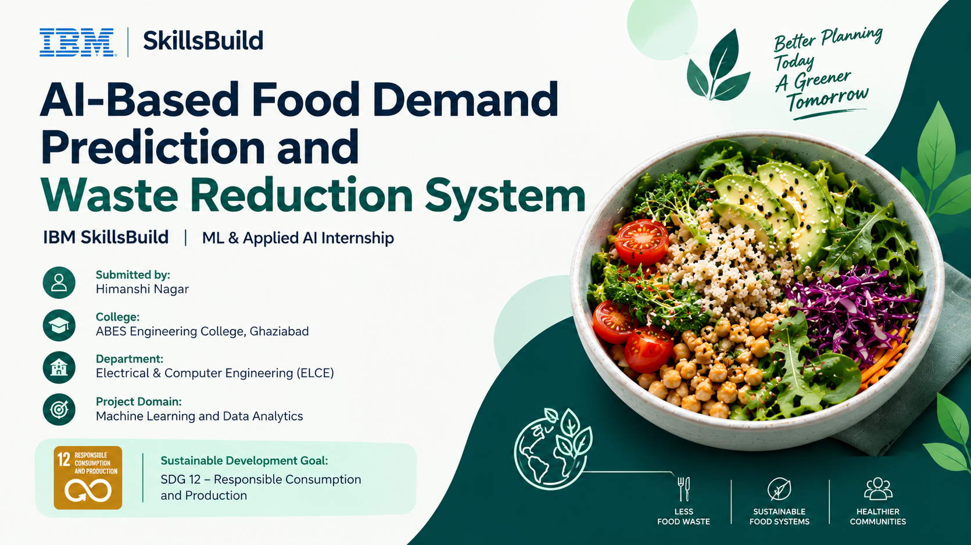

Slide 2
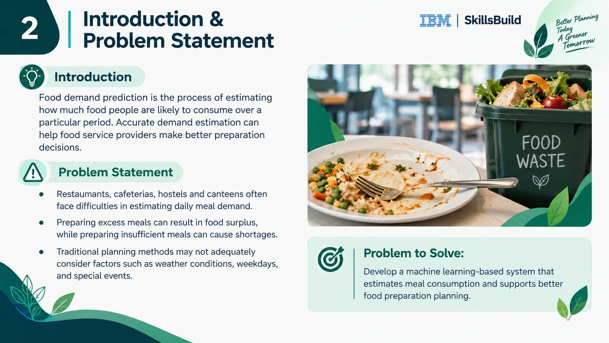

Slide 3
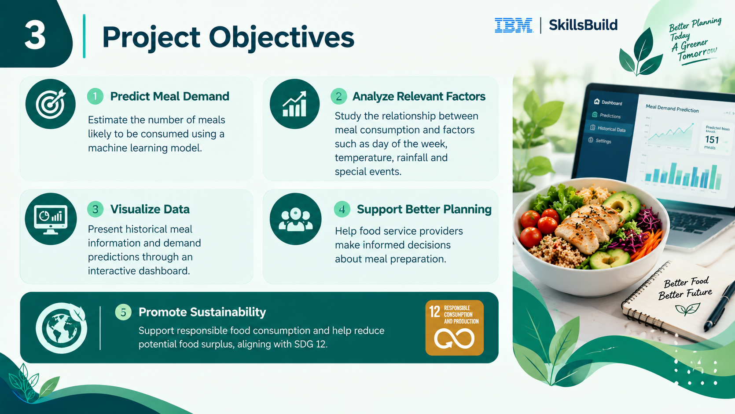

Slide 4



Dataset and Input Features
4
Input Features
Dataset Description
Feature | Description
day_of_week | Day of the week
temperature_c | Temperature in °C
rainfall_mm | Rainfall in mm
special_event | Indicates special event
meals_prepared | Meals prepared
meals_consumed | Target variable
File: food_demand_sample.csv
Total rows used: 180
Contains historical meal-related information.
Data Preparation
The model uses numerical and categorical preprocessing, including missing-value imputation and one-hot encoding for categorical features.
CSV Dataset
Preprocessing
Clean Data

Slide 5






Proposed Methodology
5
Dataset Loading
Random Forest Regression
1
Load the CSV dataset using Pandas and select the features required for prediction.
4
Train a Random Forest Regressor using Scikit-learn to estimate the number of meals consumed.
Data Preprocessing
Model Evaluation
2
Prepare numerical and categorical variables and handle missing values using imputation techniques.
5
Evaluate using MAE, RMSE and R² score.
Train-Test Split
Streamlit Dashboard
3
Divide the dataset into training and testing sets (80:20 ratio).
6
Integrate the saved model into a Streamlit app for user input and prediction.
Evaluation Metrics: MAE, RMSE, R² score

Slide 6








Technology Stack
6
Python
Pandas
Main programming language
Data loading, processing and analysis
System Components
Scikit-learn
Streamlit
Dataset
Model training script
Saved model
Streamlit application
Machine learning model training & evaluation
Interactive web dashboard
Joblib
CSV
GitHub
Model saving and loading
Dataset format
Code repository

Slide 7
Results and Dashboard
7
Model Evaluation Results
Food Demand
Prediction
Predict Meal Demand
MAE
RMSE
R² Score
Day of Week
Predicted Meals Consumed
Home
Prediction
Historical Data
About
Monday
9.51
11.63
0.554
Temperature (°C)
Rainfall (mm)
151
30
0
meals
meals
score
Special Event
meals
No
Example Predictions
Predict
Monday, 30°C, no rain, no special event
→ ~151 meals
Historical Data Overview
Saturday, 35°C, 10 mm rainfall, special event
→ ~119 meals

Slide 8



Conclusion and Future Scope
8
Conclusion
Future Scope
Developed a working prototype for predicting meal consumption.
Integrated the trained model with a Streamlit dashboard.
Demonstrated how data-driven estimates can support food preparation planning.
Supports SDG 12 by exploring a data-driven approach to responsible food consumption and reducing potential food surplus.
Train and validate the model using real-world data.
Improve prediction performance through model tuning.
Integrate a database for storing daily meal records.
Deploy the dashboard online for easier access.
Track actual surplus and food waste to measure real-world impact.
Thank You!
Questions and Discussion

