Slide 1
E-Commerce Business Analysis
Data-Driven Insights & Recommendations
May 16, 2025

Slide 2
Executive Summary
• Sales Growth: 15% projected increase
• Customer Segments: 6 distinct segments identified
• Regional Performance: South zone leads (38.90%)
• Product Categories: Electronics dominates (59.7%)
• Growth Opportunities: Strong cross-selling potential

Slide 3
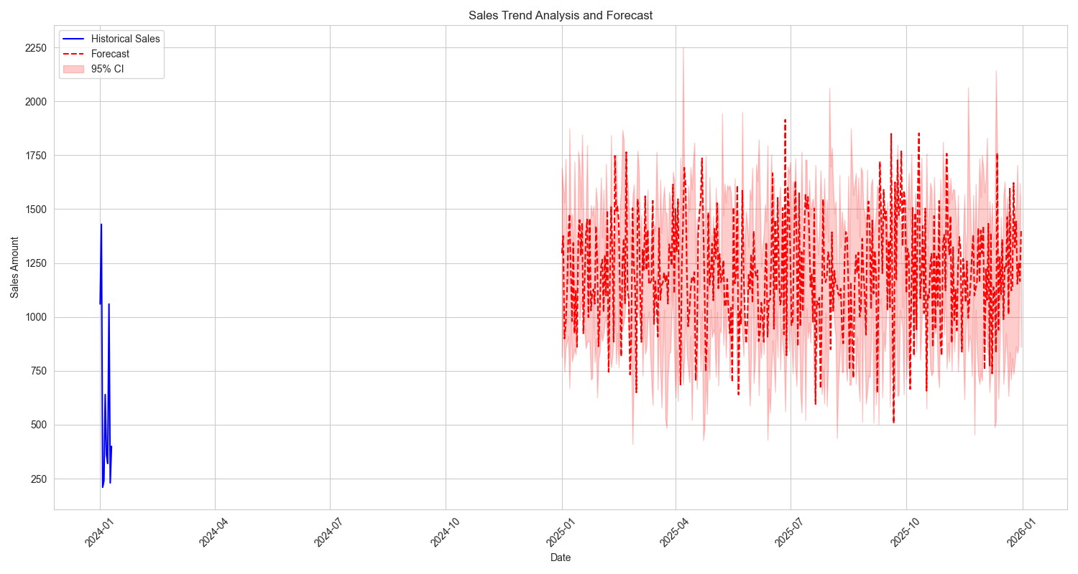
Sales Performance Analysis

Slide 4
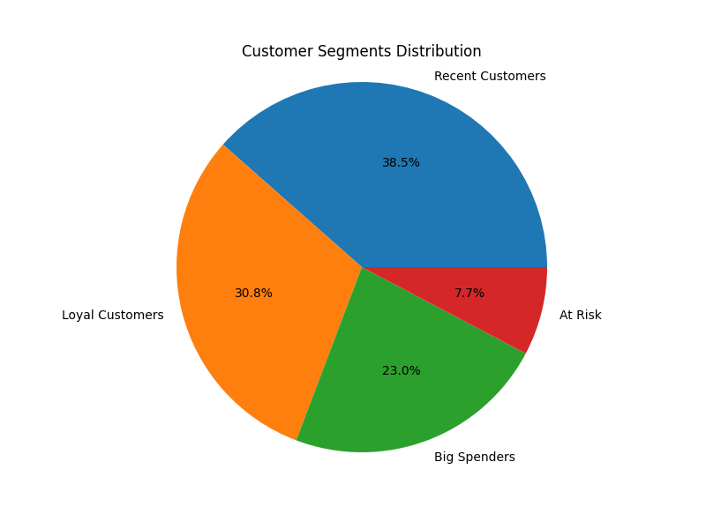
Customer Behavior Analysis

Slide 5
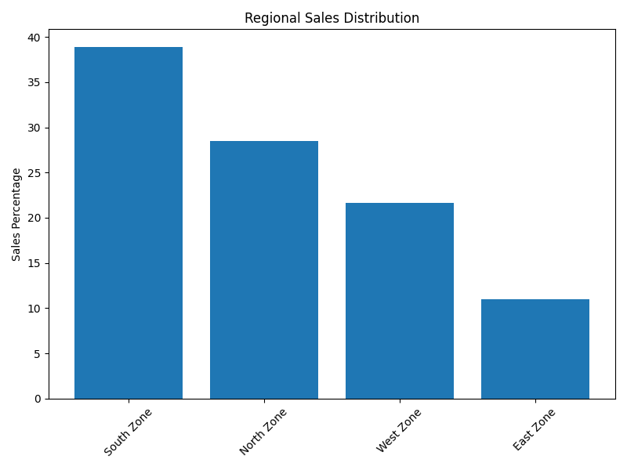
Geographic Analysis

Slide 6
Key Recommendations
• Launch Customer Retention Program
• Optimize Product Categories
• Expand in Tier 2 Cities
• Implement Cross-Selling Strategy
• Enhance Digital Experience

Slide 7
Next Steps
• Implement recommendations within 30 days
• Monitor KPIs and adjust strategies
• Regular reporting and stakeholder updates
• Quarterly review and strategy refinement

