Slide 1

Apache Kafka
CMSC 491
Hadoop-Based Distributed Computing
Spring 2016
Adam Shook

Slide 2
Overview
Kafka is a “publish-subscribe messaging rethought as a distributed commit log”
Fast
Scalable
Durable
Distributed

Slide 3
Kafka adoption and use cases
LinkedIn: activity streams, operational metrics, data bus
400 nodes, 18k topics, 220B msg/day (peak 3.2M msg/s), May 2014
Netflix: real-time monitoring and event processing
Twitter: as part of their Storm real-time data pipelines
Spotify: log delivery (from 4h down to 10s), Hadoop
Loggly: log collection and processing
Mozilla: telemetry data
Airbnb, Cisco, Gnip, InfoChimps, Ooyala, Square, Uber, …

Slide 4
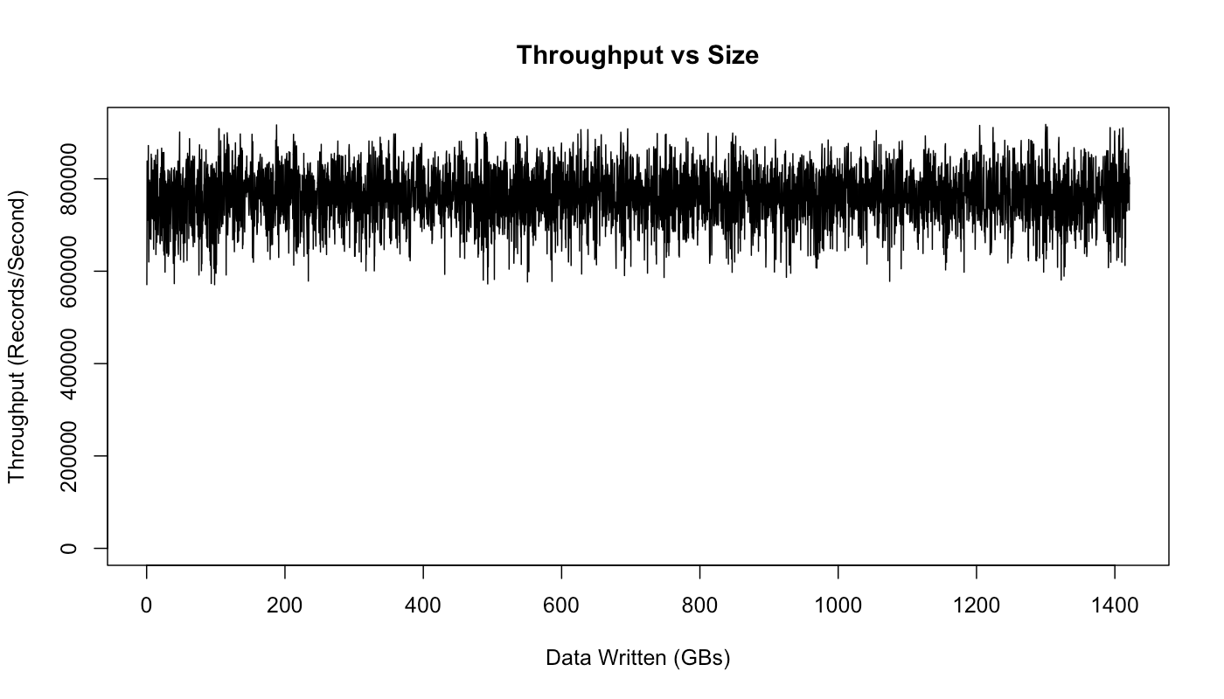
How fast is Kafka?
“Up to 2 million writes/sec on 3 cheap machines”
Using 3 producers on 3 different machines, 3x async replication
Only 1 producer/machine because NIC already saturated
Sustained throughput as stored data grows
Slightly different test config than 2M writes/sec above.

Slide 5
Why is Kafka so fast?
Fast writes:
While Kafka persists all data to disk, essentially all writes go to the page cache of OS, i.e. RAM.
Fast reads:
Very efficient to transfer data from page cache to a network socket
Linux: sendfile() system call
Combination of the two = fast Kafka!
Example (Operations): On a Kafka cluster where the consumers are mostly caught up you will see no read activity on the disks as they will be serving data entirely from cache.

Slide 6
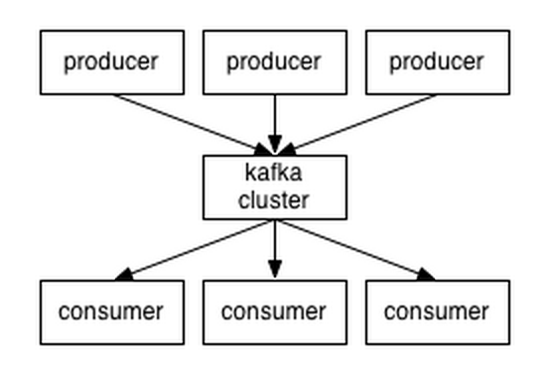
A first look
The who is who
Producers write data to brokers.
Consumers read data from brokers.
All this is distributed.
The data
Data is stored in topics.
Topics are split into partitions, which are replicated.

Slide 7
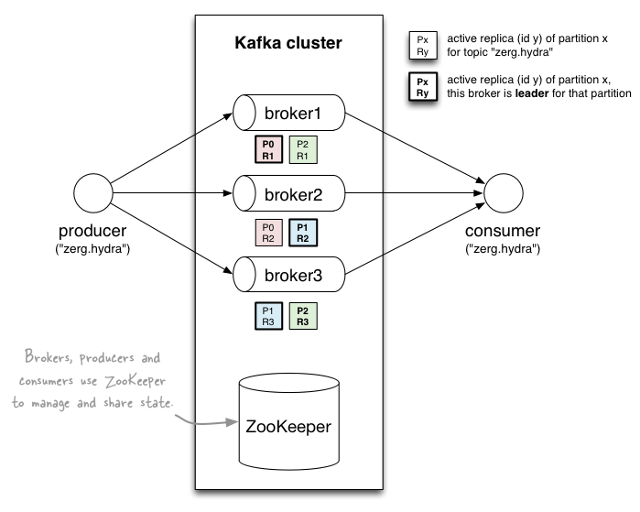
A first look

Slide 8
Topics
Topic: feed name to which messages are published
Example: “zerg.hydra”
Kafka prunes “head” based on age or max size or “key”
Producer A1
Kafka topic
Producer A2
…
…
new
Producer An
Older msgs
Newer msgs
Producers always append to “tail”
(think: append to a file)
Broker(s)

Slide 9
Topics
Consumer group C1
Consumers use an “offset pointer” to
track/control their read progress
(and decide the pace of consumption)
Consumer group C2
Producer A1
Producer A2
…
…
new
Producer An
Older msgs
Newer msgs
Producers always append to “tail”
(think: append to a file)
Broker(s)

Slide 10
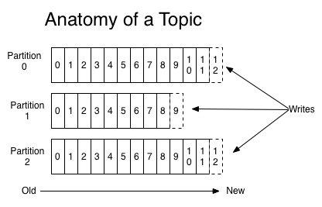
Partitions
A topic consists of partitions.
Partition: ordered + immutable sequence of messages that is continually appended to

Slide 11
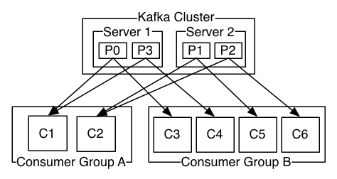
Partitions
#partitions of a topic is configurable
#partitions determines max consumer (group) parallelism
cf. parallelism of Storm’s KafkaSpout via builder.setSpout(,,N)
Consumer group A, with 2 consumers, reads from a 4-partition topic
Consumer group B, with 4 consumers, reads from the same topic

Slide 12
Partition offsets
Offset: messages in the partitions are each assigned a unique (per partition) and sequential id called the offset
Consumers track their pointers via (offset, partition, topic) tuples
Consumer group C1

Slide 13
Replicas of a partition
Replicas: “backups” of a partition
They exist solely to prevent data loss.
Replicas are never read from, never written to.
They do NOT help to increase producer or consumer parallelism!
Kafka tolerates (numReplicas - 1) dead brokers before losing data
LinkedIn: numReplicas == 2 → 1 broker can die

Slide 14
Kafka Quickstart
Steps for downloading Kafka, starting a server, and creating a console-based consumer/producer
Requires ZooKeeper to be installed and running
https://kafka.apache.org/documentation.html#quickstart
https://github.com/adamjshook/hadoop-demos/tree/master/kafka

