Slide 1
Sentiment-DRIVEN STATISTICAL TRADING STRATEGY
ISTM 689 Computer Trading Strategies
Team 3
Atharva Phand
Manoj Reddy Gurram
Nagarjuna Kolloju
Venkat Pitta
Notes:
Howdy! Good morning everyone. We are team 3 and today we'll be presenting our project "SENTIMENT-DRIVEN STATISTICAL TRADING STRATEGY".

Slide 2
Agenda
Overview
Trading Strategy
Results
Challenges
Future Work
Notes:
These are the different sections we'll be covering today.

Slide 3
Overview
Notes:
So we'll start with Overview.

Slide 4
Overview
In this project, we have developed a hybrid strategy that combines statistical modeling and news trading to inform our trading decisions.
We've leveraged OHLC (Open, High, Low, Close) and insider data to generate indicators for our statistical model.
We have incorporated sentiment analysis into our news trading to validate signal generation and improve our entry points.
We conducted a rigorous back testing from January 2023 to April 2024 and refined our model to optimize its performance.
Finally, we have successfully transitioned our strategy to production- ready version, executing paper-trades via IBrokers and verifying order placement.
Notes:
So we have come up with a hybrid strategy which has 2 parts. First, we use the traditional OHLC data along with insider trading data to generate indicators for our statistical model.
And then we perform sentiment analysis on the news trading data to confirm the signals and improve entry points. The backtesting period is from Jan 2023 to April 2024. Lastly, we're executing paper trades in a simulated production environment using IBrokers.

Slide 5
Trading Strategy

Slide 6
Trading Strategy
When making a stock purchase, we carefully consider two critical factors:
Overselling or overbuying conditions
Assessing the stock's momentum direction.
Overselling and overbuying conditions present opportunities for price corrections, with overselling potentially leading to price increases and overbuying potentially leading to price decreases.
Additionally, we utilize momentum indicators to determine the direction of price movements, providing valuable insights into the stock's underlying strength.
To further validate our trading signals, we incorporate news analysis, considering positive or negative (news) related to the stock, to confirm our entry points.
Notes:
Firstly we consider 2 key factors : overselling and overbuying points. In an event of overselling the price tends to increase and in the case of overbuying the price tends to decrease.
Next, we utilize three momentum indicators to further determine the direction in which prices are moving.
Finally, we incorporate the sentiment analysis results such as positive/negative news to validate the trading signals.

Slide 7


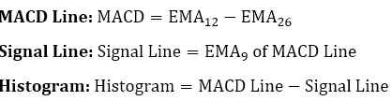
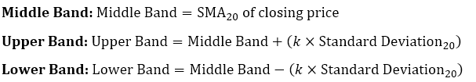
Indicators Used
Dataset : OHLC (Open, High, Low, Close)
RSI (Relative Strength Index):
MACD (Moving Average Convergence and Divergence):
Bollinger Bands:
Notes:
So for the OHLC data we have these 3 indicators. We have RSI, MACD, and Bollinger Bands. All these are momentum oscillators.
RSI is calculated using the average gain and average loss over a defined period of time.
MACD uses the Exponential Moving Average values for calculation of the lines as shown.
Bollinger Bands define upper and lower price range levels. There are 2 parameters used for this – first is period which is 20 day moving average by default, and second is standard deviation with 2 being the default value of k.
It is most applicable in non-trending markets.
The crossover of the two lines give trading signals similar to a two moving average system.
So the bands basically help determine whether prices are high or low on a relative basis.

Slide 8
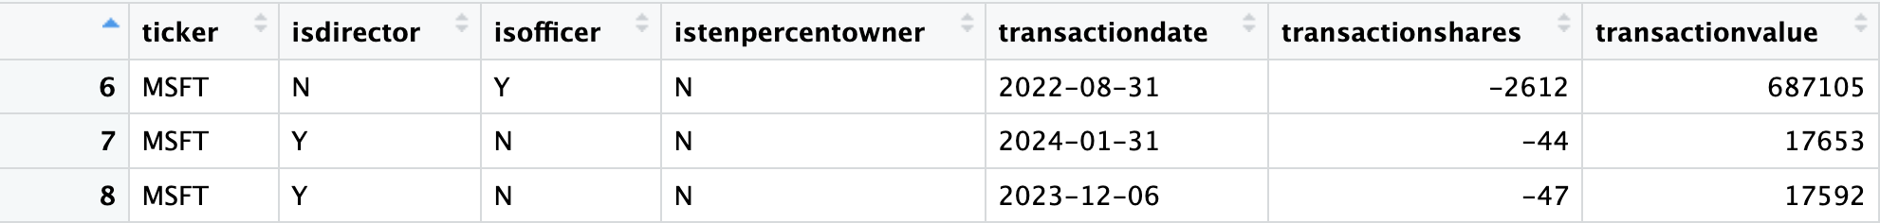
Indicators Used
Dataset : Insider Data
We've developed a system that assigns weights to insider trades based on their roles, acknowledging varying levels of influence and information access.
Directors' trades are given the highest weight (1.5), followed by 10% Owners (1.3) and Officers (1.0).
Notes:
Next in the insider data, we assign different weights to different levels of employees such as directors, officers, and 10% owners. The weight values were a simple design choice. We assign the highest weight of 1.5 to directors, then 1.3 to 10% owners, and 1 to officers.

Slide 9
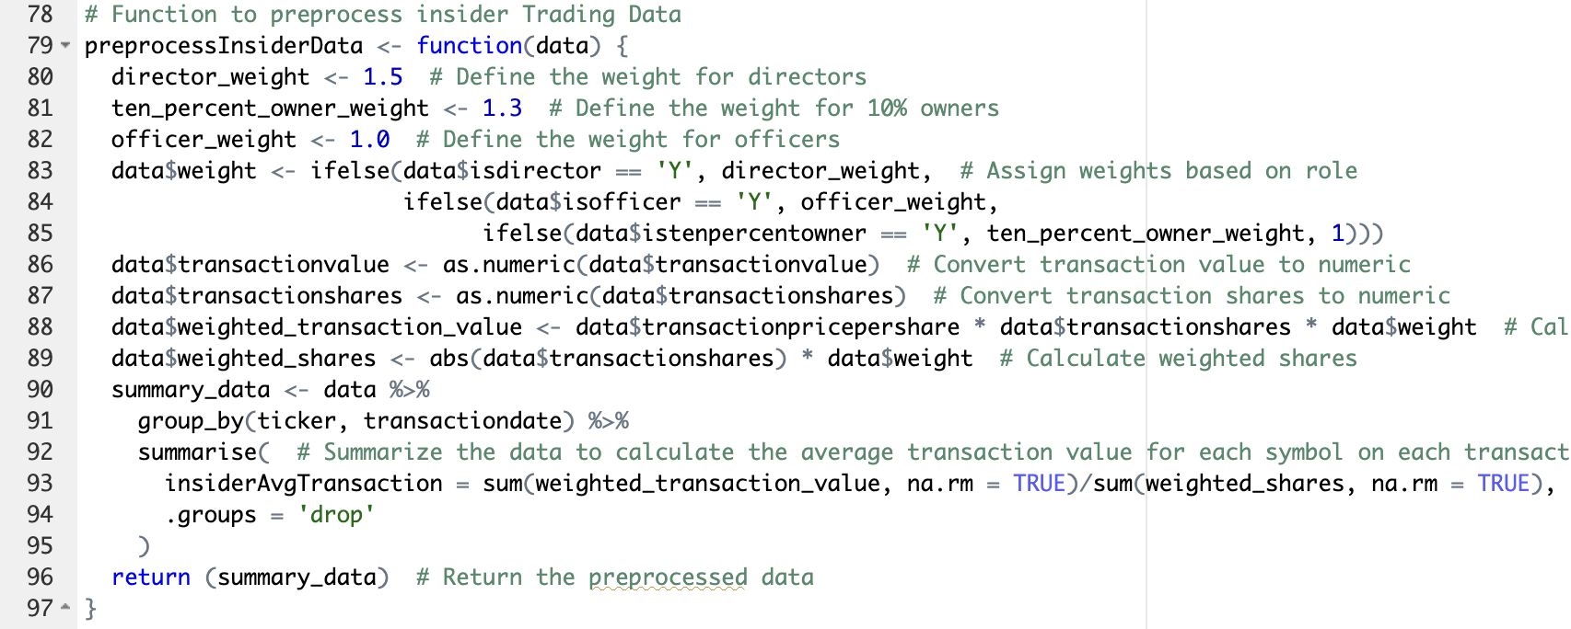
Indicators Used
Notes:
This is the corresponding code where we assign weights and then calculate the weighted transaction values for a given symbol and date.

Slide 10
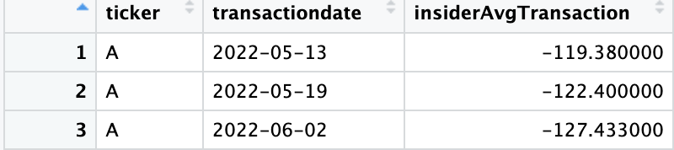
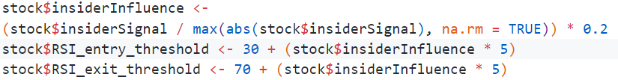
Indicators Used
Dataset : Insider Trading
We then calculate a weighted average transaction value, normalizing it between -0.2 and 0.2 to derive, what we call "Insider Influence".
This influence is used to adjust trading signals, with negative influence increasing the RSI entry threshold and positive influence decreasing the RSI exit threshold.
Notes:
Next, we normalize the transaction values between -0.2 and 0.2 to get the "insider influence". This influence is used to adjust the RSI thresholds. So a negative influence value increases the RSI entry threshold and positive influence decreases the RSI exit threshold.

Slide 11
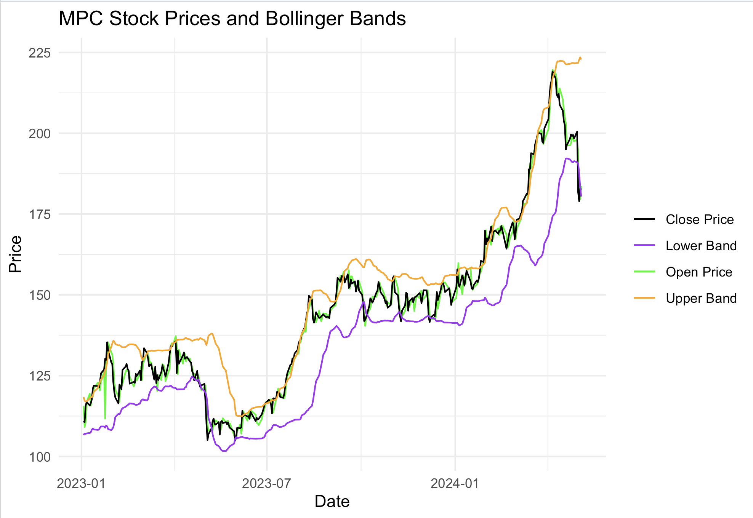
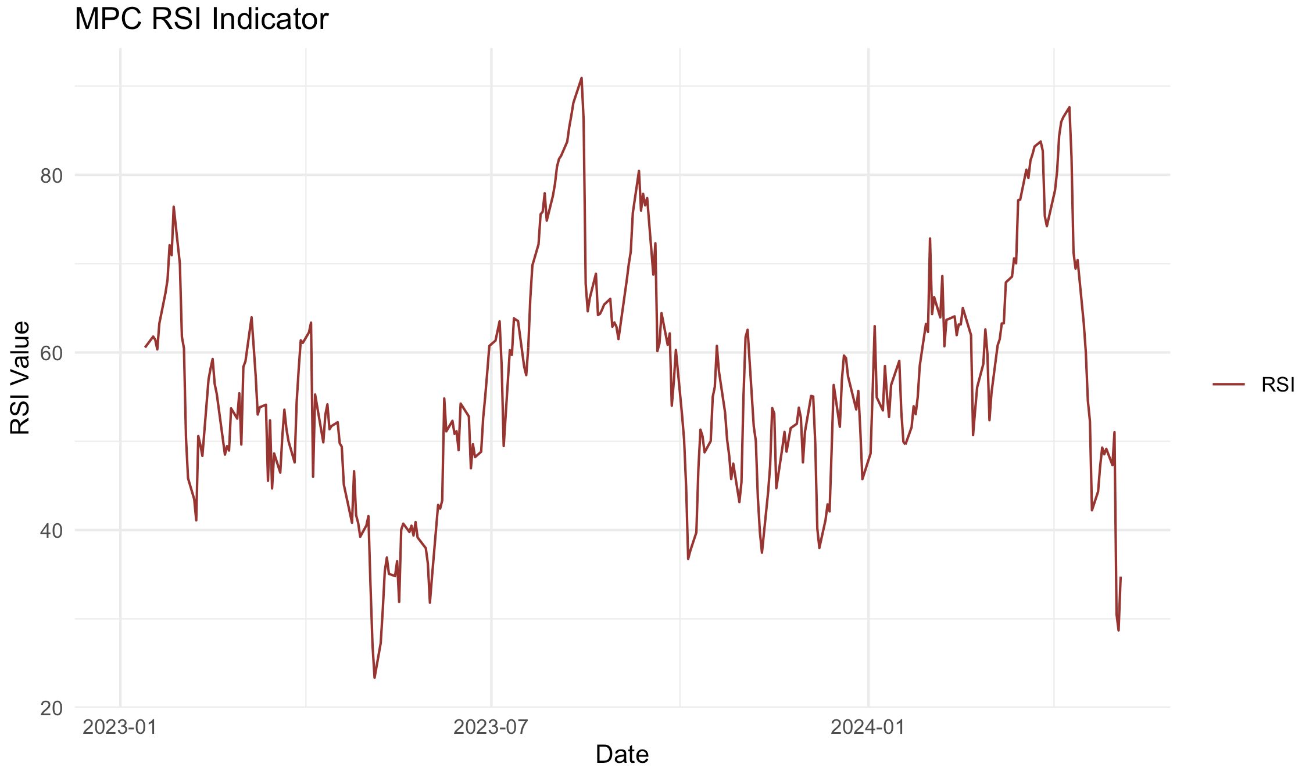
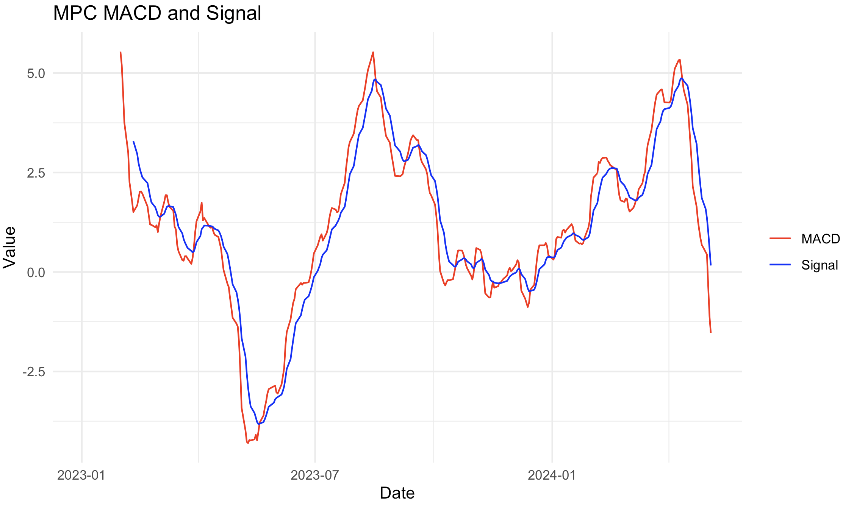
Indicators Used
Notes:
These are the plots for the indicators.
This represents the stock prices over the back testing time period.
This represents the RSI values. And this represents the MACD line and signal line.

Slide 12


News Trading
Reference: Overnight events affect asset price
Notes:
News trading is a crucial aspect of the financial markets because strong breaking news can significantly impact a company's asset price overnight. This is supported by a research publication linked here.

Slide 13
News Trading
Stop Words Removal
Lemmatization
Tokenization
Categorize tokens to positive or negative
Get Top Popular News (Past 10 Days)
Data Preprocessing
Combine all news to get Sentiment Score
News API:
https://newsapi.org/
Bing Sentiment Lexicon:
https://emilhvitfeldt.github.io/textdata/reference/lexicon_bing.html
Classify !
Notes:
Let's see the logic flow:
Fetch top news articles from News API
Split news into individual words (tokens)
Use Bing Lexicon to label each word as Positive or Negative.
Add up sentiments to get overall score for each news.
We sum up for all news, determine the sentiment to classify as positive or negative.

Slide 14
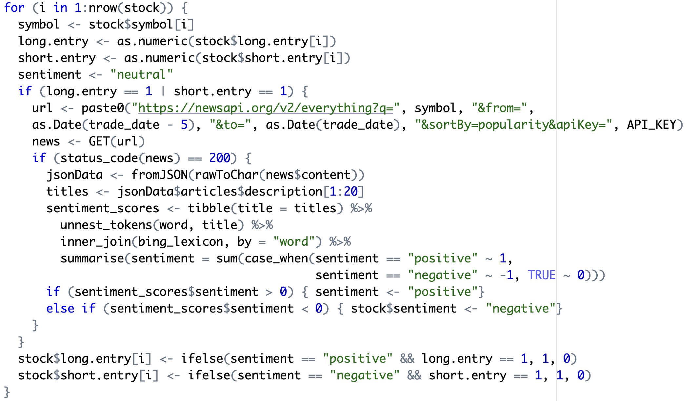
News Trading
Notes:
Here is the script for news trading. We query the NEWS API with stock and date to get relevant news articles for past 10 days. We convert the response to Json format. We then tokenize, get the sentiment score and classify as positive or negative.

Slide 15
Trading Rules (Long Entry)
Condition 1: Price and Momentum Analysis - Criteria: The stock’s closing price must be below the lower Bollinger Band, and the MACD value must be above its signal line.
Condition 2: Market Sentiment via RSI Adjusted for Insider Activity - Criteria: The stock’s RSI is below a modified entry threshold, which is adjusted based on insider buying activity.
Condition 3: Confirmation through News Sentiment - Criteria: After meeting either or both of the above conditions, check the sentiment of the most recent news regarding the stock.
Action: Only proceed with entering a long position if the news sentiment is positive. If the sentiment is negative or mixed, avoid entering the trade.
Notes:
Now lets see the rules for entering a long position.
Condition 1 is stock close price goes below lower bollinger band, it indicates oversold conditions. When MACD value > singal line, it indicates bullish signal, suggesting potential price rise.
Condition 2 is the RSI value < modified threshold for oversold condition, in general it is 30. But when there is a huge insiders buying activity, we increase it for a potential buy. If either of the above conditions are met, we then confirm the signal via news trading, if there is a positive sentiment, we go ahead and enter.

Slide 16
Trading Rules (Long Exit)
When managing a long position, consider exiting the trade if any of the following conditions are met.
Condition 1: Price Reversion - Criteria: The stock’s closing price rises above the lower Bollinger Band.
Condition 2: Momentum Loss - Criteria: The MACD falls below its signal line.
Condition 3: RSI Threshold - Criteria: The RSI reaches neutral value (45).
Notes:
We exit a long position, if any of the given conditions are met. Condition 1: stock close price rises above lower bollinger band indicating reversal of oversold condition. Condition 2: MACD falls below signal line and when RSI reaches a value 45 indicating neutral movements.

Slide 17
Trading Rules (Short Entry)
When considering entering a short position, the strategy demands that all the following conditions must be satisfied before proceeding.
Condition 1: Price Extremes - Criteria: The stock’s closing price is above the upper Bollinger Band.
Condition 2: Overbought Indicator - Criteria: The RSI is higher than a modified exit threshold.
Condition 3: Momentum Shift - Criteria: The MACD is below its signal line.
Final Confirmation: Negative Market Sentiment - Criteria: Check the sentiment of the latest news regarding the stock.
Action: Proceed with entering a short position only if the news sentiment is negative.
Notes:
Hello, I'm Nagarjuna. Let's examine when to enter short positions. We've developed a rigorous approach to handle entering short positions as it involves borrowing money with the hope of repaying it later
Our strategy requires four conditions to be met:
The stock's closing price must be above the upper Bollinger Band, indicating an overbought condition and a potential price drop.
The RSI must be greater than a modified exit threshold, typically 70. However, if there's significant insider selling activity, we adjust the threshold downward.
The MACD line must be below the signal line, indicating a bearish signal.
we then verify the latest news about the stock, looking back around 10-15 days, to gauge market sentiment. If the news sentiment is negative, we enter a short position.

Slide 18
Trading Rules (Short Exit)
When managing a short position, consider exiting the trade if any of the following conditions are met.
Condition 1: Price Movement - Criteria: The stock’s price falls below the upper Bollinger Band.
Condition 2: Momentum Reversal - Criteria: The MACD rises above its signal line.
Condition 3: Overbought/Oversold Indicator - Criteria: The RSI reaches almost neural/stable value (45).
Notes:
When exiting our short position, we aim to minimize risk.
We exit our short position when any of the following three conditions are met:
The stock price falls below the upper Bollinger Band, indicating a potential reversal in the overbought condition.
There is a momentum reversal, signaled by the MACD line crossing above the signal line.
The RSI reaches a neutral value, dropping back down from 70, indicating a decrease in overbought conditions.

Slide 19
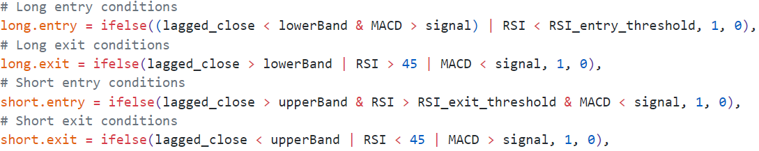
Trading Rules (Summary)
Notes:
To summarize:
we enter long when we see oversold condition and bullish signal.
Enter short when we see overbought condition and bearish signal. These are strengthed by news signal and insider activity.

Slide 20
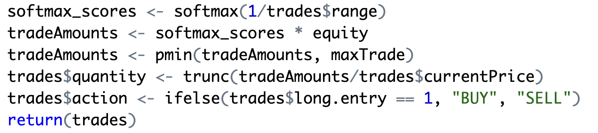
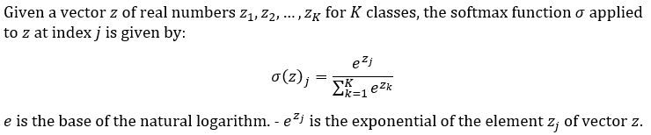
Diversify Investments
Instead of investing the same amount of money for each equity, we can smartly adjusts the sizes of trading positions based on the associated risks. (Range of Bollinger Bands).
By using the soft-max function (LDATS package), we can normalize trade sizes, giving preference to less volatile trades, thus aiming to maximize returns while minimizing risk exposure.
Notes:
Instead of investing the same amount of money for each equity during opening positions, we smartly adjusted the prices based on risk. Risk is bollinger band width which goes by range. Less risk indicates more investment, so we take an inverse and apply softmax to get its investment distribution.
Softmax is a function which takes a vector and makes a probability distribution out of it.
As you can see, the code replicates my thoughts here, i.e doing softmax and distributing equity. We used LDATS package to for softmax.

Slide 21
Results

Slide 22
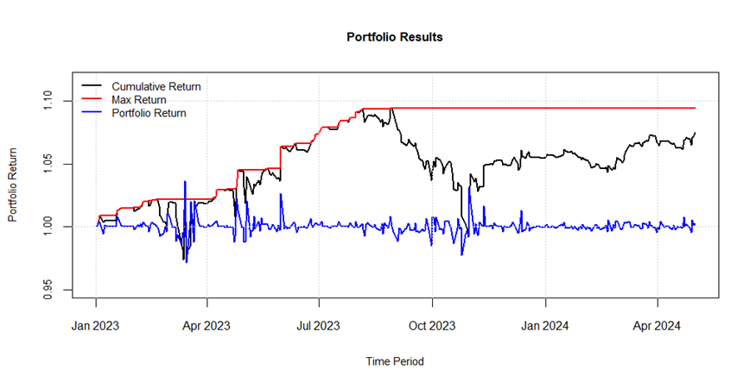
Results (Back - testing)
Notes:
The chart shows the performance of a portfolio using our strategy from January 2023 to April 2024, measured by Cumulative Return, Max Return, and Portfolio Return. The Cumulative Return steadily increases, indicating a generally positive performance in the beginning.

Slide 23
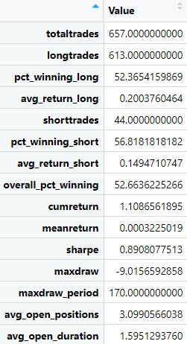
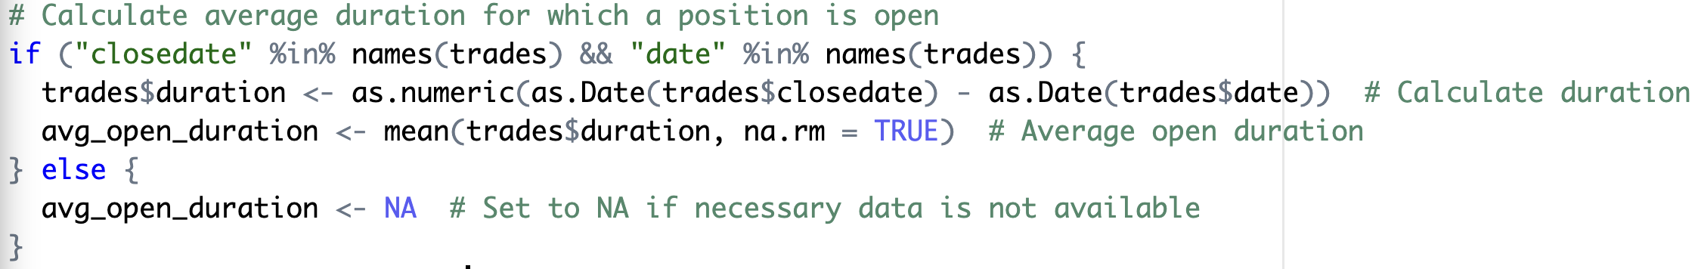
Results (Performance Results)
Code for calculating average open duration:
Notes:
Our trading strategy analysis reveals a high-frequency, bullish approach with 657 total trades, mostly long positions (613). Very less no of short trades is attributed to our rigid entry point of short. While the strategy is profitable, it has a modest win rate (52.66%) and moderate risk-adjusted return (Sharpe Ratio 0.89). The portfolio experienced a significant max drawdown (-9.01%) and has room for improvement in trade selection and timing. The strategy excels in rising markets but may struggle in bearish conditions, with a lower win rate for short trades (56.81%). We open an average of 3 positions, and hold them for around 2 days. Over to venkat, to discuss about our production results.

Slide 24
Production - Version
User selects an option: Q (quit), E (execute trades), M (modify price), D (delete trade), or C (change trade quantity).
If executing trades, check if total value exceeds available equity and prompt adjustment if necessary.
If deleting or changing trade quantity, validate user input (row number and position size).
After adjustments, calculate final equity and return updated trades and equity.
Process repeats until user chooses to execute or quit.
Notes:
Our production version lets you trade with flexibility and control. You can stop trading, adjust positions, and change prices in real-time. The system updates your equity and ensures safe trading automatically

Slide 25
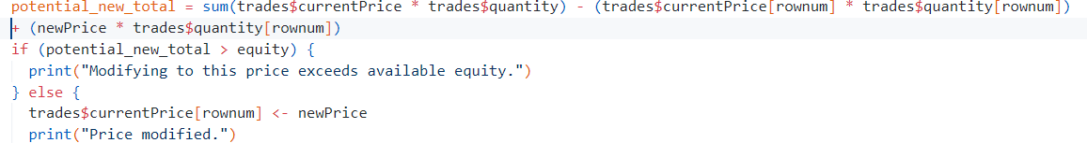
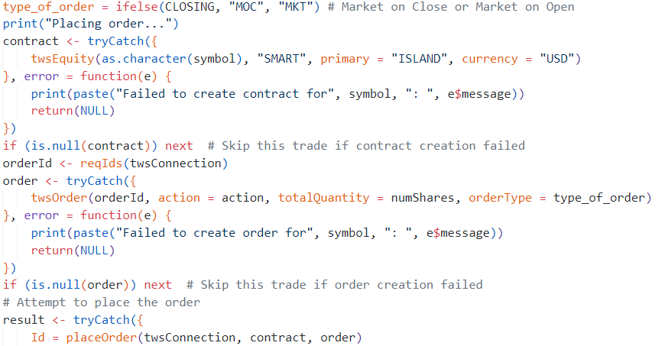
Production - Version
Extra Check !!
Doesn’t have "MOO", using "MKT" here.
Notes:
When a user modifies positions or quantity, we ensure our equity doesn't become negative. You can see this in the code, where we added a check after the user updates.
Our backtested strategy enters a position at the market open price and exits at the market close price. In the production version, we aimed to replicate this, but the API doesn't provide Market On Open (MOO) orders. Instead, we used Market (MKT) orders at the instant price and closing with Market On Close (MOC) orders.
Code:Here, we determine the order type, create a contract, and place the order."
Let me know if you'd like any further adjustments!

Slide 26
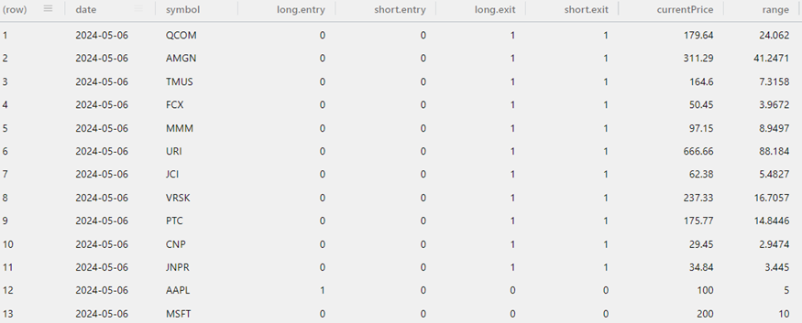
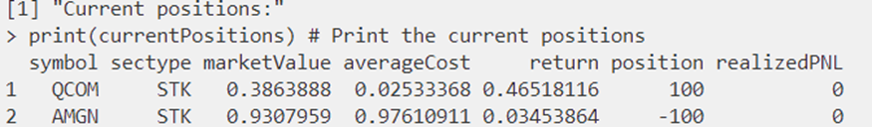
Results (Production - Version)
Trading Signals:
Portfolio details:
Notes:
Our production version has generated trading signals indicating a long position in Apple (AAPL) stock and a exit from our existing position in Qualcomm (QCOM) stock. With $5 lakh available in our trading account, we are well-positioned to execute these trades. Currently, our portfolio holds a position in Qualcomm stock, which our strategy suggests we partially exit.

Slide 27
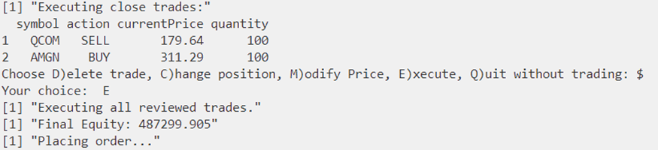
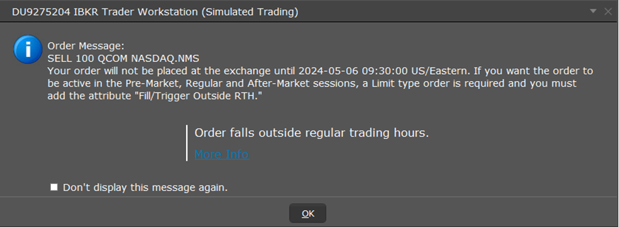
Results (Production - Version)
Closing Positions:
Confirmation message:
Notes:
Our script sugges to exit QCOM and AMGN stock, when we execute. We get the final updated equity to have brief overview of remaining bucks in our account. Here you can see that we get a confirmation message.

Slide 28
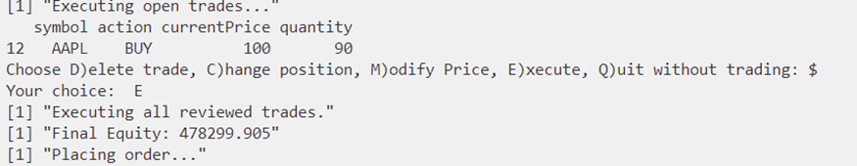
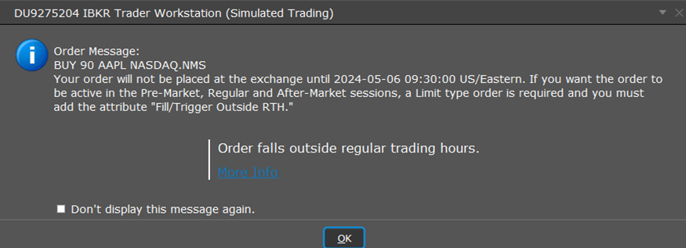
Results (Production - Version)
Opening Positions:
Confirmation message:
Notes:
We open new positions, our strategy suggest to open APPL and buy 90 shares at price of 100. After placing order, we get a confirmation message.

Slide 29
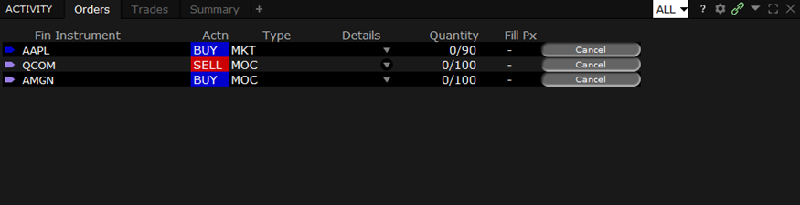
Results (Production - Version)
Trader workstation confirmation:
Notes:
As you can see, our orders are updted here in the trader work station.

Slide 30
Challenges

Slide 31
Challenges
News Availability for Back Testing:
Due to News API call limitations, we can't generate the required volume for a year of back testing.
Tracking IBrokers Orders:
We haven't integrated order tracking due to limited documentation, resources, and time constraints.
Data Analysis:
Coming up with a technical indicator for insider data
Handling empty responses from News API

Slide 32
Future Work

Slide 33
Future Work
In-depth analysis of insider data for enhanced insights.
Robust implementation of statistical analysis for improved accuracy.
Integration of transformers/neural networks for advanced sentiment analysis.
Efficient cache management and order execution tracking.
Incorporation of real transaction costs in the production version.
** These features were considered but couldn't be implemented due to time and resource constraints.

Slide 34
"THANK YOU" We are Open to Questions !

