Slide 1
Ruby On Rails

Slide 2
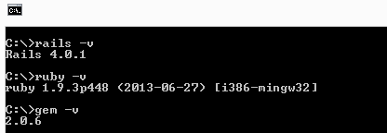
Installing Rails
http://railsinstaller.org
Prerequisites:
The Ruby language version 1.9.3 or newer.
The RubyGems packaging system, which is installed with Ruby versions 1.9 and later. To learn more about RubyGems, please read the RubyGems Guides.
A working installation of the SQLite3 Database.

Slide 3
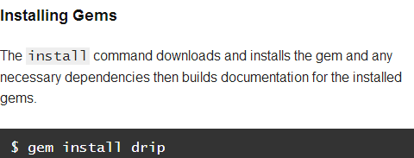
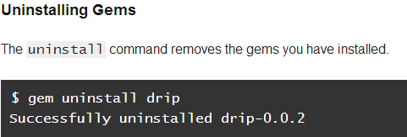
RubyGems
RubyGems software allows you to easily download, install, and use ruby software packages on your system.
The software package is called a "gem" and contains a package Ruby application or library.
Commonly used to distribute reusable functionality that is shared with other Rubyists for use in their applications and libraries.

Slide 4
What is Rails?
Rails is a web application development framework written in the Ruby language.
It is designed to make programming web applications easier by making assumptions about what every developer needs to get started.
It allows you to write less code while accomplishing more.
The Rails philosophy includes two major guiding principles:
Don't Repeat Yourself: DRY is a principle of software development which states that "Every piece of knowledge must have a single, unambiguous, authoritative representation within a system." By not writing the same information over and over again, our code is more maintainable, more extensible, and less buggy.
Convention Over Configuration: Rails has opinions about the best way to do many things in a web application, and defaults to this set of conventions, rather than require that you specify every minutiae through endless configuration files.

Slide 5
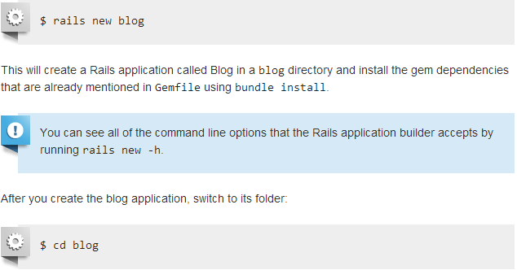
New Rails Project
Rails comes with a number of scripts called generators that are designed to make your development life easier by creating everything that's necessary to start working on a particular task.
One of these is the new application generator, which will provide you with the foundation of a fresh Rails application so that you don't have to write it yourself.
To use this generator, open a terminal, navigate to a directory where you have rights to create files, and type:

Slide 6
New Rails Project cont.…
After creating a new Rails application, the next step is to use Bundler to install and include the gems needed by the app.
Bundler is run automatically (via bundle install) by the rails command
The bundle install command might take a few moments, but when it’s done our application will be ready to run.

Slide 7
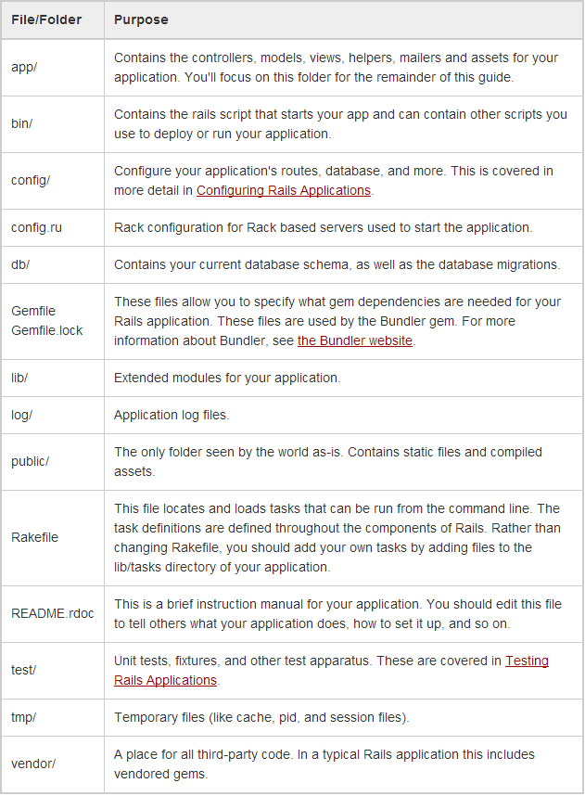
New Rails Project cont.…

Slide 8
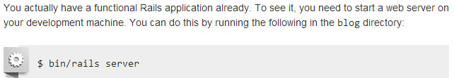
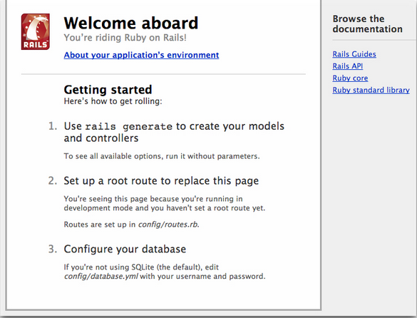
Start Rails Web Server
To stop the web server, hit Ctrl+C in the terminal window where it's running.

Slide 9
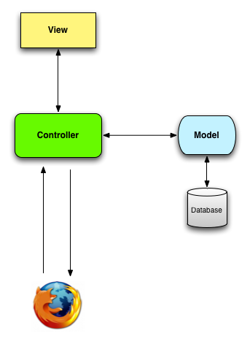
MVC Architecture in Rails
Controller – Entry point of the application. Handles IO. Ruby files
View – Templates displayed to the user. HTML files with Ruby
Model – Functions that interact with the database or perform complex operations. SQL queries in Ruby

Slide 10

Version Controlling in Rails
Version control is a system that records changes to a file or set of files over time so that you can recall specific versions later.
Much of the Rails ecosystem depends in one way or another on a version control system called Git
Installing:
http://git-scm.com/book/en/Getting-Started-Installing-Git

Slide 11


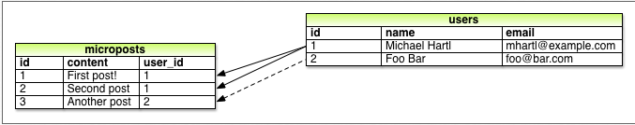
Creating blog app in Rails
App will be a microblog, with only users and short (micro)posts
Users of our demo app will have
unique integer identifier called id,
publicly viewable name (of type string),
emailaddress (also a string) that will double as a username
Micropost has only an id and a content field for the micropost’s text (of type string).
There’s an additional complication, though: we want to associate each micropost with a particular user; we’ll accomplish this by recording the user_id of the owner of the post.

Slide 12
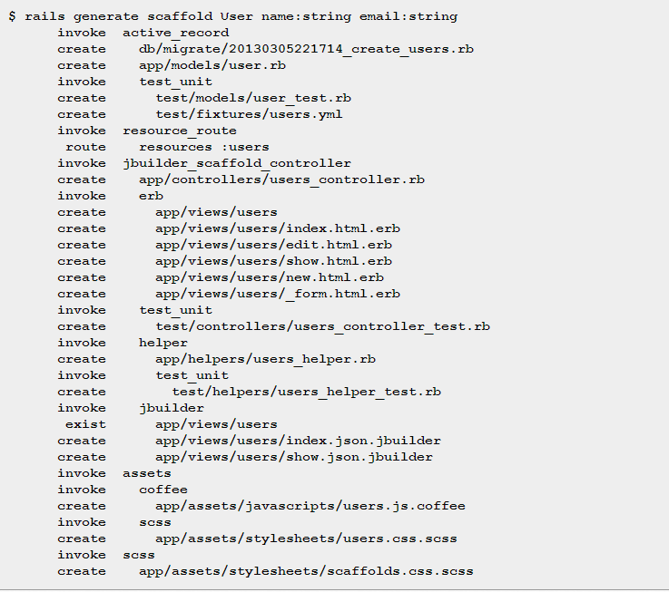
Creating blog app in Rails cont.…
Rails scaffolding is generated by passing the scaffold command to the rails generate script.
The argument of the scaffold command is the singular version of the resource name (in this case, User), together with optional parameters for the data model’s attributes

Slide 13
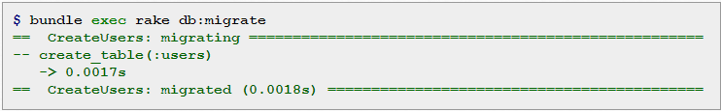
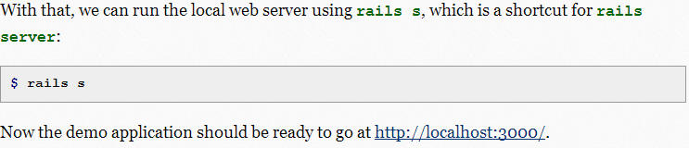
Creating blog app in Rails cont.…
By including name:string and email:string, we have arranged for the User model to have the form with name and email fields.
(Note that there is no need to include a parameter for id; it is created automatically by Rails for use as the primary key in the database.)
To proceed with the demo application, we first need to migrate the database using Rake
This simply updates the database with our new users data model.

Slide 14
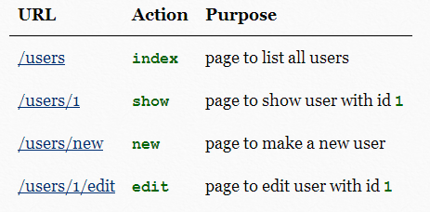
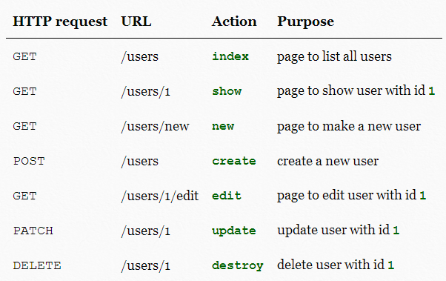
Creating blog app in Rails cont.…

Slide 15
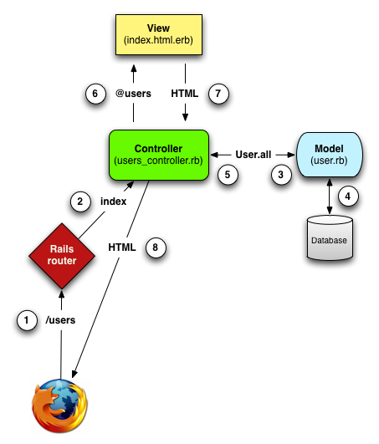
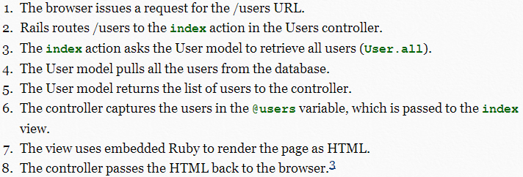
Creating blog app in Rails cont.…

Slide 16
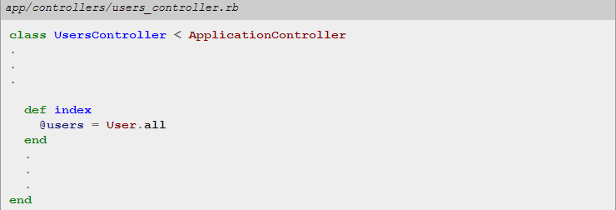
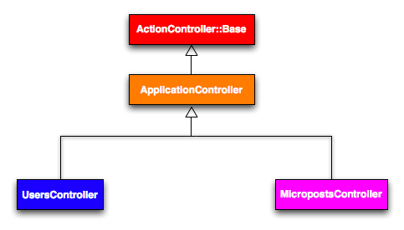
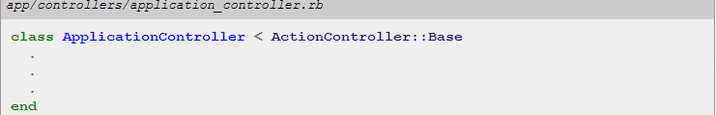
Creating blog app in Rails cont.…
To examine the relationship between the Users controller and the User model, let’s focus on a simplified version of the index action
Users controller inherits from the Application controller, ApplicationController itself inherits
from ActionController::Base; this is the base class for controllers provided by the Rails library Action Pack
Variables that start with the @ sign, called instance variables, are automatically available in the view; in this case, the index.html.erb

Slide 17

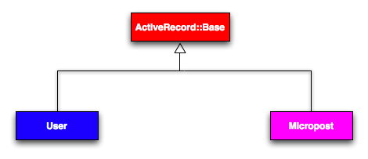
Creating blog app in Rails cont.…
User model inherit (via the left angle bracket <) from ActiveRecord::Base, which is the base class for models provided by ActiveRecord.
It is by inheriting from ActiveRecord::Base that model objects gain the ability to communicate with the database, treat the database columns as Ruby attributes, and so on.

Slide 18
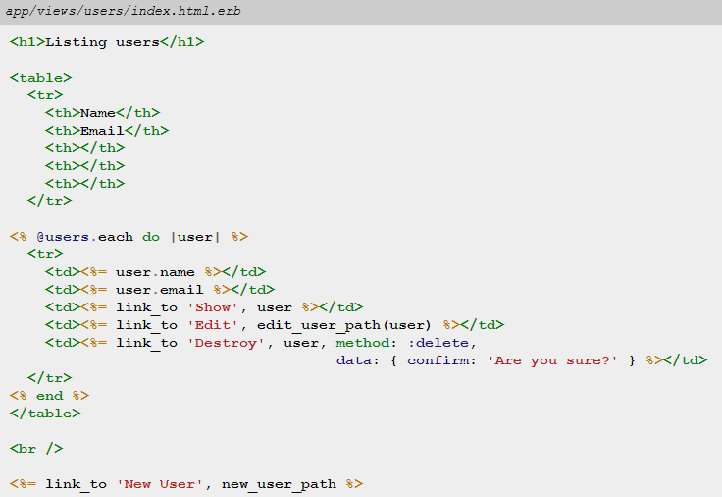
Creating blog app in Rails cont.…

Slide 19
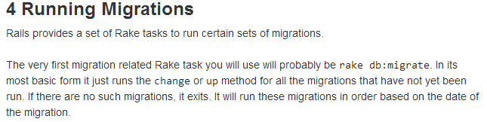
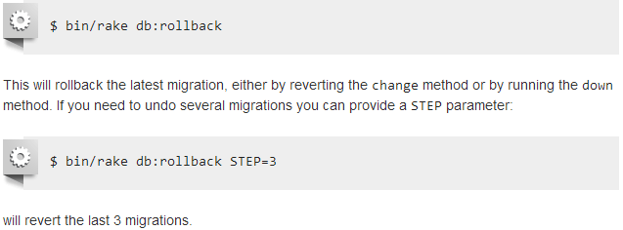
Active Record Migrations

Slide 20
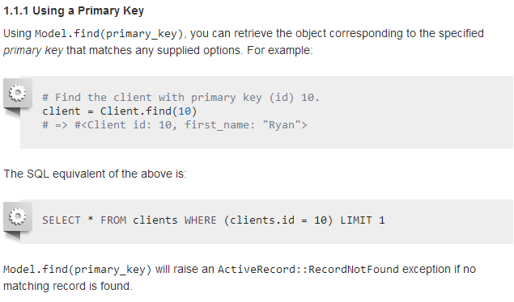
Active Record Query Interface
http://guides.rubyonrails.org/active_record_querying.html

Slide 21
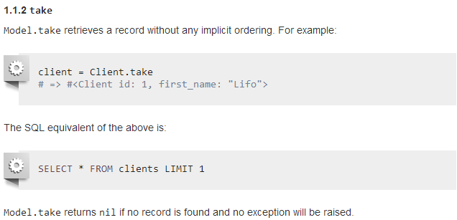
Active Record Query Interface Cont.…

Slide 22
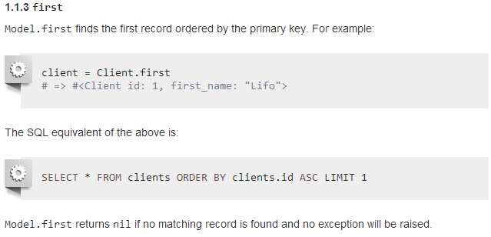
Active Record Query Interface Cont.…

Slide 23
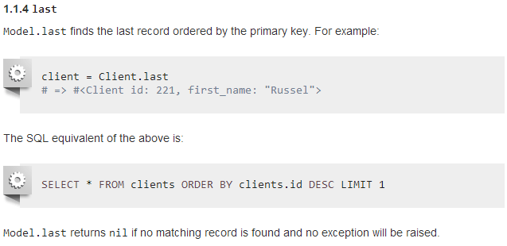
Active Record Query Interface Cont.…

Slide 24
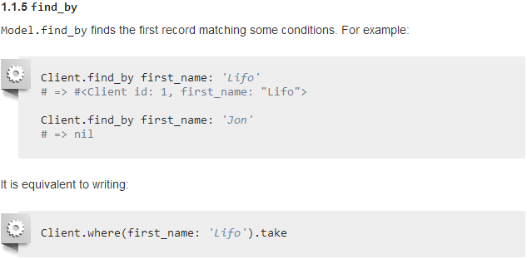
Active Record Query Interface Cont.…

Slide 25
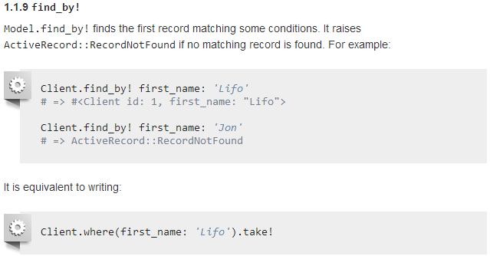
Active Record Query Interface Cont.…

Slide 26
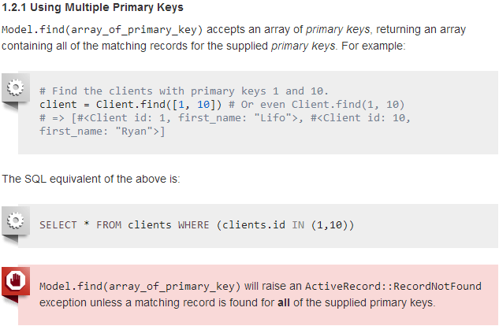
Active Record Query Interface Cont.…

Slide 27
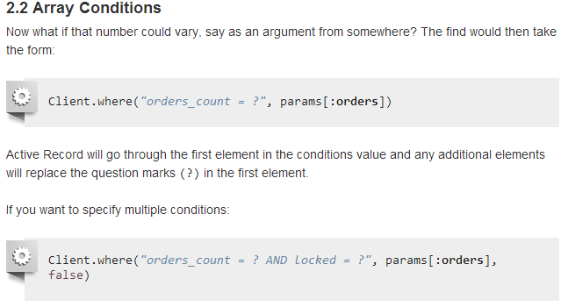
Active Record Query Interface Cont.…

Slide 28
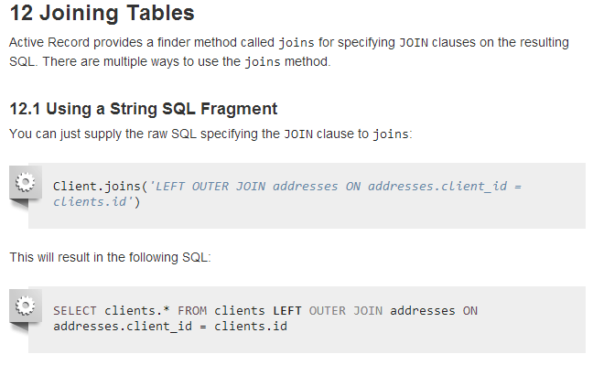
Active Record Query Interface Cont.…

Slide 29
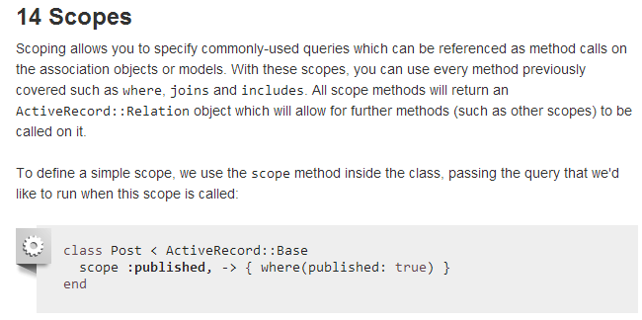
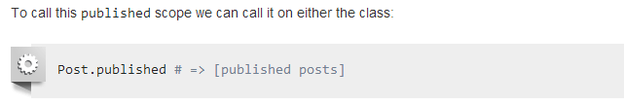
Active Record Query Interface Cont.…

Slide 30
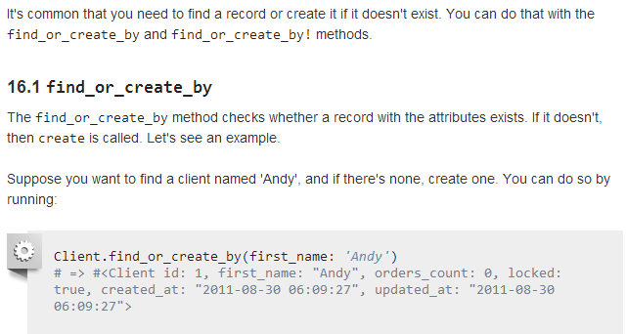
Active Record Query Interface Cont.…

Slide 31
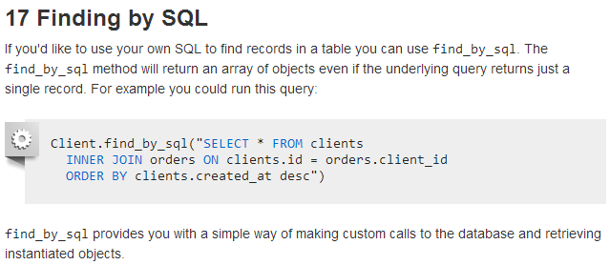
Active Record Query Interface Cont.…

Slide 32
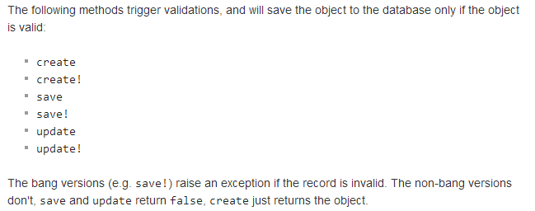
Active Record Validations

Slide 33
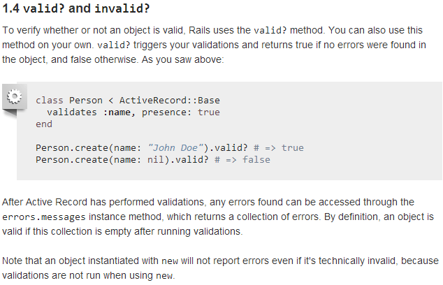
Active Record Validations Cont..

Slide 34
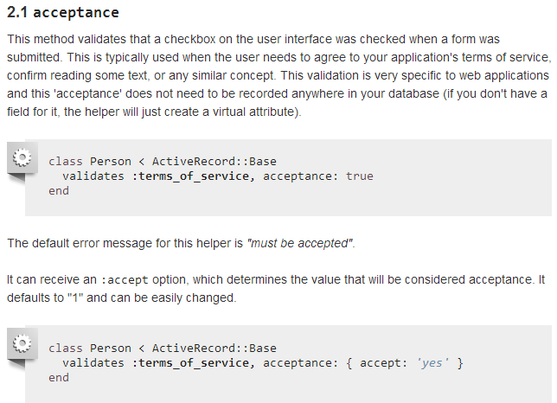
Active Record Validations Cont..

Slide 35
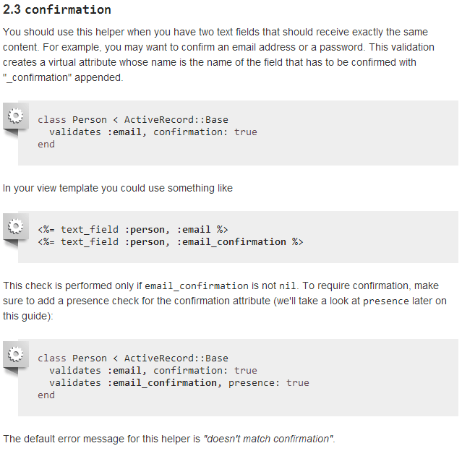
Active Record Validations Cont..

Slide 36
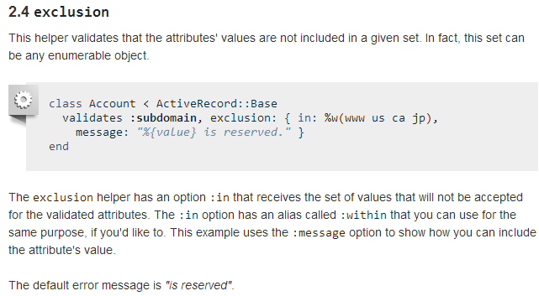
Active Record Validations Cont..

Slide 37
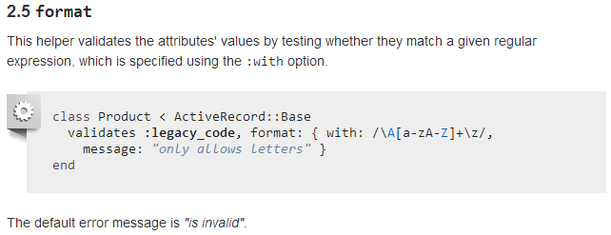
Active Record Validations Cont..

Slide 38
Active Record Validations Cont..

Slide 39
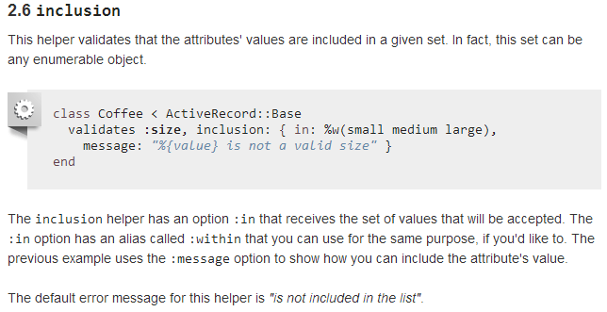
Active Record Validations Cont..

Slide 40
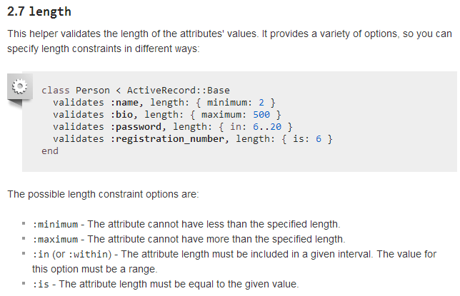
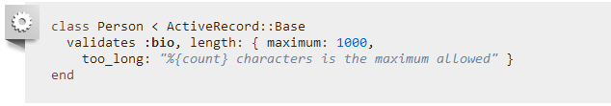
Active Record Validations Cont..

Slide 41
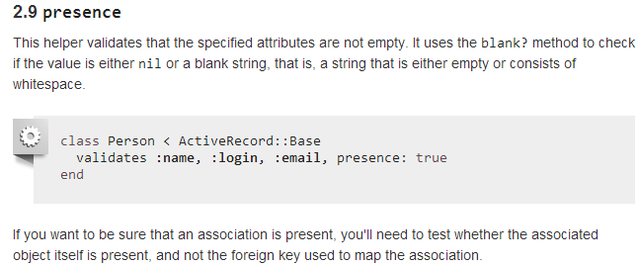
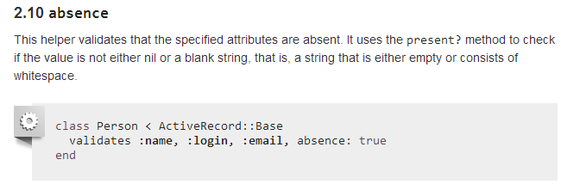
Active Record Validations Cont..

Slide 42
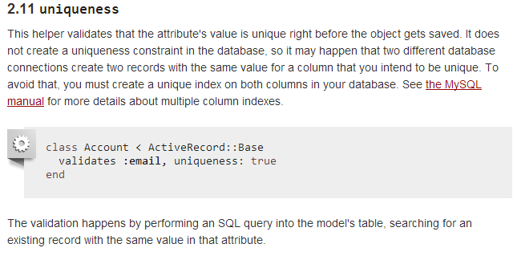
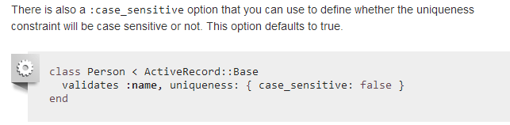
Active Record Validations Cont..

Slide 43
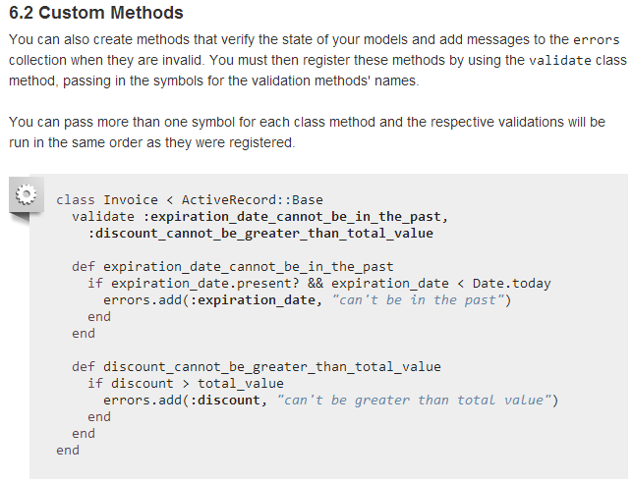
Active Record Validations Cont..

Slide 44

Active Record Associations

Slide 45

Active Record Associations
belongs_to associations must use the singular term. If you used the pluralized form in the above example for the customer association in the Order model, you would be told that there was an "uninitialized constant Order::Customers". This is because Rails automatically infers the class name from the association name. If the association name is wrongly pluralized, then the inferred class will be wrongly pluralized too.

Slide 46

Active Record Associations

Slide 47

Active Record Associations

Slide 48



Active Record Associations

Slide 49



Active Record Associations

Slide 50



Active Record Associations

Slide 51

Active Record Callbacks

Slide 52

Active Record Callbacks

Slide 53

Active Record Callbacks

Slide 54

Active Record Callbacks

Slide 55

Active Record Callbacks

Slide 56

Action Controller

Slide 57

Action Controller

Slide 58



Action Controller

Slide 59


Action Controller

Slide 60


Rails Router

Slide 61

Rails Router

