Slide 1
RUBY PROGRAMMING

Slide 2
Installing Ruby
http://rubyinstaller.org/
Open the above URL and click on ‘Download’ button.
Install Ruby-1.9.3* version of ruby or 2.0.0 version of ruby.
In the same page if you scroll down you will also see links to download ‘Development Kit’.
Install appropriate DevKit depending on the version of ruby you have installed.
After installing open command prompt and run the following command to verify your version of ruby installation:
>> ruby –v

Slide 3
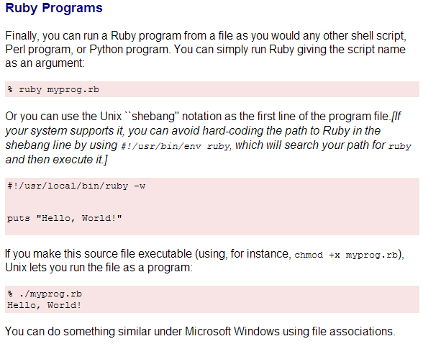
Ways to run a Ruby program

Slide 4
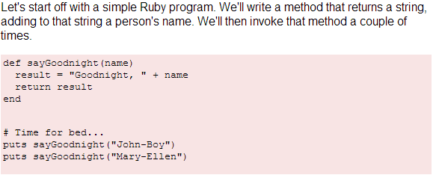
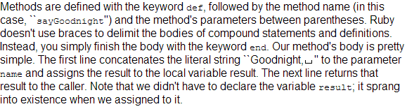

Basic Ruby

Slide 5
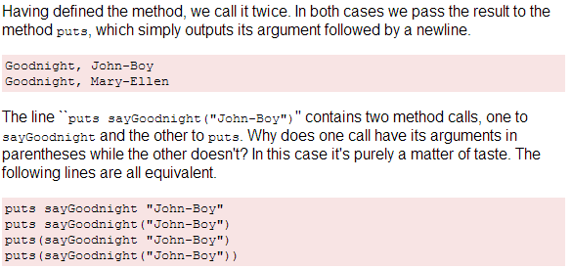
Basic Ruby Cont…

Slide 6
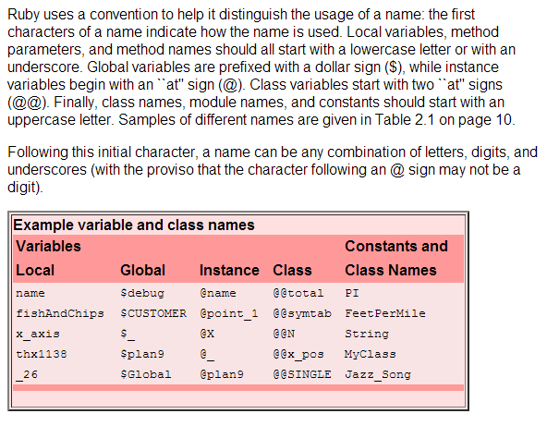
Variable Naming Convention in Ruby

Slide 7
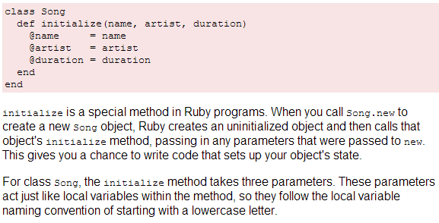

Simple Class in Ruby

Slide 8
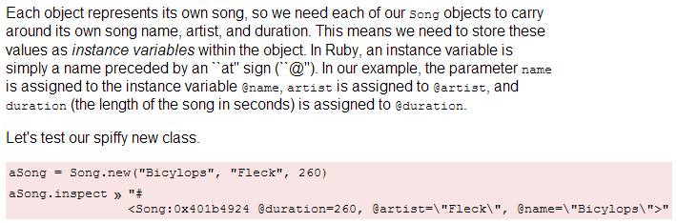
Simple Class in Ruby cont …

Slide 9
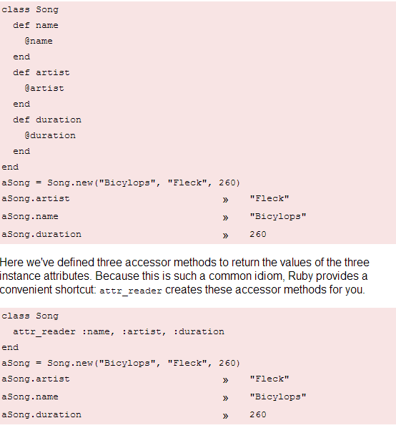
Attributes in a class & attr_reader shortcut

Slide 10
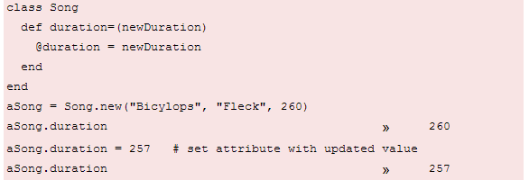
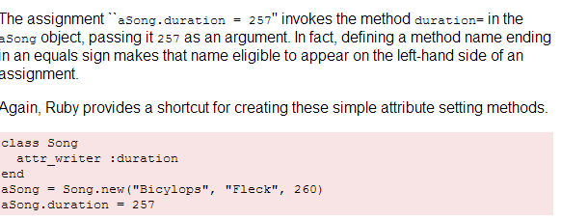
Attributes in a class & attr_writer shortcut

Slide 11
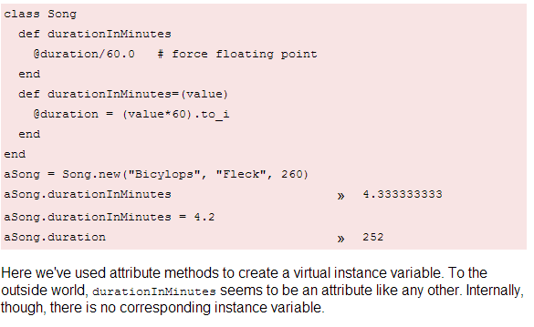
Virtual Attributes in a class

Slide 12
Including other files
It is easier to break your code up into logical groupings and place each group in a separate file or files.
When you begin using multiple files, you have a need for the Ruby's require and load methods that help you include other files in your program.
We can use require_relative (introduced in Ruby 1.9) to load a file relative to the file we're loading it from.
The load method includes the named Ruby source file every time the method is executed:
>> load 'filename.rb'
The more commonly used require method loads any given file only once:
>> require 'filename'

Slide 13
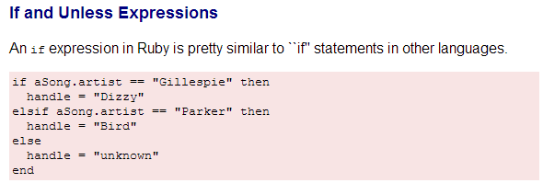
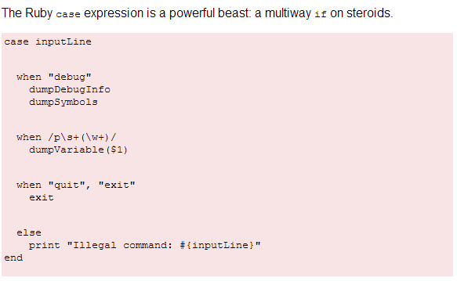
If and Unless Expressions Ruby

Slide 14
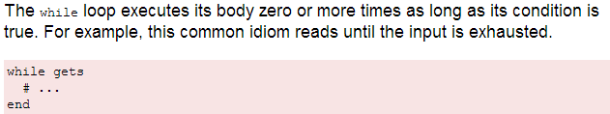
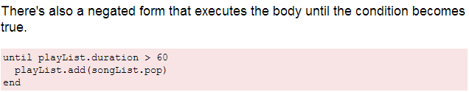
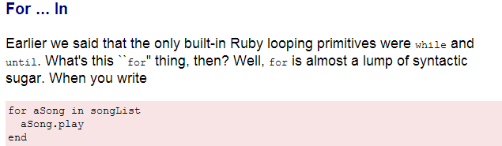
Loops in Ruby

Slide 15
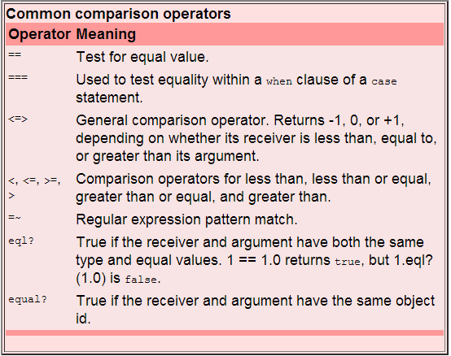
Comparison Operators in Ruby

Slide 16
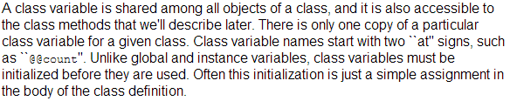
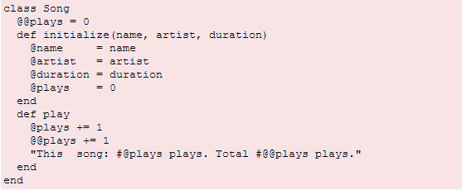

Class Variables in Ruby

Slide 17
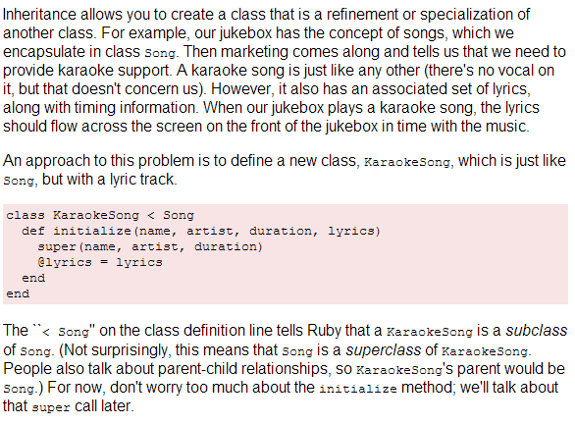
Inheritance in Ruby

Slide 18
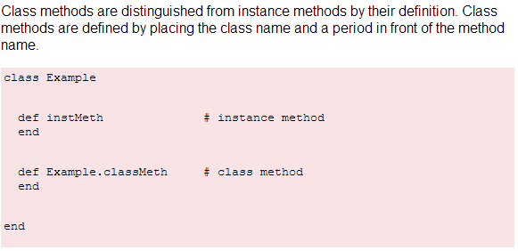
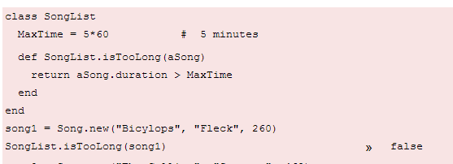
Class Methods in Ruby

Slide 19
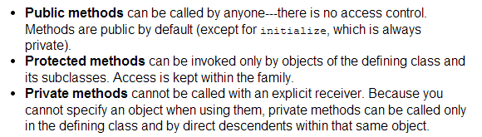
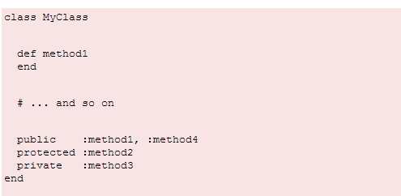
Access Control in Ruby

Slide 20
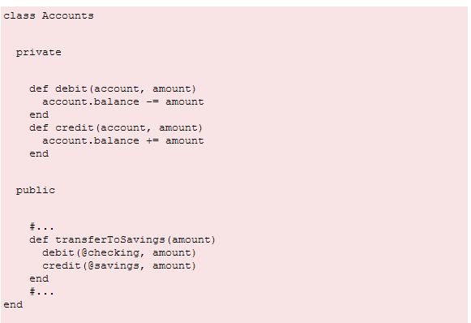
Access Control in Ruby

Slide 21
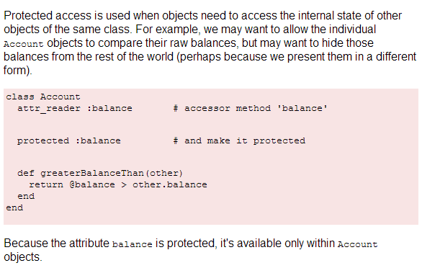
Protected access Control in Ruby

Slide 22
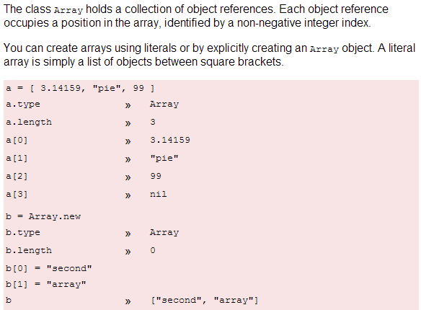
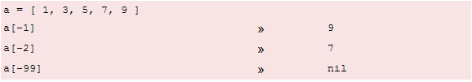
Arrays in Ruby

Slide 23
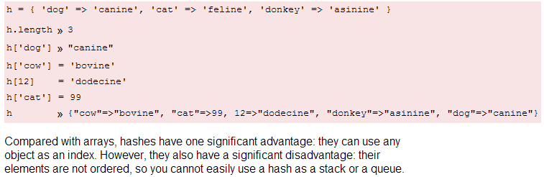
Hashes in Ruby

Slide 24
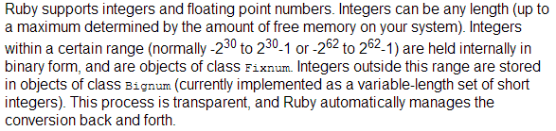
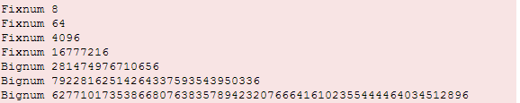
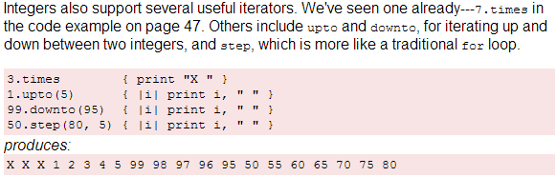
Numbers in Ruby

Slide 25


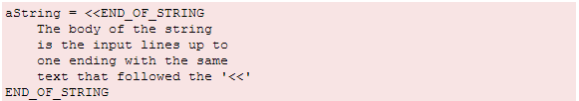
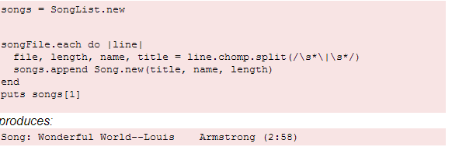
Strings in Ruby
http://www.ruby-doc.org/core-2.1.0/String.html

Slide 26
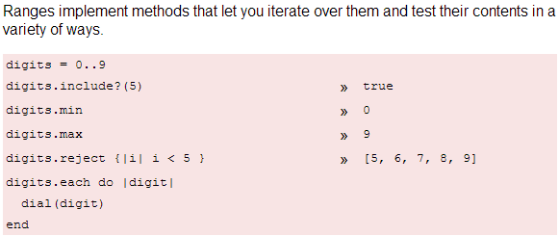
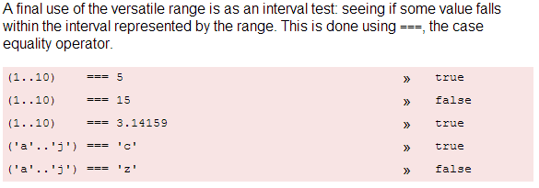
Ranges in Ruby

Slide 27
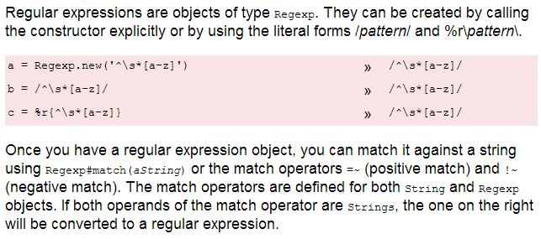
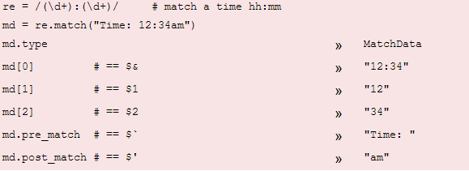
Regular Expressions in Ruby

Slide 28
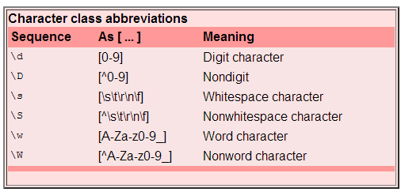
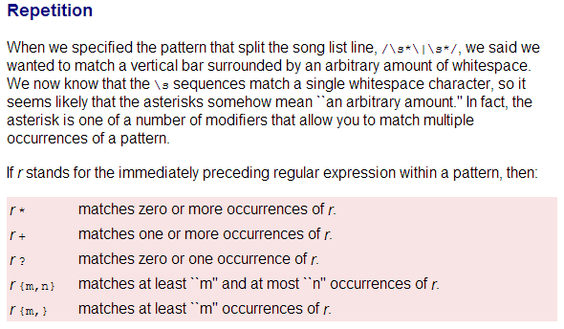
Regular Expressions in Ruby

Slide 29
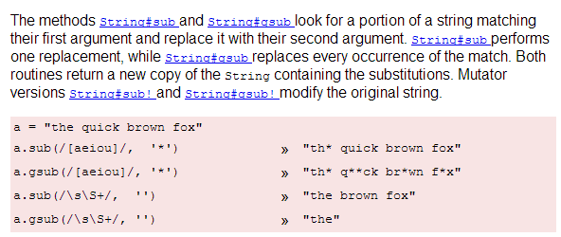
Pattern-Based Substitution in Ruby

Slide 30
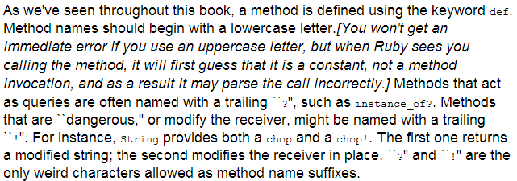
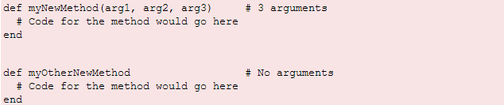
Defining method in Ruby

Slide 31

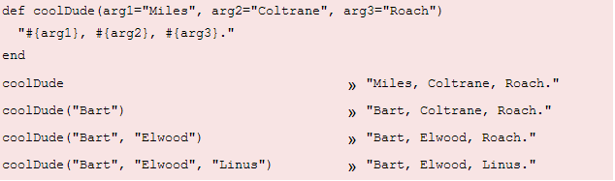
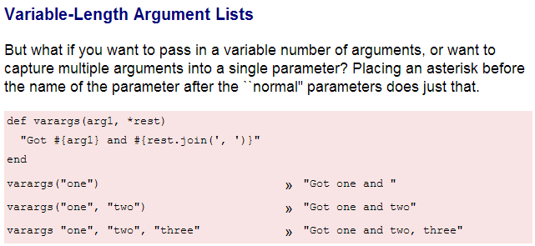
Defining method in Ruby

Slide 32
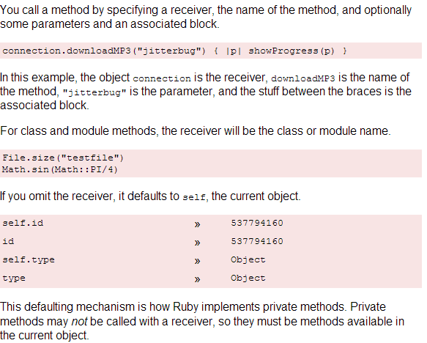
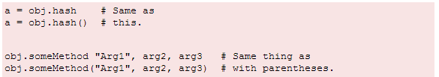
Calling a method in Ruby

Slide 33
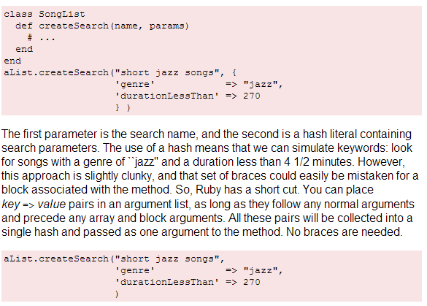
Collecting Hash Arguments in Ruby

Slide 34
Comparison Operators in Ruby

Slide 35
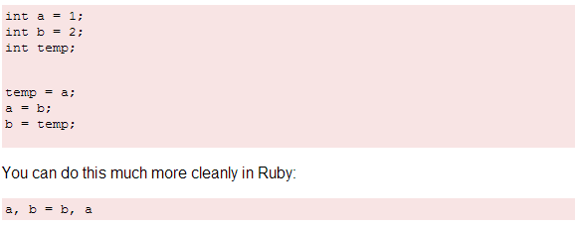
Parallel Assignment in Ruby

Slide 36
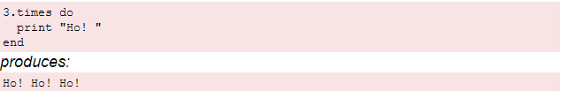


Iterators in Ruby

Slide 37

Iterators in Ruby

Slide 38




IO in Ruby

Slide 39

Variables & Object References in Ruby

Slide 40

Symbols in Ruby
A symbol looks like a variable name but it's prefixed with a colon.
Examples - :action, :line_items. You don't have to pre-declare a symbol and they are guaranteed to be unique.
There's no need to assign some kind of value to a symbol - Ruby takes care of that for you. Ruby also guarantees that no matter where it appears in your program, a particular symbol will have the same value.
string versus a symbol?
If the contents (the sequence of characters) of the object are important, use a string
If the identity of the object is important, use a symbol

Slide 41

Symbols as Hash keys in Ruby

Slide 42
Command-Line Arguments in Ruby
When you run a Ruby program from the command line, you can pass in arguments. These
are accessible in two different ways.
First, the array ARGV contains each of the arguments passed to the running program. Create
a file called cmd_line.rb that contains the following:
puts "You gave #{ARGV.size} arguments"
p ARGV
When we run it with arguments, we can see that they get passed in:
$ ruby cmd_line.rb ant bee cat dog
produces:
You gave 4 arguments
["ant", "bee", "cat", "dog"]

Slide 43
Blocks in Ruby
A block is simply a chunk of code enclosed between either braces or the keywords do and
end.
-- Ruby style seems to favor using braces for blocks that fit on one line
-- do/end when a block spans multiple lines:
some_array.each {|value| puts value * 3 }
sum = 0
other_array.each do |value|
sum += value
puts value / sum
end
-----
sum = 0
[1, 2, 3, 4].each do |value|
square = value*value
sum += square
end
puts sum
produces:
30

Slide 44




Modules in Ruby

Slide 45

Mixins in Ruby
A module can’t have instances, because a module isn’t a class.
However, you can include a module within a class definition.
When this happens, all the module’s instance methods are suddenly available as methods in the class as well. They get mixed in.
By including the Debug module, both the Phonograph and EightTrack classes gain access to the who_am_i? instance method.

Slide 46



Threads in Ruby

Slide 47


Exceptions in Ruby

Slide 48

Environment Variables in Ruby

