Slide 1
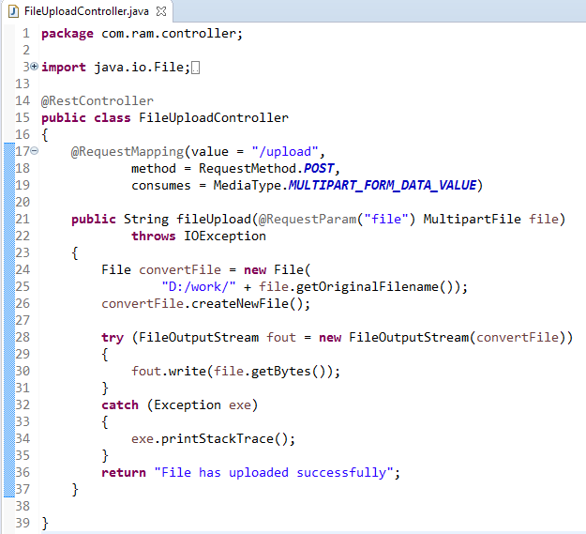
Spring Boot - File Upload
For uploading a file, We can use MultipartFile as a Request Parameter

Slide 2
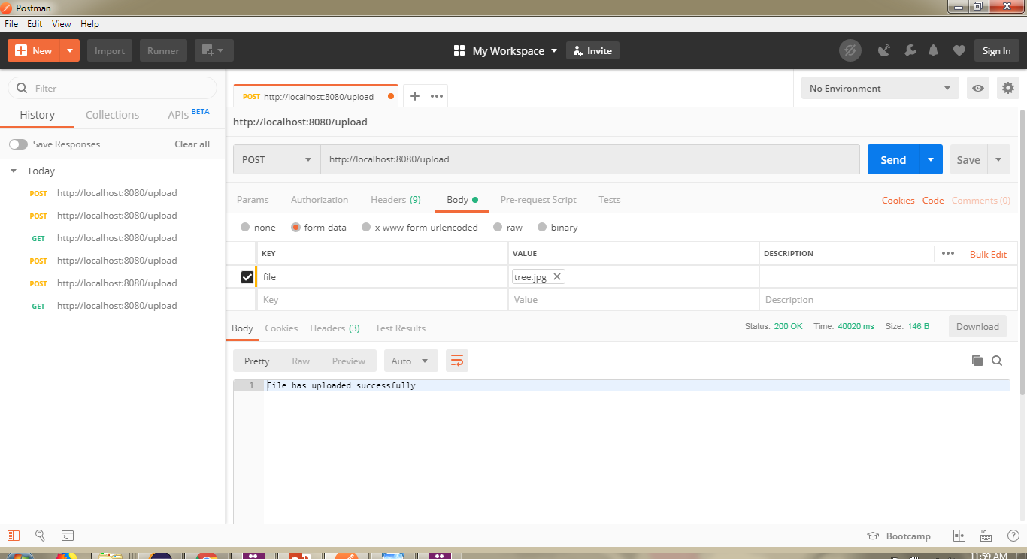
Spring Boot - File Upload
http://localhost:8080/upload

