Slide 1

Pipeline Builds & Quality Gates Prepared by CCM team

Slide 2
Index
PLM pipeline architecture Diagram
Enable/Disable Quality Gates
Junit Quality gate
SonarQube Quality gate
SAST Quality gate
Mail notifications & Feedback
SAST issues mail notifications
Junit results feedback
Sonar scan results
Mail notification on quality gate failures
Configure & run sonar scan for post production branches

Slide 3
Index
Configure a new branch for environment
Update Db deployment script file
Update Trigger job release params with new branch
Add New branch to app-db job params
Skip Test stages with build
Sync Artifactory with deployment script file changes in git
Move production or any environment to pipeline
New Artifactory migration
Repository Migration
Test deployment for any environment
Change artifactory ID in plm pipeline scripts
Add Coverity custom checkers like hardcoded password check
Add test cases (java classes) to Junit suite
Junit Configuration
Get Build Metrics

Slide 4
PLM pipeline architecture Diagram

Slide 5



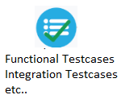






Development
Continuous Integration
Continuous Delivery
Deployment
Jenkins –(Automation server)
9. Jenkins send notification mails, build and test results to the team
3. Jenkins polls git
8. Jenkins executes automated test cases after deployment
4
5
6
2.POD Team check-in updated files to GitHub
7. Chef client continuously monitors build information changes and deploys artifacts to Dev/QA Env according to build information
6. Jenkins publish artifacts to Artifactory.
10. Team does Manual build & Deployment
1.POD team checkout code and modify files
Chef Server
Artifactory Repository
Automated Test Results
9. Business decides Release date based on the test results.
Manual Step
Automated Step
Manual Feedback
Automated Feedback

Slide 6
Enable/Disable Quality Gates

Slide 7
Enable/Disable Quality Gates
Steps to enable or disable Quality Gate for any specific application.
Browse to pipeline scripts Git repository : https://github.build.ge.com/PLM-ENOVIA/plm-secure-pipeline-scripts
Select branch : power_jenkins_branch
Open web and spinner application properties files specific to application in edit mode and update flag to true/false and commit files to git.
You can find properties files in resources/applicationproperties folder.
Example : Following are the properties files for GTCC application:
resources/applicationproperties/gtccplm/gtccplm-web-securepipline.properties
resources/applicationproperties/gtccplm/gtccplm-spinner-securepipline.properties

Slide 8
JUnit Quality Gate
To enable quality gate:
Set property junit_quality_gate=true
To disable quality gate:
Set property junit_quality_gate=false
Note: All test cases should be passed to get into next stage if JUnit quality gate is enabled.

Slide 9
SAST Quality Gate
To enable quality gate:
Set property coverity_quality_gate=true
To disable quality gate:
Set property coverity_quality_gate=false
Note: Coverity quality gate in pipeline uses coverity view to identify security vulnerabilities in PLM Applications. View names are already updated in pipeline scripts for all plm applications.

Slide 10
Coverity view using for quality gates
“Gtcc QualityGate View” for GTCC
“Energy QualityGate View” for PGPLM
“Nuclear QualityGate View” for Nuclear
“Steam QualityGate View” for Steam
“Wind QualityGate View” for Wind
You can update defect categories for each view. Build will be stopped if any defects found in the view.
Mail notification will be send to POD and CCM team members if any new defects are introduced in current scan. This setting is configured for each view mentioned above.

Slide 11
Sonarscan Quality Gate
To enable quality gate:
Set property sonarscan_quality_gate=true
To disable quality gate:
Set property sonarscan_quality_gate=false
Sonarqube server(https://i.ci.build.ge.com/ph0jp7l8/sq) is using predefined quality gate "GE Digital Security Gate" as default quality gate applicable for all the PLM Applications.

Slide 12
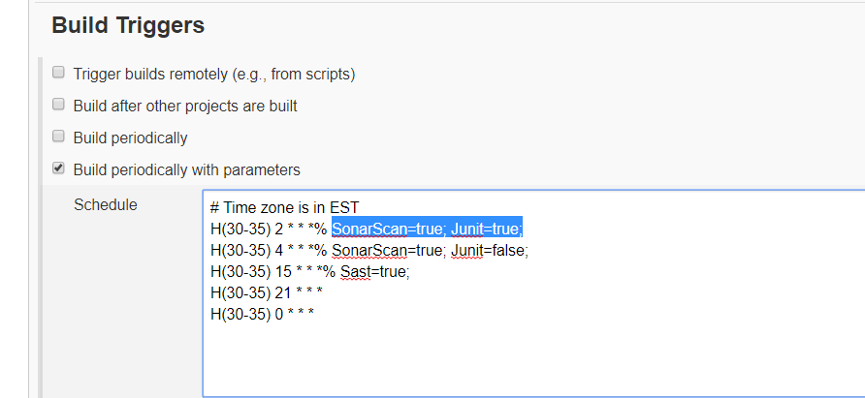
Testing : Stages and quality gates
Pass the Sonarscan, Junit and Sast parameters along with build schedule.
Enable corresponding parameter to run test stages in trigger job.
Set Junit=true to run junit.
Set Sast=true to run sast.
Set SonarScan=true to run sonar scan.
Enable Quality gate param in pipeline scripts for Quality gates to stop builds.
Set junit_quality_gate=true
Set coverity_quality_gate=true
Set sonarscan_quality_gate=true

Slide 13
Mail notifications & Feedback

Slide 14
Mail notifications and feedback
Test results: Mail notifications & Feedback
Junit : Test results will be send through mail to POD team mails id configured in properties file.
SAST : If any new defects (not earlier scan defects) found in current scan then they will be send through mail from coverity connect server.
Sonar scan : No sonar test results will be send through mail, Team has to login into SonarQube server with their SSO to view results.
We will see mail notification configuration in next slides.

Slide 15
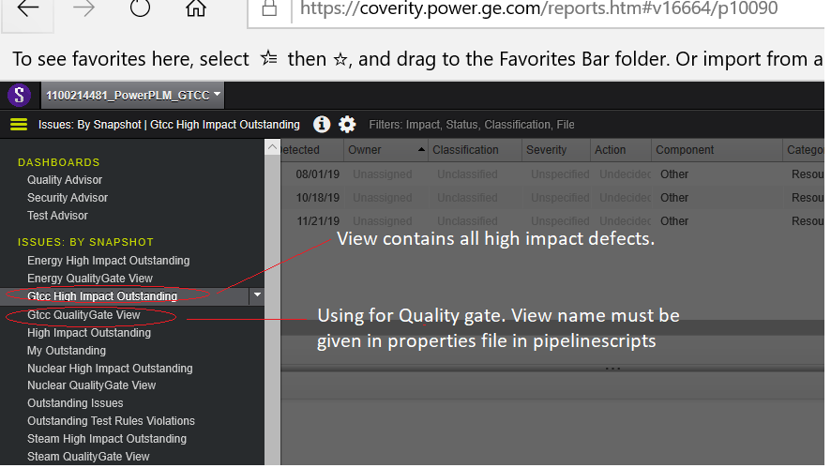
Coverity results - mail notifications
There are two views created for each PLM application in coverity connect server
View for only mail notification(To send weekly mail notification on high impact issues to a big group)
View for Quality Gate ( To send mail notification on each scan to POD and CCM team if any new defects are found)

Slide 16
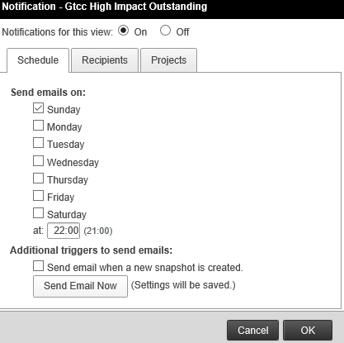
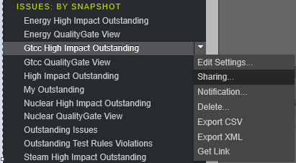
Update Mail Notification in Coverity View
Login with functional sso # 502808103 in coverity connect server
Select Project from the dropdown list
Select view and click on down arrow that is showing on the view and select Notification.
Update schedule, Recipients list as per the requirement and click on “Ok” button to save the view.

Slide 17
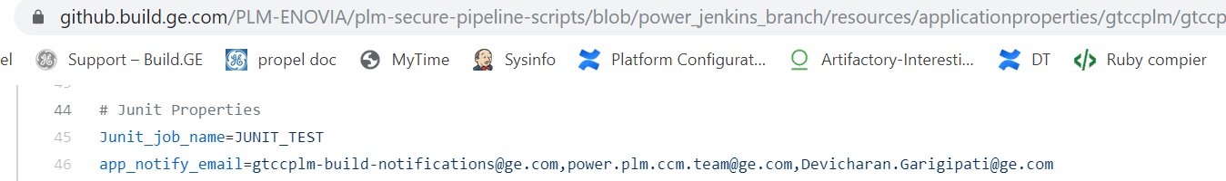
Junit results- Mail notification
Update app_notify_email property in pipeline scripts with email Id’s to send junit results to the team in mail. Test results will be send in mail as soon as Junit stage execution is completed in jenkins.
Properties file screenshot#

Slide 18
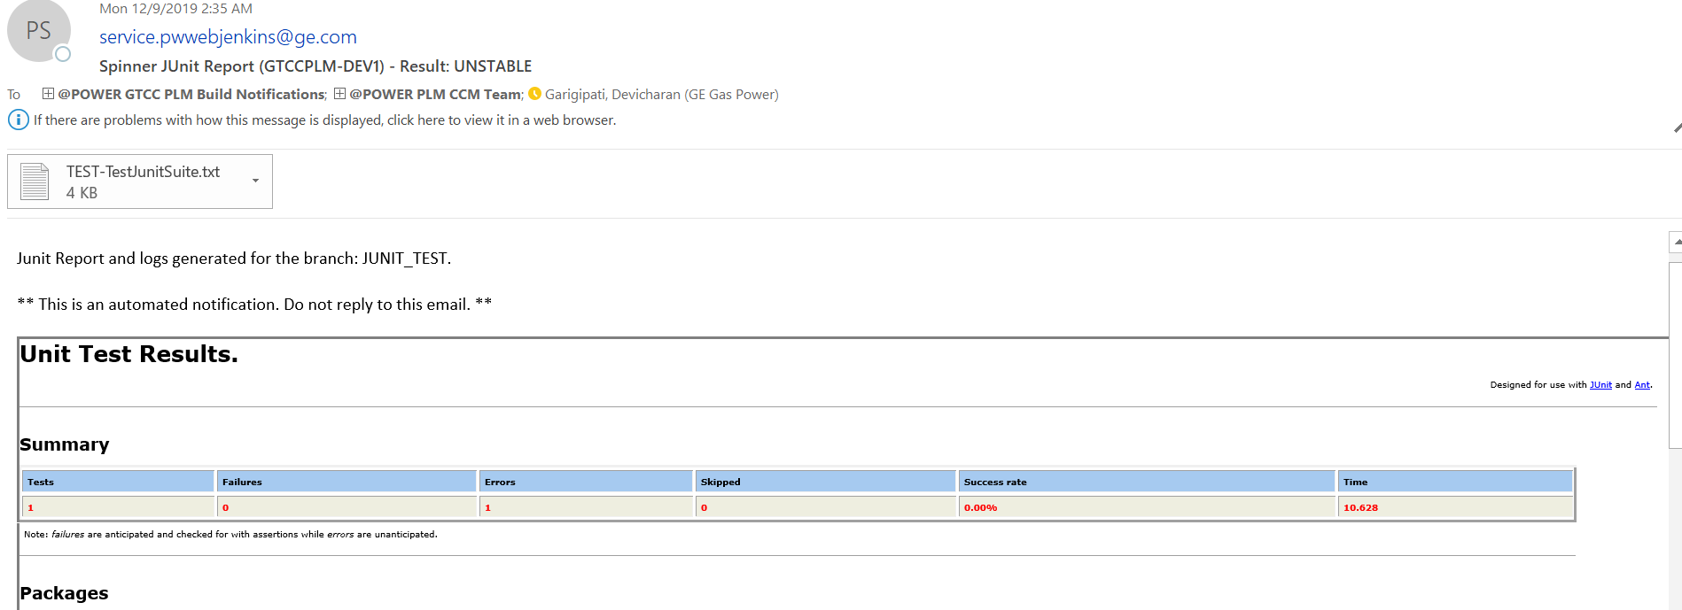
Junit results mail notification screenshot#.
Note: log text file is attached to the junit report in mail. If any test cases are failed POD/CCM team need to go through the logs and find out the root cause.

Slide 19
Sonar Scan Results
We are not sending results in mail after the build.
POD team has to login with their GitHub credentials into SonarQube server to view the results.
GITHub authentication was already enabled on SonarQube server
SonarQube server URL: https://i.ci.build.ge.com/ph0jp7l8/sq
Rating:
Security and Reliability ratings are based on the severity of the worst open issue in that domain:
E - Blocker
D - Critical
C - Major
B - Minor
A - Info or no open issues

Slide 20
Run Sonarscan for post production branches

Slide 21
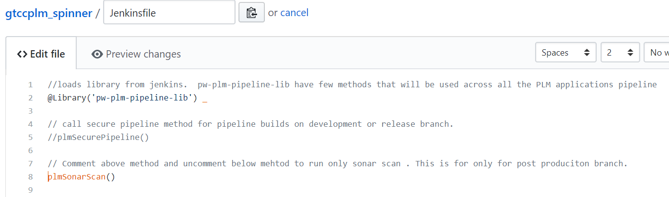
Sonarscan for post prod branches
comment or remove plmSecurePipeline method and uncomment plmSonarScan in jenkinsfile for post production branches only to run sonar scan.
Screenshot#

Slide 22
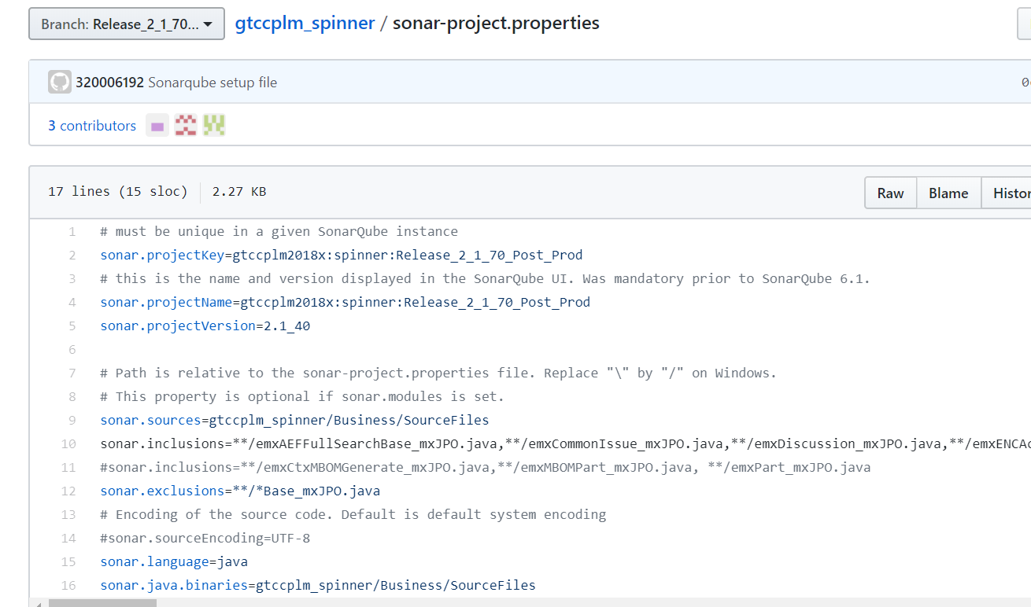
Update sonar-project properties file
POD team has to update project key,project name and sonar.inclusions and exclusions in sonar-project.properties file in post production branch.
Note: Do the sonar scan when ever POD request it for post prod branch. Please verify sonar project properties file before initiate it.

Slide 23
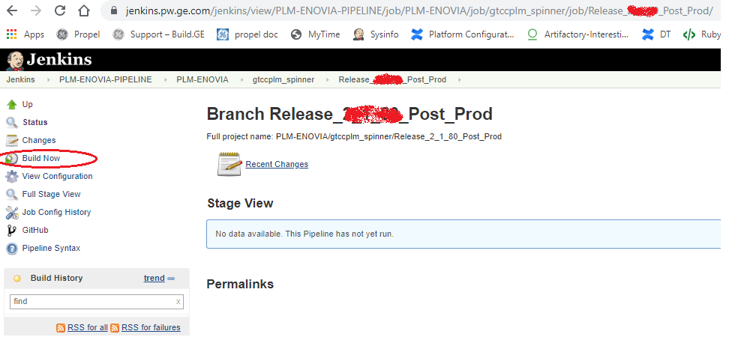
Go to PLM-ENOVIA organization job folder in jenkins, find branch and run build
Verify test results in SonarQube server after build or stage execution is completed.

Slide 24
Configure new branch on environment

Slide 25

Configure new branch on environment
Update the new branch name in db deployment script file manually in Build-Team/Artifactory-Build-Files Git repository in respective script file.
Note: Jenkins job PLM-UTIL-JOBS/PLM-ENOVIA-DEPLOYMENT-SCRIPT-UPLOAD-OLD-ARTIFACTORY will be triggered automatically and upload script files to artifactory in next 10 minutes after db script file updated.
Update WebRelease and SpinnerRelease parameters with new branch name in trigger job specific to environment.
Note: After new artifactory migration, you can disable PLM-ENOVIA-DEPLOYMENT-SCRIPT-UPLOAD-OLD-ARTIFACTORY job. PLM-ENOVIA-DEPLOYMENT-SCRIPT-UPLOAD job is pointing to new artifactory (BUILD.GE).

Slide 26
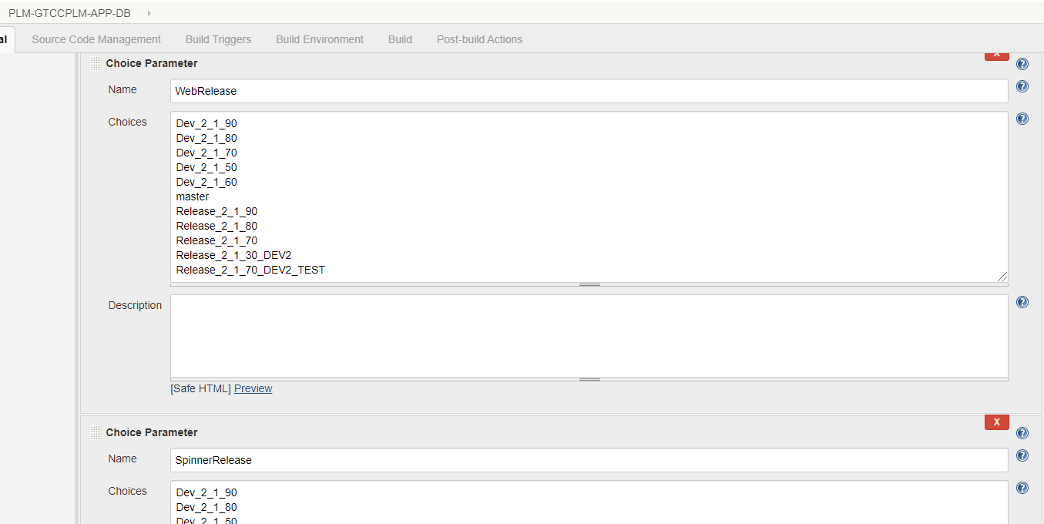
Add new branch to WebRelease and SpinnerRelease parameters list in app-db job.
Screenshot for reference

Slide 27
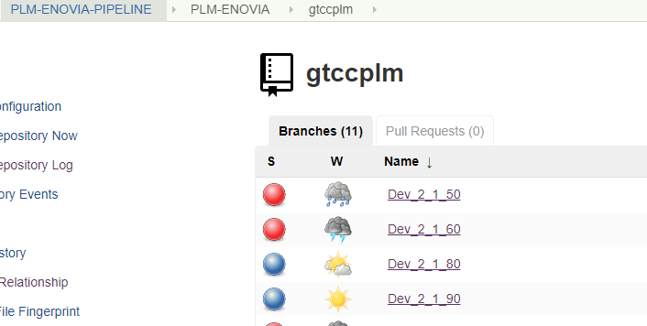
Verify if branch is scanned or not in respective repository folder under PLM-ENOVIA organization job.
Sample screenshot#
If the branch is not found then click on link “Scan Organization Now” in PLM-ENOVIA organization job.
Usually organization job scans the repositories once a day as per the configuration. If any new branches are created, need to wait for one day for them to be reflected under respective repositories in PLM-ENOVIA job folder.
For immediate branch scanning: Either you can change the scan configuration or scan the organization manually using “Scan organization Now” button shown under PLM-ENOVIA organization job.

Slide 28
Skip Test stages

Slide 29
To skip test stages
Select respective teststage input parameter (junit/sonarscan) as false in build schedule to skip test stage execution in jenkins trigger job.
If sast quality gate is enabled in pipeline scripts then quality gate will be executed though sast input parameter is selected as false in jenkins jobs.
SAST quality gate refers previous builds SAST results from the view and abort the build if any defects found in the view.

Slide 30
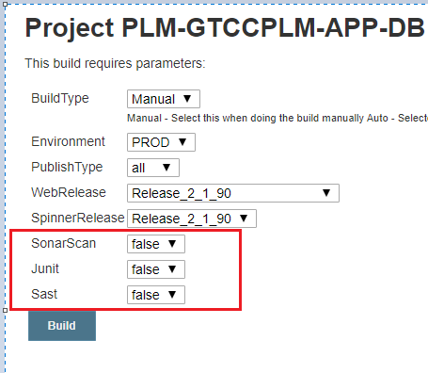
Sample screenshot for production build

Slide 31
Sync Artifactory with deployment script file changes in git

Slide 32

Sync deployment script files
There are few scenarios where changes in deployment script files are required.
Branch name change in db deployment file
New files will be added to git repo when new environment is added.
Email ID changes to send deployment mail notifications
Any other changes
For any changes in deployment script file, you need to update the respective script files in GitHub repository Build-Team/Artifactory-Build-Files
Following jobs poll the git changes and upload the files into New(Build.GE) and old(Devcloud) Artifactories.
To upload files into Build.GE
Note: You can delete the PLM-ENOVIA-DEPLOYMENT-SCRIPT-UPLOAD-OLD-ARTIFACTORY job after new artifactory migration is completed.
To upload files into Devcloud Artifactory

Slide 33
Move production or any environment to pipeline

Slide 34
Move production or any environment to pipeline
If you are moving production or any environment to pipeline for the first time then go through below changes.
Add environment specific properties related to artifactory files to both web and spinner properties file.
Required properties
<ENV>_artifactory_appconfig_file
<ENV>_artifactory_artifact_file
<ENV>_artifactory_deployment_script
Pipeline scripts read the build parameters and place the build artifact, appconfig json file in the paths mentioned in properties file for the specific environment (ex: PROD, DEV1, QA, QA1)

Slide 35
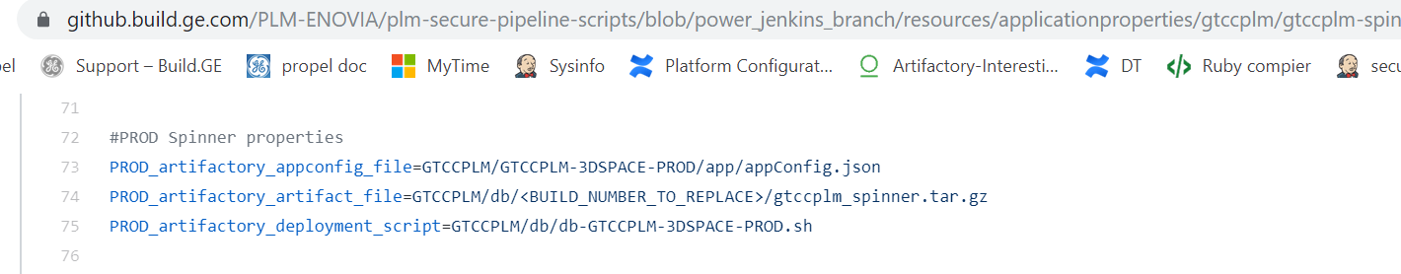
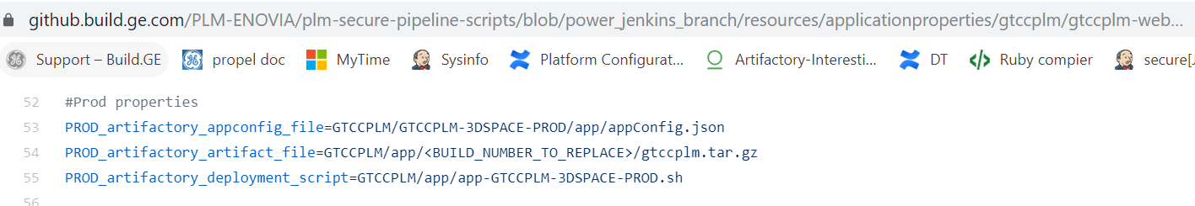
Sample properties for production environment.
Spinner properties
Web properties
These are the artifactory related properties using for deployment like appconfig json , artifact (war or spinner tar files) and deployment script file paths. No need to mention QQHDK repository in path. Take relative path starts from the repository name.

Slide 36
Change chef cron role
In case deployment is already happening from the repository where pipeline scripts are placing artifacts, then you can ignore this step.
Otherwise check with EC support team to change the cron role.
Devcloud QQHDK Repository
Using for pipeline builds.
Chef role# power-deploy-plm
Build.GE QQHDK Repository
Using for pipeline builds (Migration is still in progress).
Chef role# ????

Slide 37
New Artifactory migration

Slide 38
New Artifactory migration
List of files to migrate Devcloud to Build.GE artifactory.
Folders to migrate SXZZG repo-> QQHDK repo: https://devcloud.swcoe.ge.com/artifactory/SXZZG/Applications/ENERGYPLM/
https://devcloud.swcoe.ge.com/artifactory/SXZZG/Applications/NuclearPLM/
https://devcloud.swcoe.ge.com/artifactory/SXZZG/Applications/WINDPLM/
https://devcloud.swcoe.ge.com/artifactory/SXZZG/Applications/BoilersPLM/
https://devcloud.swcoe.ge.com/artifactory/SXZZG/Applications/PLM
https://devcloud.swcoe.ge.com/artifactory/SXZZG/Applications/PLM-BUILD-MERTICS
https://devcloud.swcoe.ge.com/artifactory/SXZZG/Applications/PLM-CODE-REVIEW
https://devcloud.swcoe.ge.com/artifactory/SXZZG/Applications/PLM-TEST-METRICS
https://devcloud.swcoe.ge.com/artifactory/SXZZG/Applications/PLM-TEST-PROJECT
https://devcloud.swcoe.ge.com/artifactory/SXZZG/Applications/PLMTEST/KEEPALIVED-DEV/wx/pw_web_apache/ssl
https://devcloud.swcoe.ge.com/artifactory/SXZZG/Applications/SHAREDSLM
https://devcloud.swcoe.ge.com/artifactory/SXZZG/Applications/plm-slm
https://devcloud.swcoe.ge.com/artifactory/SXZZG/Applications/plm-standards
https://devcloud.swcoe.ge.com/artifactory/SXZZG/Applications/plm-standards-NEW
https://devcloud.swcoe.ge.com/artifactory/SXZZG/Applications/plm-standards-test/vdcald06964
https://devcloud.swcoe.ge.com/artifactory/SXZZG/Applications/GTCCPLM/

Slide 39
Service requests raised to migrate devcloud to Build.GE repository
RITM0193208
RITM0196666
Status: Repository migration is in progress as of today,12/12/2019
Do changes as mentioned in following slides after migration is completed to support builds from the new artifactory

Slide 40
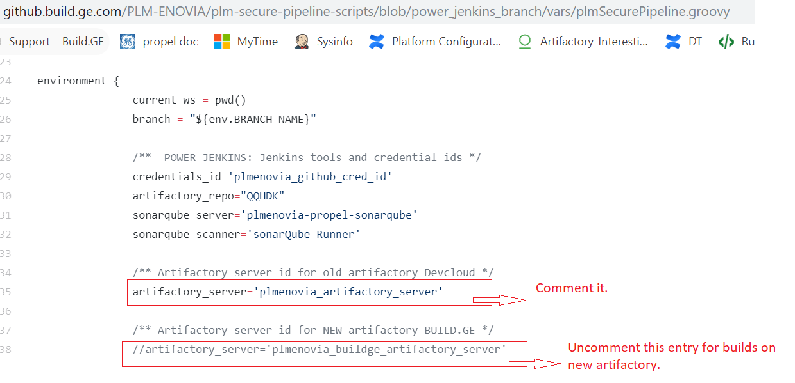
To support PLM builds from new artifactory
Change artifactory_server property value in .groovy files under vars folder in pipeline scripts PLM-ENOVIA/plm-secure-pipeline-scripts repository.
Change configuration in job: PLM-UPDATE-BUILD-INFO to connect to new artifactory server.
PLM EC support team will change the cron role on all PLM environments to connect new artifactory server for deployments.
Initiate a build from jenkins and verify deployment on each environment except PROD
We will be good with migration if build and deployment is working as expected on all PLM environments.

Slide 41
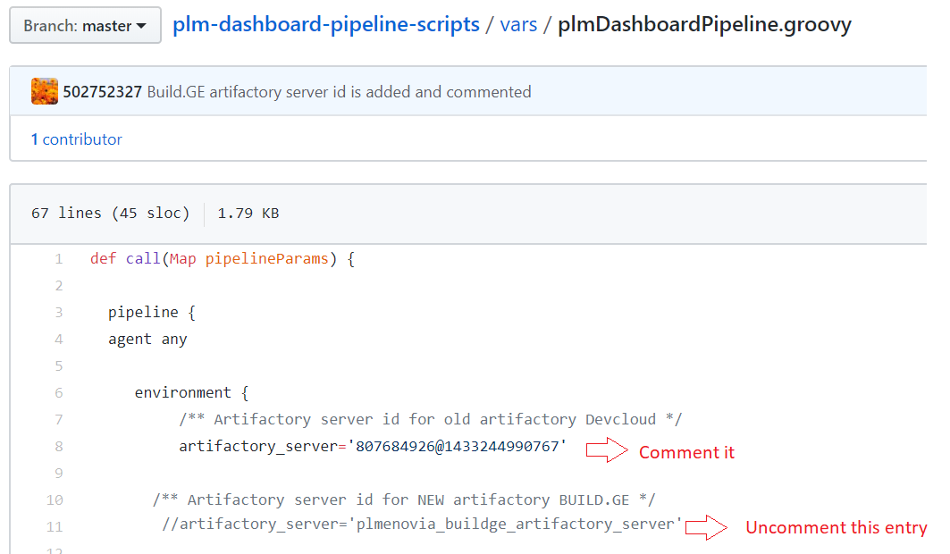
To support Docker builds from new artifactory
Change artifactory_server property value in .groovy files under vars folder in PLM-ENOVIA/plm-dashboard-pipeline-scripts repository
Inform CCM and EC support team about this change and ask Lanka/Matt to initiate and verify the build from propel jenkins https://i.ci.build.ge.com/mz5slog0

Slide 42
Add Coverity Custom checkers like hardcoded password check

Slide 43
Coverity Custom checker
Custom checker json file is already available in pipeline scripts and the path is: resources/coverity_custom_checkers/plm_coverity_text_checkers.json
To add new custom checker:
Open plm_coverity_text_checkers.json file in Edit mode in github
Add new custom checkers entry under directives in json file then update text_checker_name, file and defect patterns, description, impact, category, cwe etc..
No need to load custom checker file if you add checker in existing file(plm_coverity_text_checkers.json ) as logic is already placed to load json file.
Update cov-analyze command by enabling custom checker to run app or db scans.

Slide 44
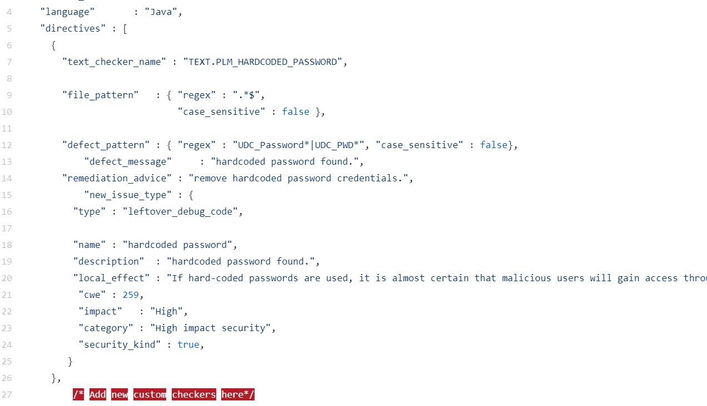
Add new custom checker here under directives.

Slide 45
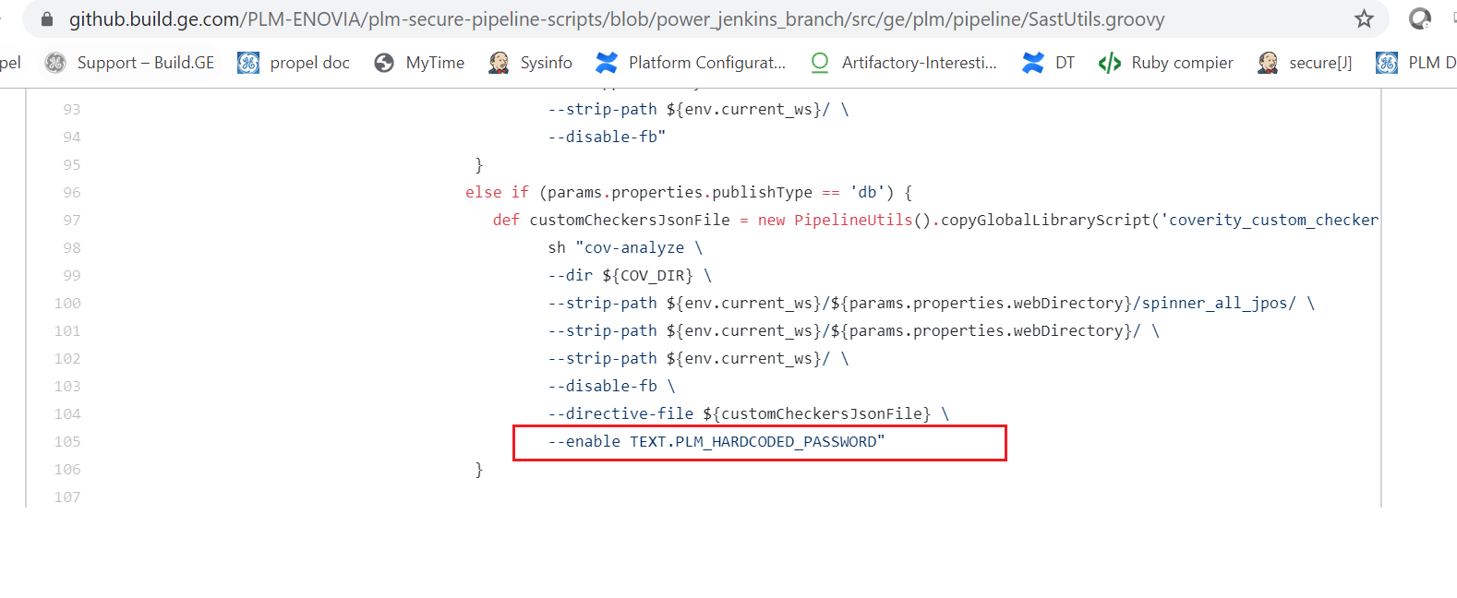
Screenshot# Update cov-analyze command with custom checker

Slide 46
Add test cases (java classes) to Junit suite

Slide 47
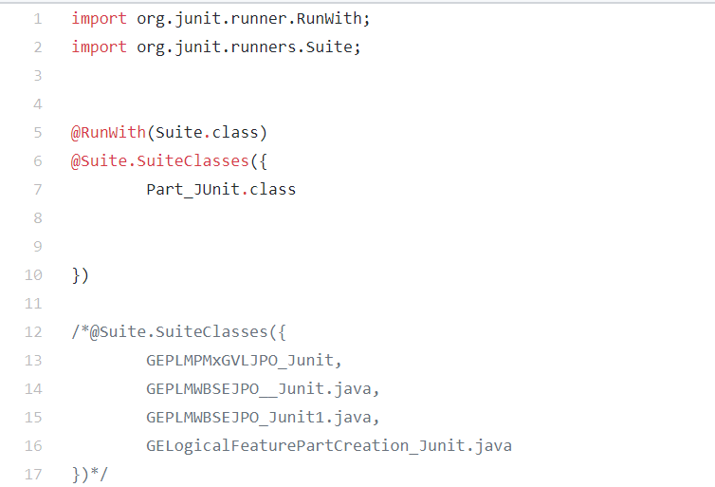
Add test cases to Junit suite
In Junit, test suite allows us to aggregate all test cases from multiple classes in one place and run it together. you need to annotate a class using below-mentioned annotations: @Runwith(Suite.class)
Add all junit test java files under src/test folder in Junit branch and then add class names to suite.
Add class names here in TestJunitSuite.java to run junit test cases.

Slide 48
Junit configuration

Slide 49
Junit is not yet configured for Steamplm and nuclear plm applications. Below changes required to configure junit for them in future after junit testscases are placed in one branch.
Web code changes
Spinner code changes
Properties file changes in pipeline scripts
Add junit-plm-test.xml in ant/build folder . This file is used to run junit test cases on spinner code. Copy it from any existing application
Add junit-noframes.xsl file used as css for report formatting. File location : ant/build
Add environment specific junit context properties file in war/src folder
Ex: war/src/dev1-junit-context.properties
Jenkinsfile
Call plmJunitPipeline() method in Junit branch spinner code in jenkinsfile.
Web and spinner properties file specific to application
Update Junit_job_name property value with junit branch name where testcases are placed.

Slide 50
Get Build Metrics

Slide 51
Steps:
Login into artifactory with your credentials
Navigate through repo: /QQHDK/Applications/PLM-BUILD-METRICS
Download file : PLM_BUILD_METRICS.CSV
To get total build count for the year
Open latest build metrics csv file and filter Date header and select year (Ex: 2019,2020)
You can see the total build numbers count in bottom of the page at left side.
To get the total Releases count for the year
Open latest build metrics csv file and filter Date header and select year (Ex: 2019,2020)
Filter Environment header and select “PROD” value.
You will get the total release count.

