Slide 1
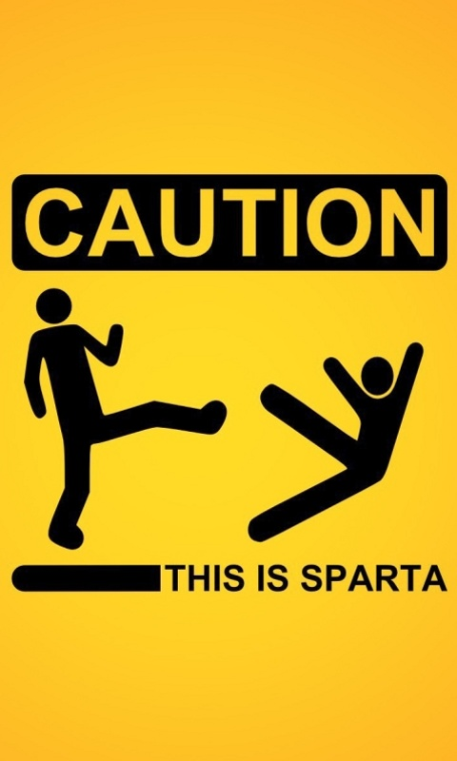
SinglePageApplicationReusable TemplateANce

Slide 2
Description
Our goal is to provide a basic framework for developing any SPA (Single Page Application) implementing a custom flavour of MVC design.
To add on to this we’ll be exposing a variety of components that can be simply used / consumed in any application built using our framework.

Slide 3
Dependencies:
JQuery for DOM manipulation
Require.js for asynchronous modular code
Underscore.js for enabling template based entities.

Slide 4
Challenges
There’s no such framework available in date, which provides support for MVC along with custom widgets.
We are targeting:
There can be multiple representations for a single view. So Multiple templates.
Some templates might need a reference of the controller in order to be dynamic & self sustainable in nature.
Every template will be carrying it’s own styling properties but should be easily overridable.

Slide 5
How to make it work
Step 1:
A module loader (Require.js) will be used to pickup various components (as per the configuration) and assemble them at runtime .
Step 2:
A templating library (Underscore.js) will be used to merge the templates with the modals and generate dynamic HTML.
Step 3:
The initial set of load settings will be defined that will bring up the data templates & further the controllers would handle the transitions on the page based upon the action of the users.
Step 4:
A configuration that keeps tracks of the bindings between the View, ViewHandler and the respective controller.
Step 5:
Defining transitions between the load of different modules & structures.

Slide 6
What’s included?
SPA using MVC pattern. Single page means that the page does not reload at any point. The idea is to make it modular & a de-coupled binding between the Model View & Controller. A model can be used by multiple views & a controller may coordinate with multiple views.
CSS. This would be entirely up to user, what he wants to fill in. Our templates will have their own CSS
Templates.
Controller
Controller : Model
CSS
The output will be a framework app which can be deployed on IIS & will display a sample page.
It would also contain some configured components that will be selected by the user according to the requirement of the project to be built.

Slide 7
Development Model
The target is to be based in 2 major divisions:
The SPARTAN-Framework: architecture of the entire end application backbone. Connections, bindings and the dependencies.
The SPARTAN-Weapons: different independent units that will flow along the design and can be selected by the user as whether to include or not in their end application.

Slide 8
What’s a SPARTAN-Weapon?
These will be quick, adaptable and modular widgets/tools/components that will help the user make their app more interactive & responsive. Some basic usable components like:
A Grid
A nameplate
A quick weather stamp
Footer display
Chat component
A BouncyCombo, etc.

Slide 9
What’s a SPARTAN-Weapon?
These will be quick, adaptable and modular widgets/tools/components that will help the user make their app more interactive & responsive. Some basic usable components like:
A Grid
A nameplate
A quick weather stamp
Footer display
Chat component
A form, etc.

Slide 10

In a SPARTANry
We are aiming to roll-out a SPA framework that will support use of programmable & extensible components/widgets and these widgets are open to all.
The aim for these widgets would be to make a SPA application easy to implement and program. Anyone with a derivation of our concept can create these components and roll out for an open source use.

