Slide 1
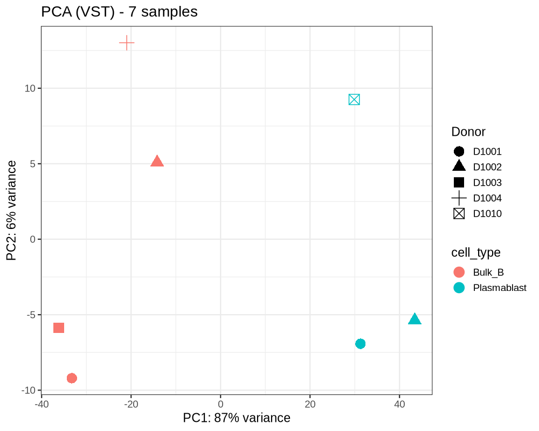
Bulk B cells vs Plasmablasts
Chromatin accessibility across B-cell differentiation
7 samples · 5 donors · ATAC-seq
87%
of variance separates
the two cell types
14,662
differentially accessible
regions
ETS → IRF
the transcription factor
handover
Samples separate by cell type, not by donor
sysbiol19 · Project P04
Notes:
Seven samples, five donors, resting cells. PC1 is 87% of the variance and it separates bulk B from plasmablast cleanly. Donor symbols scatter across both groups, so the split is biological, not technical.

Slide 2
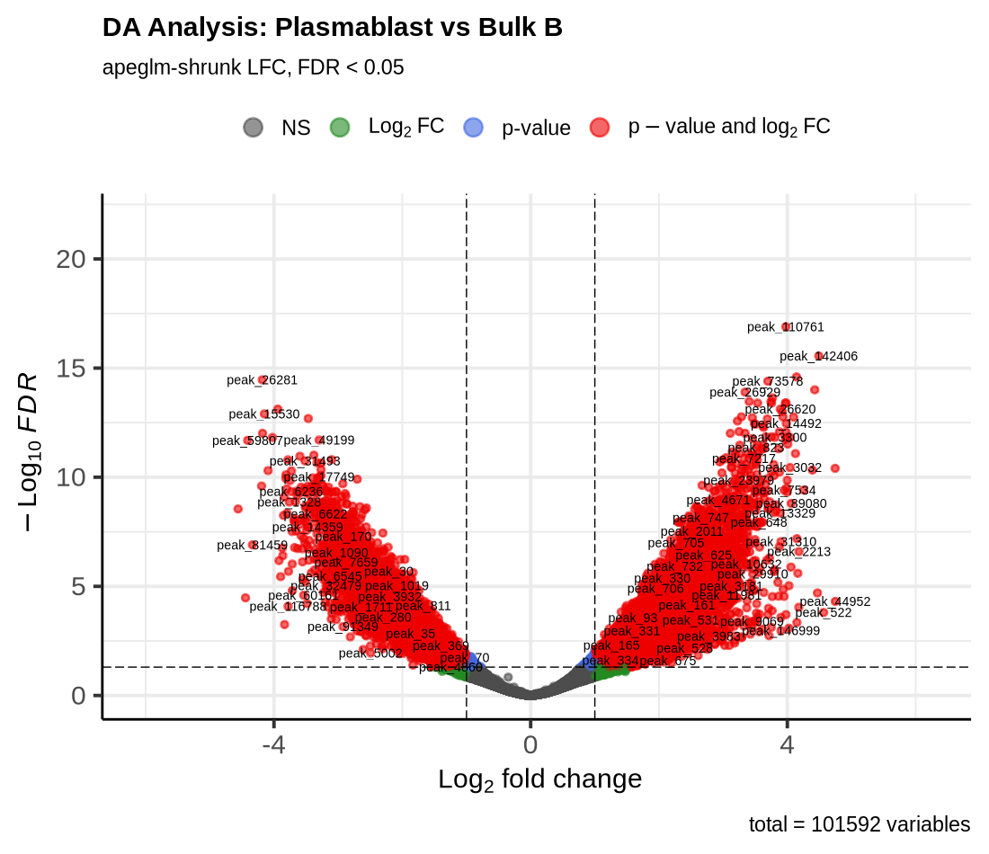
One in seven open regions changes
What this means biologically
14,662 of 101,593 tested regions are differentially accessible (FDR < 0.05, |log2FC| ≥ 1).
The split is near-balanced: 7,976 open in plasmablasts, 6,686 open in bulk B.
Differentiation is an exchange, not a general opening of chromatin — one identity programme is dismantled while another is installed.
These are two stages of one lineage, so a change this large reflects a full rewiring of the regulatory landscape.
Notes:
14% of tested regions change, near-balanced in both directions. That balance matters: a strong asymmetry would suggest a normalisation artefact rather than biology. Individual loci confirm it — PRDM1 opens across thirteen distal enhancers, MS4A1 shuts down at its promoter.

Slide 3
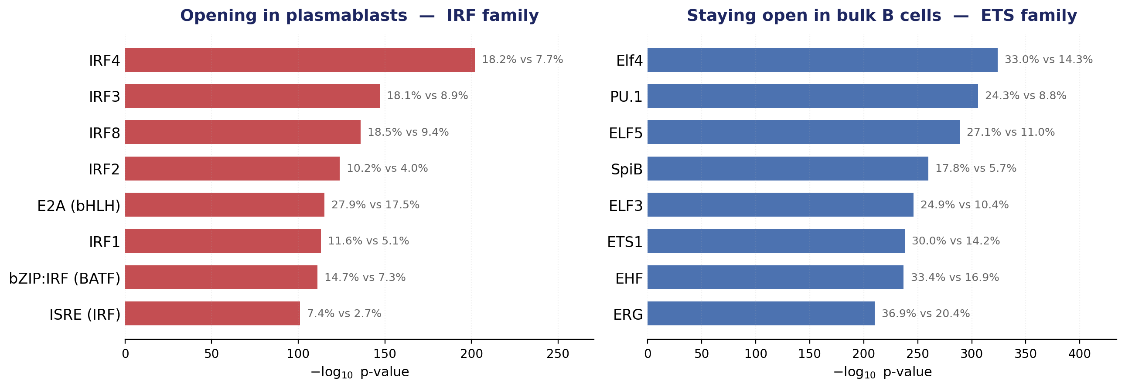
A transcription factor handover
Motif enrichment in the regions that changed (HOMER, background = all open regions)
Notes:
Completely clean split. Regions closing in plasmablasts are dominated by ETS motifs — PU.1 and SpiB, the factors that hold B-cell identity in place. Regions opening are dominated by the IRF family, with IRF4 top at 1e-202. IRF4 was also one of my six target genes, chosen independently, so the gene-level and sequence-level analyses agree.

Slide 4
Thank you
Questions and discussion welcome
An AI assistant was used to help prepare the figures and slide layout of this presentation. All analyses, parameter choices and interpretations are my own.
Notes:
Happy to take questions.

