Slide 1
MKTG 562 Driving up housing sales prices in IOWA
Naga Soundari Balamurugan
Manasi Kulkarni
Mervin Sundaram
Aditya Wakade

Slide 2
Agenda
Problem Statement
Our Data
Customer Centric Business Question
Tools Used
Data Cleaning
Our selected features
Exploratory Analysis
Regression
Recommendations

Slide 3

House Prices: Advanced Regression Technique
Open data set available on Kaggle
Rigorous dataset containing 79 explanatory variables about the house
Wider arena to understand what could influence pricing
Variables span across Garage, Roof, Layout, indoors, aesthetics, environment etc.

Slide 4



Customer Centric Question
“Which features of the Iowa Housing dataset influences the customer buying decision and how well can these features be used to predict future sale price of a house and attract potential house buyers?”

Slide 5
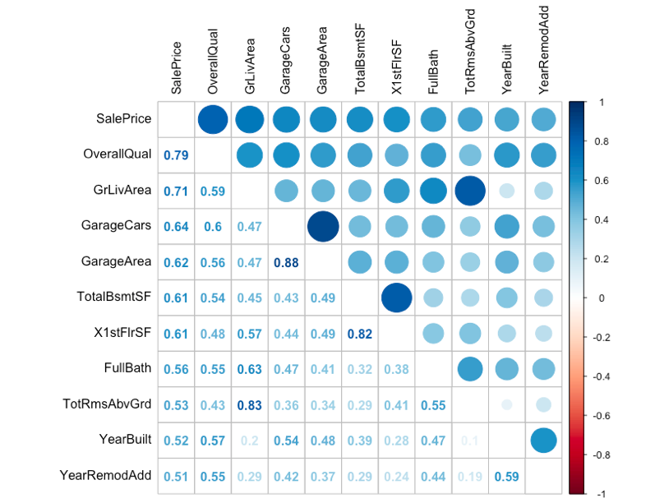
Data Cleaning and Variable selection
79 variables were too many for our analysis
Removed the columns containing maximum NULL/NA values.
Addressed multicollinearity by removing those columns altogether.
Plotted the correlation of the variables with the Sale Price, keeping the threshold of the correlation to >0.5
Zeroed down to 10 important variables that could affect the Sale Price and customer buying decision.

Slide 6
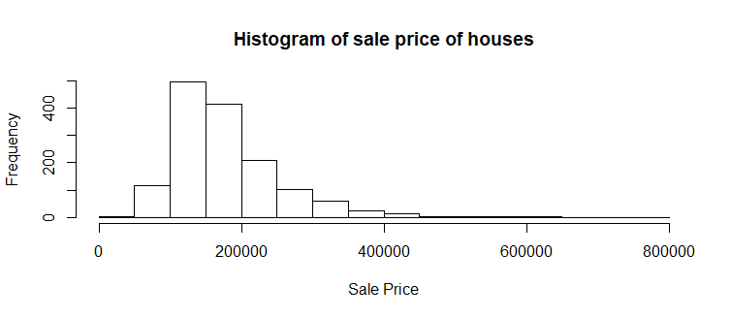
Price Analysis
Most of the houses fall under the price range 100K – 200K
This price range in normal in only most of the cities in the mid-east and mid-west of U.S.
There are only a very few houses that are above 500K.
Below table has the summary of the price
Minimum | 1st Quartile | Median | Mean | 3rd Quartile | Maximum
$34900 | $129975 | $163000 | $180921 | $214000 | $755000

Slide 7
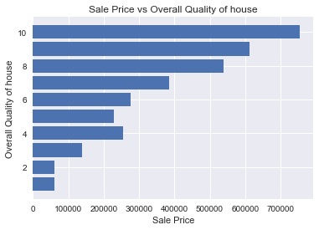
Overall Quality
The ‘Overall Quality’ was the most promising and influencing variable for affecting the Sale Price.
Plotting it against the Sale price, we see that houses with higher ‘Overall Quality Score’ tend to have higher sale price as well.
This score could be derived from a lot of other influencing factors but the relation goes in hand.
> Quality = > Sale Price
Insight: Customers tend to pay higher for houses with a good OverQual Score

Slide 8
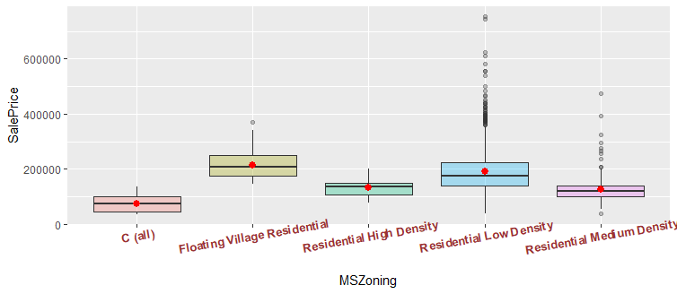
External Factor - Zoning Classification
The sales in "Floating Village Residential" area have the highest average sale price, and then followed by "Residential Low Density".
"Commercial" sales have the lowest average sale price.
People ideally pay a lot more for commercial zoning.
The ‘Area’ could have a possible impact on the zoning?

Slide 9
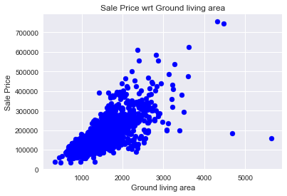
Ground Living Area
Mapping the area with the Zone, we see that the Commercial have the smallest size followed Residential Medium and Residential High.
Highest area is for Floating Village.
Scatter plot confirms that
>GrLivArea tends to >Sale Price
Insight: Customers tend to pay higher for houses with larger area. Zone doesn’t seem to have an effect on the customer choice of buying at a larger sale price.
Zoning Type | Size(in Sq.ft)
Commercial | 1191.4
Floating Village Residential | 1574.5
Residential High Density | 1510.1
Residential Low Density | 1551.6
Residential Medium Density | 1322

Slide 10
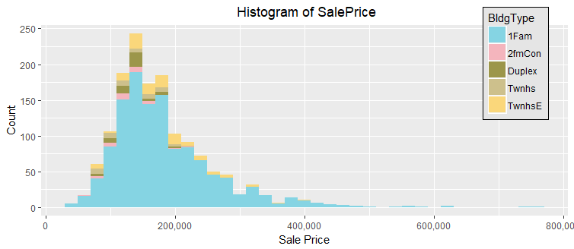
Internal Factor- Building Type
Mapping the area with the Zone, we see that the Commercial have the smallest size followed Residential Medium and Residential High.
Highest area is for Floating Village.
Scatter plot confirms that
>GrLivArea tends to >Sale Price
Insight: Customers tend to pay higher for houses with larger area. Zone doesn’t seem to have an effect on the customer choice of buying at a larger sale price.

Slide 11
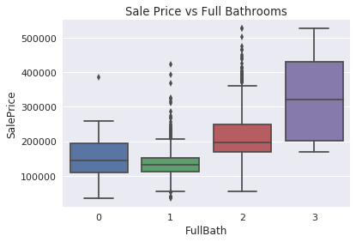
Aesthetics- Bathrooms

Slide 12
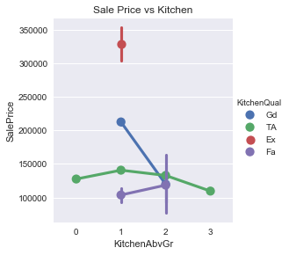
Aesthetics- Kitchen
Plotted the ratings of the kitchen vs the sale price to visualise it into a factor plot.
Prices generally seem to not be much affected with multiple kitchens.
But, having one kitchen of excellent quality hikes the sales price marginally.
Insight: The amenities in the kitchen could be a deciding factor to understand the luxury of the house thereby increasing the sale price.

Slide 13
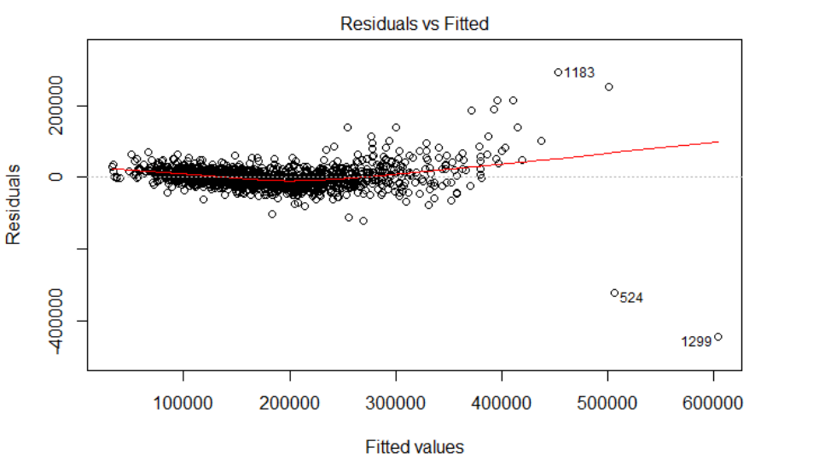
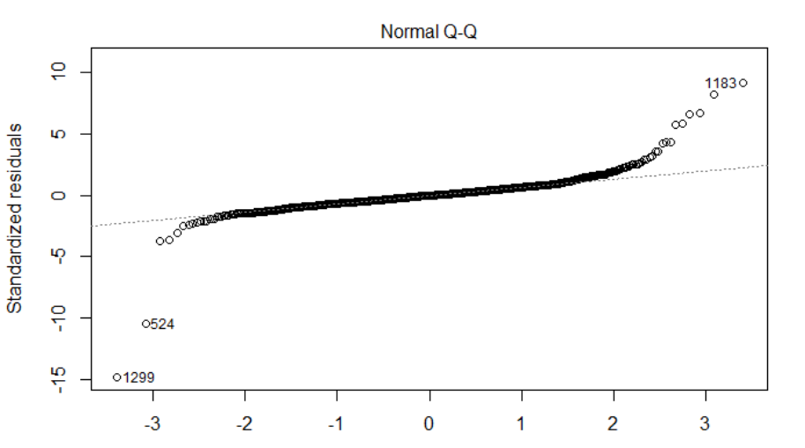
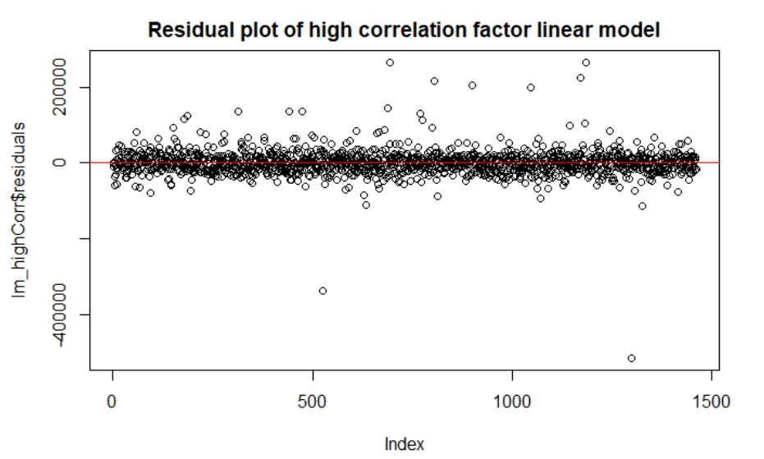
Best Fitting Model
Among the various linear models, the one with best fit had the R-Squared value of 0.8322172 and Adjusted R-Squared value of 0.8289343. Its highly significant with p-value 22204xe-15.
The predictors included in the model are OverallQual, GarageCars, D, YearBuilt, Fireplaces, WoodDeckSF, X2ndFlrSF, LotArea, BsmtFullBath, RoofStyle, SaleCondition, Neighborhood, BedroomAbvGr, RoofMatl, Functional, ScreenPorch, Exterior1st, LandSlope, Street, LandContour, Condition2, YrSold, OverallCond, MSSubClass, KitchenAbvGr, KitchenQual, ExterQual
Residual data points were evenly spread across 0 axis.
Has a very few outliers.

Slide 14
Significant Predictors
Predictors | Coefficient
Overall quality | 12953.67
Garage size | 10683.02
No. of bedrooms | 3685.47
No. of fireplaces | 3980.096
Full bath in basement | 13120.28
Roof Material | 3360.49
Home functionality | 4703.95
Land slope | 9561.84
Type of road access to street | 37973.33
Overall Condition | 4399.53
Independent variables with high coefficient values are listed to the left.
Concentrating on these features of houses could increase the sale price of the houses
Amount of investment to earnings ratio are significantly high for several features
Builders could construct houses of the model that are popular to easily sell them
Notes:
Road access-average cost per square foot is between $3.50 and $4.50. Roughly costs close to $5000 on an average.
Roof replacement not worth it
Adding a fireplace costs $4000-5000 if not more
Adding a garage costs a minimum of $7500 on an average
Adding a bathroom costs $10000-15000

Slide 15
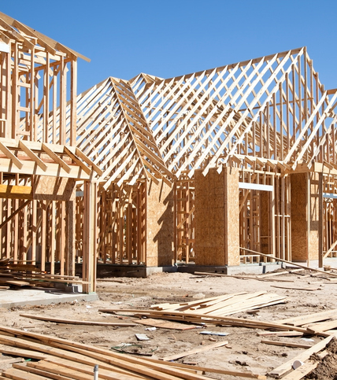
How Sale Price can be driven up
New Houses
Each of these factors contributes to the overall quality score of a house
Increasing the number of bedrooms
Adding extra fireplaces
Having paved path road access
Using superior roofing material
Providing a full bath in the basement
Adding a garage(or extra garages)
Keeping in mind the land-sloping when buying land/house

Slide 16
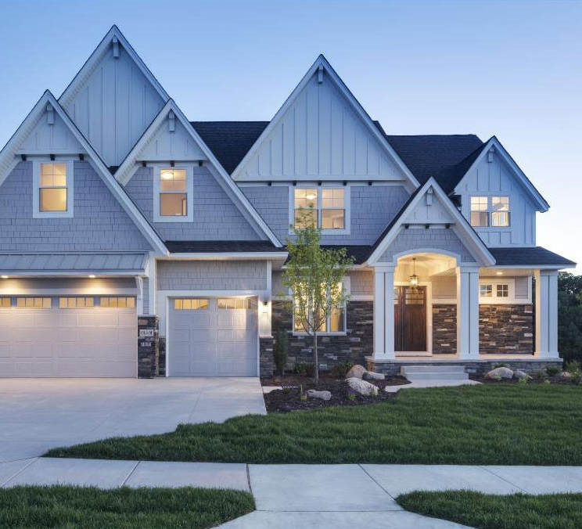
How Sale Price can be driven up
Existing Houses
Adding extra fireplaces
Changing road access from gravel to paved paths
Changing roofing material
All the other factors if easy to add

Slide 17



Questions?

