Slide 1
CS 5600: Group Project 5 Online Project Report Submission and Evaluation
Team members
Kalla Naga Suresh
Akhilesh Reddy Erravally
Vijayendar Reddy Jajala
Harish Polishetti

Slide 2
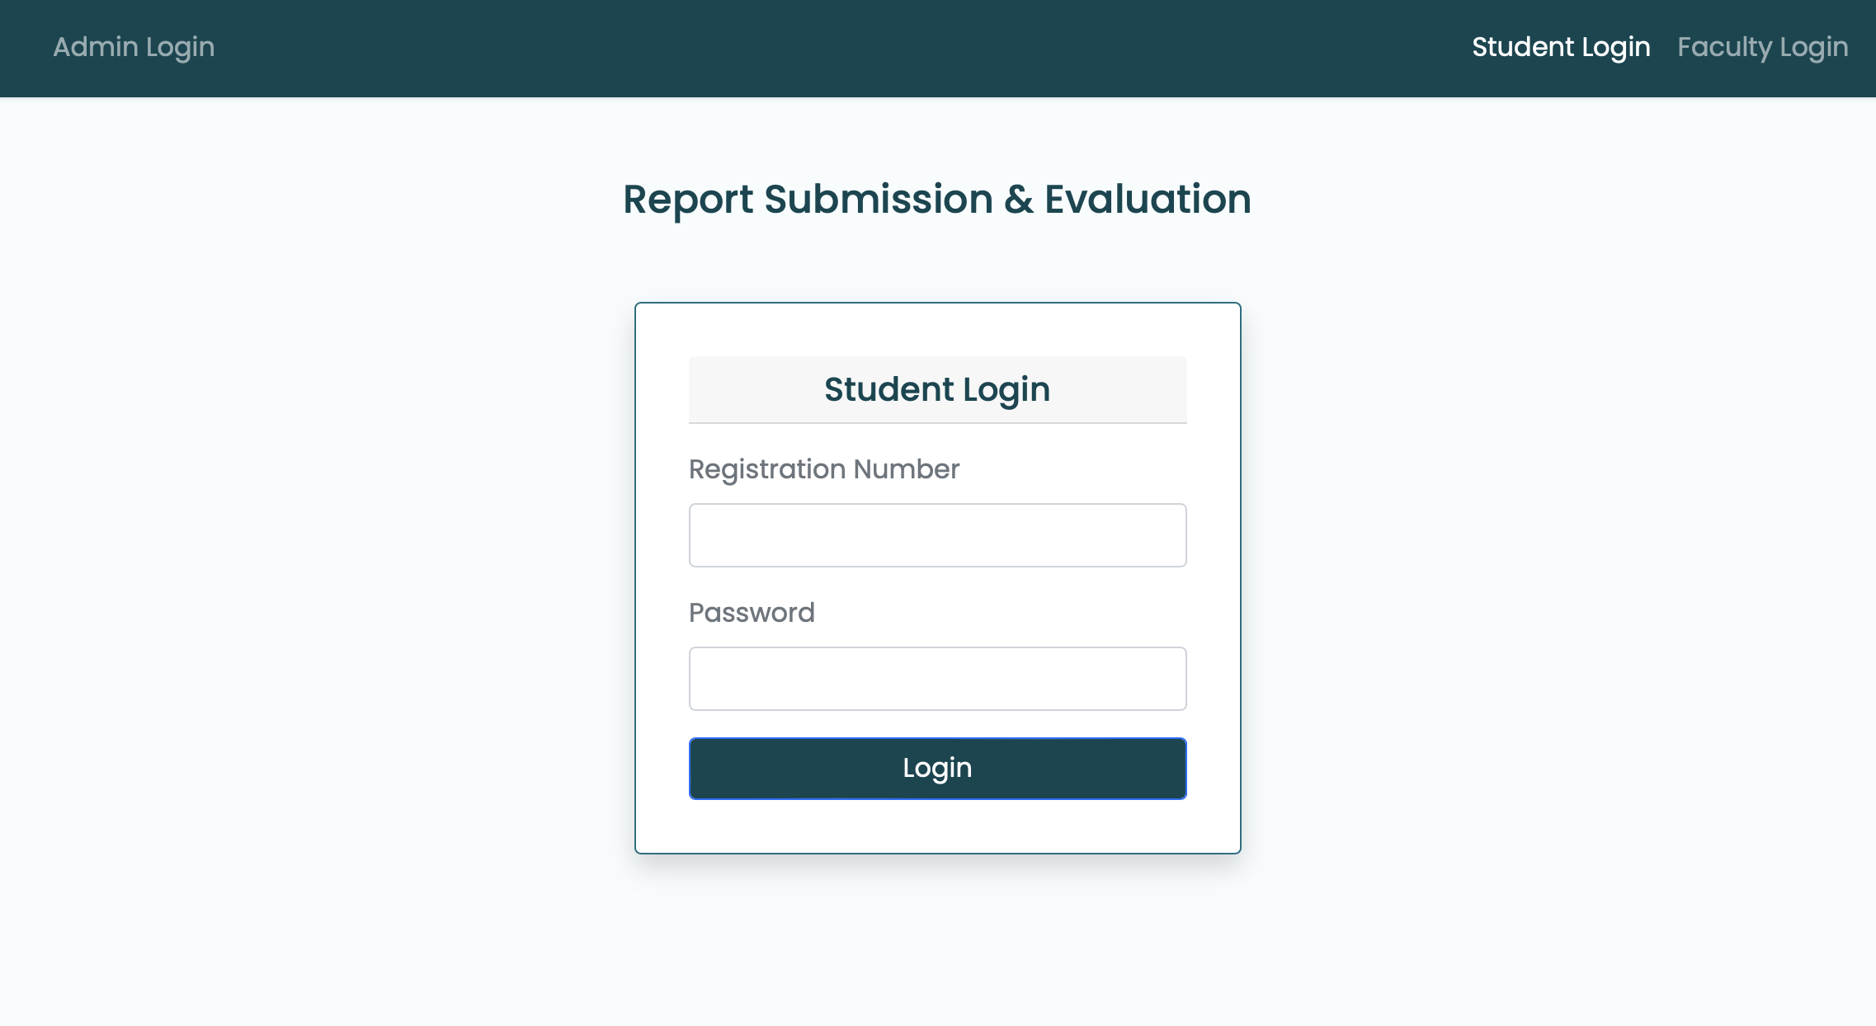
This system offers a consolidated and effective means to organize project submissions and evaluations, which will be beneficial to students, faculty, and administrators. The project guide, or instructor, can observe the student's work and provide online comments, but the student must update the system with their updates. This application has three main roles: student, professor, and administrator.

Slide 3
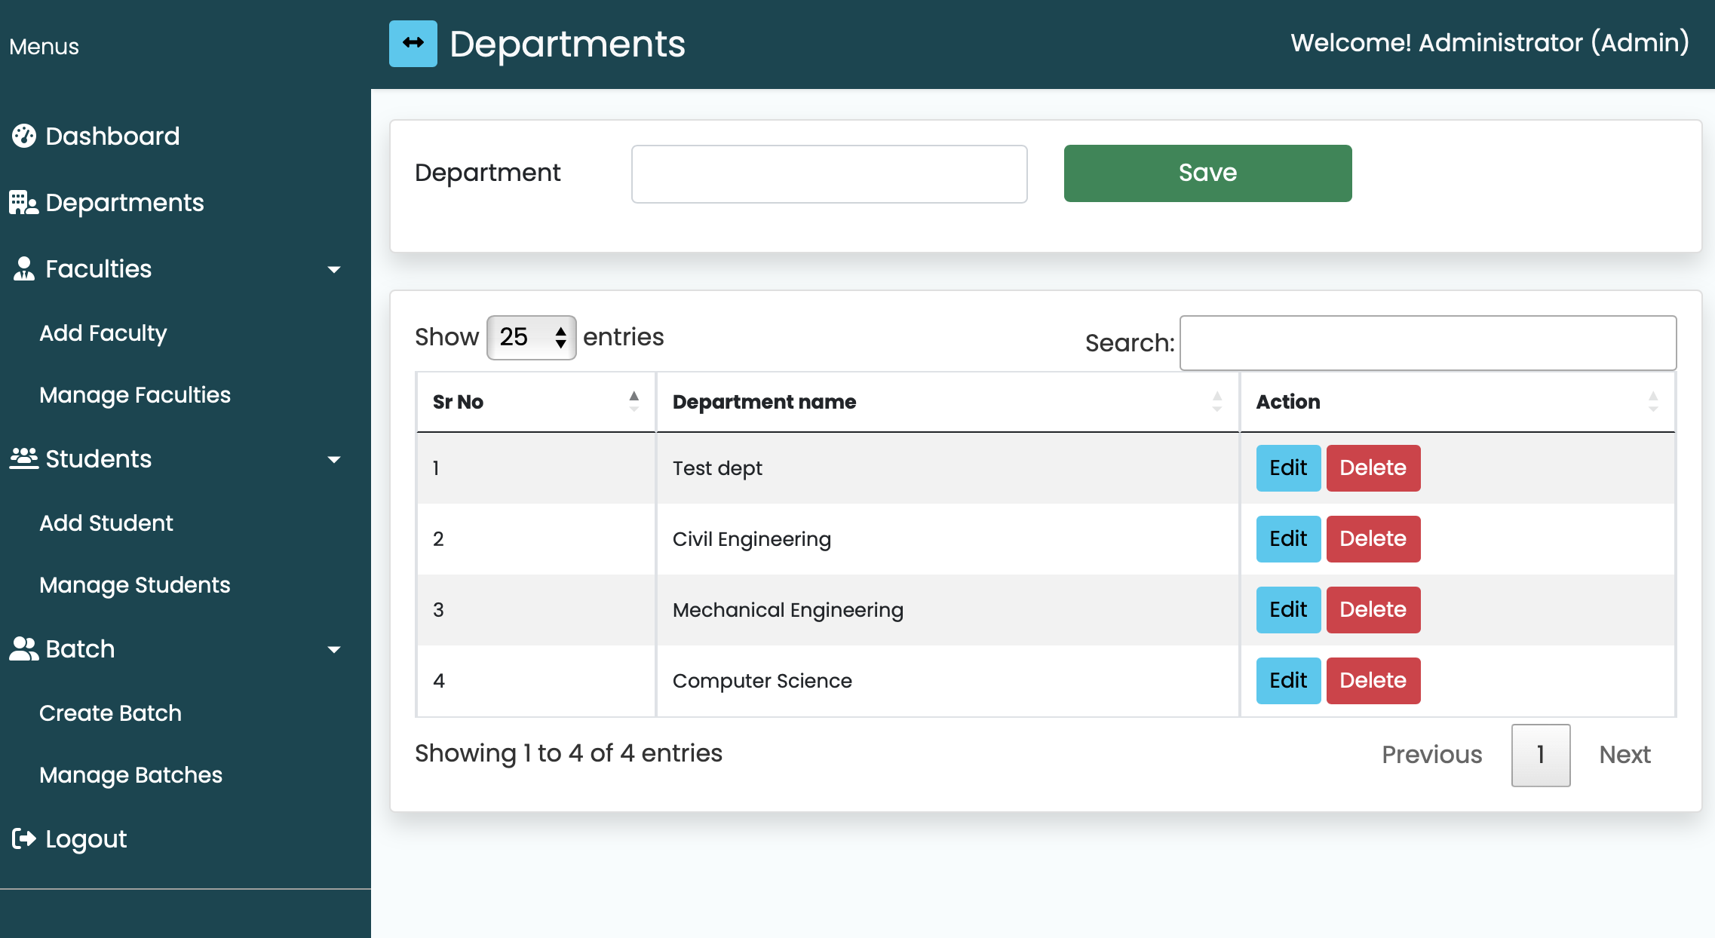
Admin : Add Departments add new departments such as Computer Science, Electrical Engineering, etc., to the system. Manage Students Add students to the system, assigning them to specific departments. Modify student details. Remove students Manage Faculties Add faculty members to the system, specifying their department. Modify faculty details. Remove faculty members. Create Batches Create batches and Assign a faculty member as a project guide to a specific batch of students.

Slide 4
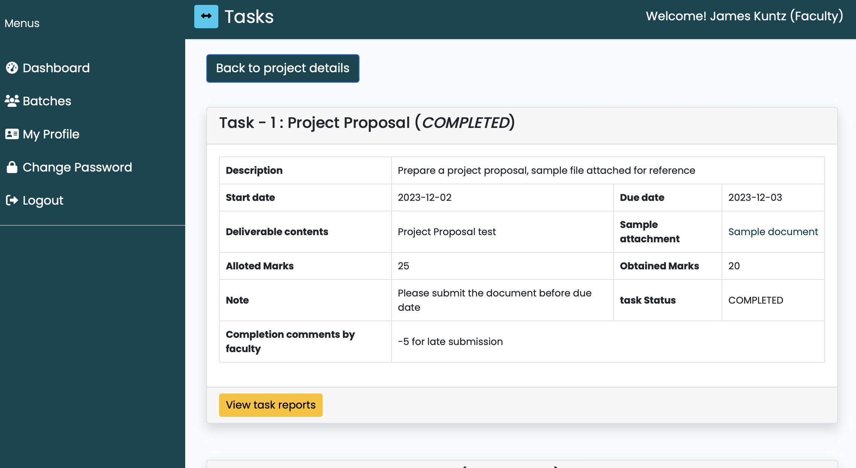
Faculty : Login View Batch Details faculty members can view batch details, including information about the students within the batch. Add Project Plan Faculty members can add a project plan. This includes providing a project description, start date, end date, and estimated cost. Assign Tasks & SubTasks Faculties can add task description, due date, allotted marks, sample file (if applicable), and any additional notes for clarification . Approve or Reject Reports Allocate Marks Update Profile Details Change Password

Slide 5
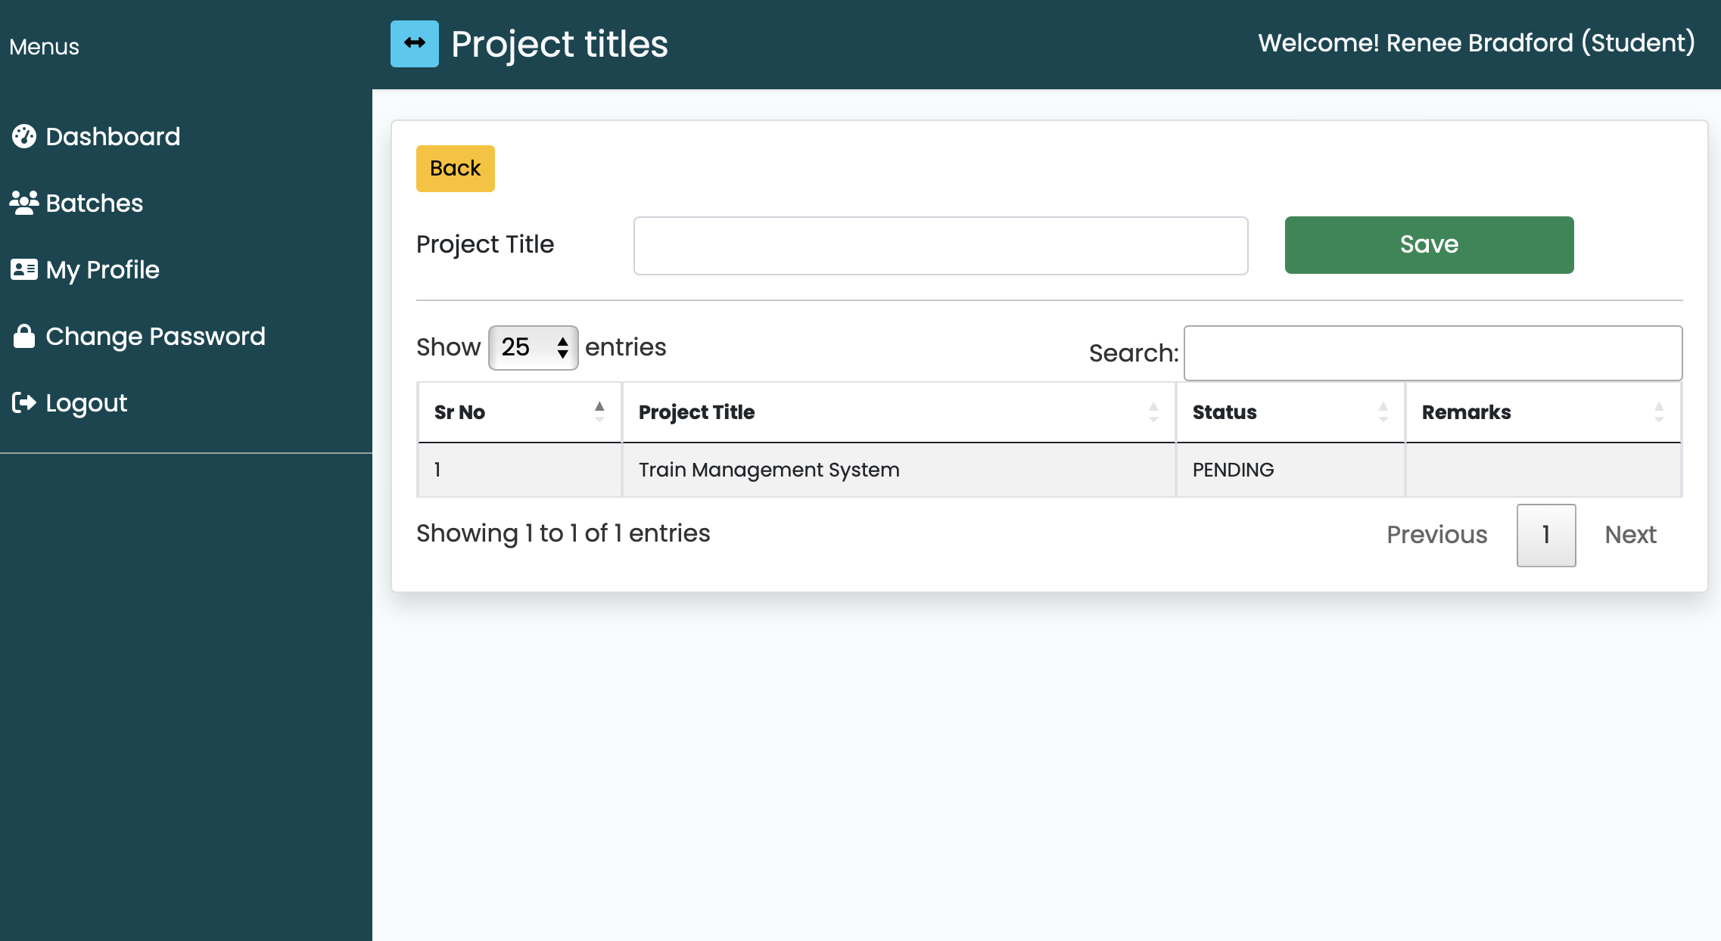
Student : Login View Batch Details & Project student members can view batch details, including information about the students within the batch and project tasks. Propose Project Title & Reports students can propose project title which is either approved or rejected by faculty View Tasks & SubTasks by viewing the tasks students can upload a document and pass it for approval to the faculty Update Profile Details Change Password

Slide 6
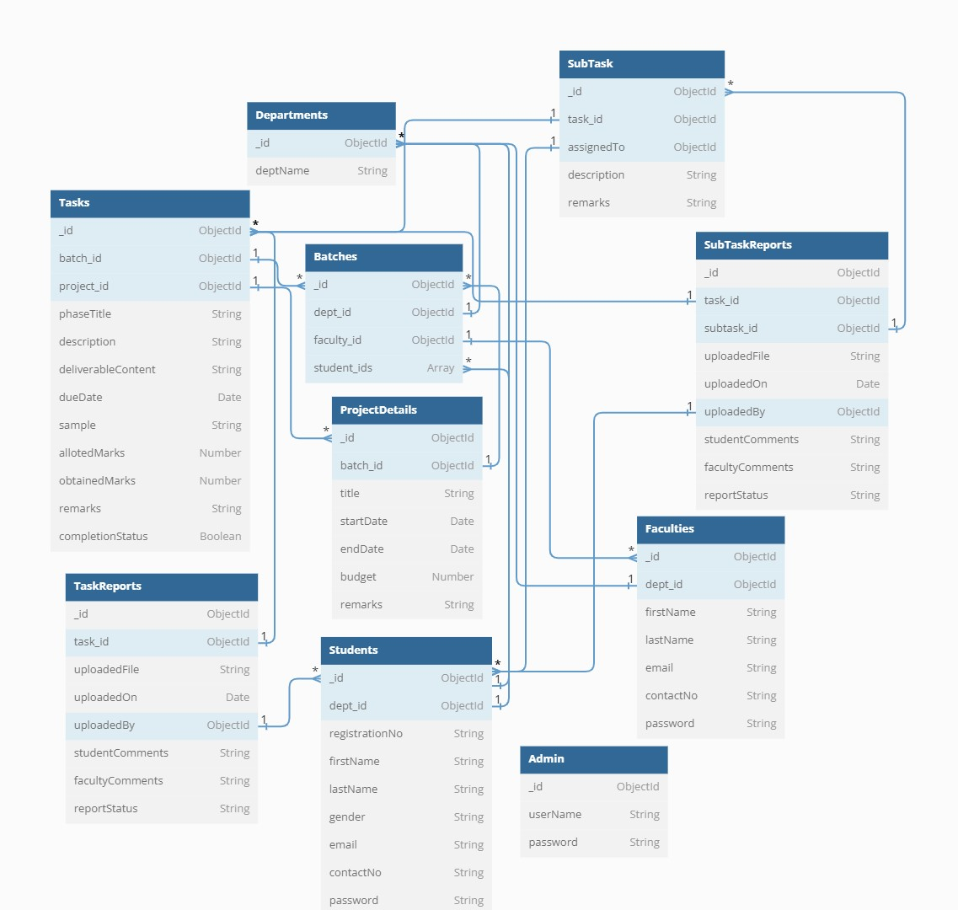

Slide 7
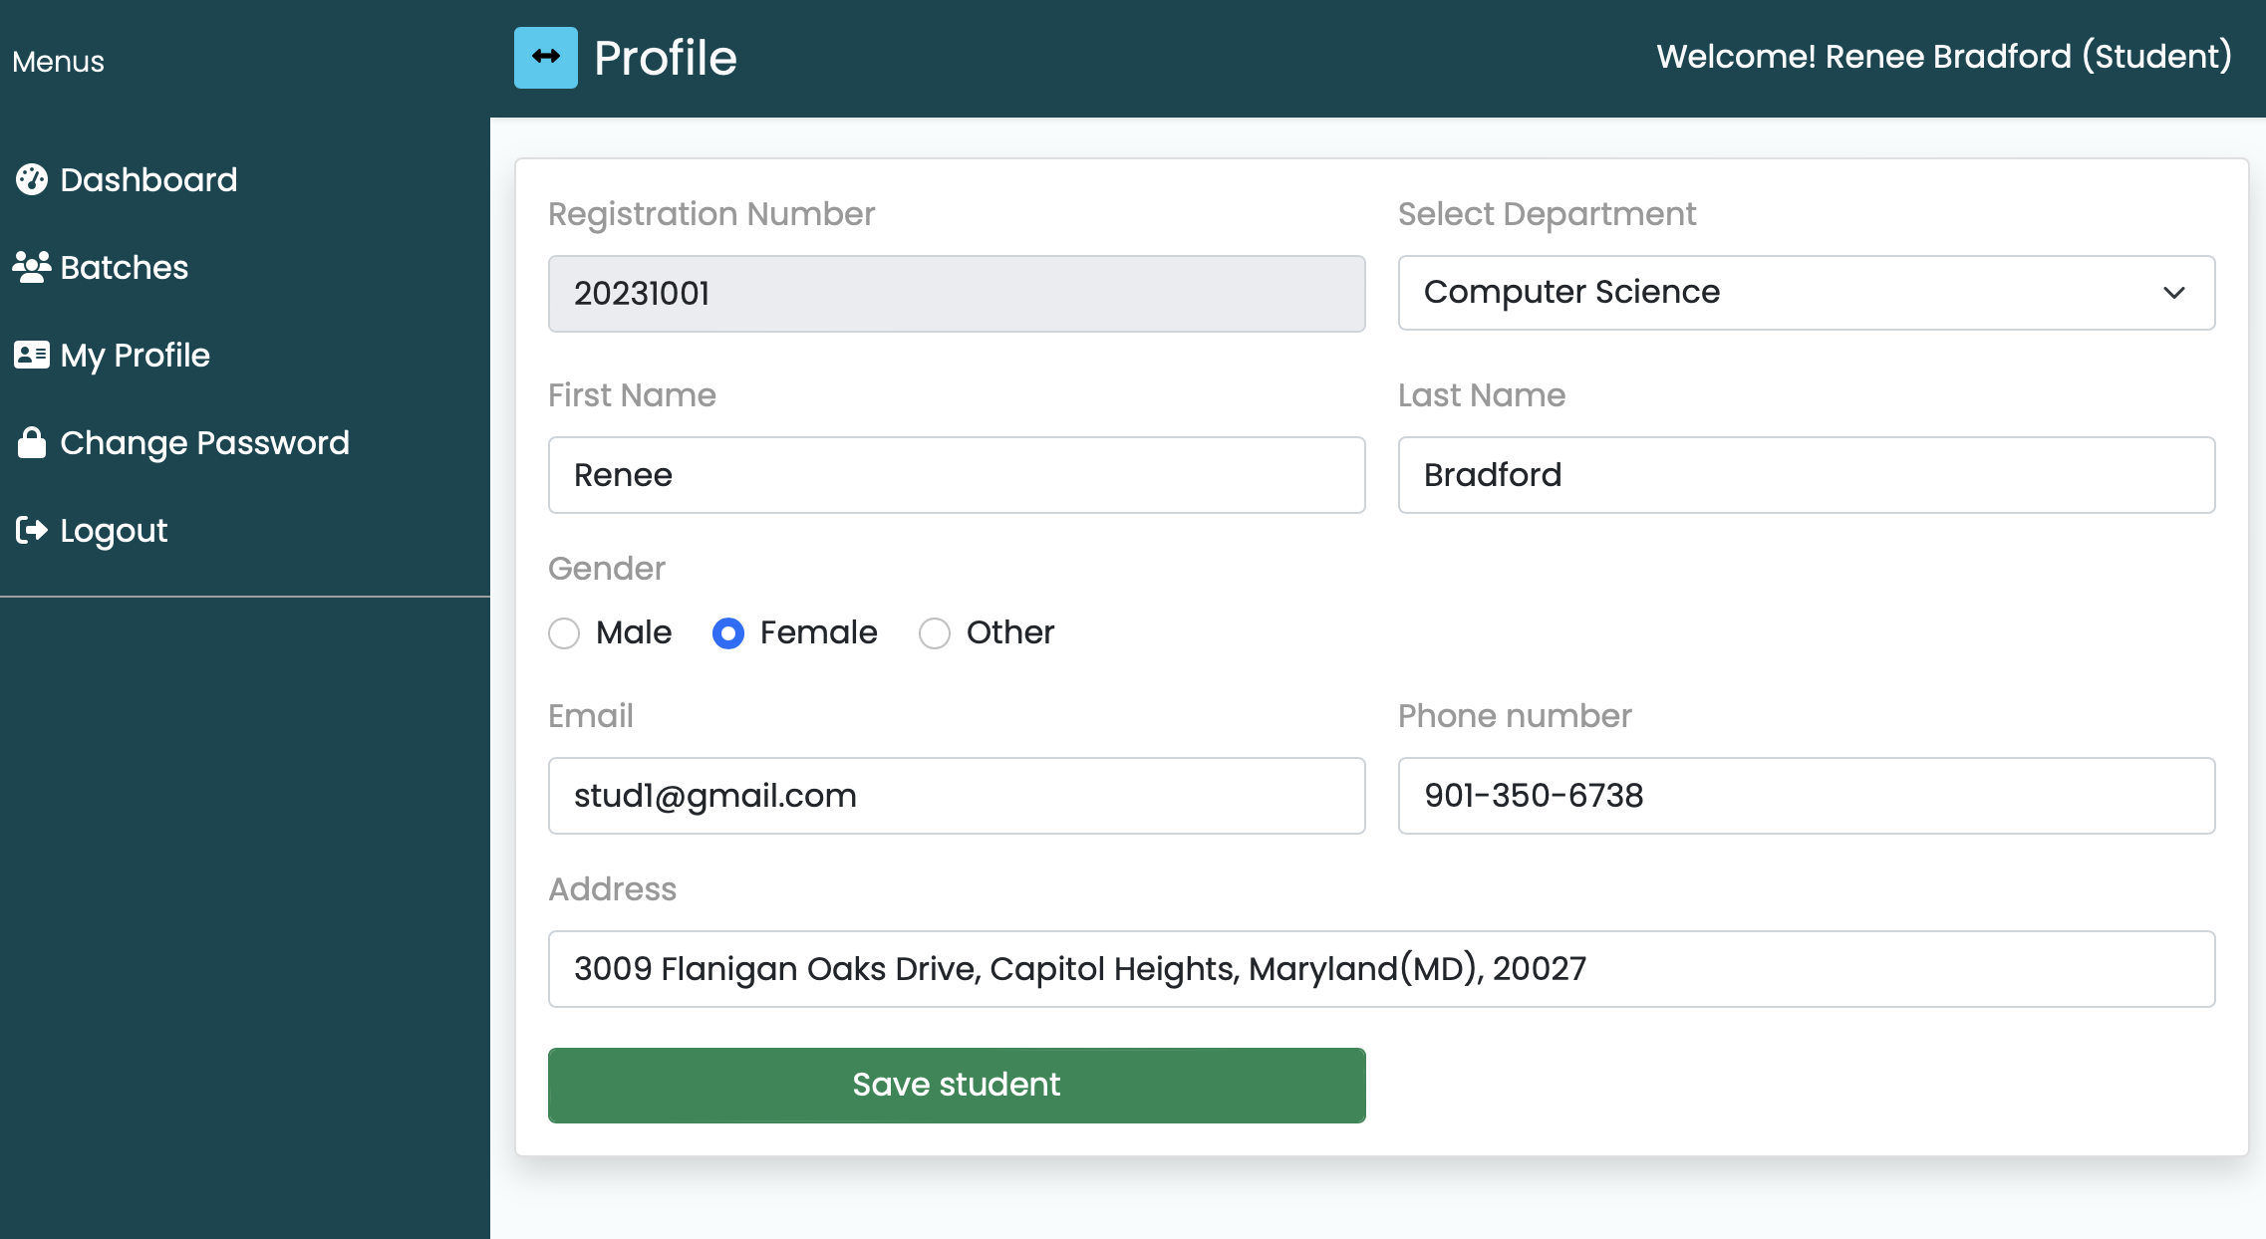

Slide 8
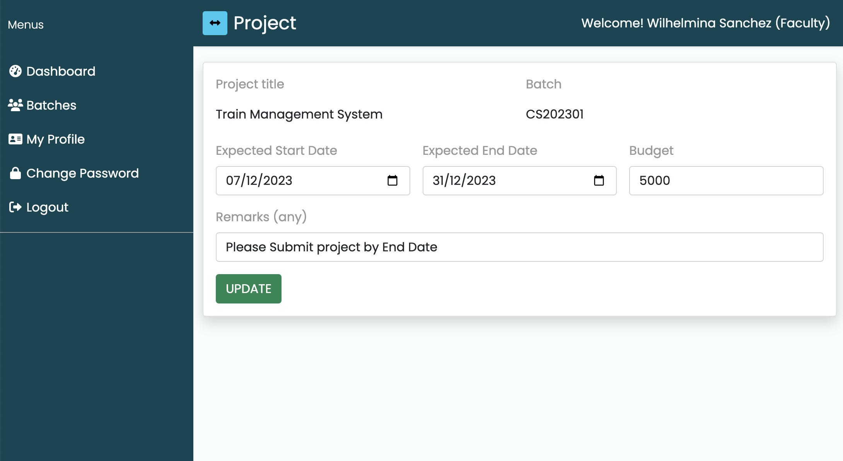

Slide 9
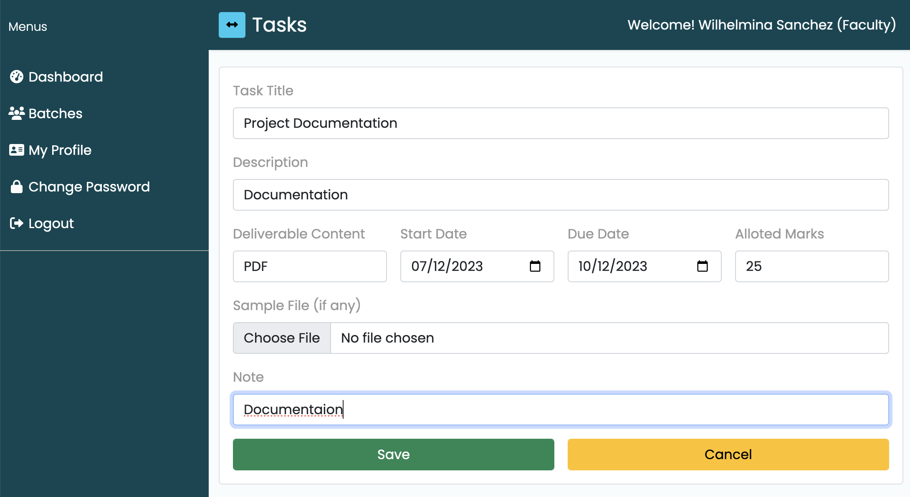

Slide 10
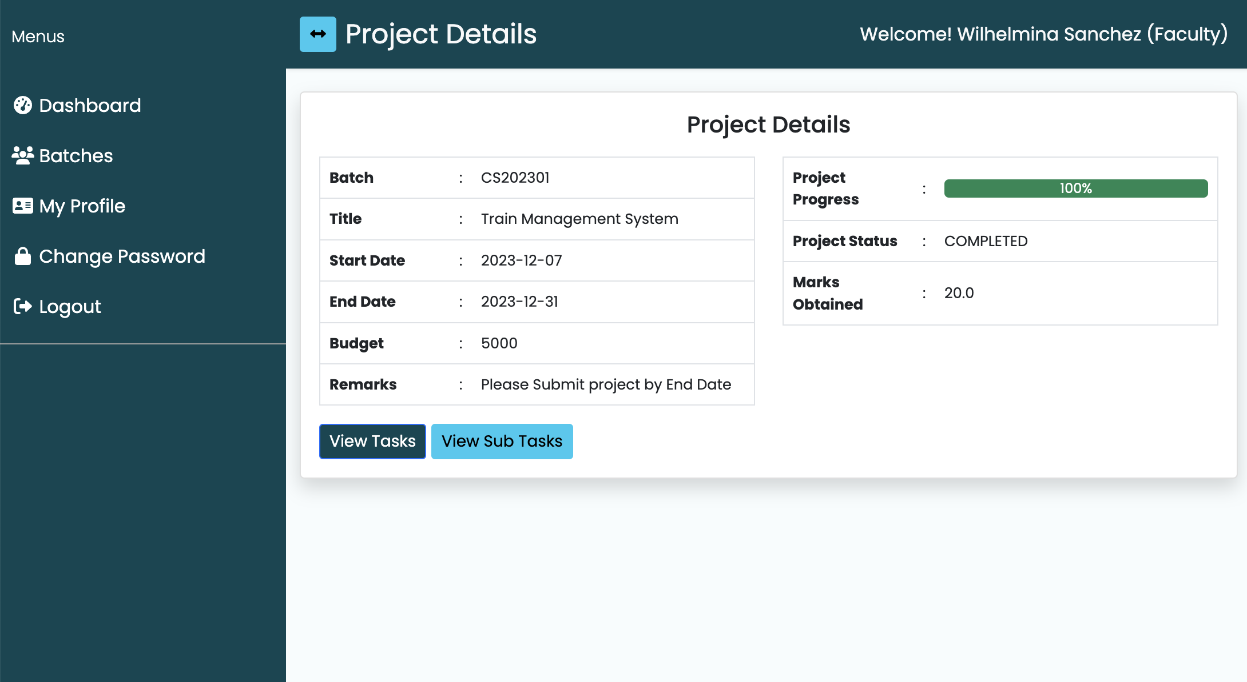

Slide 11


