Slide 1
Calculating Non-uniform Grating Spectra with Transfer Matrix Method
Yu Di
August 19, 2025

Slide 2
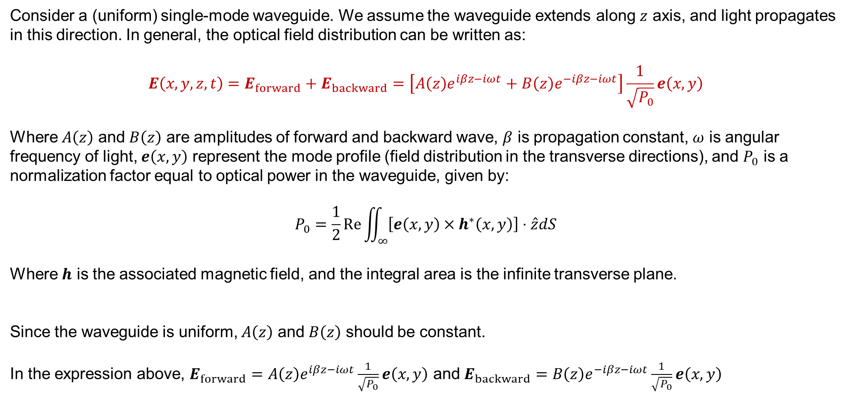
Problem setup
Consider a (uniform) single-mode waveguide. We assume the waveguide extends along $z$ axis, and light propagates in this direction. In general, the optical field distribution can be written as:
$$E\left(x,y,z,t\right)=E_{forward}+E_{backward}=\left[A\left(z\right)e^{iβz−iωt}+B\left(z\right)e^{−iβz−iωt}\right]\frac{1}{\sqrt{P_{0}}}e\left(x,y\right)$$
Where $A\left(z\right)$ and $B\left(z\right)$ are amplitudes of forward and backward wave, $β$ is propagation constant, $ω$ is angular frequency of light, $e\left(x,y\right)$ represent the mode profile (field distribution in the transverse directions), and $P_{0}$ is a normalization factor equal to optical power in the waveguide, given by:
$$P_{0}=\frac{1}{2}Re\iint_{∞}{\left[e\left(x,y\right)×h^{∗}\left(x,y\right)\right]⋅\hat{z}dS}$$
Where $h$ is the associated magnetic field, and the integral area is the infinite transverse plane.
Since the waveguide is uniform, $A\left(z\right)$ and $B\left(z\right)$ should be constant.
In the expression above, $E_{forward}=A\left(z\right)e^{iβz−iωt}\frac{1}{\sqrt{P_{0}}}e\left(x,y\right)$ and $E_{backward}=B\left(z\right)e^{−iβz−iωt}\frac{1}{\sqrt{P_{0}}}e\left(x,y\right)$
Notes:
Bold symbol represents vector, while normal one represent scalar.

Slide 3
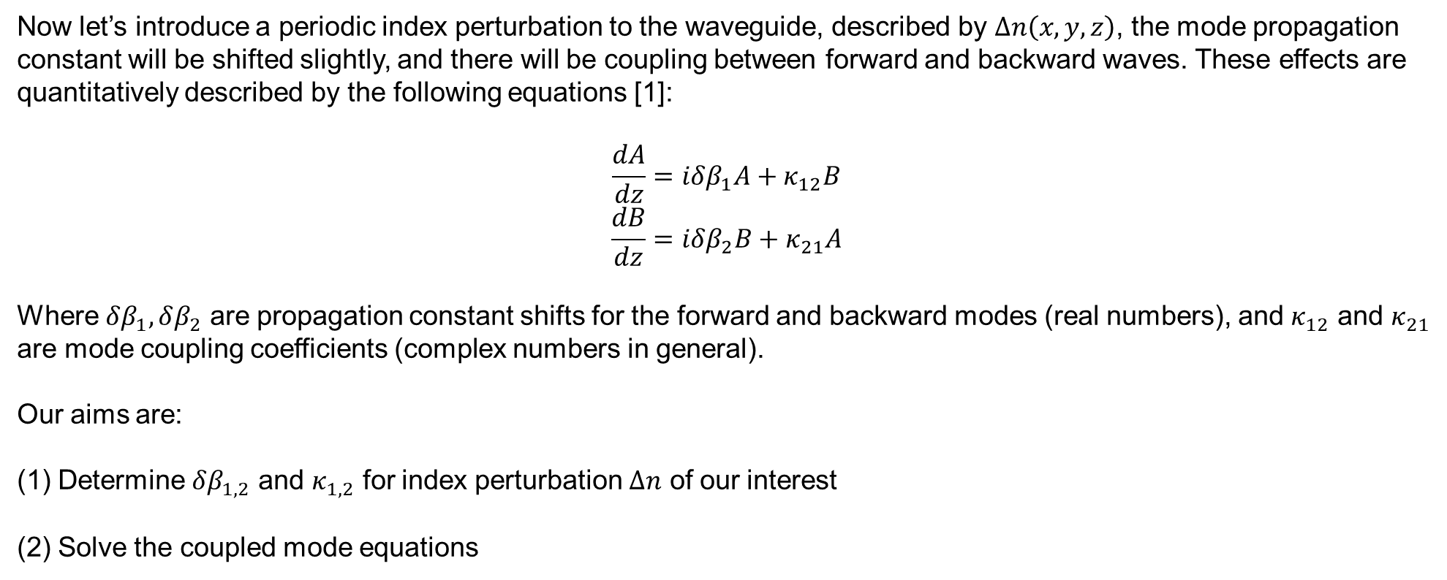
Coupled mode equations
Now let’s introduce a periodic index perturbation to the waveguide, described by $Δn\left(x,y,z\right)$, the mode propagation constant will be shifted slightly, and there will be coupling between forward and backward waves. These effects are quantitatively described by the following equations [1]:
$$\frac{dA}{dz}=iδβ_{1}A+κ_{12}B$$
$$\frac{dB}{dz}=iδβ_{2}B+κ_{21}A$$
Where $δβ_{1},δβ_{2}$ are propagation constant shifts for the forward and backward modes (real numbers), and $κ_{12}$ and $κ_{21}$ are mode coupling coefficients (complex numbers in general).
Our aims are:
Determine $δβ_{1,2}$ and $κ_{1,2}$ for index perturbation $Δn$ of our interest
Solve the coupled mode equations
[1] Osgood Jr, Richard, and Xiang Meng. "Principles of photonic integrated circuits." Graduate Texts in Physics (2021).
Notes:
Bold symbol represents vector, while normal one represent scalar.

Slide 4
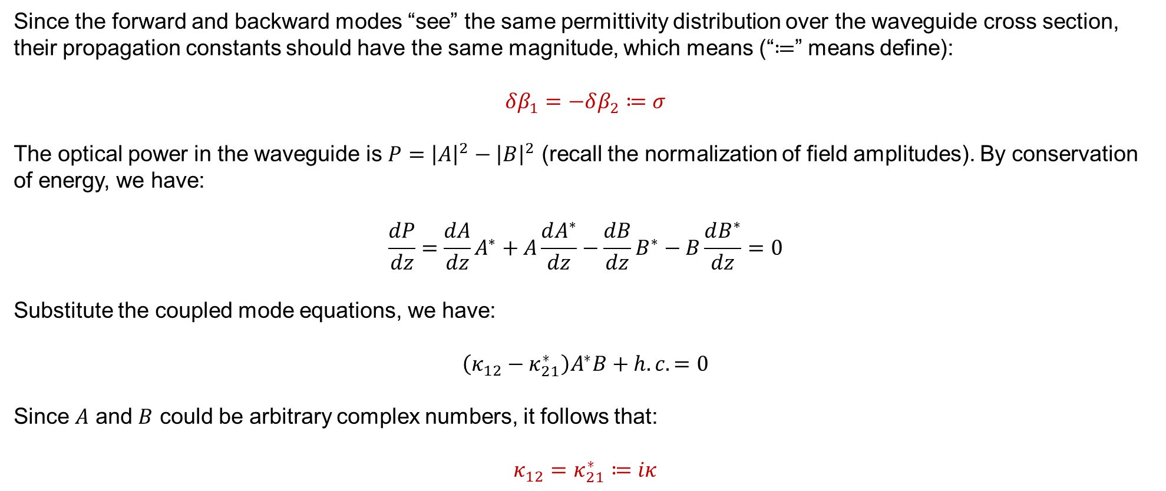
Symmetry of coupling coefficients
Since the forward and backward modes “see” the same permittivity distribution over the waveguide cross section, their propagation constants should have the same magnitude, which means (“$≔$” means define):
$$δβ_{1}=−δβ_{2}≔σ$$
The optical power in the waveguide is $P={\left|A\right|}^{2}−{\left|B\right|}^{2}$ (recall the normalization of field amplitudes). By conservation of energy, we have:
$$\frac{dP}{dz}=\frac{dA}{dz}A^{∗}+A\frac{dA^{∗}}{dz}−\frac{dB}{dz}B^{∗}−B\frac{dB^{∗}}{dz}=0$$
Substitute the coupled mode equations, we have:
$$\left(κ_{12}−κ_{21}^{∗}\right)A^{∗}B+h.c.=0$$
Since $A$ and $B$ could be arbitrary complex numbers, it follows that:
$$κ_{12}=κ_{21}^{∗}≔iκ$$
Notes:
Bold symbol represents vector, while normal one represent scalar.

Slide 5
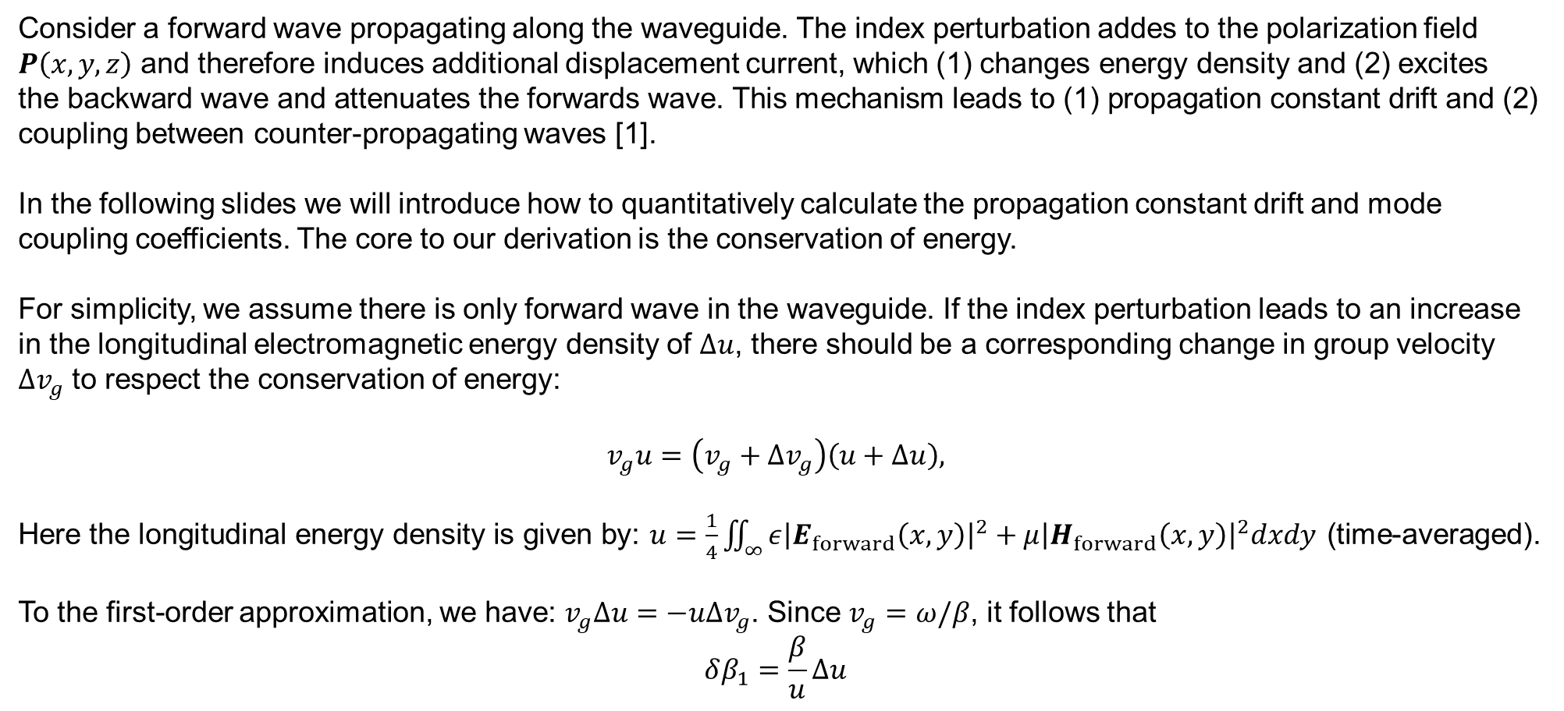
How to calculate $σ$
Consider a forward wave propagating along the waveguide. The index perturbation addes to the polarization field $P\left(x,y,z\right)$ and therefore induces additional displacement current, which (1) changes energy density and (2) excites the backward wave and attenuates the forwards wave. This mechanism leads to (1) propagation constant drift and (2) coupling between counter-propagating waves [1].
In the following slides we will introduce how to quantitatively calculate the propagation constant drift and mode coupling coefficients. The core to our derivation is the conservation of energy.
For simplicity, we assume there is only forward wave in the waveguide. If the index perturbation leads to an increase in the longitudinal electromagnetic energy density of $Δu$, there should be a corresponding change in group velocity $Δv_{g}$ to respect the conservation of energy:
$$v_{g}u=\left(v_{g}+Δv_{g}\right)\left(u+Δu\right),$$
Here the longitudinal energy density is given by: $u=\frac{1}{4}\iint_{∞}{ε{\left|E_{forward}\left(x,y\right)\right|}^{2}+μ{\left|H_{forward}\left(x,y\right)\right|}^{2}dxdy}$ (time-averaged).
To the first-order approximation, we have: $v_{g}Δu=−uΔv_{g}$. Since $v_{g}=ω/β$, it follows that
$$δβ_{1}=\frac{β}{u}Δu$$
[1] Osgood Jr, Richard, and Xiang Meng. "Principles of photonic integrated circuits." Graduate Texts in Physics (2021).
Notes:
Bold symbol represents vector, while normal one represent scalar.

Slide 6
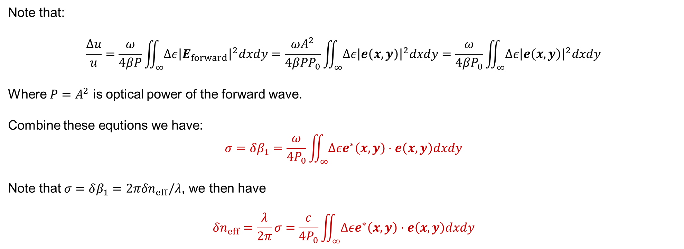
How to calculate $σ$ (continued)
Note that:
$$\frac{Δu}{u}=\frac{ω}{4βP}\iint_{∞}{Δε{\left|E_{forward}\right|}^{2}dxdy}=\frac{ωA^{2}}{4βPP_{0}}\iint_{∞}{Δε{\left|e\left(x,y\right)\right|}^{2}dxdy}=\frac{ω}{4βP_{0}}\iint_{∞}{Δε{\left|e\left(x,y\right)\right|}^{2}dxdy}$$
Where $P=A^{2}$ is optical power of the forward wave.
Combine these equtions we have:
$$σ=δβ_{1}=\frac{ω}{4P_{0}}\iint_{∞}{Δεe^{∗}\left(x,y\right)⋅e\left(x,y\right)dxdy}$$
Note that $σ=δβ_{1}=2πδn_{eff}/λ$, we then have
$$δn_{eff}=\frac{λ}{2π}σ=\frac{c}{4P_{0}}\iint_{∞}{Δεe^{∗}\left(x,y\right)⋅e\left(x,y\right)dxdy}$$
[1] Osgood Jr, Richard, and Xiang Meng. "Principles of photonic integrated circuits." Graduate Texts in Physics (2021).
Notes:
Bold symbol represents vector, while normal one represent scalar.

Slide 7
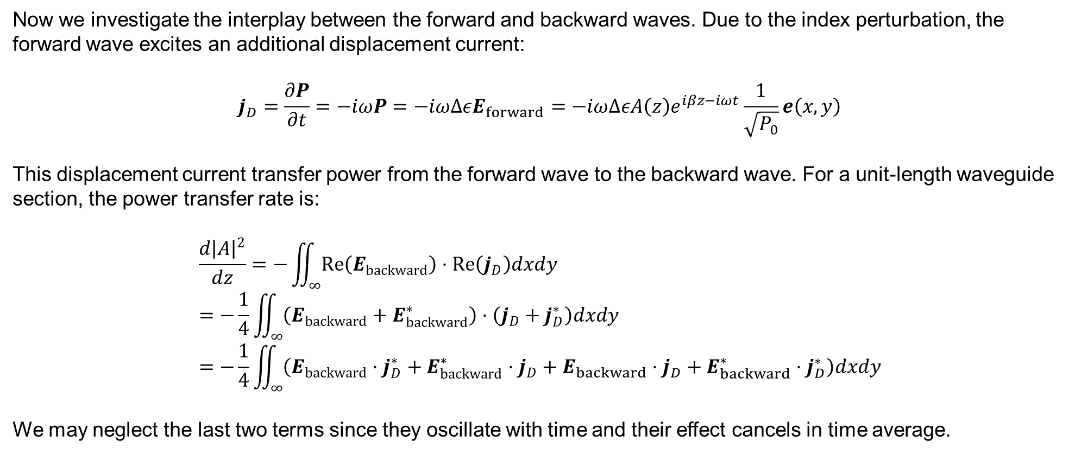
How to calculate $κ$
Now we investigate the interplay between the forward and backward waves. Due to the index perturbation, the forward wave excites an additional displacement current:
$$j_{D}=\frac{∂P}{∂t}=−iωP=−iωΔεE_{forward}=−iωΔεA\left(z\right)e^{iβz−iωt}\frac{1}{\sqrt{P_{0}}}e\left(x,y\right)$$
This displacement current transfer power from the forward wave to the backward wave. For a unit-length waveguide section, the power transfer rate is:
$$\frac{d{\left|A\right|}^{2}}{dz}=−\iint_{∞}{Re\left(E_{backward}\right)⋅Re\left(j_{D}\right)dxdy} \\ =−\frac{1}{4}\iint_{∞}{\left(E_{backward}+E_{backward}^{∗}\right)⋅\left(j_{D}+j_{D}^{∗}\right)dxdy} \\ =−\frac{1}{4}\iint_{∞}{\left(E_{backward}⋅j_{D}^{∗}+E_{backward}^{∗}⋅j_{D}+E_{backward}⋅j_{D}+E_{backward}^{∗}⋅j_{D}^{∗}\right)dxdy}$$
We may neglect the last two terms since they oscillate with time and their effect cancels in time average.
[1] Osgood Jr, Richard, and Xiang Meng. "Principles of photonic integrated circuits." Graduate Texts in Physics (2021).
Notes:
Bold symbol represents vector, while normal one represent scalar.

Slide 8
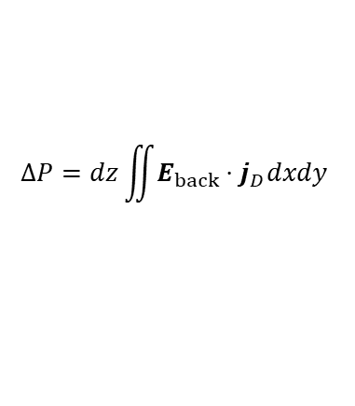



How to calculate $κ$ (continued)
Then, we may write
$$\frac{d{\left|A\right|}^{2}}{dz}=−\frac{1}{4}\iint_{∞}{\left(E_{backward}⋅j_{D}^{∗}+h.c.\right)dxdy} \\ =−\frac{1}{4}\iint_{∞}{\left(B\left(z\right)e^{−iβz−iωt}\frac{1}{\sqrt{P_{0}}}e⋅iωΔεA{\left(z\right)}^{∗}e^{−iβz+iωt}\frac{1}{\sqrt{P_{0}}}e^{∗}+h.c.\right)dxdy} \\ =−\frac{iω}{4P_{0}}e^{−2iβz}A{\left(z\right)}^{∗}B\left(z\right)\iint_{∞}{Δεe⋅e^{∗}dxdy}+h.c.$$
On the other hand, from the coupled mode equations we have:
$$\frac{d{\left|A\right|}^{2}}{dz}=A^{∗}Biκ+h.c.$$
Comparing the two equations above, we have:
$$κ=−\frac{ω}{4P_{0}}e^{−i2βz}\iint_{∞}{Δεe^{∗}\left(x,y\right)⋅e\left(x,y\right)dxdy}$$
$$ΔP=dz\iint{E_{back}⋅j_{D}dxdy}$$
$$P\left(z\right)={\left|A\left(z\right)\right|}^{2}$$
$$P\left(z+Δz\right)={\left|A\left(z+Δz\right)\right|}^{2}$$
Illustration of power in forward wave
[1] Osgood Jr, Richard, and Xiang Meng. "Principles of photonic integrated circuits." Graduate Texts in Physics (2021).
Notes:
Bold symbol represents vector, while normal one represent scalar.

Slide 9
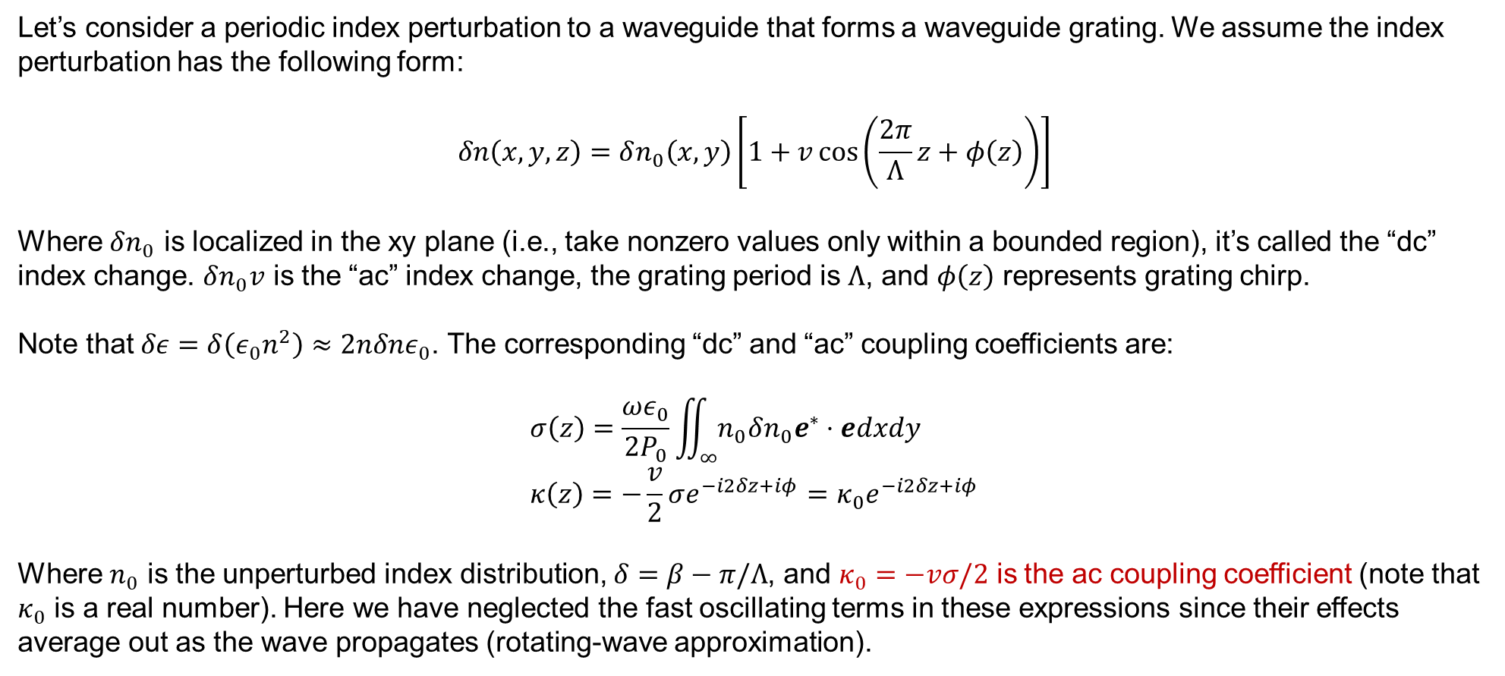
Coupled mode equations for gratings
Let’s consider a periodic index perturbation to a waveguide that forms a waveguide grating. We assume the index perturbation has the following form:
$$δn\left(x,y,z\right)=δn_{0}\left(x,y\right)\left[1+v\cos\left(\frac{2π}{Λ}z+φ\left(z\right)\right)\right]$$
Where $δn_{0}$ is localized in the xy plane (i.e., take nonzero values only within a bounded region), it’s called the “dc” index change. $δn_{0}v$ is the “ac” index change, the grating period is $Λ$, and $φ\left(z\right)$ represents grating chirp.
Note that $δε=δ\left(ε_{0}n^{2}\right)≈2nδnε_{0}$. The corresponding “dc” and “ac” coupling coefficients are:
$$σ\left(z\right)=\frac{ωε_{0}}{2P_{0}}\iint_{∞}{n_{0}δn_{0}e^{∗}⋅edxdy} \\ κ\left(z\right)=−\frac{v}{2}σe^{−i2δz+iφ}=κ_{0}e^{−i2δz+iφ}$$
Where $n_{0}$ is the unperturbed index distribution, $δ=β−π/Λ$, and $κ_{0}=−vσ/2$ is the ac coupling coefficient (note that $κ_{0}$ is a real number). Here we have neglected the fast oscillating terms in these expressions since their effects average out as the wave propagates (rotating-wave approximation).
[1] Erdogan, Turan. "Fiber grating spectra." Journal of lightwave technology 15.8 (2002): 1277-1294.
Notes:
Bold symbol represents vector, while normal one represent scalar.

Slide 10
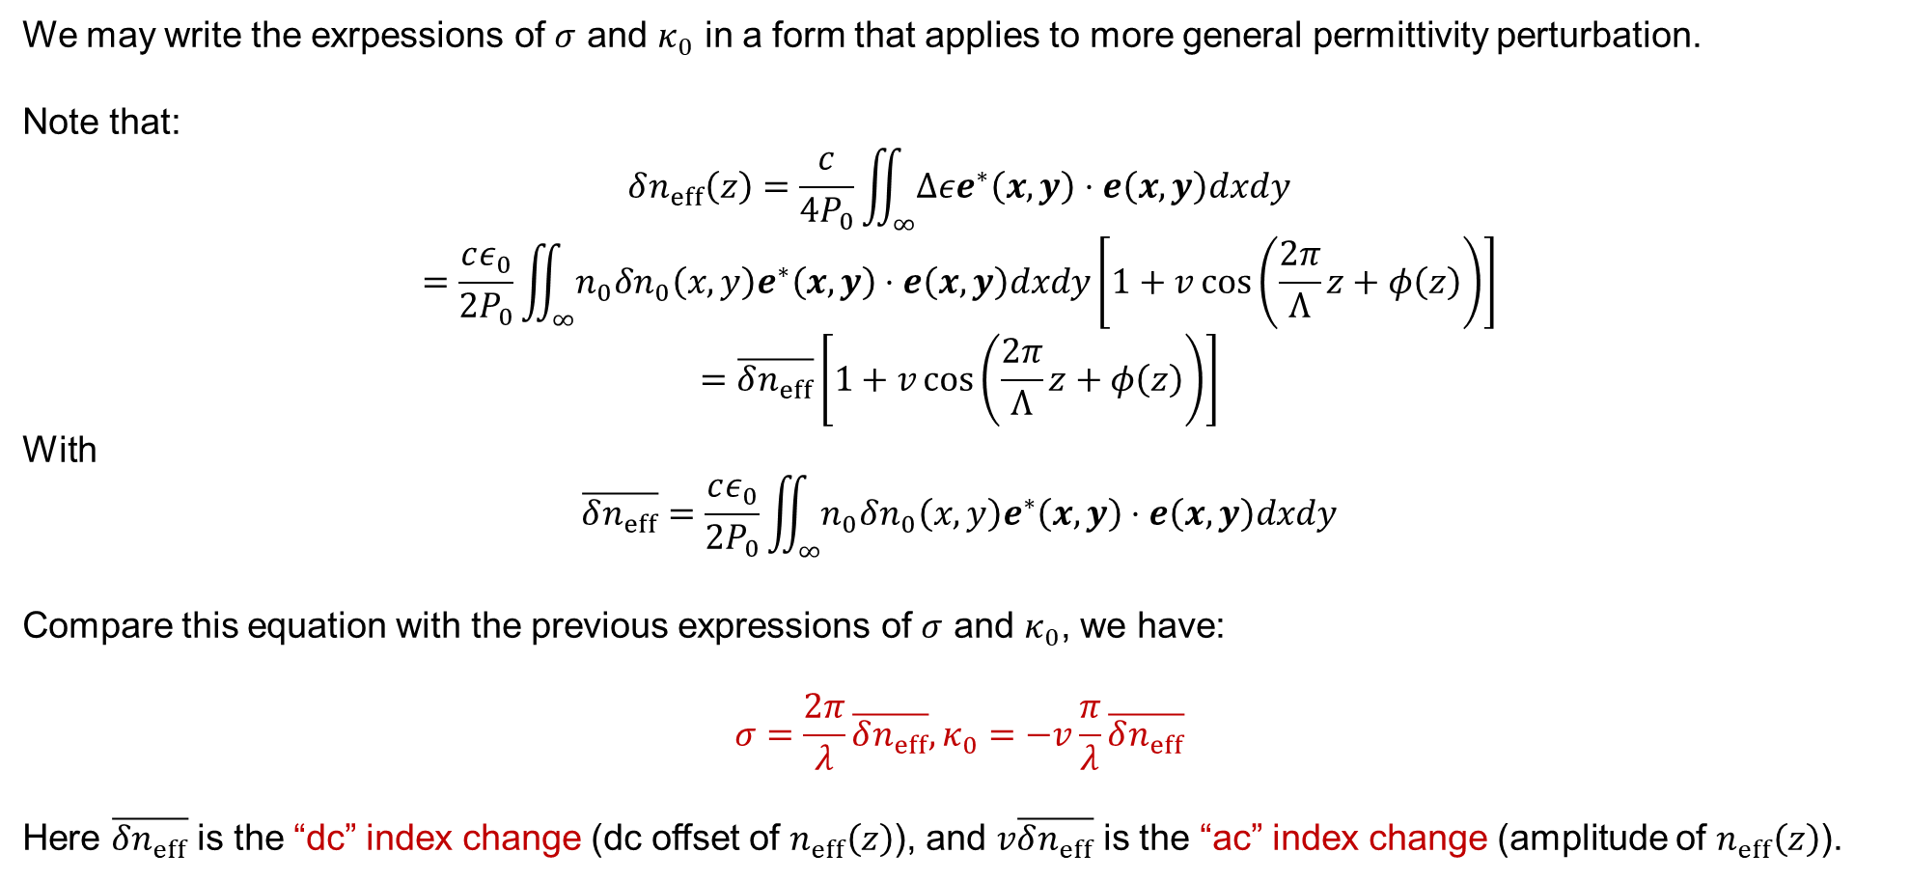
Coupled mode equations for gratings (continued)
We may write the exrpessions of $σ$ and $κ_{0}$ in a form that applies to more general permittivity perturbation.
Note that:
$$δn_{eff}\left(z\right)=\frac{c}{4P_{0}}\iint_{∞}{Δεe^{∗}\left(x,y\right)⋅e\left(x,y\right)dxdy}$$
$$=\frac{cε_{0}}{2P_{0}}\iint_{∞}{n_{0}δn_{0}\left(x,y\right)e^{∗}\left(x,y\right)⋅e\left(x,y\right)dxdy}\left[1+v\cos\left(\frac{2π}{Λ}z+φ\left(z\right)\right)\right]$$
$$=\overline{δn_{eff}}\left[1+v\cos\left(\frac{2π}{Λ}z+φ\left(z\right)\right)\right]$$
With
$$\overline{δn_{eff}}=\frac{cε_{0}}{2P_{0}}\iint_{∞}{n_{0}δn_{0}\left(x,y\right)e^{∗}\left(x,y\right)⋅e\left(x,y\right)dxdy}$$
Compare this equation with the previous expressions of $σ$ and $κ_{0}$, we have:
$$σ=\frac{2π}{λ}\overline{δn_{eff}},κ_{0}=−v\frac{π}{λ}\overline{δn_{eff}}$$
Here $\overline{δn_{eff}}$ is the “dc” index change (dc offset of $n_{eff}\left(z\right)$), and $v\overline{δn_{eff}}$ is the “ac” index change (amplitude of $n_{eff}\left(z\right)$).
[1] Erdogan, Turan. "Fiber grating spectra." Journal of lightwave technology 15.8 (2002): 1277-1294.
Notes:
Bold symbol represents vector, while normal one represent scalar.

Slide 11
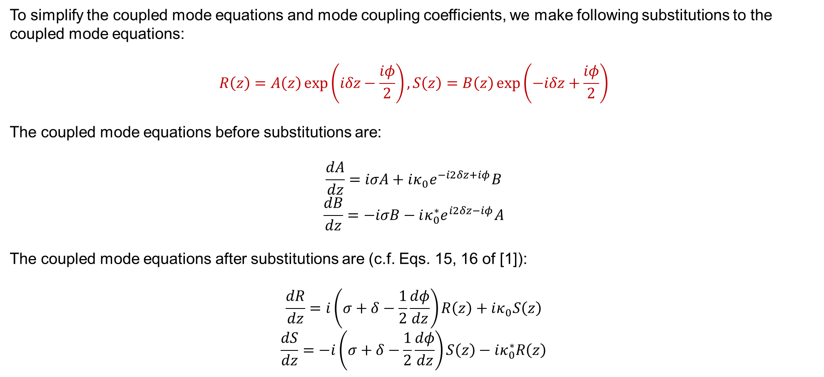
Coupled mode equations for gratings (continued)
To simplify the coupled mode equations and mode coupling coefficients, we make following substitutions to the coupled mode equations:
$$R\left(z\right)=A\left(z\right)\exp\left(iδz−\frac{iφ}{2}\right),S\left(z\right)=B\left(z\right)\exp\left(−iδz+\frac{iφ}{2}\right)$$
The coupled mode equations before substitutions are:
$$\frac{dA}{dz}=iσA+iκ_{0}e^{−i2δz+iφ}B$$
$$\frac{dB}{dz}=−iσB−iκ_{0}^{∗}e^{i2δz−iφ}A$$
The coupled mode equations after substitutions are (c.f. Eqs. 15, 16 of [1]):
$$\frac{dR}{dz}=i\left(σ+δ−\frac{1}{2}\frac{dφ}{dz}\right)R\left(z\right)+iκ_{0}S\left(z\right)$$
$$\frac{dS}{dz}=−i\left(σ+δ−\frac{1}{2}\frac{dφ}{dz}\right)S\left(z\right)−iκ_{0}^{∗}R\left(z\right)$$
[1] Erdogan, Turan. "Fiber grating spectra." Journal of lightwave technology 15.8 (2002): 1277-1294.
Notes:
Bold symbol represents vector, while normal one represent scalar.

Slide 12

Coupled mode equations for gratings (continued)
Denote dc coupling coefficient $\hat{σ}=σ+δ−\frac{1}{2}\frac{dφ}{dz}$, the coupled mode equations can be written as:
$$\frac{dR}{dz}=i\hat{σ}R\left(z\right)+iκ_{0}S\left(z\right)$$
$$\frac{dS}{dz}=−i\hat{σ}S\left(z\right)−iκ_{0}^{∗}R\left(z\right)$$
Where
$$δ=β−\frac{π}{Λ}$$
$$σ=\frac{2π}{λ}\overline{δn_{eff}}$$
$$κ_{0}=−\frac{π}{λ}v\overline{δn_{eff}}$$
[1] Erdogan, Turan. "Fiber grating spectra." Journal of lightwave technology 15.8 (2002): 1277-1294.
Notes:
Bold symbol represents vector, while normal one represent scalar.

Slide 13
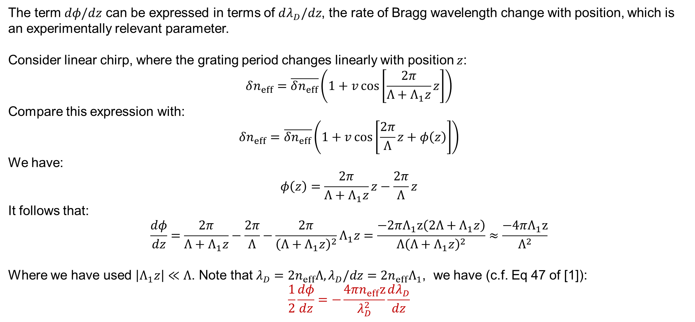
Expression for chirp term
The term $dφ/dz$ can be expressed in terms of $dλ_{D}/dz$, the rate of Bragg wavelength change with position, which is an experimentally relevant parameter.
Consider linear chirp, where the grating period changes linearly with position $z$:
$$δn_{eff}=\overline{δn_{eff}}\left(1+v\cos\left[\frac{2π}{Λ+Λ_{1}z}z\right]\right)$$
Compare this expression with:
$$δn_{eff}=\overline{δn_{eff}}\left(1+v\cos\left[\frac{2π}{Λ}z+φ\left(z\right)\right]\right)$$
We have:
$$φ\left(z\right)=\frac{2π}{Λ+Λ_{1}z}z−\frac{2π}{Λ}z$$
It follows that:
$$\frac{dφ}{dz}=\frac{2π}{Λ+Λ_{1}z}−\frac{2π}{Λ}−\frac{2π}{{\left(Λ+Λ_{1}z\right)}^{2}}Λ_{1}z=\frac{−2πΛ_{1}z\left(2Λ+Λ_{1}z\right)}{{Λ\left(Λ+Λ_{1}z\right)}^{2}}≈\frac{−4πΛ_{1}z}{Λ^{2}}$$
Where we have used $\left|Λ_{1}z\right|≪Λ$. Note that $λ_{D}=2n_{eff}Λ,λ_{D}/dz=2n_{eff}Λ_{1}$, we have (c.f. Eq 47 of [1]):
$$\frac{1}{2}\frac{dφ}{dz}=−\frac{4πn_{eff}z}{λ_{D}^{2}}\frac{dλ_{D}}{dz}$$
[1] Erdogan, Turan. "Fiber grating spectra." Journal of lightwave technology 15.8 (2002): 1277-1294.
Notes:
Bold symbol represents vector, while normal one represent scalar.

Slide 14
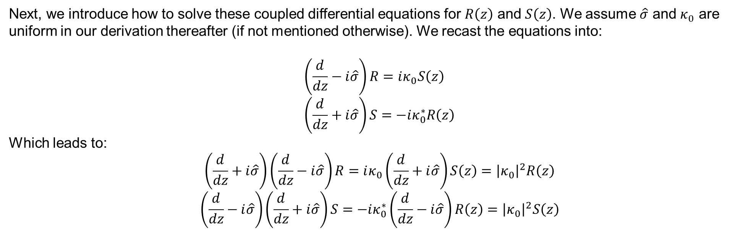
Solve the coupled mode equations for grating
Next, we introduce how to solve these coupled differential equations for $R\left(z\right)$ and $S\left(z\right)$. We assume $\hat{σ}$ and $κ_{0}$ are uniform in our derivation thereafter (if not mentioned otherwise). We recast the equations into:
$$\left(\frac{d}{dz}−i\hat{σ}\right)R=iκ_{0}S\left(z\right) \\ \left(\frac{d}{dz}+i\hat{σ}\right)S=−iκ_{0}^{∗}R\left(z\right)$$
Which leads to:
$$\left(\frac{d}{dz}+i\hat{σ}\right)\left(\frac{d}{dz}−i\hat{σ}\right)R=iκ_{0}\left(\frac{d}{dz}+i\hat{σ}\right)S\left(z\right)={\left|κ_{0}\right|}^{2}R\left(z\right)$$
$$\left(\frac{d}{dz}−i\hat{σ}\right)\left(\frac{d}{dz}+i\hat{σ}\right)S=−iκ_{0}^{∗}\left(\frac{d}{dz}−i\hat{σ}\right)R\left(z\right)={\left|κ_{0}\right|}^{2}S\left(z\right)$$
[1] Erdogan, Turan. "Fiber grating spectra." Journal of lightwave technology 15.8 (2002): 1277-1294.
Notes:
Bold symbol represents vector, while normal one represent scalar.

Slide 15
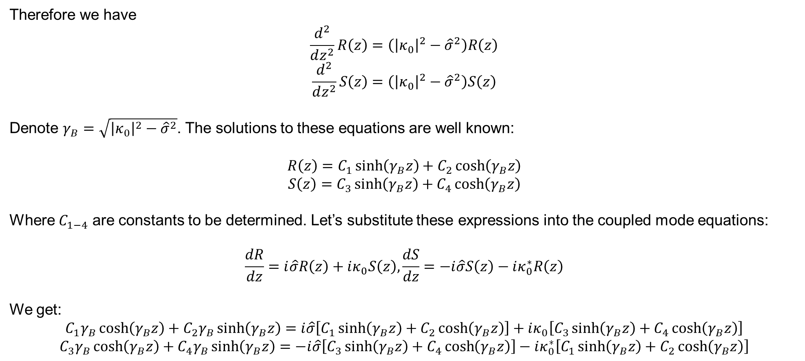
Solve the coupled mode equations for grating (continued)
Therefore we have
$$\frac{d^{2}}{dz^{2}}R\left(z\right)=\left({\left|κ_{0}\right|}^{2}−{\hat{σ}}^{2}\right)R\left(z\right)$$
$$\frac{d^{2}}{dz^{2}}S\left(z\right)=\left({\left|κ_{0}\right|}^{2}−{\hat{σ}}^{2}\right)S\left(z\right)$$
Denote $γ_{B}=\sqrt{{\left|κ_{0}\right|}^{2}−{\hat{σ}}^{2}}$. The solutions to these equations are well known:
$$R\left(z\right)=C_{1}\sinh\left(γ_{B}z\right)+C_{2}\cosh\left(γ_{B}z\right)$$
$$S\left(z\right)=C_{3}\sinh\left(γ_{B}z\right)+C_{4}\cosh\left(γ_{B}z\right)$$
Where $C_{1−4}$ are constants to be determined. Let’s substitute these expressions into the coupled mode equations:
$$\frac{dR}{dz}=i\hat{σ}R\left(z\right)+iκ_{0}S\left(z\right),\frac{dS}{dz}=−i\hat{σ}S\left(z\right)−iκ_{0}^{∗}R\left(z\right)$$
We get:
$$C_{1}γ_{B}\cosh\left(γ_{B}z\right)+C_{2}γ_{B}\sinh\left(γ_{B}z\right)=i\hat{σ}\left[C_{1}\sinh\left(γ_{B}z\right)+C_{2}\cosh\left(γ_{B}z\right)\right]+iκ_{0}\left[C_{3}\sinh\left(γ_{B}z\right)+C_{4}\cosh\left(γ_{B}z\right)\right]$$
$$C_{3}γ_{B}\cosh\left(γ_{B}z\right)+C_{4}γ_{B}\sinh\left(γ_{B}z\right)=−i\hat{σ}\left[C_{3}\sinh\left(γ_{B}z\right)+C_{4}\cosh\left(γ_{B}z\right)\right]−iκ_{0}^{∗}\left[C_{1}\sinh\left(γ_{B}z\right)+C_{2}\cosh\left(γ_{B}z\right)\right]$$
[1] Erdogan, Turan. "Fiber grating spectra." Journal of lightwave technology 15.8 (2002): 1277-1294.
Notes:
Bold symbol represents vector, while normal one represent scalar.

Slide 16
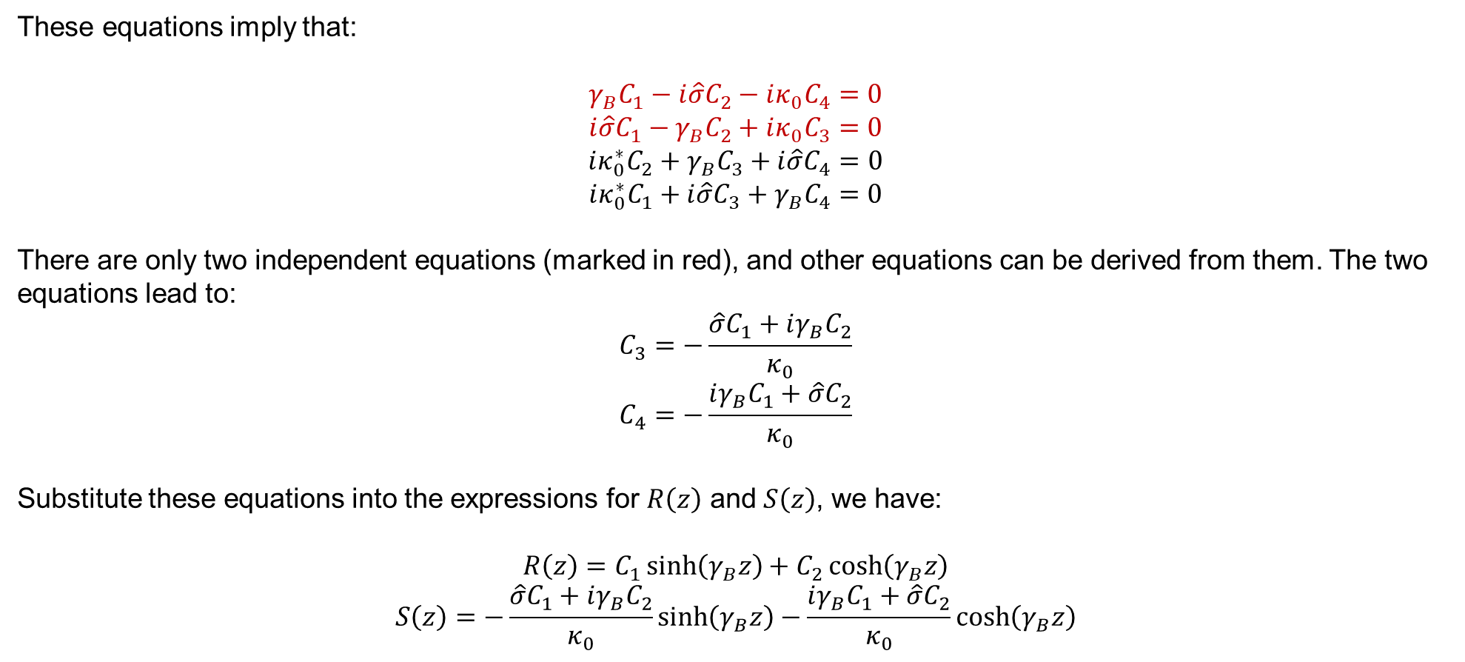
Solve the coupled mode equations for grating (continued)
These equations imply that:
$$γ_{B}C_{1}−i\hat{σ}C_{2}−iκ_{0}C_{4}=0$$
$$i\hat{σ}C_{1}−γ_{B}C_{2}+iκ_{0}C_{3}=0$$
$$iκ_{0}^{∗}C_{2}+γ_{B}C_{3}+i\hat{σ}C_{4}=0$$
$$iκ_{0}^{∗}C_{1}+i\hat{σ}C_{3}+γ_{B}C_{4}=0$$
There are only two independent equations (marked in red), and other equations can be derived from them. The two equations lead to:
$$C_{3}=−\frac{\hat{σ}C_{1}+iγ_{B}C_{2}}{κ_{0}}$$
$$C_{4}=−\frac{iγ_{B}C_{1}+\hat{σ}C_{2}}{κ_{0}}$$
Substitute these equations into the expressions for $R\left(z\right)$ and $S\left(z\right)$, we have:
$$R\left(z\right)=C_{1}\sinh\left(γ_{B}z\right)+C_{2}\cosh\left(γ_{B}z\right)$$
$$S\left(z\right)=−\frac{\hat{σ}C_{1}+iγ_{B}C_{2}}{κ_{0}}\sinh\left(γ_{B}z\right)−\frac{iγ_{B}C_{1}+\hat{σ}C_{2}}{κ_{0}}\cosh\left(γ_{B}z\right)$$
[1] Erdogan, Turan. "Fiber grating spectra." Journal of lightwave technology 15.8 (2002): 1277-1294.
Notes:
Bold symbol represents vector, while normal one represent scalar.

Slide 17
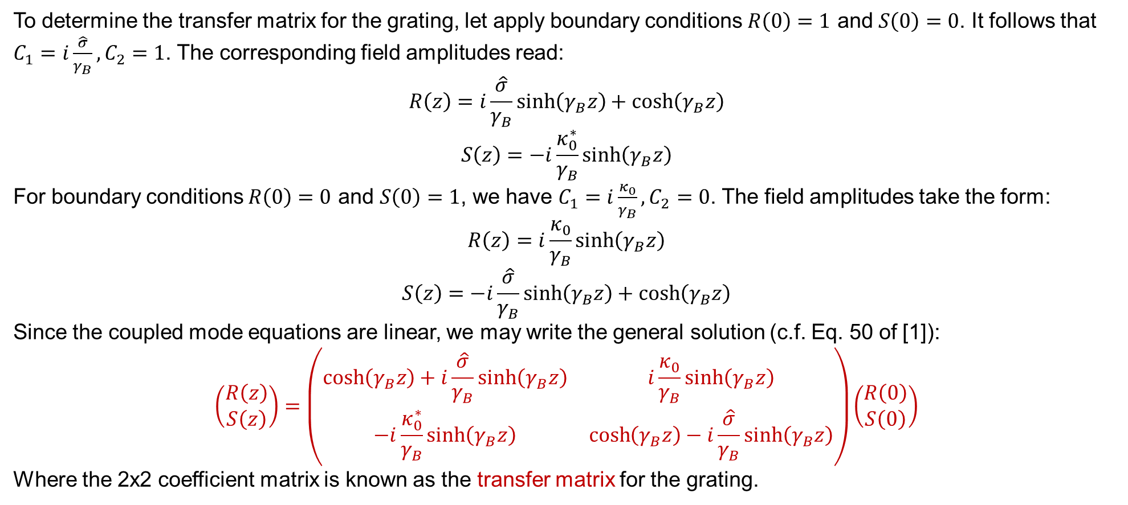
Transfer matrix for grating
To determine the transfer matrix for the grating, let apply boundary conditions $R\left(0\right)=1$ and $S\left(0\right)=0$. It follows that $C_{1}=i\frac{\hat{σ}}{γ_{B}},C_{2}=1$. The corresponding field amplitudes read:
$$R\left(z\right)=i\frac{\hat{σ}}{γ_{B}}\sinh\left(γ_{B}z\right)+\cosh\left(γ_{B}z\right)$$
$$S\left(z\right)=−i\frac{κ_{0}^{∗}}{γ_{B}}\sinh\left(γ_{B}z\right)$$
For boundary conditions $R\left(0\right)=0$ and $S\left(0\right)=1$, we have $C_{1}=i\frac{κ_{0}}{γ_{B}},C_{2}=0$. The field amplitudes take the form:
$$R\left(z\right)=i\frac{κ_{0}}{γ_{B}}\sinh\left(γ_{B}z\right)$$
$$S\left(z\right)=−i\frac{\hat{σ}}{γ_{B}}\sinh\left(γ_{B}z\right)+\cosh\left(γ_{B}z\right)$$
Since the coupled mode equations are linear, we may write the general solution (c.f. Eq. 50 of [1]):
$$\left(\begin{aligned}R\left(z\right) \\ S\left(z\right)\end{aligned}\right)=\left(\begin{matrix}\cosh\left(γ_{B}z\right)+i\frac{\hat{σ}}{γ_{B}}\sinh\left(γ_{B}z\right) & i\frac{κ_{0}}{γ_{B}}\sinh\left(γ_{B}z\right) \\ −i\frac{κ_{0}^{∗}}{γ_{B}}\sinh\left(γ_{B}z\right) & \cosh\left(γ_{B}z\right)−i\frac{\hat{σ}}{γ_{B}}\sinh\left(γ_{B}z\right)\end{matrix}\right)\left(\begin{aligned}R\left(0\right) \\ S\left(0\right)\end{aligned}\right)$$
Where the 2x2 coefficient matrix is known as the transfer matrix for the grating.
[1] Erdogan, Turan. "Fiber grating spectra." Journal of lightwave technology 15.8 (2002): 1277-1294.
Notes:
Bold symbol represents vector, while normal one represent scalar.

Slide 18
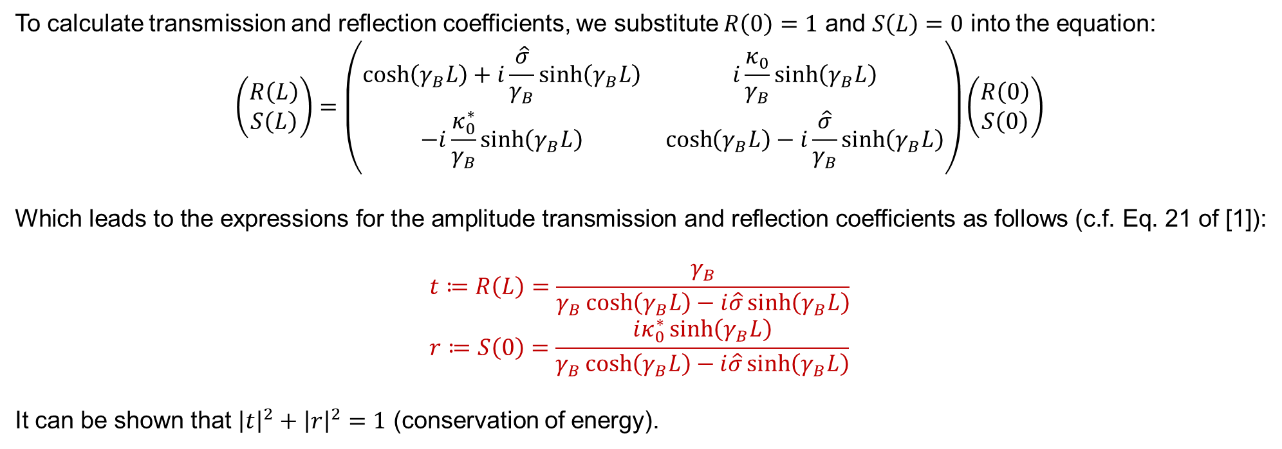
Transmission and reflection coefficients for grating
To calculate transmission and reflection coefficients, we substitute $R\left(0\right)=1$ and $S\left(L\right)=0$ into the equation:
$$\left(\begin{aligned}R\left(L\right) \\ S\left(L\right)\end{aligned}\right)=\left(\begin{matrix}\cosh\left(γ_{B}L\right)+i\frac{\hat{σ}}{γ_{B}}\sinh\left(γ_{B}L\right) & i\frac{κ_{0}}{γ_{B}}\sinh\left(γ_{B}L\right) \\ −i\frac{κ_{0}^{∗}}{γ_{B}}\sinh\left(γ_{B}L\right) & \cosh\left(γ_{B}L\right)−i\frac{\hat{σ}}{γ_{B}}\sinh\left(γ_{B}L\right)\end{matrix}\right)\left(\begin{aligned}R\left(0\right) \\ S\left(0\right)\end{aligned}\right)$$
Which leads to the expressions for the amplitude transmission and reflection coefficients as follows (c.f. Eq. 21 of [1]):
$$t≔R\left(L\right)=\frac{γ_{B}}{γ_{B}\cosh\left(γ_{B}L\right)−i\hat{σ}\sinh\left(γ_{B}L\right)}$$
$$r≔S\left(0\right)=\frac{iκ_{0}^{∗}\sinh\left(γ_{B}L\right)}{γ_{B}\cosh\left(γ_{B}L\right)−i\hat{σ}\sinh\left(γ_{B}L\right)}$$
It can be shown that ${\left|t\right|}^{2}+{\left|r\right|}^{2}=1$ (conservation of energy).
[1] Erdogan, Turan. "Fiber grating spectra." Journal of lightwave technology 15.8 (2002): 1277-1294.
Notes:
Bold symbol represents vector, while normal one represent scalar.

Slide 19
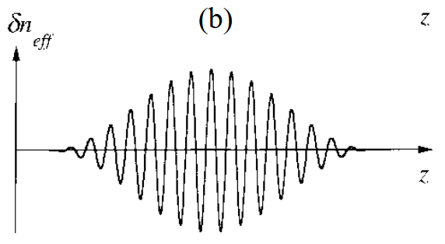
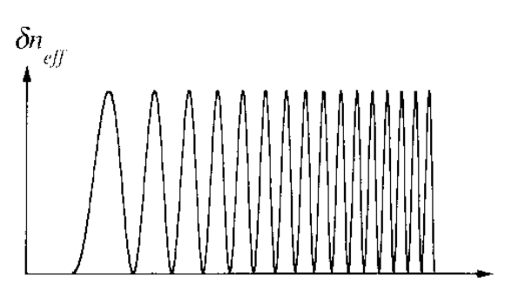

Introduction to non-uniform grating spectra
Non-uniform gratings with chirp or apodization are widely used in applications such as DWDM and pulsed lasers.
The spatial variation in effective index for apodized grating and chirped grating is illustrated below:
In this section, we use the transfer matrix method to calculate their transmission and reflection spectra. This method is computationally efficient and can provide very accurate results.
$$z$$
Apodized grating
Chirped grating

Slide 20
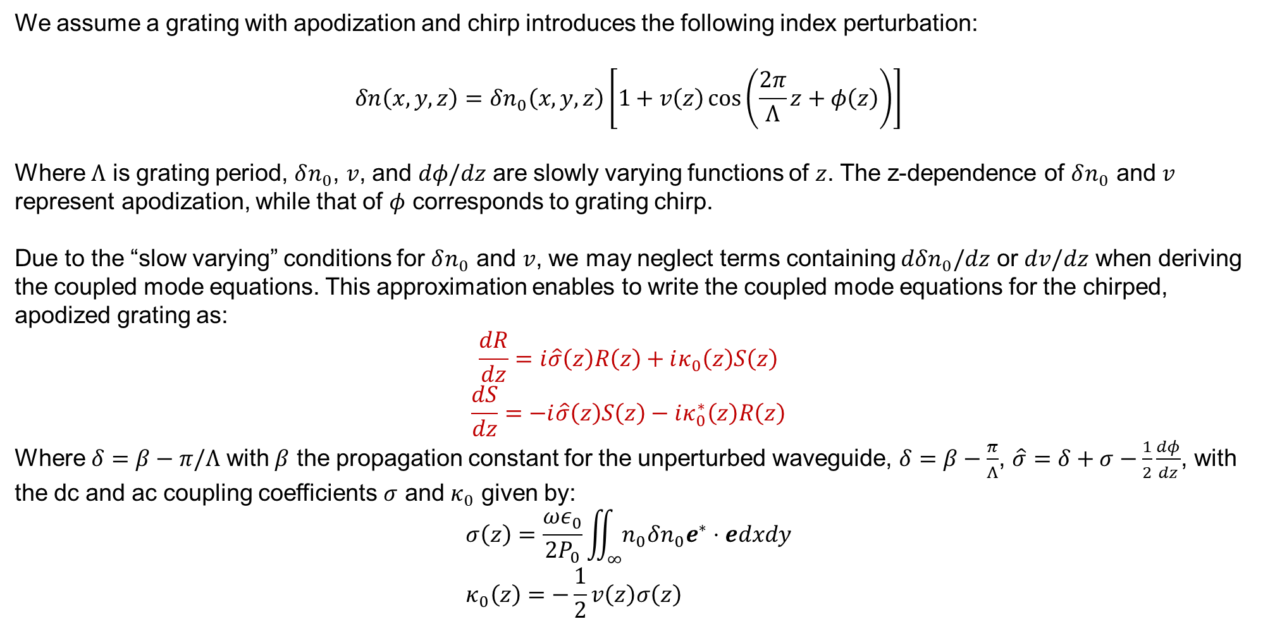
Couped mode equations for non-uniform gratings
We assume a grating with apodization and chirp introduces the following index perturbation:
$$δn\left(x,y,z\right)=δn_{0}\left(x,y,z\right)\left[1+v\left(z\right)\cos\left(\frac{2π}{Λ}z+φ\left(z\right)\right)\right]$$
Where $Λ$ is grating period, $δn_{0}$, $v$, and $dφ/dz$ are slowly varying functions of $z$. The z-dependence of $δn_{0}$ and $v$ represent apodization, while that of $φ$ corresponds to grating chirp.
Due to the “slow varying” conditions for $δn_{0}$ and $v$, we may neglect terms containing $dδn_{0}/dz$ or $dv/dz$ when deriving the coupled mode equations. This approximation enables to write the coupled mode equations for the chirped, apodized grating as:
$$\frac{dR}{dz}=i\hat{σ}\left(z\right)R\left(z\right)+iκ_{0}\left(z\right)S\left(z\right)$$
$$\frac{dS}{dz}=−i\hat{σ}\left(z\right)S\left(z\right)−iκ_{0}^{∗}\left(z\right)R\left(z\right)$$
Where $δ=β−π/Λ$ with $β$ the propagation constant for the unperturbed waveguide, $δ=β−\frac{π}{Λ}$, $\hat{σ}=δ+σ−\frac{1}{2}\frac{dφ}{dz}$, with the dc and ac coupling coefficients $σ$ and $κ_{0}$ given by:
$$σ\left(z\right)=\frac{ωε_{0}}{2P_{0}}\iint_{∞}{n_{0}δn_{0}e^{∗}⋅edxdy} \\ κ_{0}\left(z\right)=−\frac{1}{2}v\left(z\right)σ\left(z\right)$$

Slide 21
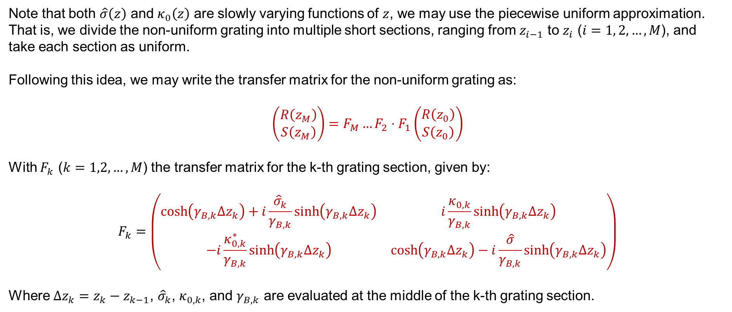
Solve couped mode equations for non-uniform gratings
Note that both $\hat{σ}\left(z\right)$ and $κ_{0}\left(z\right)$ are slowly varying functions of $z$, we may use the piecewise uniform approximation. That is, we divide the non-uniform grating into multiple short sections, ranging from $z_{i−1}$ to $z_{i}$ ($i=1, 2,…,M$), and take each section as uniform.
Following this idea, we may write the transfer matrix for the non-uniform grating as:
$$\left(\begin{aligned}R\left(z_{M}\right) \\ S\left(z_{M}\right)\end{aligned}\right)=F_{M}…F_{2}⋅F_{1}\left(\begin{aligned}R\left(z_{0}\right) \\ S\left(z_{0}\right)\end{aligned}\right)$$
With $F_{k}$ ($k=1,2,…,M$) the transfer matrix for the k-th grating section, given by:
$$F_{k}=\left(\begin{matrix}\cosh\left(γ_{B,k}Δz_{k}\right)+i\frac{{\hat{σ}}_{k}}{γ_{B,k}}\sinh\left(γ_{B,k}Δz_{k}\right) & i\frac{κ_{0,k}}{γ_{B,k}}\sinh\left(γ_{B,k}Δz_{k}\right) \\ −i\frac{κ_{0,k}^{∗}}{γ_{B,k}}\sinh\left(γ_{B,k}Δz_{k}\right) & \cosh\left(γ_{B,k}Δz_{k}\right)−i\frac{\hat{σ}}{γ_{B,k}}\sinh\left(γ_{B,k}Δz_{k}\right)\end{matrix}\right)$$
Where $Δz_{k}=z_{k}−z_{k−1}$, ${\hat{σ}}_{k}$, $κ_{0,k}$, and $γ_{B,k}$ are evaluated at the middle of the k-th grating section.

Slide 22
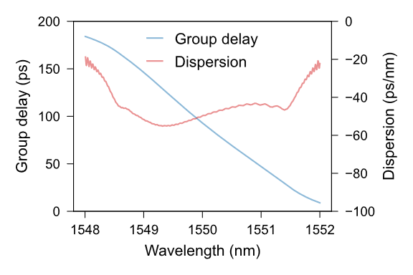
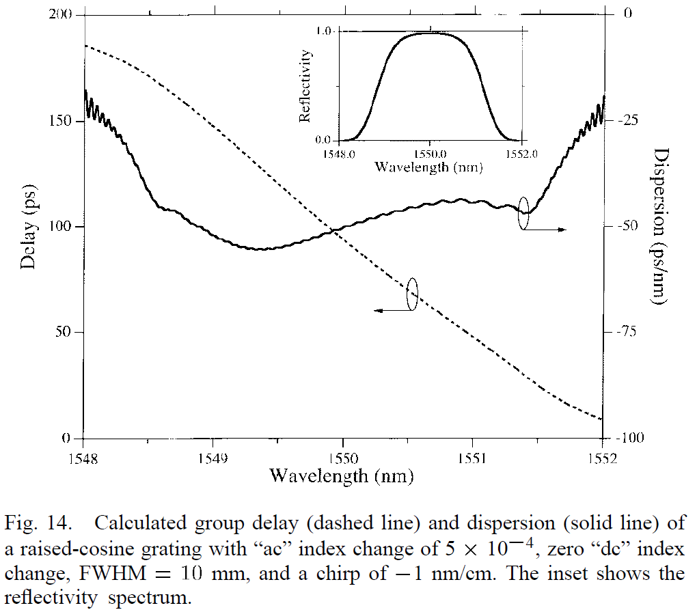
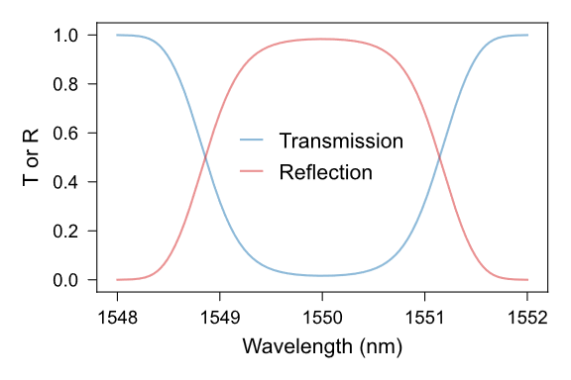
Verification of our code implementation of transfer matrix method
We implemented the transfer matrix method using Python to compute non-uniform grating spectra.
Specifically, we used our code (source) to simulate a chirped grating spectra and the results are in good consistency with the literature results (Fig. 14 of [1]):
Our results
Literature results
[1] Erdogan, Turan. "Fiber grating spectra." Journal of lightwave technology 15.8 (2002): 1277-1294.

Slide 23





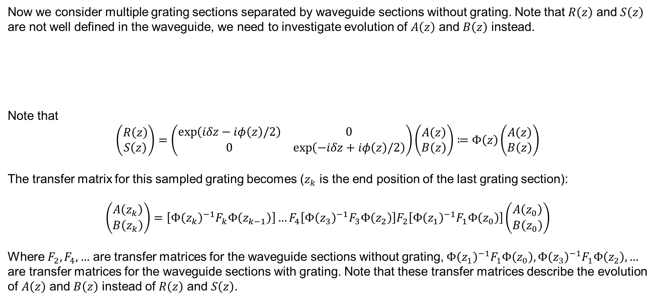







Transfer matrix for sampled grating
Now we consider multiple grating sections separated by waveguide sections without grating. Note that $R\left(z\right)$ and $S\left(z\right)$ are not well defined in the waveguide, we need to investigate evolution of $A\left(z\right)$ and $B\left(z\right)$ instead.
Note that
$$\left(\begin{aligned}R\left(z\right) \\ S\left(z\right)\end{aligned}\right)=\left(\begin{matrix}\exp\left(iδz−iφ\left(z\right)/2\right) & 0 \\ 0 & \exp\left(−iδz+iφ\left(z\right)/2\right)\end{matrix}\right)\left(\begin{aligned}A\left(z\right) \\ B\left(z\right)\end{aligned}\right)≔Φ\left(z\right)\left(\begin{aligned}A\left(z\right) \\ B\left(z\right)\end{aligned}\right)$$
The transfer matrix for this sampled grating becomes ($z_{k}$ is the end position of the last grating section):
$$\left(\begin{aligned}A\left(z_{k}\right) \\ B\left(z_{k}\right)\end{aligned}\right)=\left[Φ{\left(z_{k}\right)}^{−1}F_{k}Φ\left(z_{k−1}\right)\right]…F_{4}\left[Φ{\left(z_{3}\right)}^{−1}F_{3}Φ\left(z_{2}\right)\right]F_{2}\left[Φ{\left(z_{1}\right)}^{−1}F_{1}Φ\left(z_{0}\right)\right]\left(\begin{aligned}A\left(z_{0}\right) \\ B\left(z_{0}\right)\end{aligned}\right)$$
Where $F_{2},F_{4},…$ are transfer matrices for the waveguide sections without grating, $Φ{\left(z_{1}\right)}^{−1}F_{1}Φ\left(z_{0}\right),Φ{\left(z_{3}\right)}^{−1}F_{1}Φ\left(z_{2}\right),…$ are transfer matrices for the waveguide sections with grating. Note that these transfer matrices describe the evolution of $A\left(z\right)$ and $B\left(z\right)$ instead of $R\left(z\right)$ and $S\left(z\right)$.
$$Δz_{1}$$
$$Δz_{2}$$
$$Δz_{3}$$
$$Δz_{4}$$
$$Δz_{5}$$
$$…$$
$$z_{0}$$
$$z_{1}$$
$$z_{2}$$
$$z_{3}$$
$$z_{4}$$
$$z_{5}$$

Slide 24
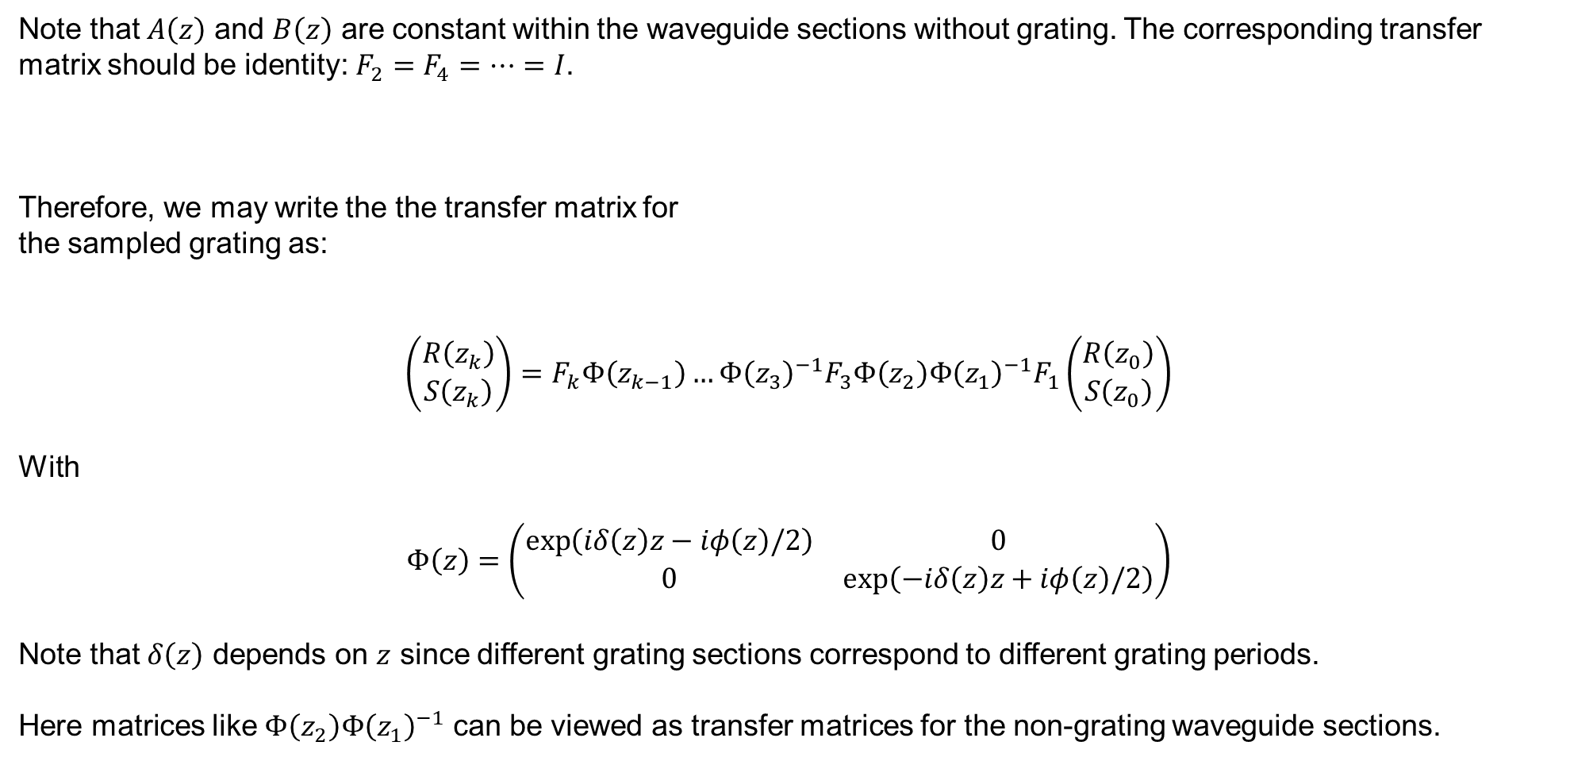
Transfer matrix for sampled grating (continued)
Note that $A\left(z\right)$ and $B\left(z\right)$ are constant within the waveguide sections without grating. The corresponding transfer matrix should be identity: $F_{2}=F_{4}=…=I$.
Therefore, we may write the the transfer matrix for
the sampled grating as:
$$\left(\begin{aligned}R\left(z_{k}\right) \\ S\left(z_{k}\right)\end{aligned}\right)=F_{k}Φ\left(z_{k−1}\right)…Φ{\left(z_{3}\right)}^{−1}F_{3}Φ\left(z_{2}\right)Φ{\left(z_{1}\right)}^{−1}F_{1}\left(\begin{aligned}R\left(z_{0}\right) \\ S\left(z_{0}\right)\end{aligned}\right)$$
With
$$Φ\left(z\right)=\left(\begin{matrix}\exp\left(iδ\left(z\right)z−iφ\left(z\right)/2\right) & 0 \\ 0 & \exp\left(−iδ\left(z\right)z+iφ\left(z\right)/2\right)\end{matrix}\right)$$
Note that $δ\left(z\right)$ depends on $z$ since different grating sections correspond to different grating periods.
Here matrices like $Φ\left(z_{2}\right)Φ{\left(z_{1}\right)}^{−1}$ can be viewed as transfer matrices for the non-grating waveguide sections.
$$Δz_{1}$$
$$Δz_{2}$$
$$Δz_{3}$$
$$Δz_{4}$$
$$Δz_{5}$$
$$…$$
$$z_{0}$$
$$z_{1}$$
$$z_{2}$$
$$z_{3}$$
$$z_{4}$$
$$z_{5}$$

Slide 25




Numerical simulations: settings
Consider a sampled as illustrated below. It consists of four grating segments with different periods.
$$Λ_{1}$$
$$Λ_{2}$$
$$Λ_{3}$$
$$Λ_{4}$$
We consider how the reflection spectrum of this device depends on:
Number of channels (grating segments)
Channel spacing
Apodization
Key parameters (Detailed parameter setting available in the [script]):
Center operation wavelength = 1550 nm
Channel spacing = 50/100 GHz
Apodization = Raised-cosine/None
Number of channels = 1/4/8
Grating segment length = 4 mm
Grating segment separation = 1 mm

Slide 26
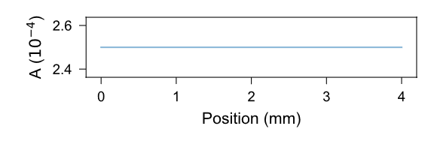
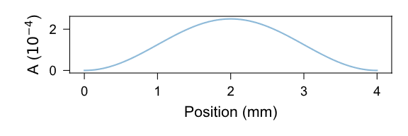
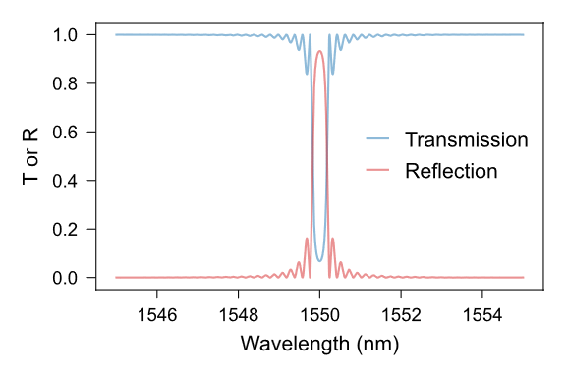
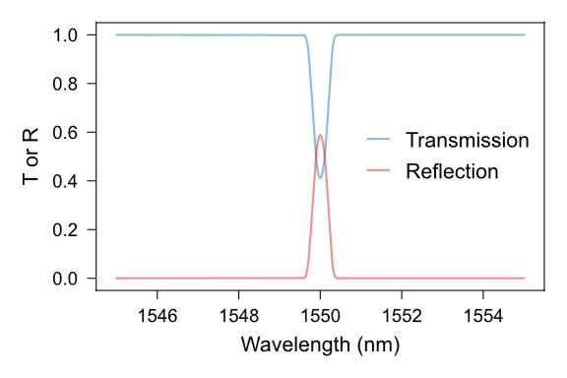
Numerical simulations: results (single grating)
Grating’s index perturbation: $δn_{eff}\left(z\right)=A\left(z\right)\cos\left(\frac{2π}{Λ\left(z\right)}z\right)$ with $A$ amplitude, $Λ$ period, $z$ position.
No apodization
Raised-cosine apodized
Apodization can effectively suppress sidelobe reflection from grating

Slide 27
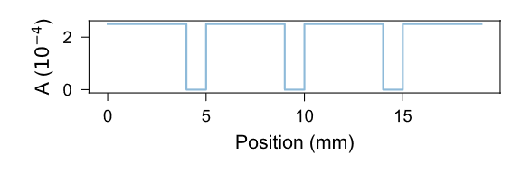
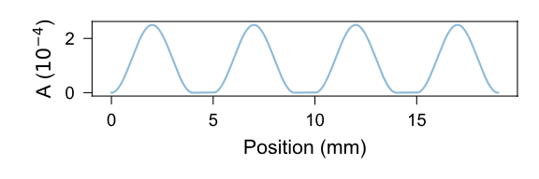
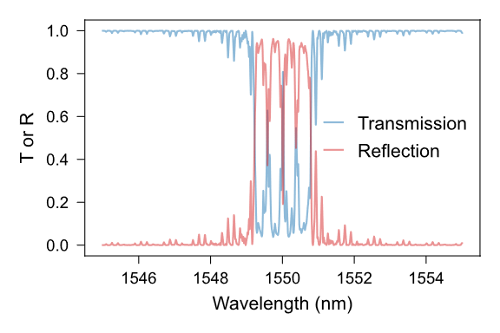
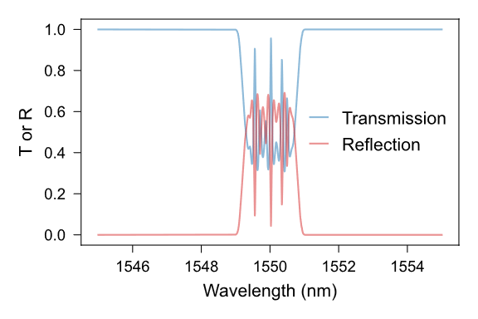
Numerical simulations: results (channel spacing 50 GHz)
Grating’s index perturbation: $δn_{eff}\left(z\right)=A\left(z\right)\cos\left(\frac{2π}{Λ\left(z\right)}z\right)$ with $A$ amplitude, $Λ$ period, $z$ position.
For 50 GHz channel spacing, the gratings have overlapped reflection spectra, leading to FP oscillation in the spectra
Apodization doesn’t help

Slide 28
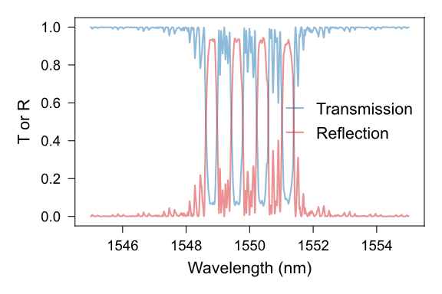
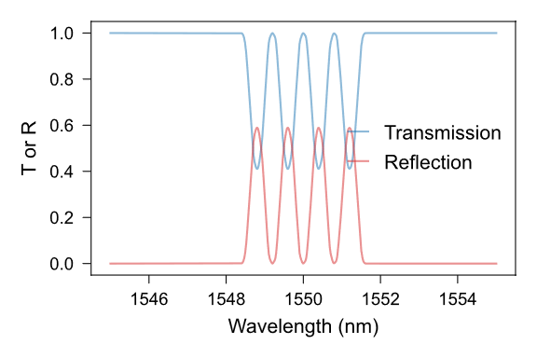
Numerical simulations: results (channel spacing 100 GHz)
Grating’s index perturbation: $δn_{eff}\left(z\right)=A\left(z\right)\cos\left(\frac{2π}{Λ\left(z\right)}z\right)$ with $A$ amplitude, $Λ$ period, $z$ position.
For 100 GHz channel spacing, the channel crossing is weak
When apodization is applied, we get ideal multi-wavelength reflection spectrum

