Slide 1
Irish Residential Property Price Register Analysis
Members
Snehal Deshmukh
Madhusudan Panwar
Akanksha Raut

Slide 2
Problem Statement
Ireland started residential property house price register in 2010
Addresses of houses sold
The price for which houses were sold
Comparing the house prices from 2010 to 2020 for a range of Irish towns and to generate some insightful visualisations to represent the analysis.

Slide 3
Data Cleaning
Extraction of town level data
Combining all files from 2010-2020
Eliminating duplicate entries

Slide 4
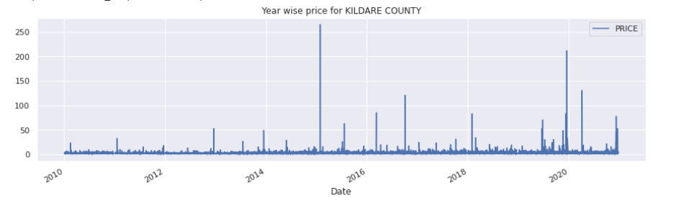
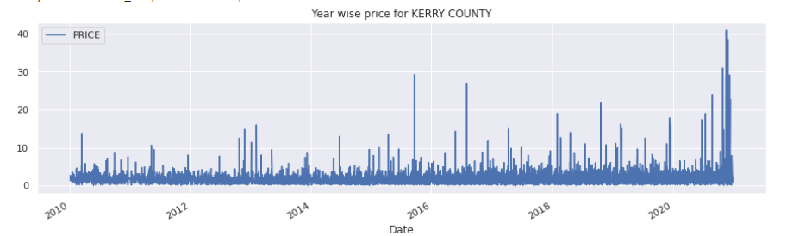
Year wise price for Kildare and Kerry

Slide 5
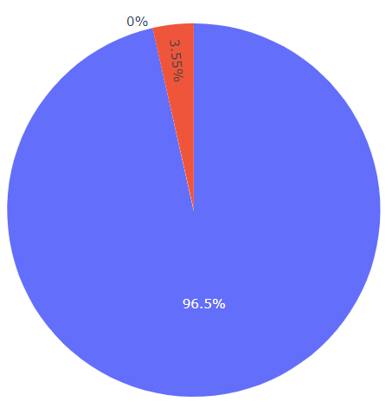
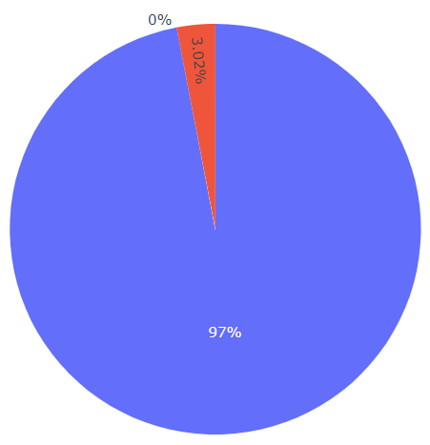

Percentage of costly houses out of all sold
Kildare
Kerry

Slide 6
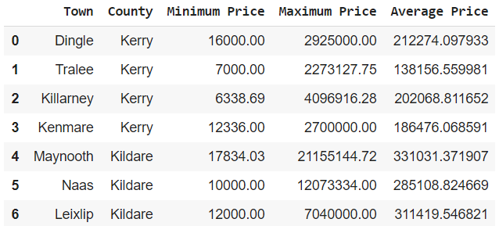
Minimum, Maximum and Average price for each town

Slide 7
Property type wise comparison

Slide 8
Comparative study of prices of all towns

Slide 9
Study of count of sales per year for each town
Study of sum of sales for all towns

Slide 10
Study of mean of sales for all towns

Slide 11
Overall comparison of mean selling price

Slide 12
Results
Price ranges are high for Kerry in the decade of 2010-2020
Kildare has more number of costly houses than Kerry in its price range
According to average selling prices, Maynooth most expensive town in Kildare and Dingle in Kerry
More number of houses are sold in Naas till 2020
Dingle and Killarney being most popular places in Kerry

