Slide 1




UrbanSpoon
Find Your Foody Way

Slide 2
About the project
UrbanSpoon is a restaurant review website that people can use to find and learn about restaurants in their area based on customer-specific conditions. Recently added, customers can also make online restaurant reservations through the UrbanSpoon system, though this feature is currently only available via mobile or iPad applications. As there are several other similar Web sites including Yelp, Open Table, Metro mix and Time Out, it is important for Urban spoon to monitor where it stands with users in the restaurant review market to take the appropriate actions to stay competitive. The usability of its Web site is one of the most important factors which affect its competitiveness.

Slide 3
Objective
Objective of the project is to develop a Web Application for an Online Restaurant finder website by which people new to the city or place will be able to find the best restaurant near him by viewing to the customer review
Recently added, customers can also make online restaurant reservations through the UrbanSpoon system
Users can also book their dining through the website if they are impressed customers review and the features provided at the website

Slide 4
Organization of the Project
In this project we have developed an Online Portal website names UrbanSpoon, which finds a way to choose best restaurant
It contains various web pages that are generated in real-time.
These pages use various Web technologies such as HTML, CSS, JS for form validations; Servlets as the business layer technologies; MySQL as the Database.

Slide 5
Abstract
In this urban spoon project we will show list of restaurants, from where a customer can choose to book a table or rate a restaurant.
User will be redirected to home page of our software from index page where user can choose to login or register.
User will be redirected to register page if user is new to software or can directly login using credentials stored in database stored from register page.
Through login we can be differentiate whether user is already signed up or not yet signed up or admin!
If user is admin, he will be shown options like manage bookings, manage users and logout.
Through manage bookings admin can accept or cancel customer’s bookings.
Through manage users admin can remove any customer’s account.

Slide 6
Abstract
If user is customer, he will be given options like MyBookings, Profile, rate a restaurant, book for a occasion in restaurant and logout .
Profile shows details of current user.
User can rate a restaurant from his previous experience in the form of stars.
User can book tables after filling the required details and check for status in MyBookings.

Slide 7
Modules
Index Page
Admin Login
Registration Page
User or customer Login
Home Page
Online Booking
Rate the restaurant
Manage Bookings
Manage Users
Logout

Slide 8
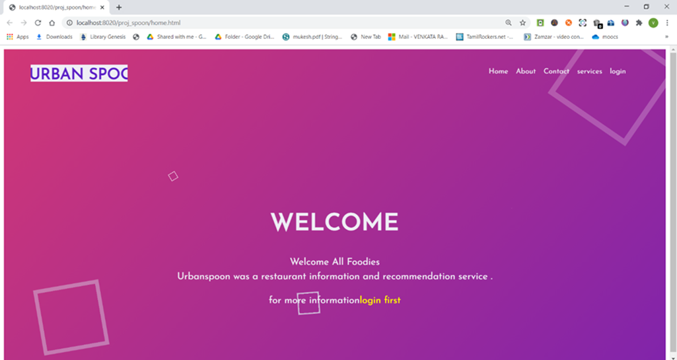
Module wise description
Index Page:
  On opening the project, the first module will be index page which has links which allows users, admin to login or register.
  It also gives additional buttons through home, about, contact, services, login.

Slide 9
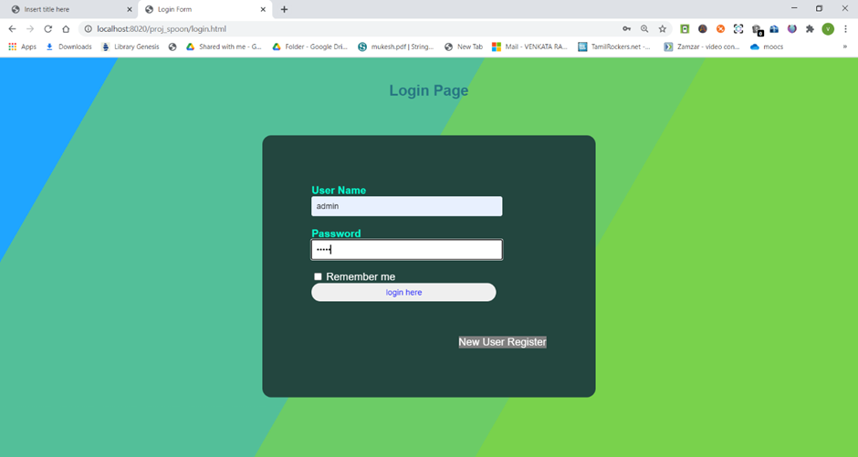
Module wise description
Admin Login:
  Our project will have an admin who will be able to details used for registration by the customer or user.
  Admin can update and delete the user information from database

Slide 10
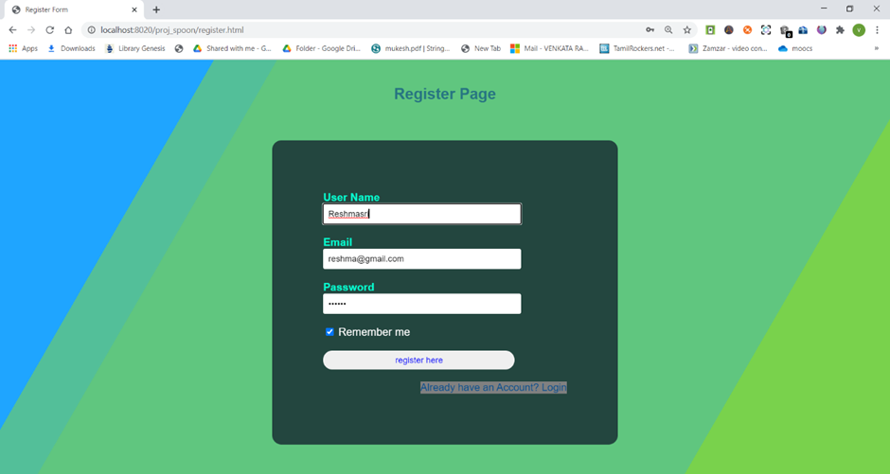
Module wise description
Registration Page:
  A customer or user can register into software only after registering by giving their username, email and password.
  These details will be stored into database directly after submission if it is without any errors.

Slide 11
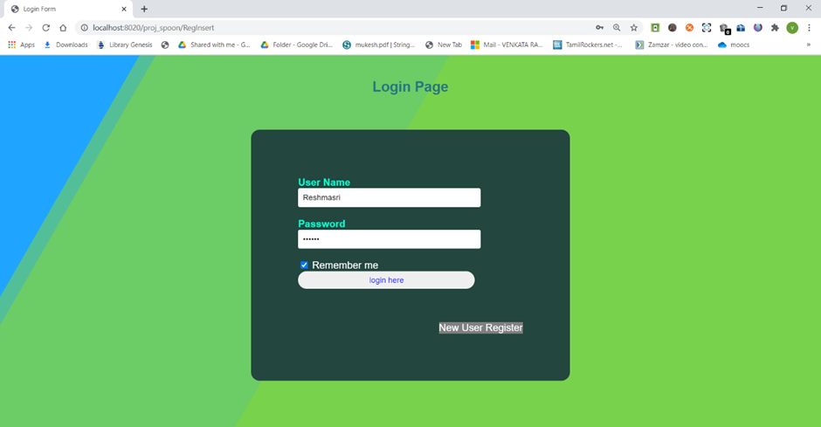
Module wise description
User or customer Login
  A particular user or customer can login into urban spoon if and only if already registered into urban spoon
  Login credentials username, password should match with those stored in database while registration.

Slide 12
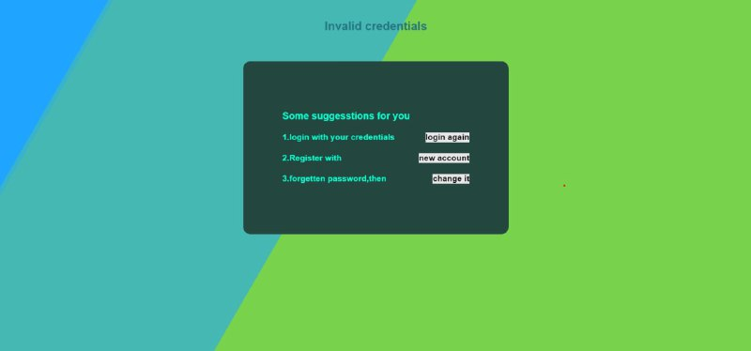
Error Page
If login credentials are given wrong, user will be given three options i.e, login again, register and forgot password.

Slide 13
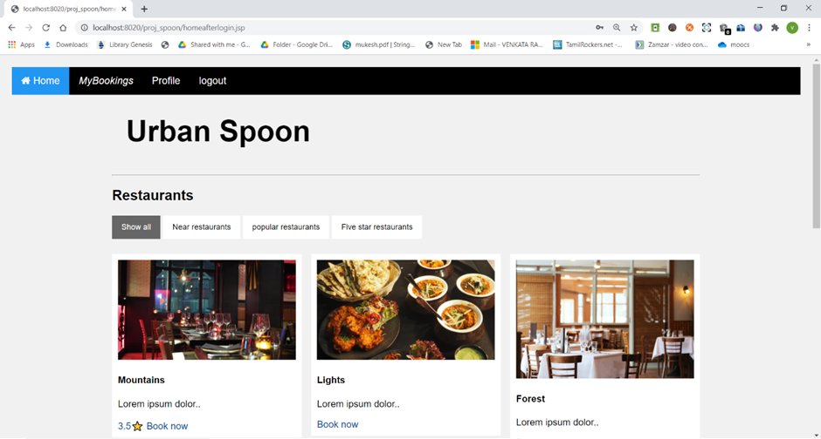
Module wise description
Home Page
  After login, here comes home page which shows restaurants in different locations and shows a option which allows user to know more about it
  It also allows users to reserve tables.

Slide 14
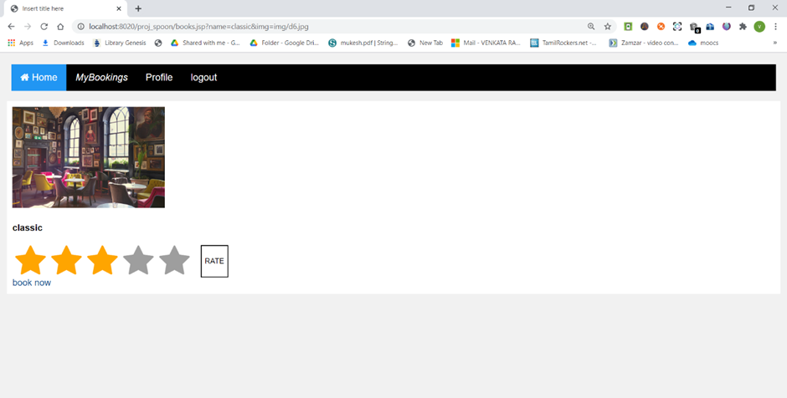
Module wise description
Online Booking
  User/Customer will be doing pre-booking if they want to reserve through urban spoon.
  User will be able to pre-book the place without payment.
  User information will be stored in database.

Slide 15

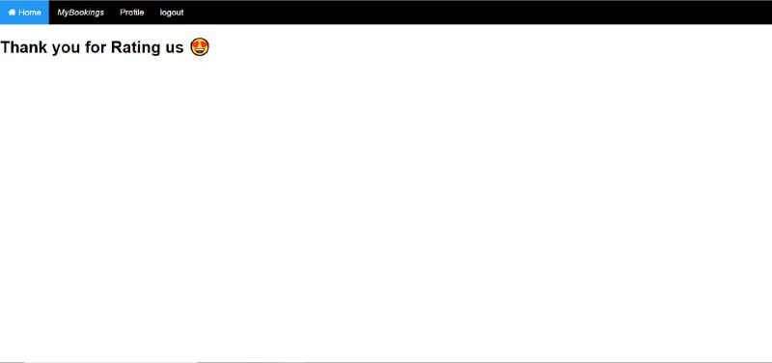
Module wise description
Rating Process
First time rating

Slide 16

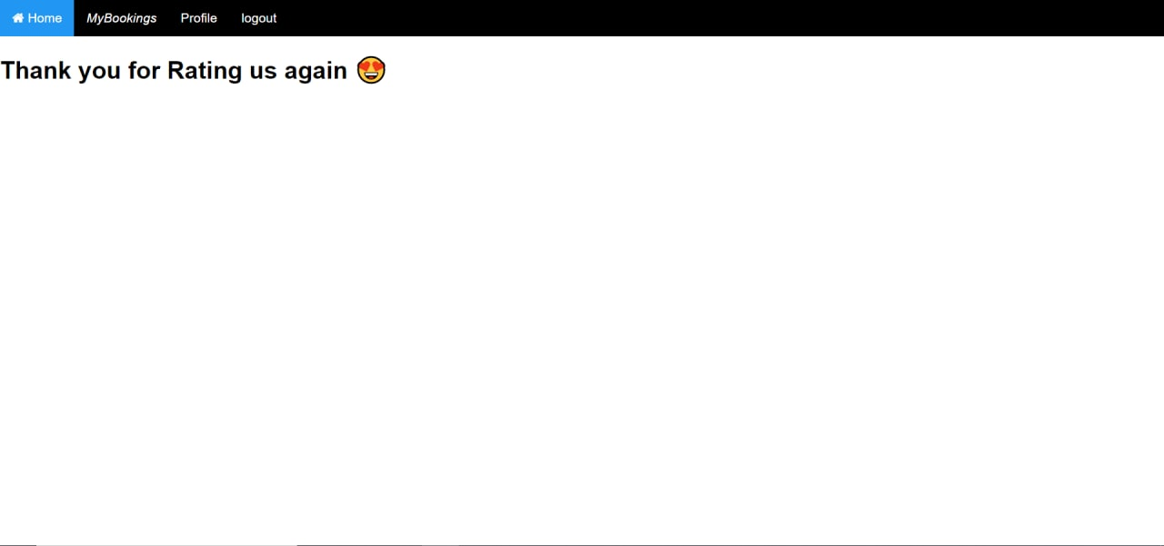
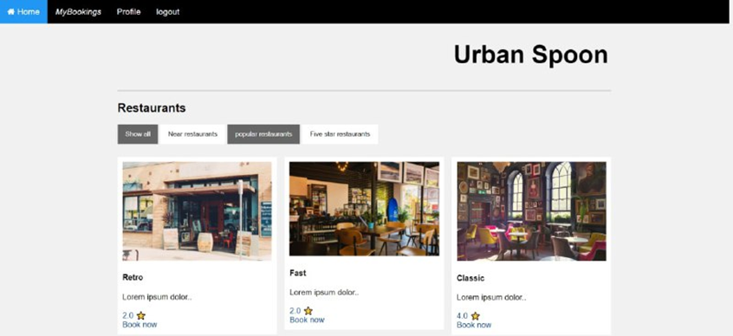
Rating Process
Updation of rating
After giving rating again, previous rating value will be updated.
Rating will be updated and displayed on home page

Slide 17
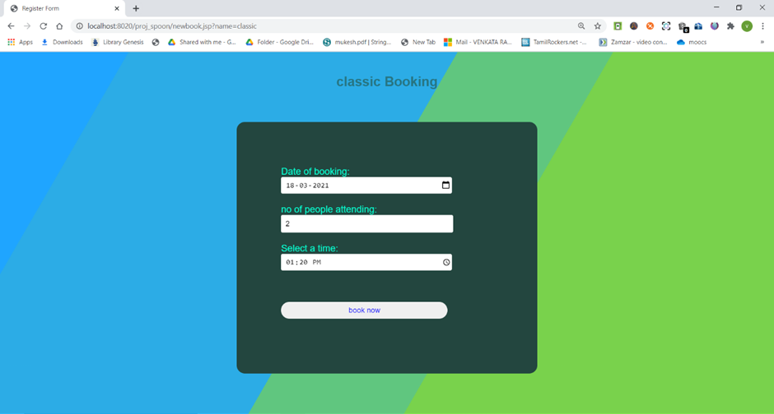
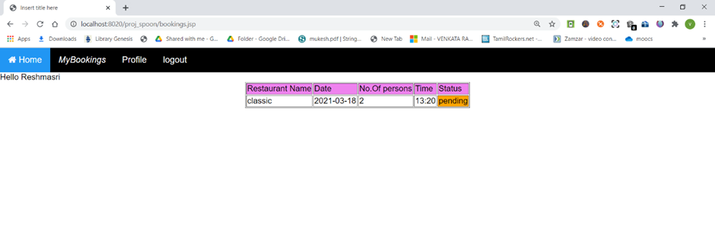
Booking process
Step-1: Click in book now
Step-2: Fill the required fields
Step-3: Check the status of booking in “MyBookings”

Slide 18
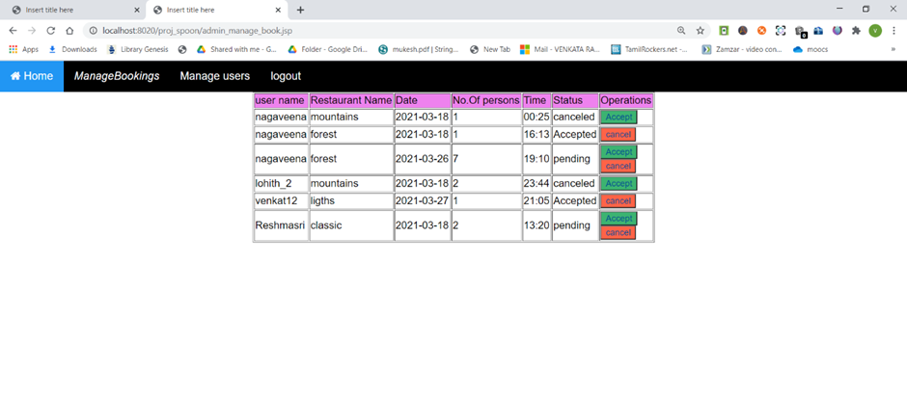
Module wise description
Manage Bookings:
  This module will be only available for admin who will login through admin portal
  Admin will have all the details of booking like username, restaurant name, date, number of persons, time, access to accept or cancel users booking .

Slide 19
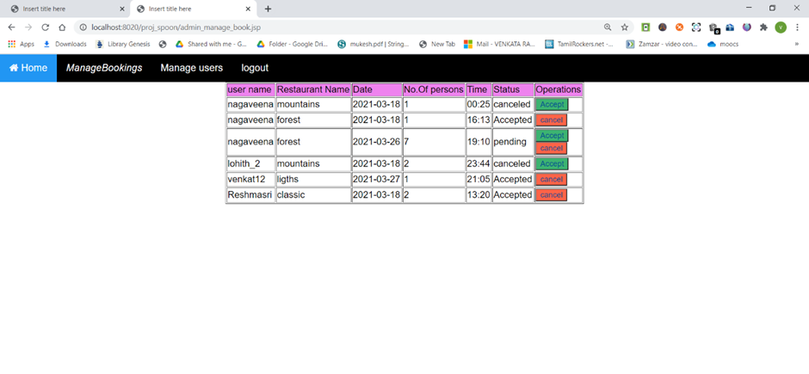
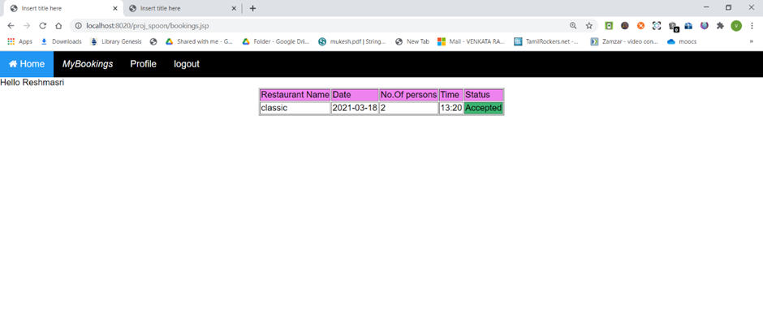
Example: On clicking accept on Reshmasri’s booking,

Slide 20
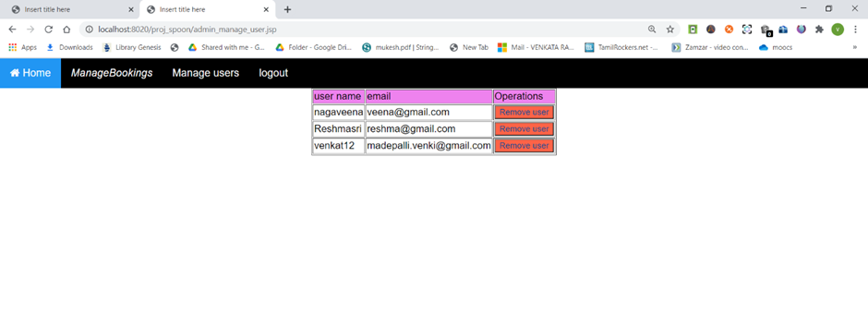
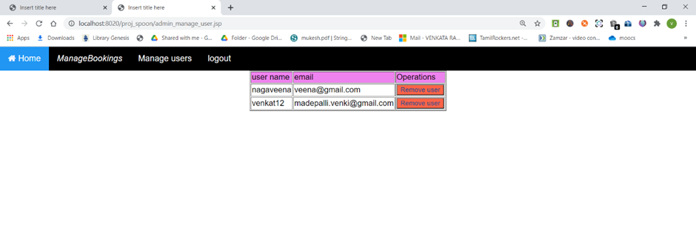
Module wise description
Manage Users:
  Only admin will be able to access this module.
  Here admin has access to remove a user/customer.

Slide 21

Module wise description
Logout:
  Both users, admins have this option where after clicking it user will be redirected to index page.

Slide 22
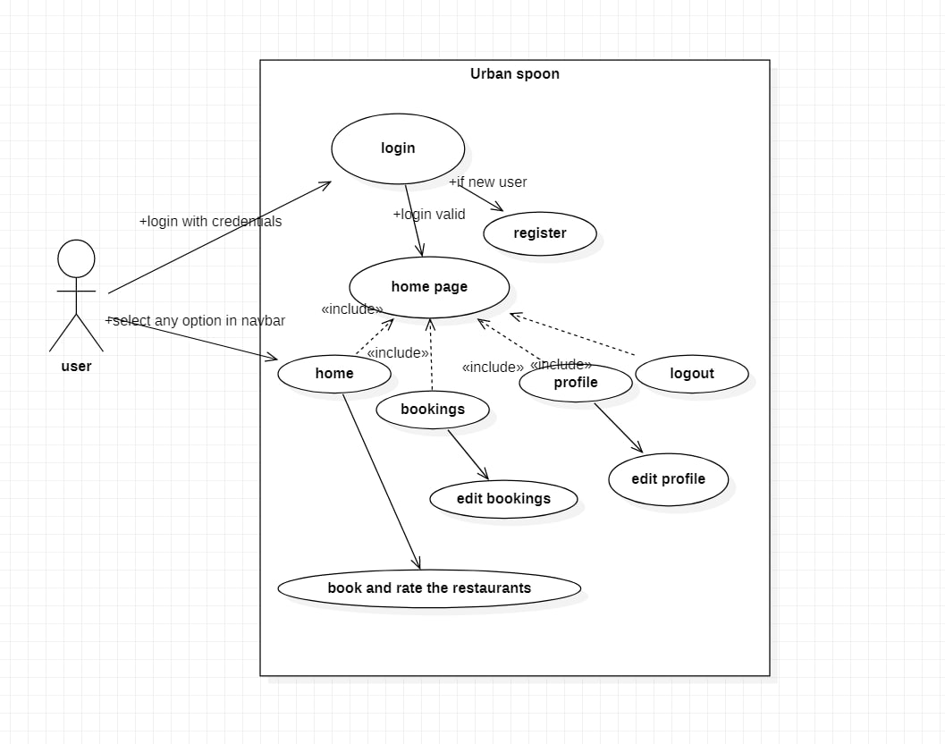
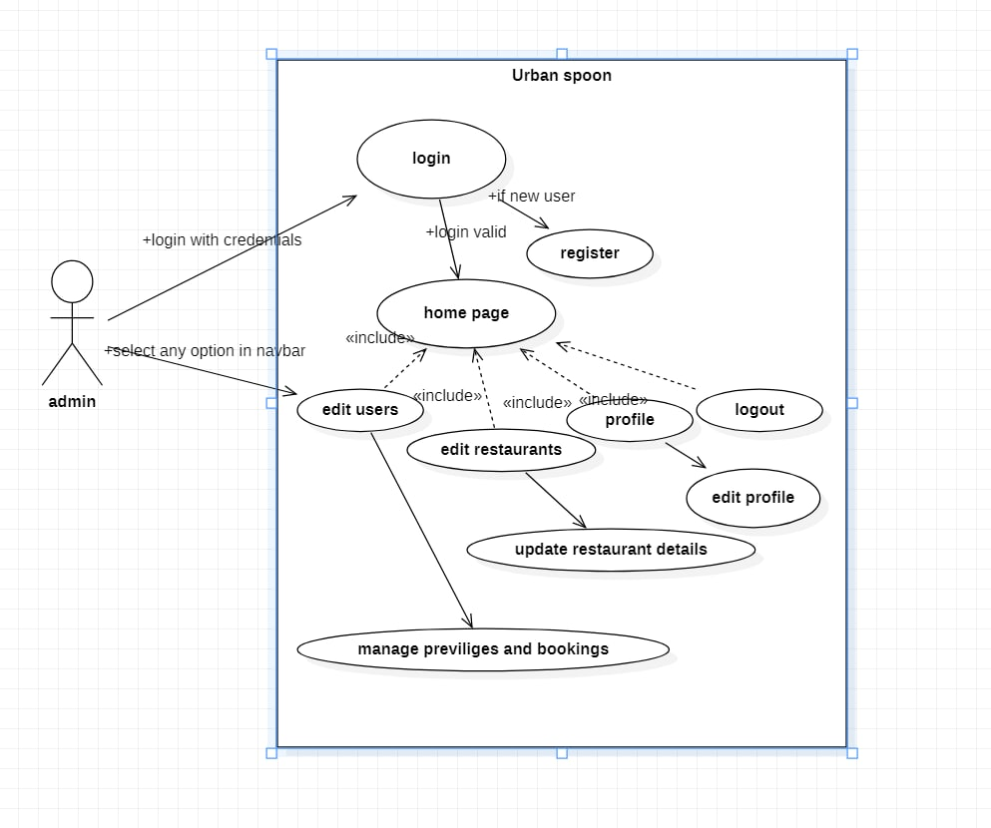
Usecase diagram

Slide 23
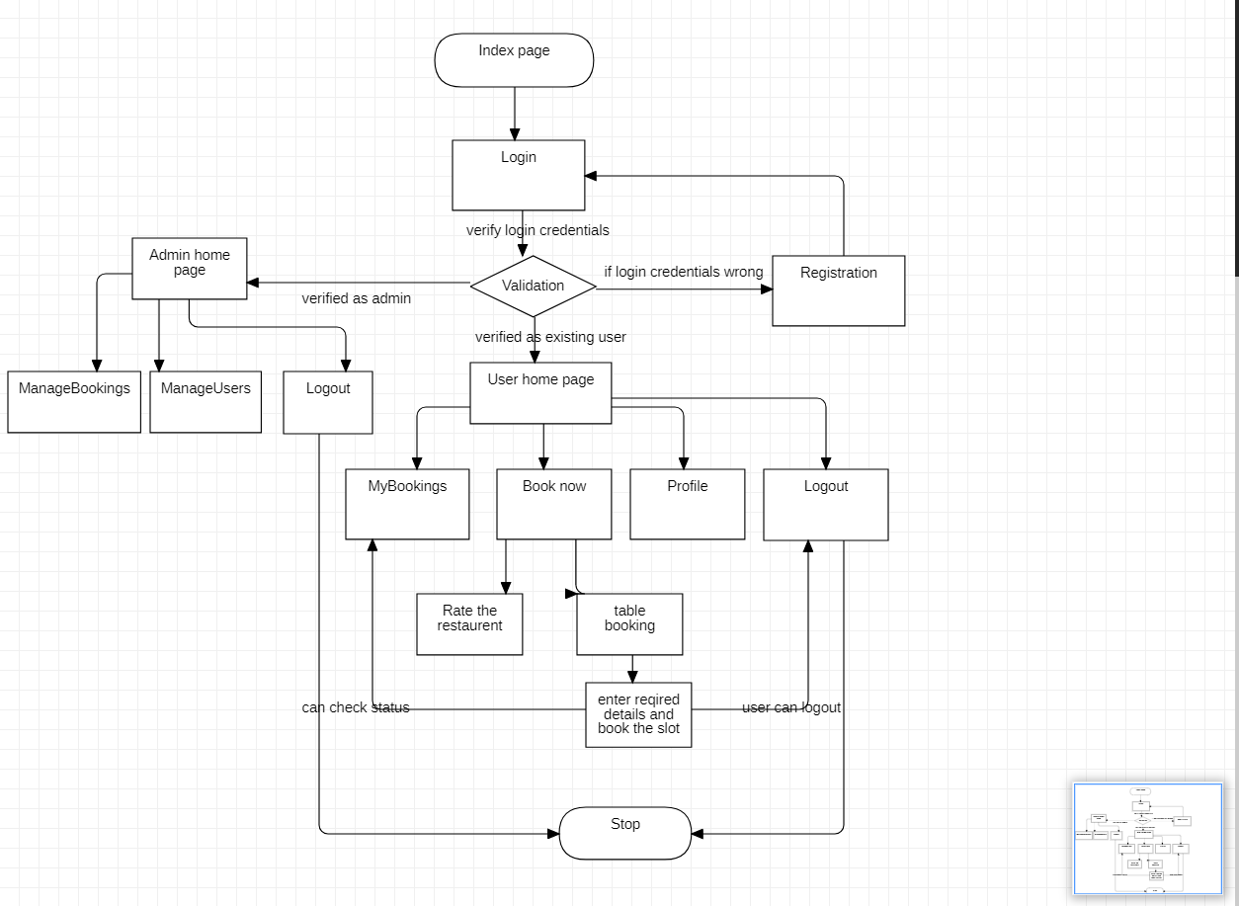
Flow Diagram

Slide 24
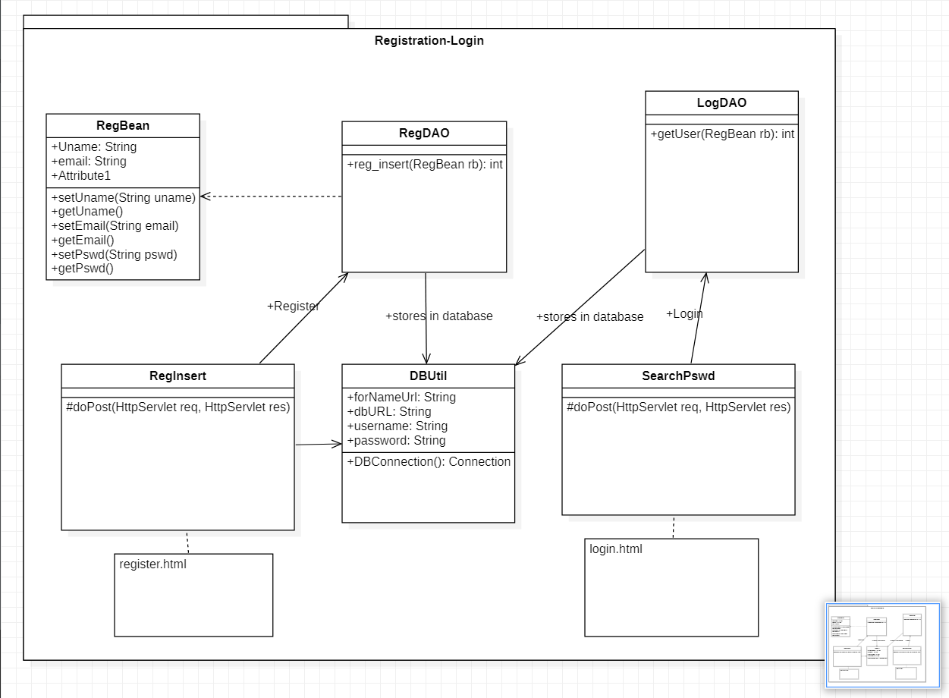
Class Diagram

Slide 25
Testing approach
Module number | Name | Input | Expected output | Actual Output | Status
M-01 | Registration | We give username as “nagaveena”, email as “veena@gmail.com”, password as “123456” | Redirect to login page | Takes us to login page | Pass
M-02 | Login | We give username as “nagaveena”, password as “123456” | Redirects to home page | Redirects to home page | Pass
M-02 | Login | We give username as “Reshmasri”, password “reshma@12” | Redirects to home page | Shows error as it is not stored in database and redirects to error page | Fail
M-04 | Booking | Click on book now | Classic booking page opens and user has to fill details | Classic booking page opens | Pass
M-05 | Booking slot | We give date as “19-04-2021”, no’of persons “5” and time as “01:16AM” | We come to home page | We redirect to home page and can check our bookings in MyBookings | Pass

Slide 26
Deployment
GitHub Account: https://github.com/nagaveena02/Urban_spoon
Database service: MySQL database
IDE : eclipse
Software used for diagrams: StarUML

Slide 27
Team Members
L Naga Veena – Front End and Back End
M Venkata Ramana – Bussiness Logic
L ReshmaSree – Front End and Back End

Slide 28


