Slide 1
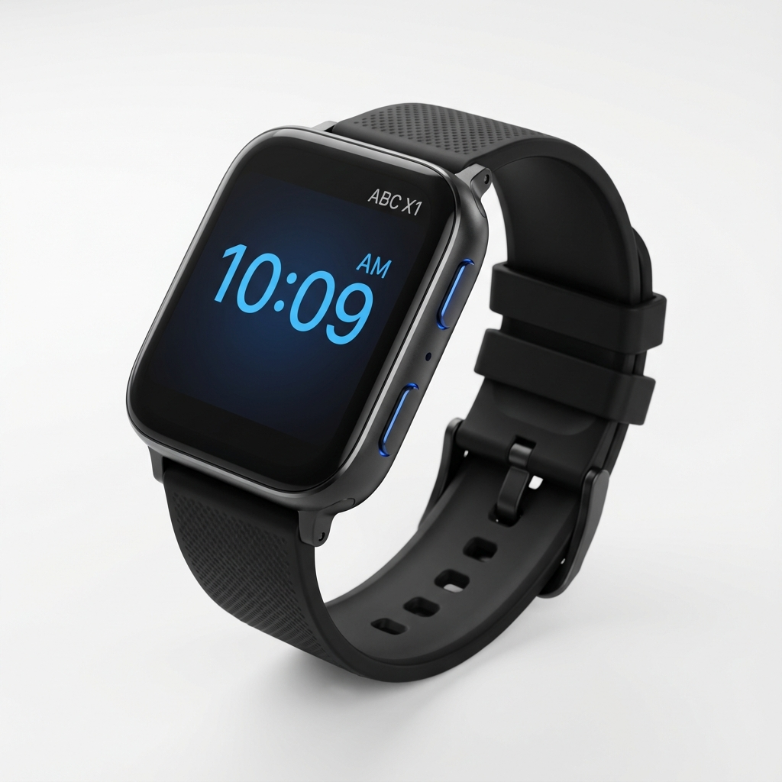
ABC X1 Smartwatch Sentiment Analyzer

Slide 2
Group Members & Project Information
Project: ABC X1 Smartwatch Review Analysis
Technology Stack:
• Python, Flask, BERT Transformers
• PyTorch, Hugging Face
Developed for:
ABC Company ML Initiative

Slide 3
Problem Statement & Objectives
Problem Statement:
• Manual analysis of 6,000+ customer reviews is time-consuming
• Need to quickly identify customer satisfaction patterns
• ABC X1 Smartwatch requires data-driven product insights
Objectives:
• Build automated sentiment analysis system
• Classify reviews: Positive / Neutral / Negative
• Deploy as user-friendly web application
• Achieve high accuracy using state-of-the-art NLP models

Slide 4
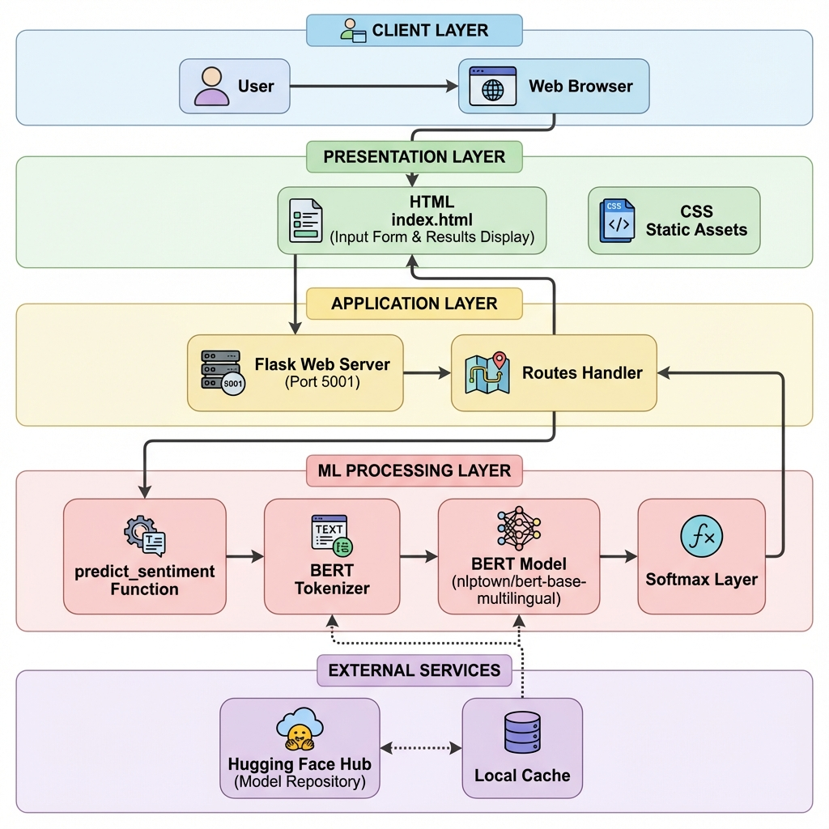
Solution: Pre-trained BERT Transformer Model
Workflow:
1. Data Collection & Preparation (6,000+ reviews)
2. Exploratory Data Analysis
3. Model Selection (Classical ML vs. BERT)
4. BERT Model Integration
5. Flask Web Application Deployment
6. Testing & Validation
Proposed Solution & System Architecture

Slide 5
Dataset & Methodology
Dataset:
• smart_watch_review.csv (6,000+ reviews)
• Star ratings (1-5) mapped to sentiments
• Cleaned and preprocessed data
Methodology:
Phase 1: Classical ML Models
→ Logistic Regression, Random Forest, SVM, etc.
→ Result: <50% accuracy
Phase 2: Pre-trained BERT Transformer
→ nlptown/bert-base-multilingual-uncased-sentiment
→ Result: High accuracy

Slide 6
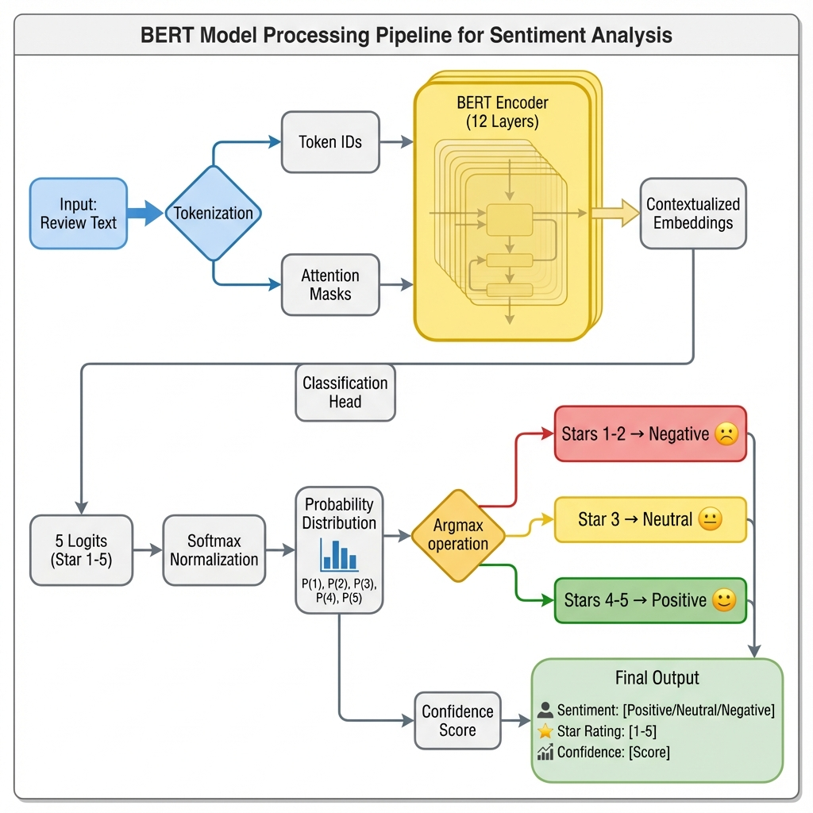
Machine Learning:
• Hugging Face Transformers (BERT)
• PyTorch (Deep Learning Framework)
• Scikit-learn (Evaluation Metrics)
Web Development:
• Flask (Python Web Framework)
• HTML/CSS (Frontend UI)
Data Processing:
• Pandas, NumPy (Data manipulation)
Technologies & Model Pipeline

Slide 7
Results & Findings
Model Performance:
• BERT Model: High accuracy on sentiment classification
• Successfully predicts Positive/Neutral/Negative
• Provides confidence scores for predictions
Verified Test Cases:
• "Worst watch ever" → Negative
• "It is okay, average" → Neutral
• "Amazing watch, love it!" → Positive
Key Insights:
• BERT outperforms classical ML models significantly
• Pre-trained models eliminate need for feature engineering
• Transfer learning is crucial for NLP tasks

Slide 8
Conclusion & Future Scope
Conclusion:
• Successfully built sentiment analysis system using BERT
• Deployed as Flask web application with professional UI
• Provides actionable insights from customer reviews
• Demonstrated superiority of transformers over classical ML
Future Scope:
• Aspect-based sentiment analysis (battery, display, features)
• Multi-language support expansion
• Real-time dashboard for review monitoring
• Integration with customer support systems
• Mobile application deployment

