Slide 1

RISE KRISHNA SAI PRAKASAM GROUP OF INSTITUTIONS (Approved by AICTE-NEW DELHI, Affiliated to JNTUK KAKINADA) (An ISO 9001:2015 certified Institute, NBA accredited for B.Tech. in CSE, ECE, EEE, CE & ME) NH-16, Valluru,-523272, Ongole, Prakasam District, A.P
Internship Presentation on
SOLAR PV PLANT DESIGN
Under the guidance of Presented by:
Mr. S. KRANTHI KUMAR M. Tech, M.I.S.T.I.E. PALEPU NEERAJA
Assistant Professor 218A1A0214

Slide 2
Contents
Introduction
Components of Solar PV Plant
Working Principle
Types of Solar Panel
Site Selection Criteria
Plant Design steps
Advantages
Certificate
Conclusion

Slide 3
Introduction
Solar photovoltaic (PV) plant design involves planning and creating a system that converts sunlight into electricity using solar panels. It is a crucial step in setting up solar power systems for homes, industries, or large-scale solar farms.
The design process includes selecting the right location, calculating the energy needs, choosing appropriate solar panels and inverters, and planning the layout for optimal performance. Factors like sunlight availability, shadow analysis, tilt angle, wiring, and safety standards are carefully considered.

Slide 4
Components of Solar PV Plant
Solar Panels (PV Modules)
Inverter
Mounting Structures
Charge Controller
Battery Bank
Combiner Box
DC and AC Cables
Junction Box
Monitoring System
Grounding and Lightning Protection
Metering System

Slide 5
Working Principle
The working principle of a solar PV plant is based on the photovoltaic effect, where sunlight is converted directly into electricity using solar panels. When sunlight (photons) falls on the solar cells in the panels, it generates direct current (DC) electricity. This DC power is then sent to an inverter, which converts it into alternating current (AC) suitable for use in homes, industries, or for feeding into the grid. In off-grid or hybrid systems, a charge controller regulates power to charge the battery bank, storing energy for later use. The system includes protective devices, monitoring equipment, and proper grounding to ensure safe and efficient operation, delivering clean and renewable energy.

Slide 6
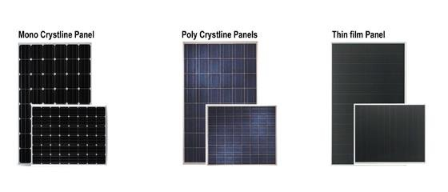
Types of Solar PV panels

Slide 7
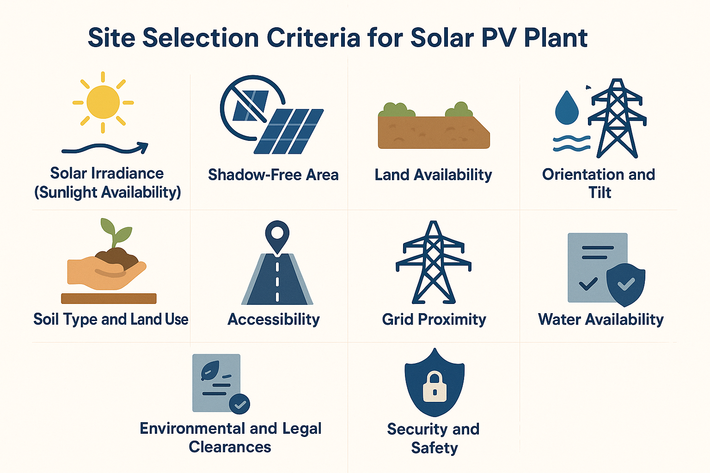

Slide 8
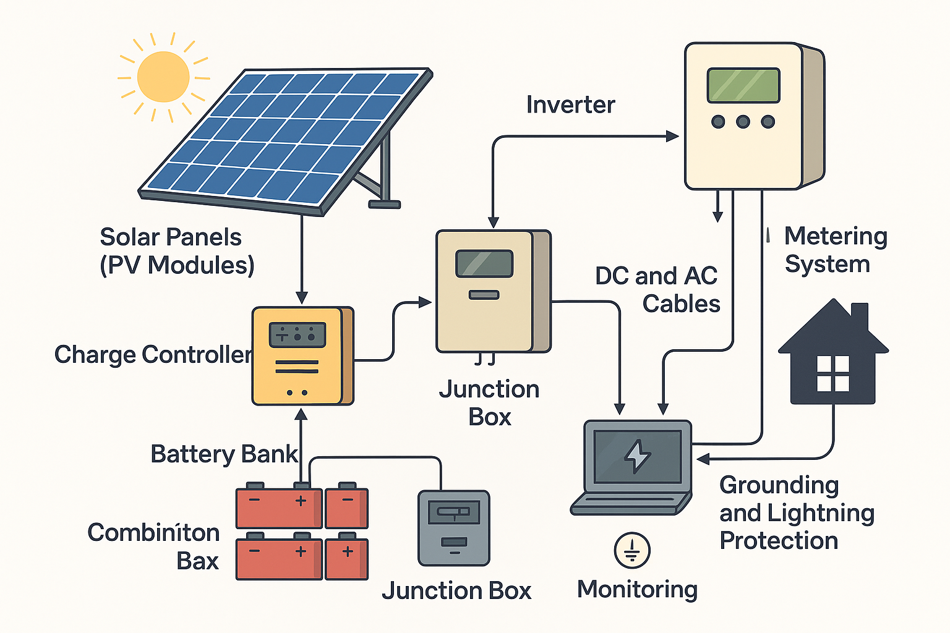
Plant Design steps

Slide 9
Advantages
Low Operating Costs.
Reduces Electricity Bills
Long Lifespan
Scalable Design.
Environmentally Friendly
Energy Independence

Slide 10
Conclusion
Solar PV plant design is a highly efficient and sustainable way to harness solar energy, contributing to cleaner environments and reducing dependence on traditional energy sources. By carefully considering factors like site selection, component choice, and system configuration, a well-designed solar PV plant can provide reliable, cost-effective, and long-term energy solutions. As technology advances, the benefits of solar power continue to grow, making it a key player in the future of global energy production.

Slide 11
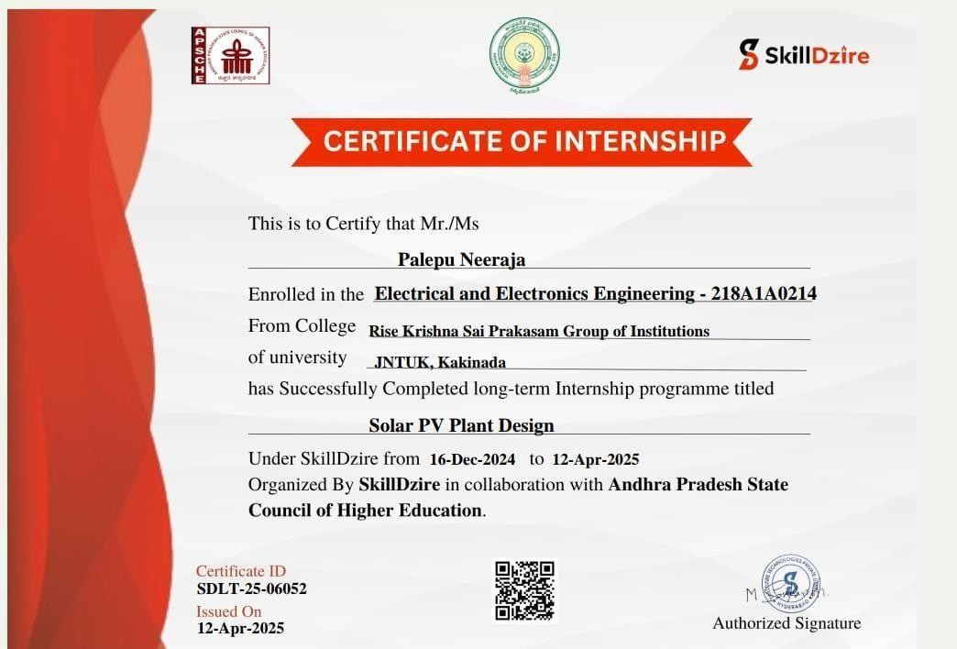

Slide 12


