Slide 1
IoTArM0r
Automatic IoT Device Scanner and Vulnerability Detector for Internet of Things Device
Submitted by
Tejaswi Kanneganti(U00871526)
Sadhvi Mandha(U00873887)
Naga Venkat Allu(U00878572)

Slide 2
Content
Introduction
Problem
Technique
Structural Design
Progress
Related work
Contribution
Demonstration
Feedback from proposal

Slide 3
Introduction
IoTArM0r is a powerful tool designed to automate the detection of IOT devices on a network, detecting vulnerabilities and providing a mitigation for them. It can scan IoT devices over exposed internet for common vulnerabilities such as Unsecure communication, Insufficient authentication and password hygiene, Insecure networks.
In addition, IoTArM0r can enumerate open ports, discover devices over local network, get server information, and detect device misconfigurations and exposed credentials. It also offers Docker support and integrated with internet surface.
IoTArM0r generates a detailed scan report after execution, allowing users to view and analyze the results and take appropriate action to mitigate any vulnerabilities detected.
With IoTArM0r, you can easily secure your online presence of IoT devices and protect your organization from cyber threats.
Tech Stack used : Python, Docker

Slide 4
Problem
The security issues that are becoming an increasing problem as the use of IoT devices grows at a never-before-seen pace. As more people rely on IoT devices for essential tasks like turning on lights in their homes and running industrial machinery, it is imperative that their security is not compromised.
The idea for this project was inspired by the critical need to create a tool that accurately pinpoints flaws in IoT devices and provides usable mitigation techniques.

Slide 5
Technique
Network scanning: The tool will use port scanning and packet sniffing techniques like nmap to identify IoT devices on the network.
Vulnerability scanning: The tool will use IoT scanners like Shodan and Censys to identify known vulnerabilities in the identified IoT devices.
Password cracking: The tool will attempt to crack device passwords using dictionary and brute-force attacks with hydra to test the strength of passwords.
Vulnerability exploitation: The tool will confirm the presence of vulnerabilities by exploiting them and assessing their impact.
Report generation: Finally, the tool will generate a report that summarizes the vulnerabilities found and the mitigation recommendations provided.

Slide 6
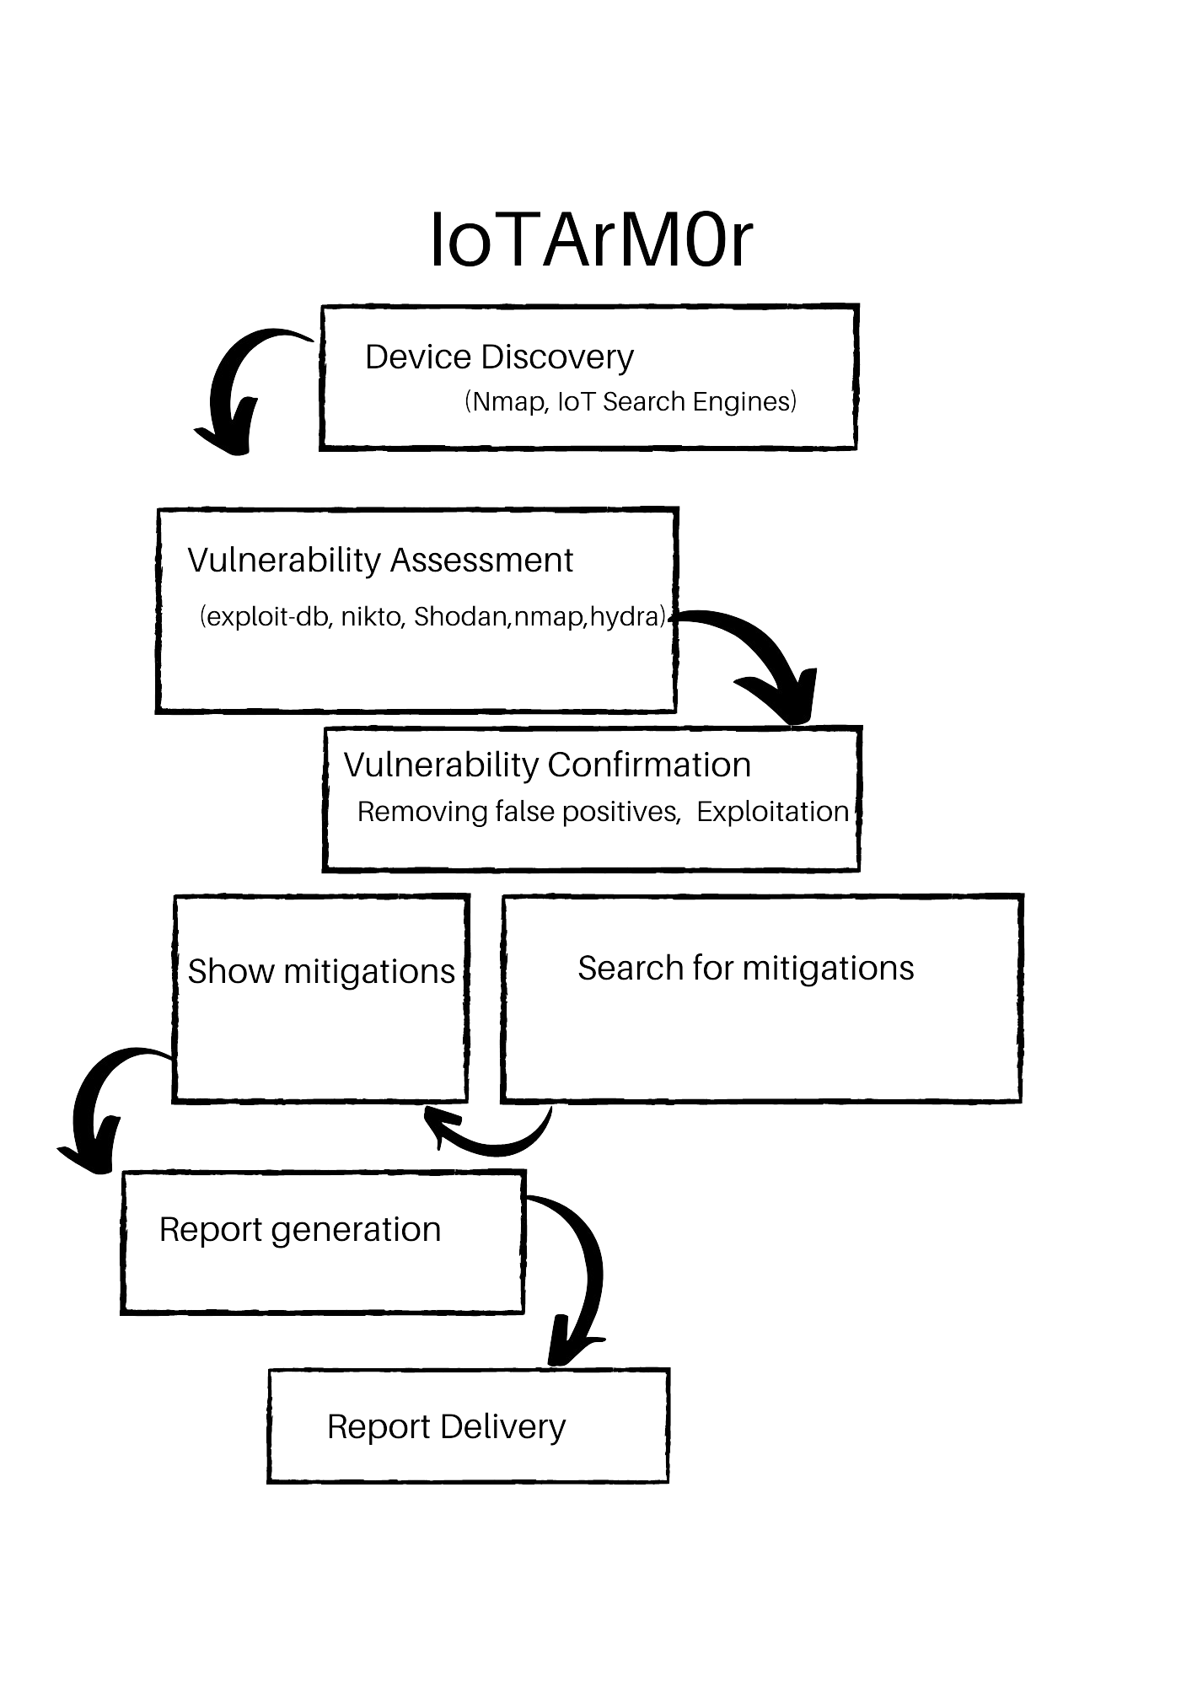
Structural Design

Slide 7
Progress
Discovered the basic tools that can be used in the tool.
Designed the control flow of the tool.
Developed the python module for integrating the nmap scanning to the tool.
Developed the code for vulnerabilities scans using the Censys Certificates,CensysIPv4 search,Zoomeye scan,Onyphe scan and Shodan scan.
Github link:- https://github.com/nagavenkatallu/IoTArM0r

Slide 8
Related Work
1)Mirza Abdur Razzaq, Sajid Habib Gill, Muhammad Ali Qureshi, and Saleem Ullah. Security Issues in the Internet of Things (IoT): A Comprehensive Study. International Journal of Advanced Computer Science and Applications (IJACSA), Vol. 8, No. 6, pp. 383-388, 2017.
The main emphasis of this paper was to highlight major security issues of IoT particularly, focusing the security attacks and their countermeasures.
2)M. Abomhara and G. M. Køien, “Security and privacy in the internet of things: Current status and open issues,” in Privacy and Security in Mobile Systems (PRISMS), International Conference on. IEEE, 2014, pp.1–8.
The main goal of this paper was to provide an explicit survey of the most important aspects of IoT with particular focus on the vision and security challenges involved in the Internet of Things.
Based on these papers the identification and resolving the security challenges in IOT devices is very vital. So, we are designing a tool which launches various scans on the IOT devices and try to exploit the vulnerabilities and provide us a report which may be used to provide mitigations to the end user of the device.

Slide 9
Contribution
All three of us were involved in the discussions on the basic discovery and structural design of the tool.
Venkat and Tejaswi has identified the python libraries for the various scanning tools(nmap,shodan,censys,zoomeye,etc..,)
Tejaswi and Sadhvi written code for performing the nmap scans and Censys Certificates,CensysIPv4 search
Venkat and Sadhvi developed the code for the Zoomeye scan,Onyphe scan and Shodan scan.

Slide 10
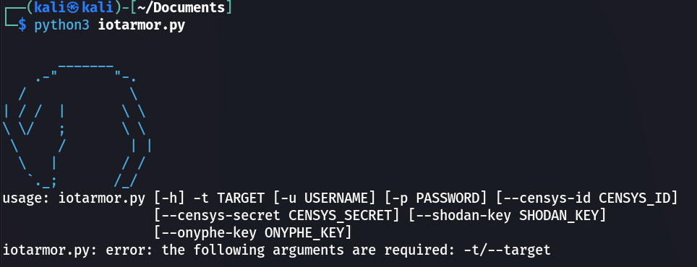
Demonstration

Slide 11
Feedback from Proposal
What type of tools that we are testing? We are testing the Security and activity trackers like home security cameras.
Are you developing a new IOT vulnerability scanner or using the existing? We are developing new IOT vulnerability scanner using the existing scanning methods(nmap,shodan,censys,zoomeye).

