Slide 1

SOCCER DATABASE PROJECT Database CIS8040 Fall 2017 Group Project

Slide 2
Outline
Introduction
Scope of Data
Data extraction
Logical model and table implementation
SQL queries and results
Unstructured Data extraction and analysis
Data visualization using Tableau

Slide 3
Introduction
Popularly known as 'The beautiful game', soccer is widely played throughout the world and many countries list soccer as its number one sport.
Anyone can play it anywhere and with anyone

Slide 4
Objective of the Project
To integrate data from multiple sources and design a well organized relational database for soccer and its various entities.
Reason for choosing this project:
To gain valuable insights from this data and find correlations between various factors affecting match outcomes and player performances.

Slide 5
Scope of data
League : La Liga & English Premier League (EPL)
Seasons : 2015-16 & 2016-17
Teams : 20 teams (tell about home team and away team)
Stadiums : European stadiums (since leagues are European)

Slide 6
Data Extraction
ESPNFC : espnfc.us
Worldfootball API: http://football-api.com/plans/world-football/
Stadium Data: StadiumDB.com
Data extracted using python from HTML source code
Data of 1520 matches, 54,000 Player scores, 1145 player, 1331 Stadium extracted.

Slide 7
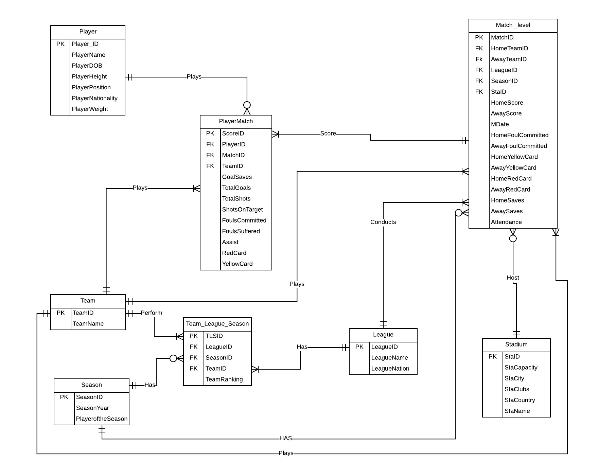
Entity Relation Diagram

Slide 8
Assumptions
A match is played between two teams in a league for every season
Team plays against another team. One is home team and other is away team. Data of match details are in Match_level table
A team can be a part of only one league but can play in multiple seasons
Stadium can host multiple matches, but a match is only played in one stadium. Some stadiums will not have any match
Player_Match table tells us about the performance of the players in a particular match
Player plays many matches. Some players might not play even a single match

Slide 9
Normalization
1NF
HTML data converted to columnar format. Primary keys such as PlayerID and MatchID identified.
2NF
All the partial dependencies removed from 1NF data to convert in 2NF form.
3NF
Transitive dependency checks done for all entities which were part of the DB design.

Slide 10
Results of SQL Queries

Slide 11
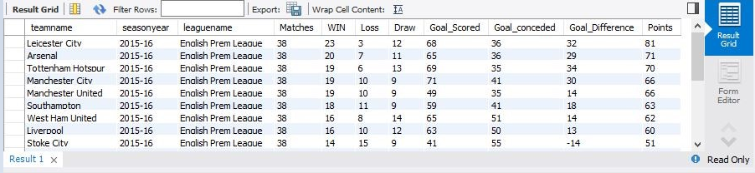
The Best of the Best !!
Using match-team-season data the season team standings can be directly found, instead of storing data in a separate table.

Slide 12

Who scored the most goals?
Lionel Messi
Cristiano Ronaldo
Luis Suarez.
Any guesses?

Slide 13
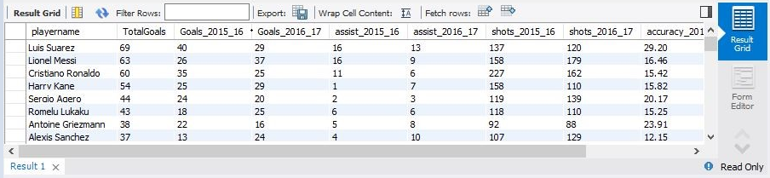
The Best Guy on the Field !!
Using player-match tables we can find the player who had the best season.

Slide 14
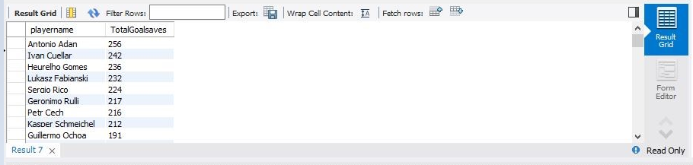
The Best Goalkeeper !!
Using player-match tables we can find the best goalkeeper.

Slide 15
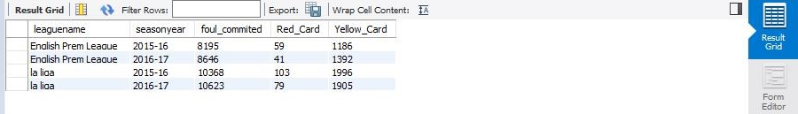
Foul Play !!
The match, season, league tables help us to point out the league in which most fouls are committed.

Slide 16
Unstructured Data Extraction And Analysis

Slide 17
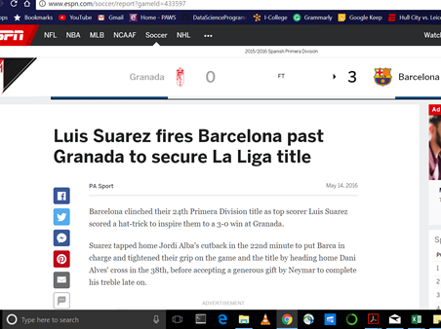
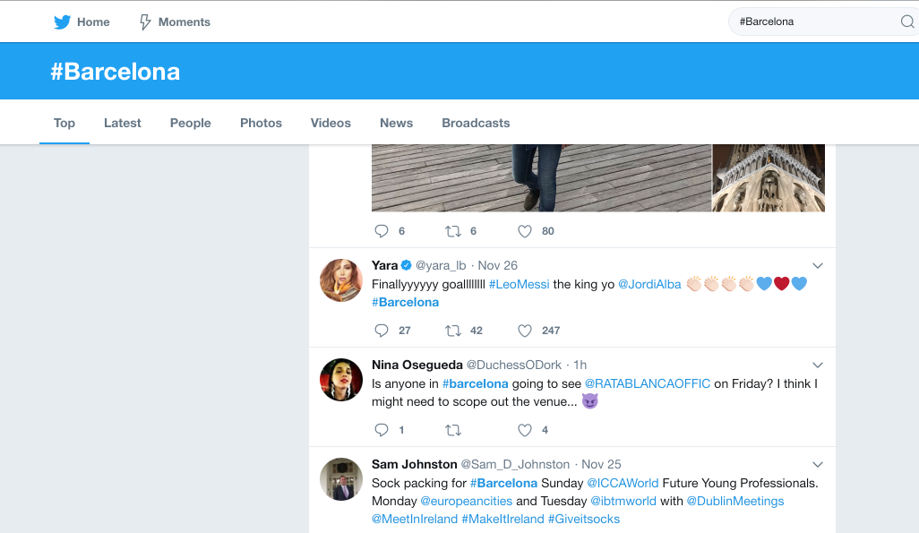
Unstructured Data

Slide 18
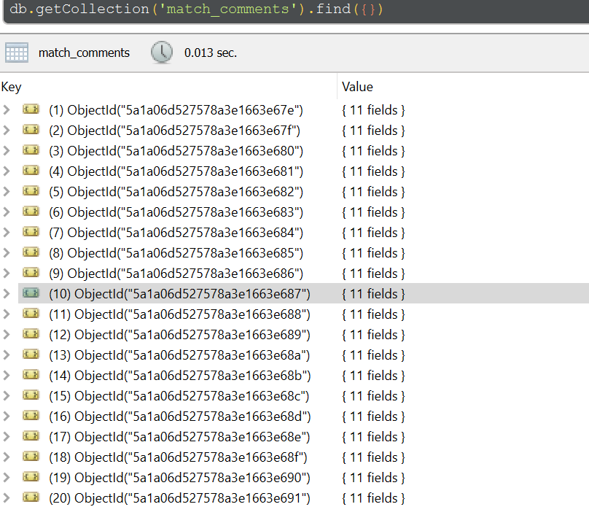
Mongo DB
MONGO DB was used for doing analysis on unstructured part.
1000+ news reports were loaded and queries were executed.

Slide 19
News Report Analysis in MongoDB
AIM | Analysis
To find which player from FC Barcelona is featured more in news reports. | There are around 78 reports about team Barcelona. Out of those 78 reports, there is only one report about Rafinha. There are 15 reports about Neymar. There are 39 reports about Messi Thus, we can say that Messi is most popular player as he has been covered more in news report.
To find number of matches played in LaLiga and EPL that resulted in home team winning and the number of matches that resulted in a draw. | We found that 25% and 23% of the total matches ended up in a draw in EPL and LaLiga respectively. Almost 47% and 45% of the teams won the match in their home ground in LaLiga and EPL respectively. So Chances of home team winning is more.

Slide 20
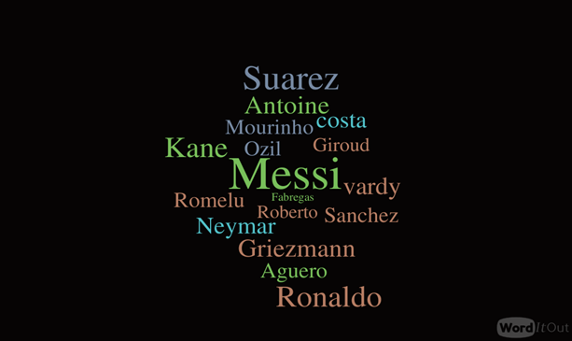
Media Coverage of Players

Slide 21
Unstructured Data Analysis using Python
Teams | Negative | Neutral | Positive | Grand Total | Neg% | Net% | Pos%
Manchester City | 1 | 1 | 179 | 181 | 1% | 1% | 99%
Manchester United | 2 | 5 | 274 | 281 | 1% | 2% | 98%
FC Barcelona | 2 | 8 | 204 | 214 | 1% | 4% | 95%
Atletico Madrid | 1 | 3 | 66 | 70 | 1% | 4% | 94%
Leicester City |  | 10 | 158 | 168 | 0% | 6% | 94%
Arsenal | 5 | 56 | 763 | 824 | 1% | 7% | 93%
Real Madrid | 17 | 29 | 269 | 315 | 5% | 9% | 85%
Espanyol |  | 3 | 17 | 20 | 0% | 15% | 85%
Chelsea | 79 | 70 | 704 | 853 | 9% | 8% | 83%

Slide 22
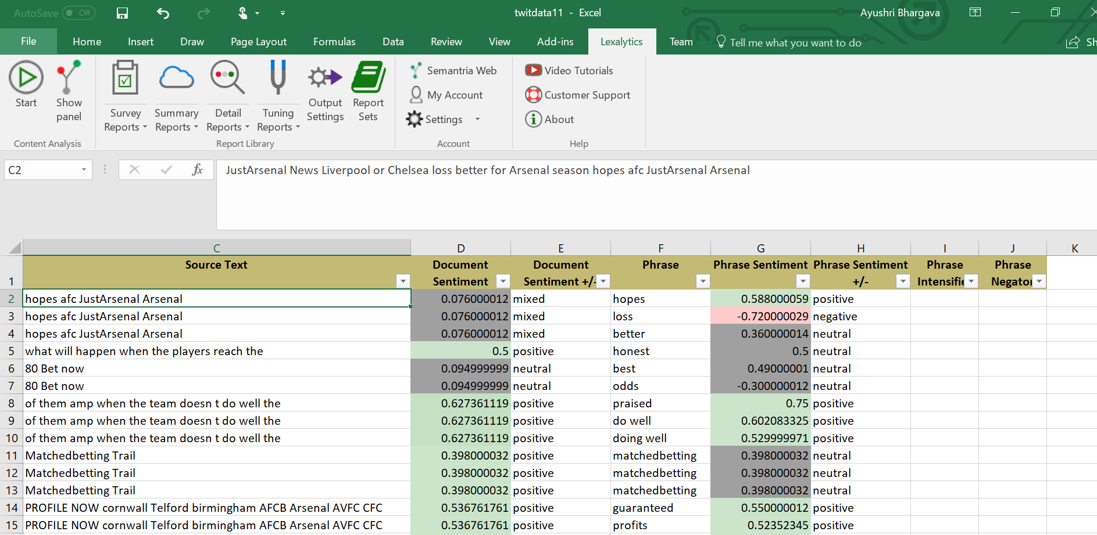
Analysis using Semantria

Slide 23
Data Visualization Using Tableau

Slide 24
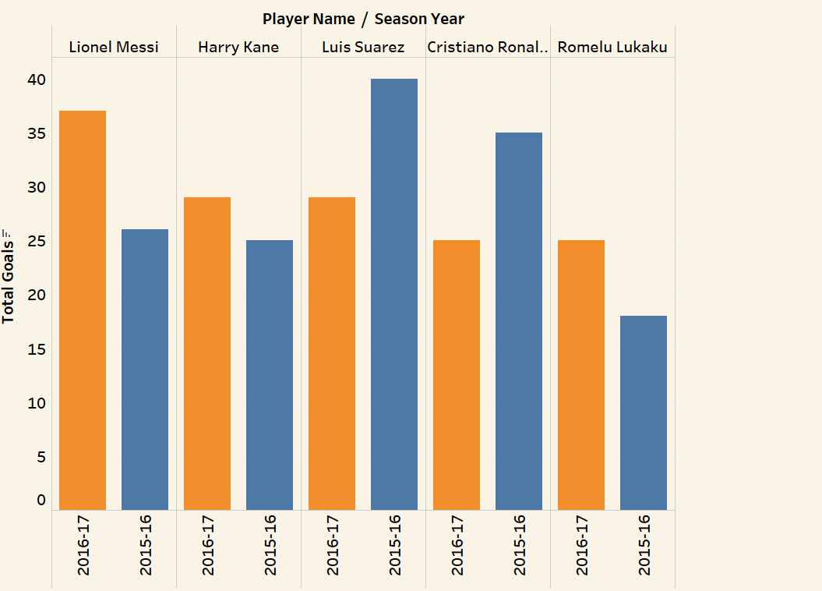
Goals Scored by each Player for every Season

Slide 25
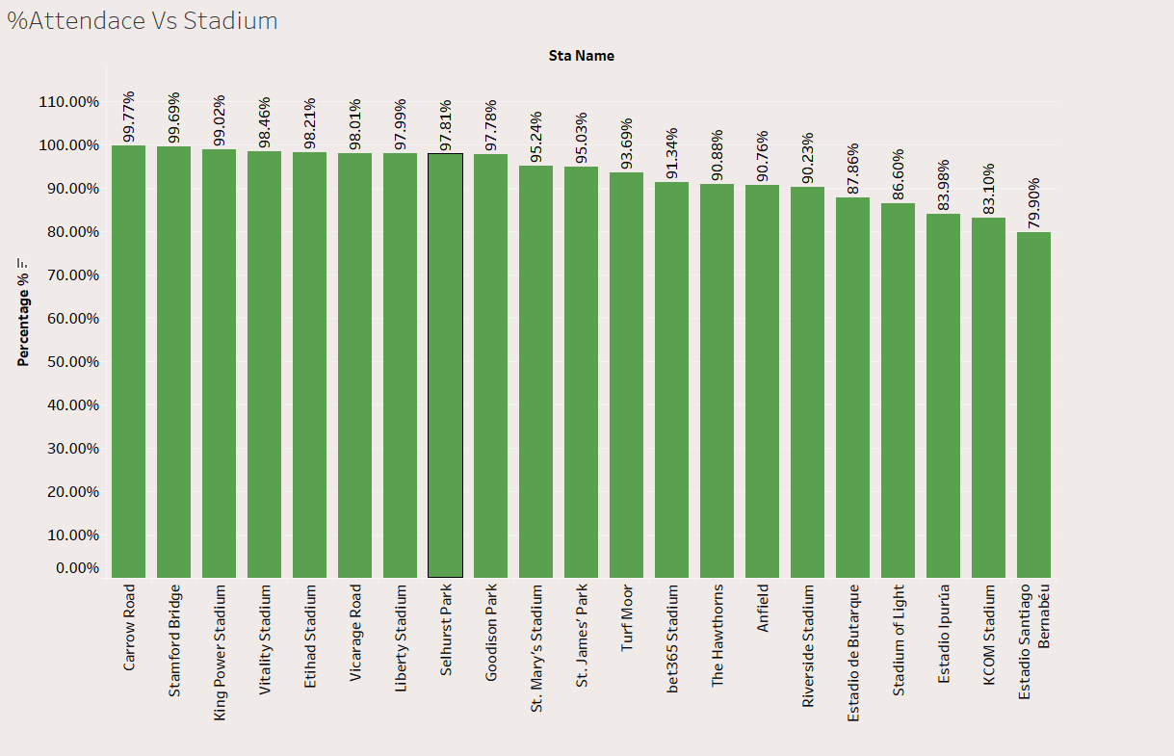
ATTENDENCE PERCENTAGE VS STADIUM
Attendance Percentage vs Stadium Capacity

Slide 26
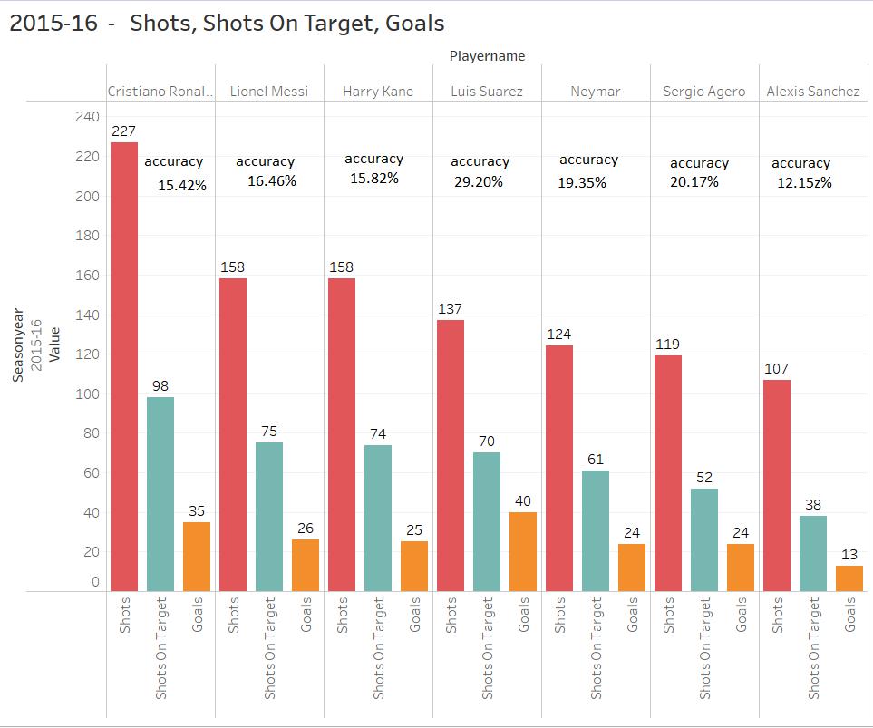
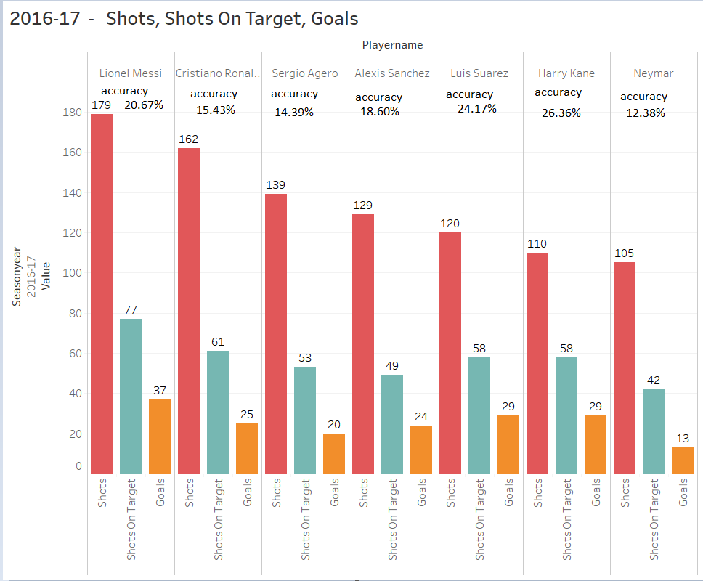
Shot Accuracy

Slide 27
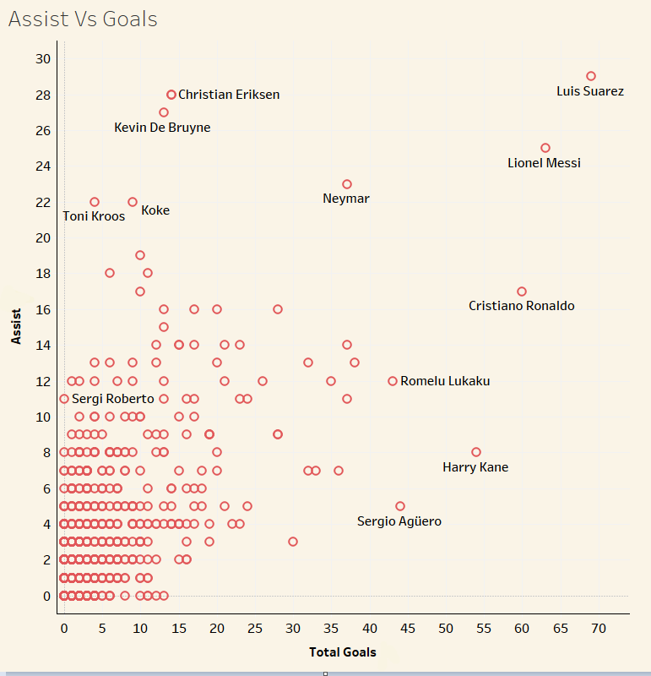
Assists vs Goals

Slide 28
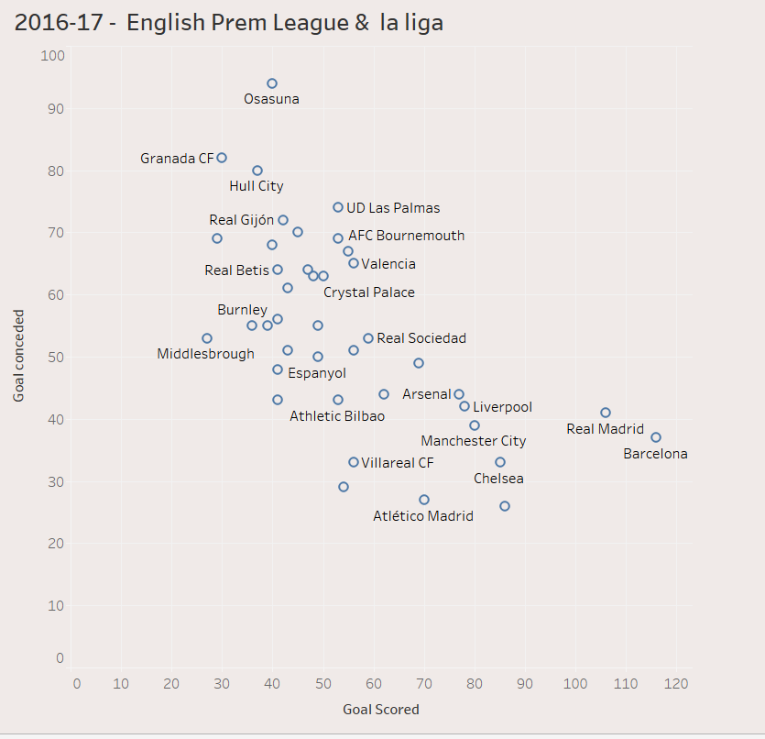
Goals Scored vs Goals Conceded

Slide 29
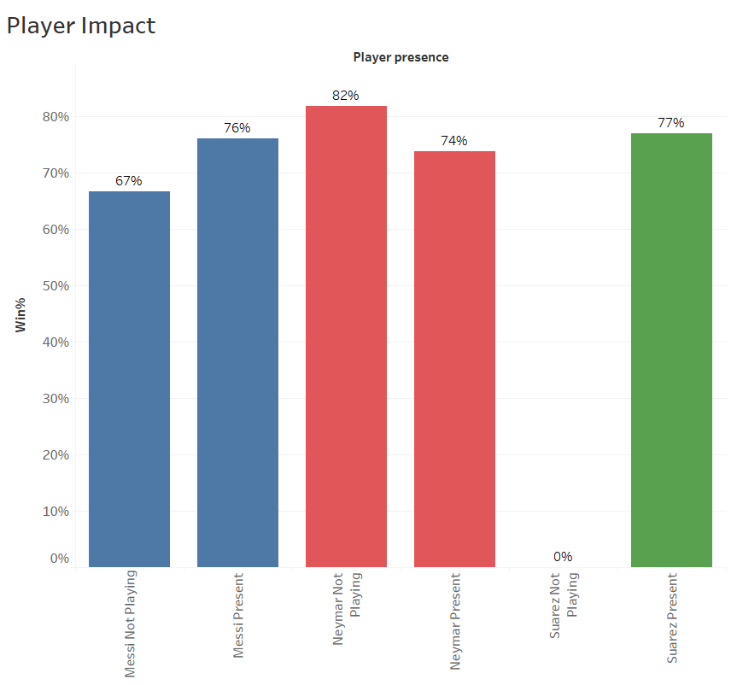
Player Impact

Slide 30
Thank You

