Slide 1

Audyogik Tantra Shikshan Sanstha's (A T S S)
Institute Of Industrial And Computer Management And Research
MCA-II sem-III AIT Project
“www.iicmrplacements.org”
Group Members :
Nagbhushan Kumbar : Roll No. 26
Prajakta Patil : Roll No. 32
Client :
IICMR College, Nigdi.

Slide 2
Objectives :
The main purpose of the placement cell is to facilitate the process of placement and to ensure that each eligible student gets an opportunity to face the recruitment process.
This project provides the facility of maintaining the details of the students and gets the requested list of candidates for the companies who would like to recruit the students based on given query. In this project we are including the chatbot for interaction between students, companies and placement officer.
To provide guidance to the students for selecting right career path.
Easy for companies to find best employees for their organization.
Easy for students to get placed in good companies.

Slide 3
Scope :
We can store information of all the students. Various companies can access the information. Students can maintain their information and can update it. Notifications are sent to students about the companies. Students can access previous information about placement.
Providing searching facility to recruiter based on the student’s knowledge.
This system helps to students to prepare as per the companies requirements as the companies post their requirements to this system.
This system also stores the all educational and other details of all eligible students for placement.
Most of the companies interact with the college by this system.

Slide 4
List of Forms :
Student Registration
Student Update Profile
Company Registration
Drive Details Form
Login (Student, Administrator, Company)
Feedback
Administrator Control Panel
Updates by the Administrator
List of Reports:
Student Report (Registered Student,Placed Students)
Company Report (Registered Company)
Notifications and Updates
Admin Confirmation(Compnay, Student)

Slide 5
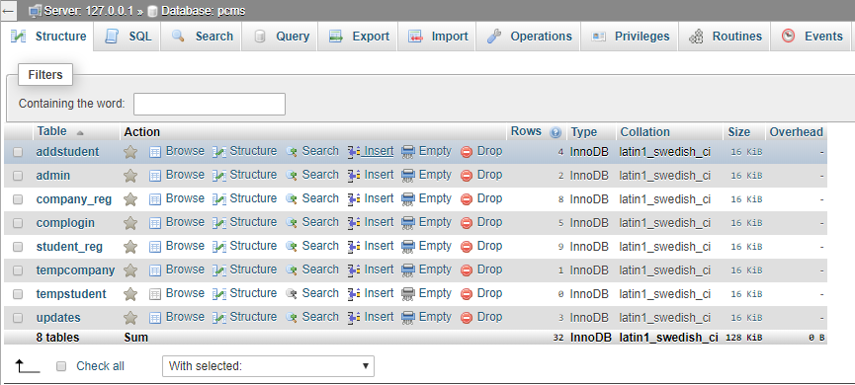
Database name : PCMS

Slide 6
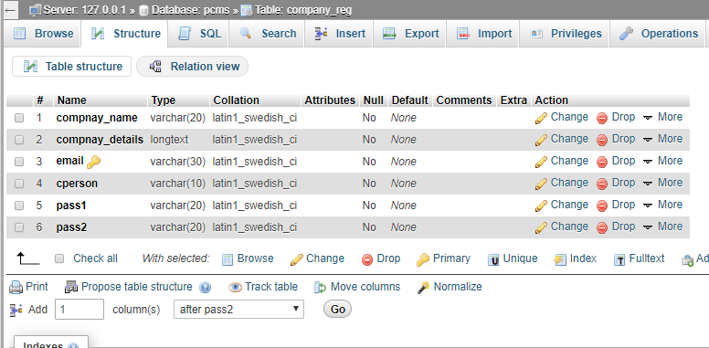
Tbale name : Company_reg

Slide 7
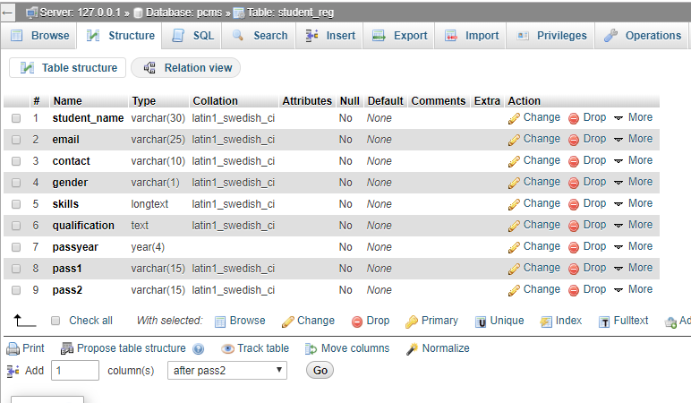
Table name : Student_reg

Slide 8
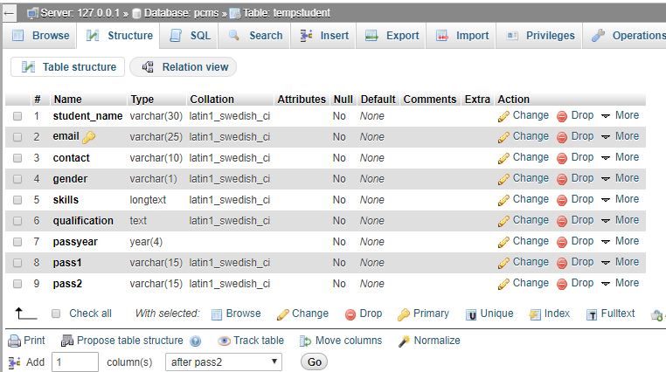
Table name : tempStudent

Slide 9
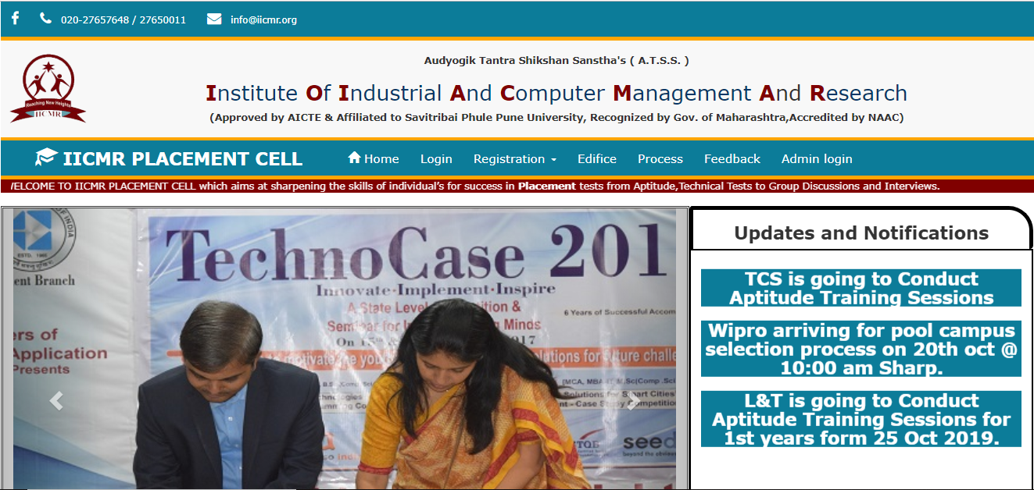
Form : Home

Slide 10
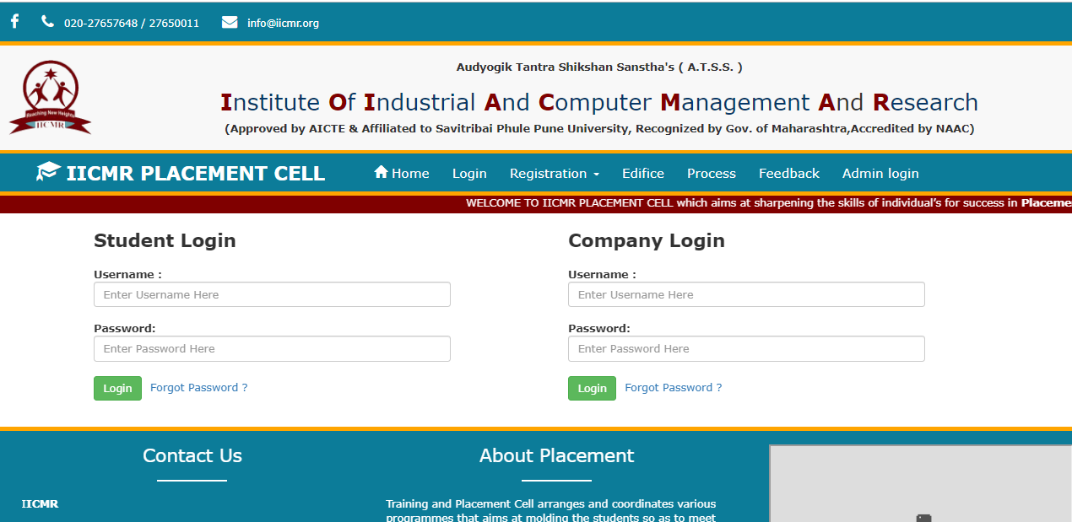
Form : Login

Slide 11
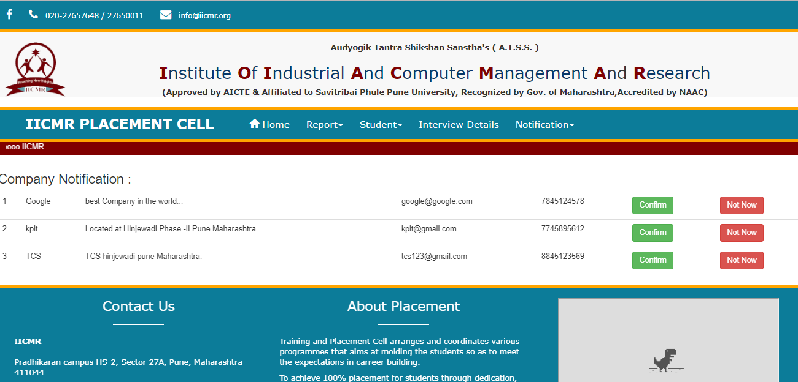
Form : Confirmation from Admin Panel

Slide 12
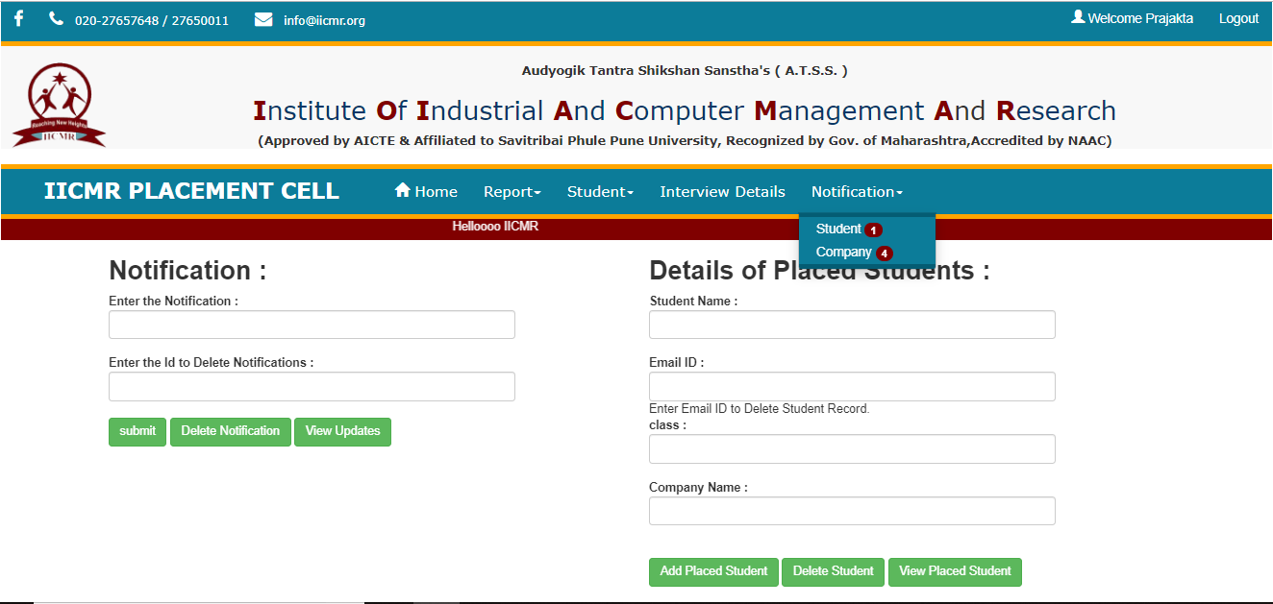
Form : Admin Panel

Slide 13
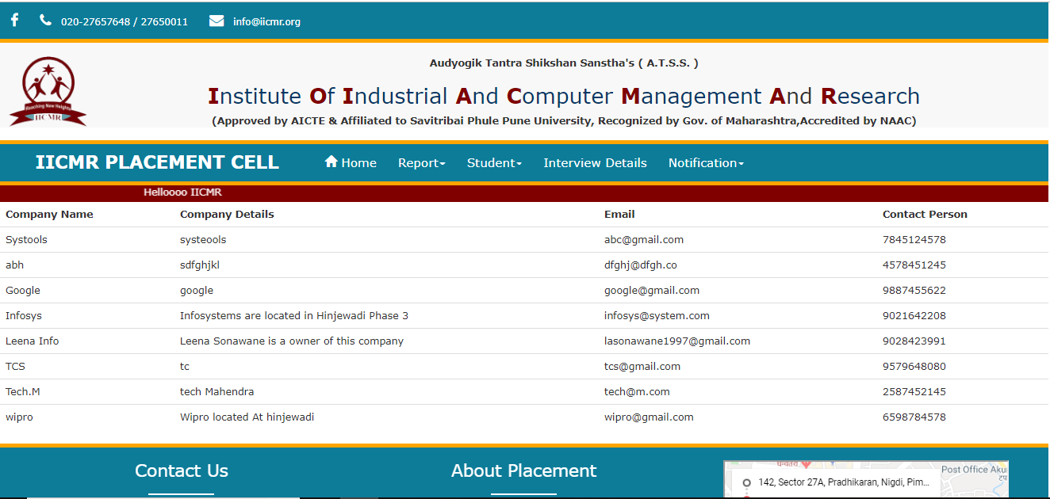
Form : Company Report

Slide 14
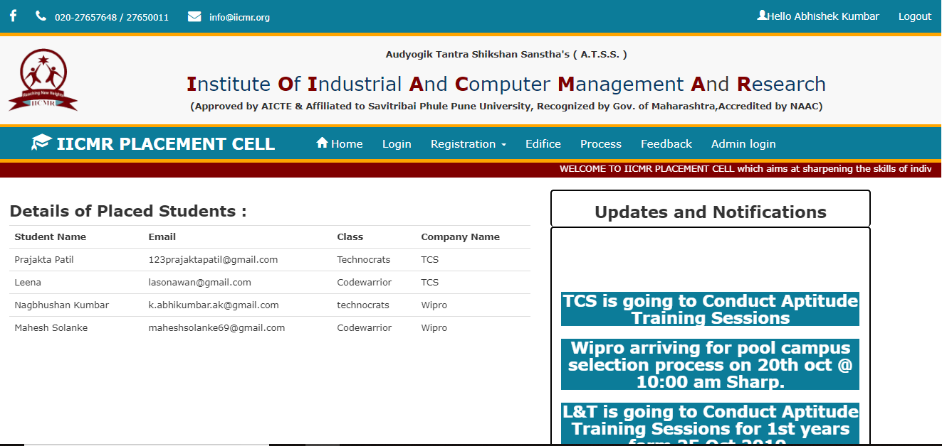
Form : Student Panel

Slide 15
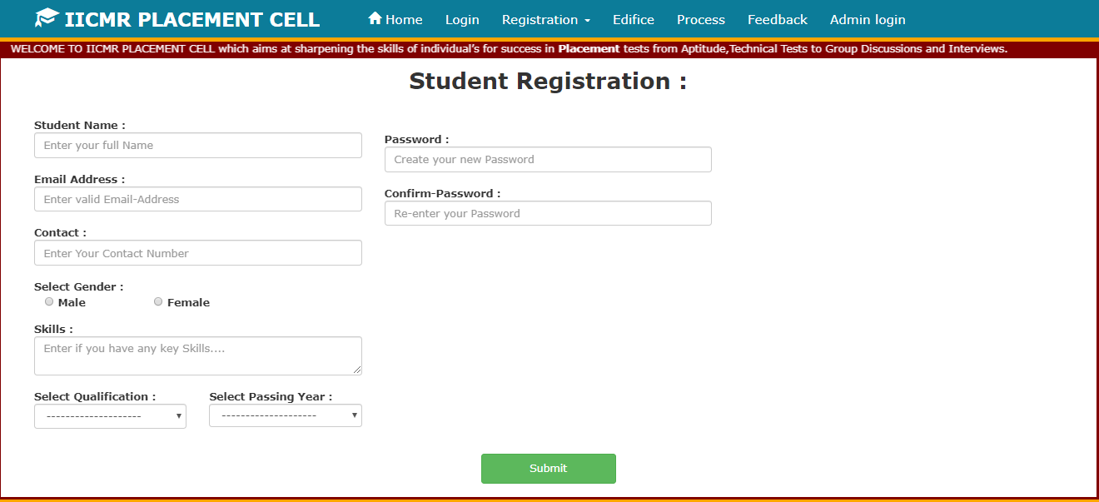
Form : Student Registration

Slide 16
Thank You

