Slide 1

SDLC Fundamentals
From idea to production—and the sustain engineer's role at every stage.
MODULE 15
SUSTAIN ENGINEERING TRAINING
17 AUGUST 2026

Slide 2
A production defect is reported at 9:00 AM.
What must happen before a safe fix reaches customers?

Slide 3
What you will be able to do
1
Map the complete software lifecycle
2
Choose an appropriate delivery method
3
Read BRD, SRS, and FRD documents
4
Connect SDLC with testing and environments
5
Plan a controlled sustain change

Slide 4
SDLC in one sentence
The Software Development Life Cycle is a structured way to plan, build, verify, release, operate, and retire software.

Slide 5


Why structure matters
Without a lifecycle, teams optimize for speed today and create incidents tomorrow.
Structure makes change repeatable, visible, and safer.

Slide 6
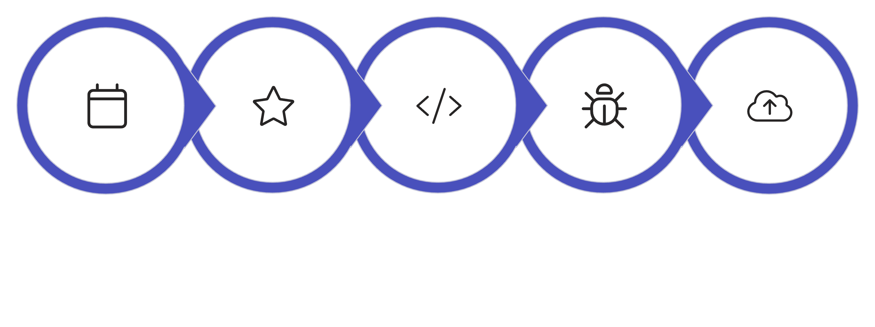
The lifecycle at a glance
Plan
Design
Build
Test
Deploy
Each stage produces evidence that the next stage depends on. Skipping stages does not remove the risk—it hides it.

Slide 7

Stage 1: Planning
Decide why the work matters, what success means, and whether it is feasible.
STAGE 1 OF 8

Slide 8
Planning outputs
Project charter
1
Scope and milestones
2
Budget and resources
3
Risk register
4
Success measures
5

Slide 9

Stage 2: Analysis
Turn business intent into clear, testable requirements.
The key question: What must the system do—and how well?
STAGE 2 OF 8

Slide 10


Functional requirements
Describe system behavior.
Example: "A customer can search restaurants by cuisine."
Functional requirements define what the system does—the actions, transactions, and behaviors users can invoke.

Slide 11
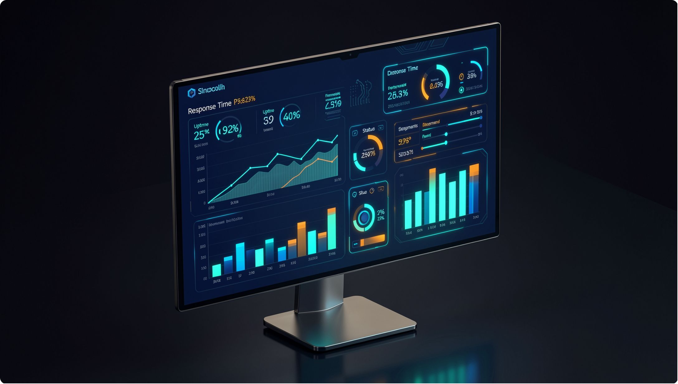
Non-functional requirements
Describe quality and constraints.
Example: "Search results appear within two seconds for 95% of requests."
Non-functional requirements define how well the system performs—speed, reliability, security, and scalability.

Slide 12
A requirement must be testable
❌ Weak
✅ Strong
"The app should be fast."
"Checkout completes within three seconds at 2,000 concurrent users."

Slide 13

Stage 3: Design
Translate requirements into a technical solution before writing production code.
STAGE 3 OF 8

Slide 14






Design decisions
Architecture and service boundaries
Data model
APIs and integrations
Security controls
Failure handling
User experience

Slide 15
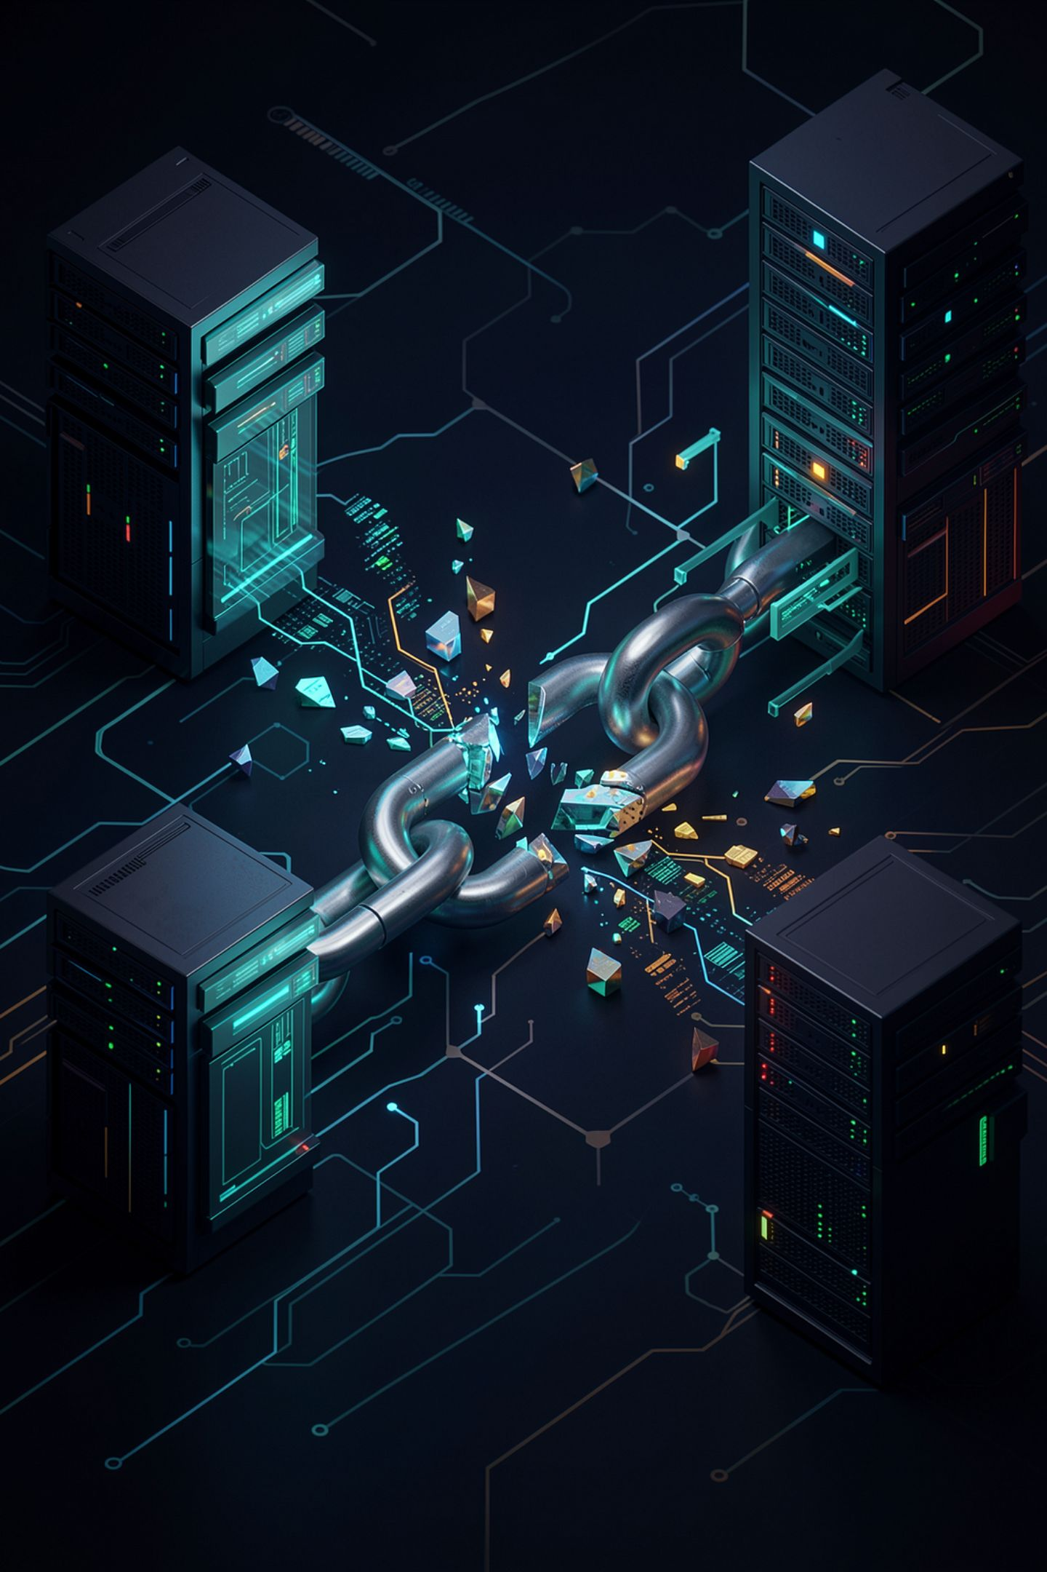
Design for failure
Reliable systems ask early:
What happens when payment, inventory, or notification services are unavailable?

Slide 16

Stage 4: Build
Develop the solution in small, reviewable, testable changes.
STAGE 4 OF 8

Slide 17
Stage 5: Test
Testing does not prove perfection.
It provides evidence that the system behaves as expected under known conditions.
STAGE 5 OF 8

Slide 18

Stage 6: Deploy
Release a verified change through a controlled, observable, reversible process.
STAGE 6 OF 8

Slide 19




A safe deployment has four parts
Approved change
Verified artifact
Health checks
Rollback plan

Slide 20

Stage 7: Maintain
Monitor, support, repair, improve, and protect the live service.
This is the sustain engineer's home ground.
STAGE 7 OF 8

Slide 21


Maintenance still uses the lifecycle
Design
A production fix still requires analysis, design, build, test, and deployment.
Analyze
Maintenance is not a shortcut around engineering discipline.
Build
Test & Deploy

Slide 22

Stage 8: Retire
End-of-life is a planned engineering activity—not simply switching a server off.
STAGE 8 OF 8

Slide 23
Checkpoint: trace the defect
The scenario
Your task
The question
A checkout defect has been reported in production.
In pairs, trace the defect through every lifecycle stage.
What evidence is produced at each stage?

Slide 24
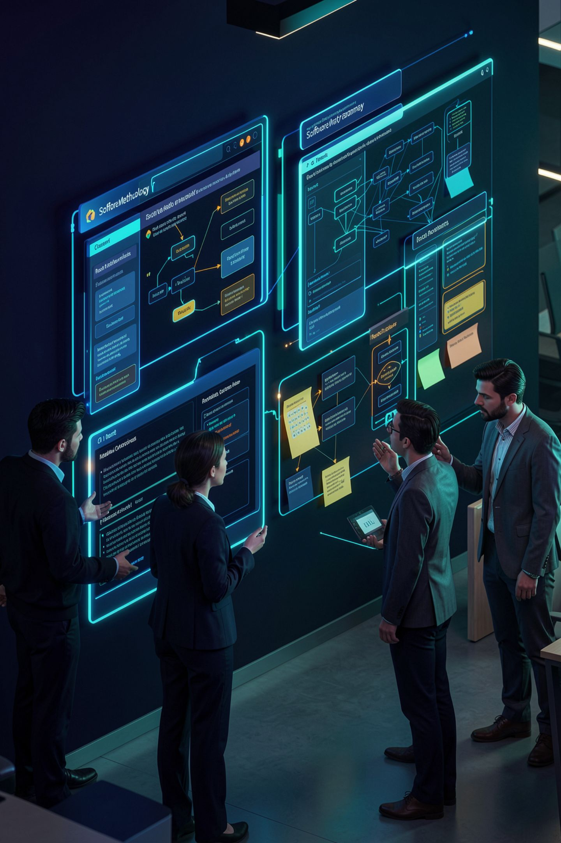
Delivery methods
The lifecycle describes what must happen.
A methodology describes how the team organizes that work.

Slide 25

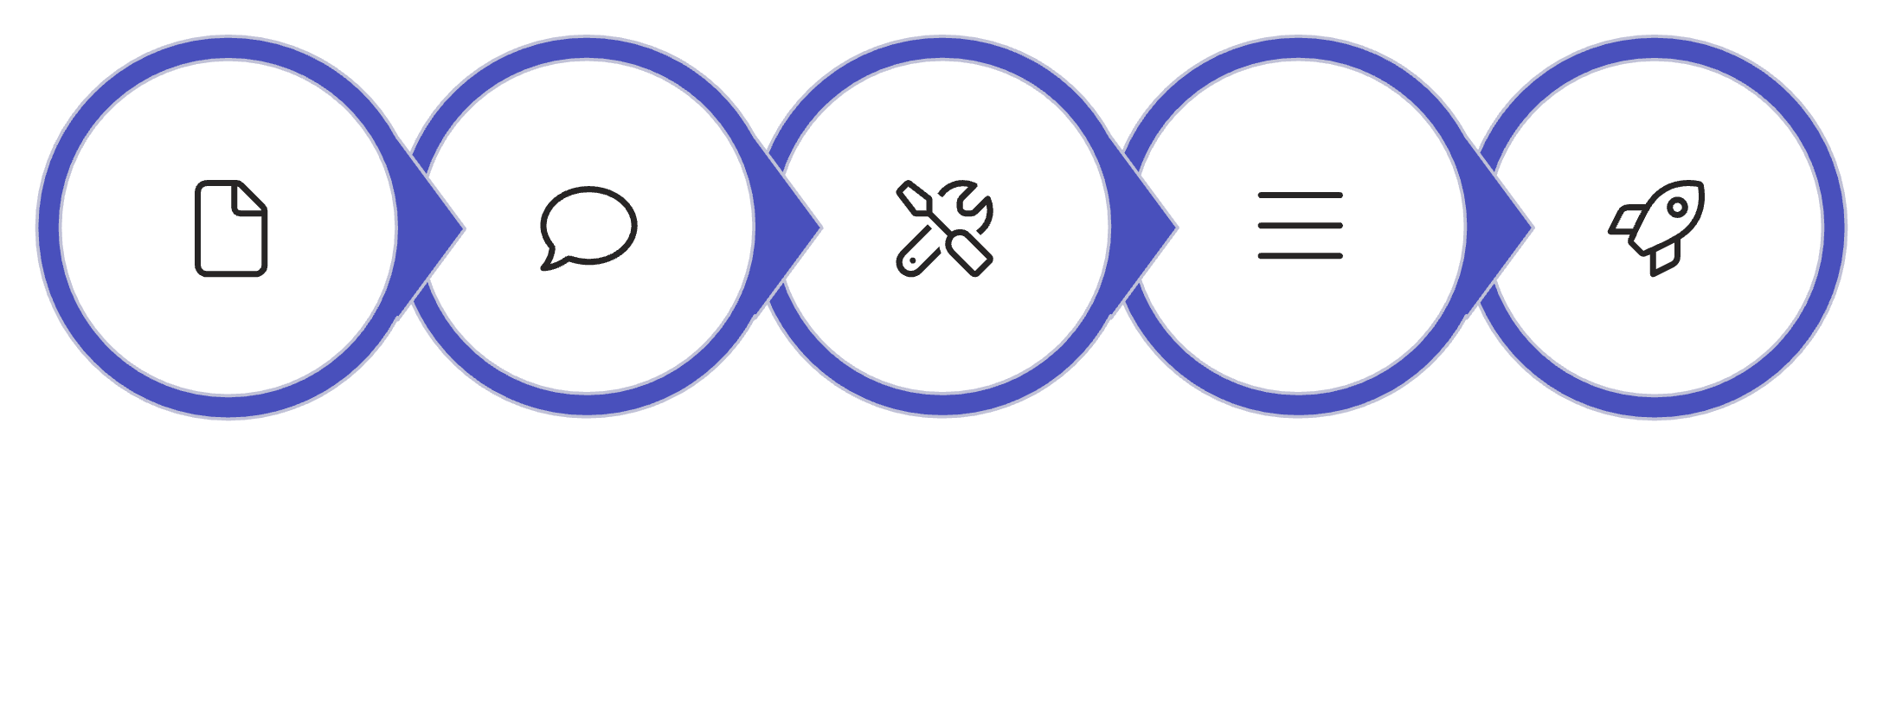
Waterfall
Work moves through defined sequential phases, with formal handoffs and approvals.
Requirements
Design
Build
Test
Deploy

Slide 26


When Waterfall fits
Stable scope
Strong regulatory controls
Requirements are well understood and unlikely to change.
Compliance demands formal phase gates and documented approvals.
Fixed contractual deliverables
Expensive late-stage change
Scope, cost, and schedule are agreed in advance.
Rework costs are high once construction begins.

Slide 27
Waterfall trade-off
When assumptions are correct
When assumptions are wrong
Predictability is high. Phases complete on schedule with expected outcomes.
Feedback arrives late. Corrections are costly and disruptive.

Slide 28
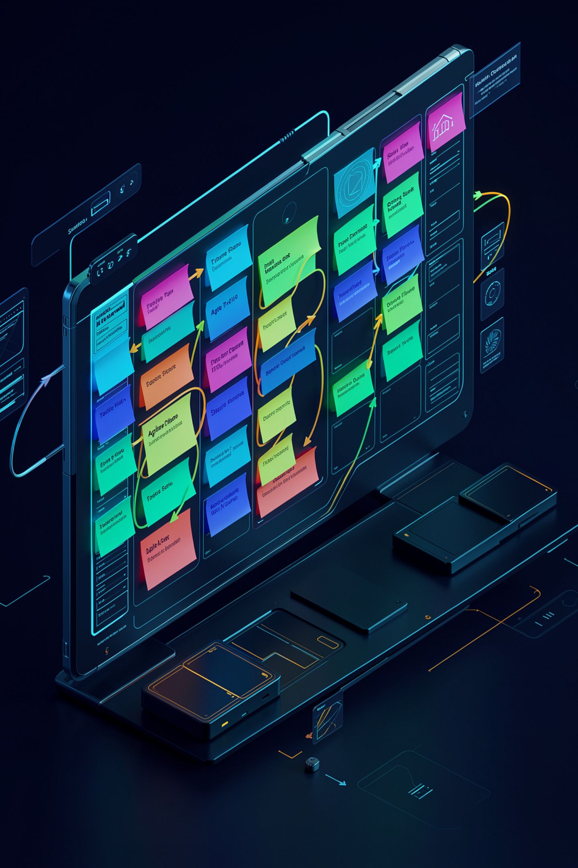
Agile
Deliver value in small increments, learn from feedback, and adapt the plan.

Slide 29
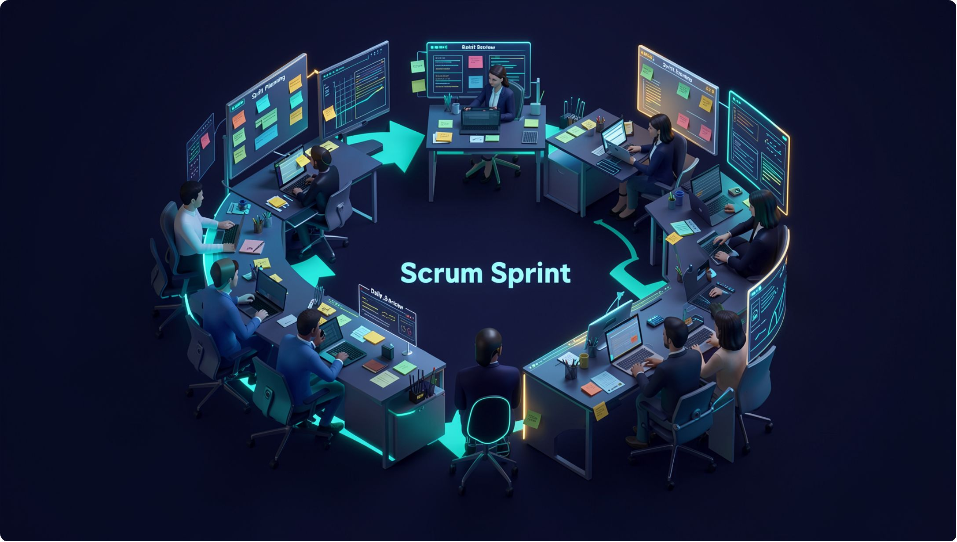
Scrum
Scrum organizes work into time-boxed sprints that produce a usable increment.
Each sprint is a complete mini-lifecycle: plan, build, test, review, and retrospect—typically two weeks long.

Slide 30


Scrum roles
Product Owner
Scrum Master
Developers
Value and priority
Flow and facilitation
Create the increment

Slide 31
Scrum events
1
2
Sprint Planning
Daily Scrum
3
4
Sprint Review
Retrospective

Slide 32
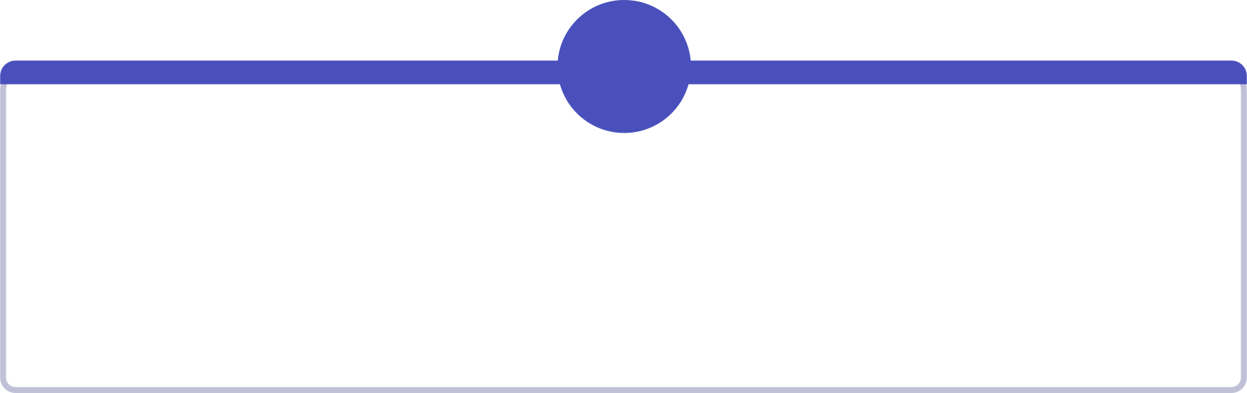
Scrum artifacts
1
2
Product Backlog
Sprint Backlog
Ordered list of all desired work
Work selected for the current sprint
3
4
Increment
Definition of Done
Usable output of each sprint
Shared quality standard for completion

Slide 33

Kanban
Visualize work, limit work in progress, and improve continuous flow.
Kanban is a pull-based system: new work enters only when capacity exists, preventing overload and revealing bottlenecks.

Slide 34
Why Kanban fits sustain work
Incidents, defects, service requests, and improvements arrive continuously—not neatly at sprint boundaries.
Kanban's continuous flow model matches the unpredictable, interrupt-driven nature of sustain engineering. Work is pulled as capacity allows, not pushed into fixed time boxes.

Slide 35
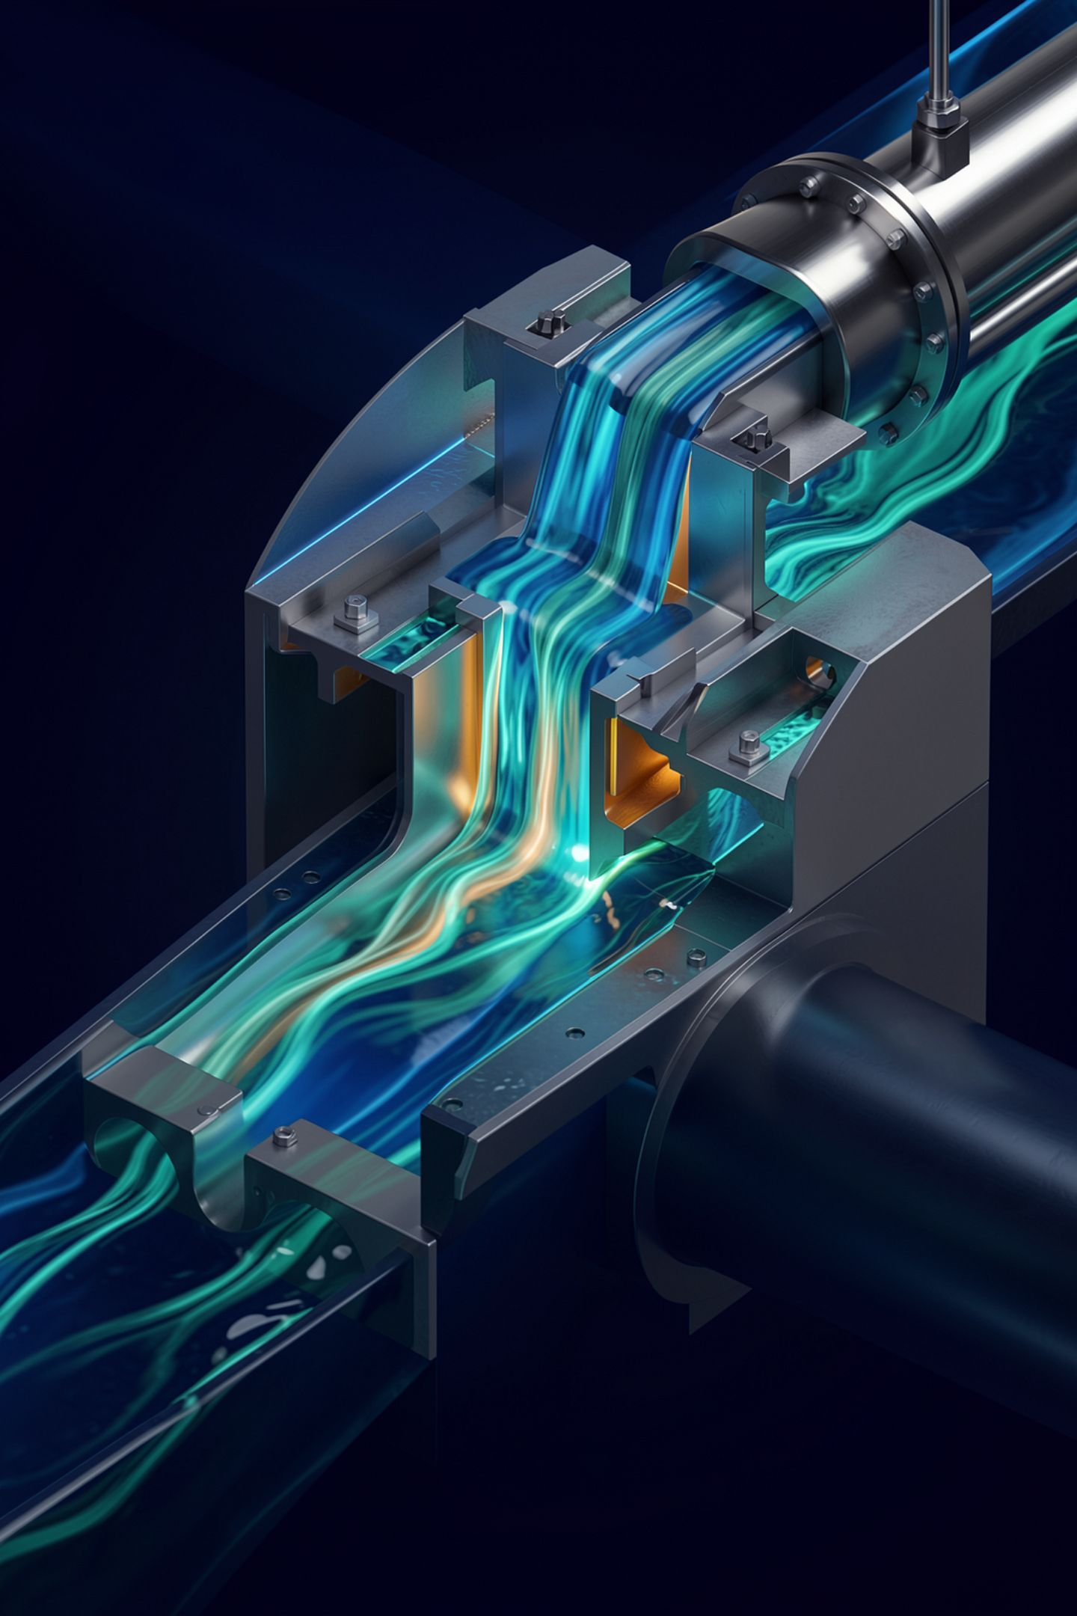
WIP limits reveal bottlenecks
Starting less work helps teams finish more work.
If testing is full, stop starting and help finish.

Slide 36
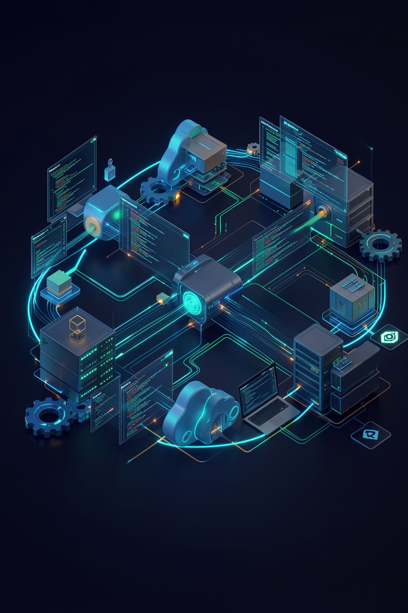
DevOps
DevOps combines culture, automation, measurement, and shared ownership to improve delivery and reliability.

Slide 37
DevOps is not a tool
Enablers
What they cannot replace
CI/CD, containers, and cloud platforms enable DevOps.
They do not replace collaboration or accountability.

Slide 38





CALMS
Culture
Automation
Lean
Measurement
Sharing

Slide 39
Choose by context
Waterfall
Scrum
For controlled sequence with stable requirements and formal approvals.
For iterative product work with evolving requirements and regular feedback.
Kanban
DevOps
For continuous flow of incoming work without fixed time boxes.
For shared delivery and operations with automation and measurement.
Real organizations often combine them.

Slide 40
Decision activity
Choose a method for each scenario:
🏦 Banking regulation change
⭐ New loyalty feature
🛠 Production support queue
☁️ Daily cloud deployment

Slide 41
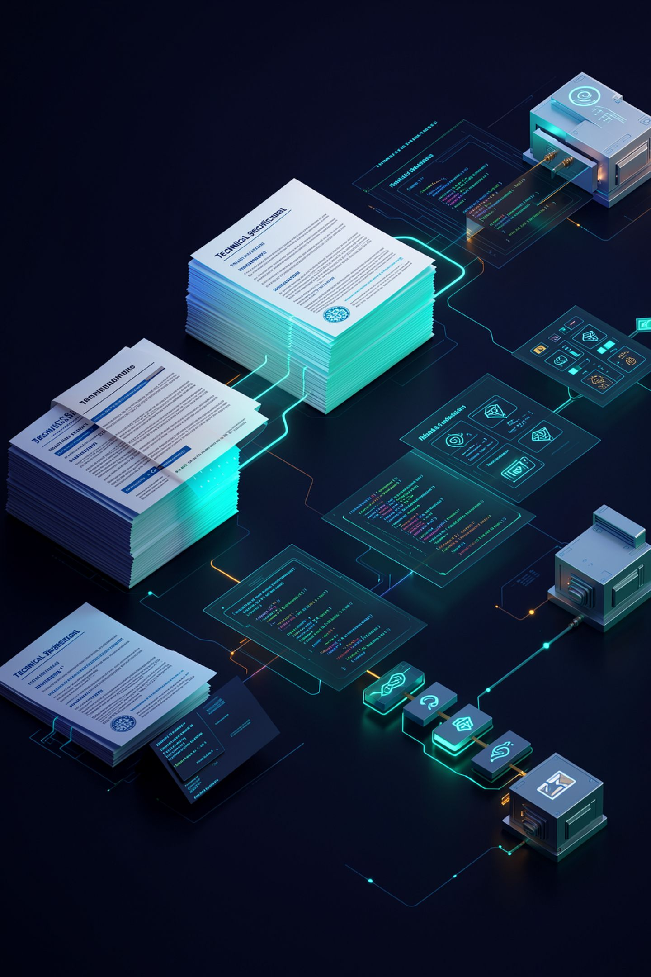
Requirements create alignment
Good documents preserve the reasoning between business intent and system behavior.

Slide 42

BRD: the business view
The Business Requirements Document explains why the initiative exists and what outcome matters.
The BRD is written for business stakeholders. It captures the problem being solved, the expected benefit, and the boundaries of the initiative—before any technical solution is proposed.

Slide 43





BRD contents
Business objective
Scope
Stakeholders
Success criteria
Constraints and assumptions

Slide 44
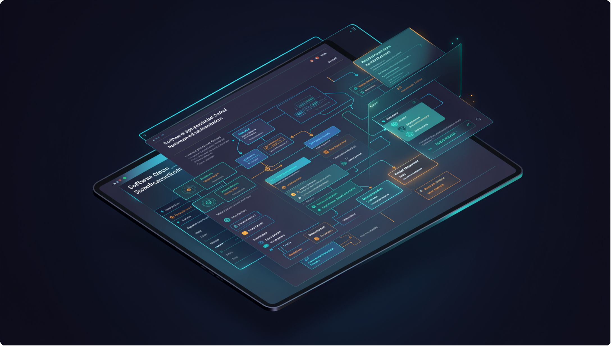
SRS: the system view
The Software Requirements Specification defines what the system must do and how well it must perform.
The SRS bridges business intent and technical design. It is the primary reference for developers, testers, and architects throughout the build and test stages.

Slide 45
SRS contents
Functional requirements
Non-functional requirements
What the system must do
How well it must perform
Interfaces
Data requirements
External system connections
Structure and constraints on data
Constraints
Error behavior
Technical and regulatory limits
How the system handles failures

Slide 46
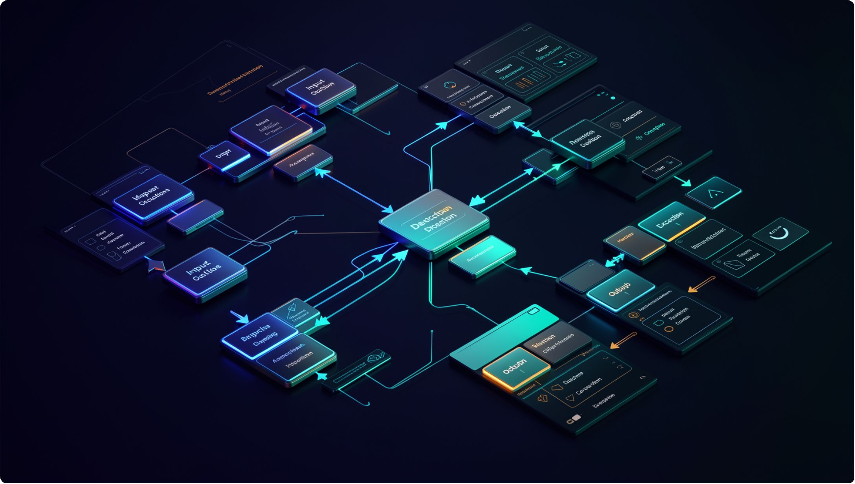
FRD: the functional detail
The Functional Requirements Document describes detailed workflows, rules, inputs, outputs, and exceptions.
Where the SRS defines what the system must do, the FRD explains exactly how each function works—step by step, field by field, exception by exception.

Slide 47
BRD vs SRS vs FRD
BRD
SRS
FRD
Business why
Why does this initiative exist? What outcome do we need?
System what
What must the system do and how well must it perform?
Functional how
How does each function work in detail?

Slide 48
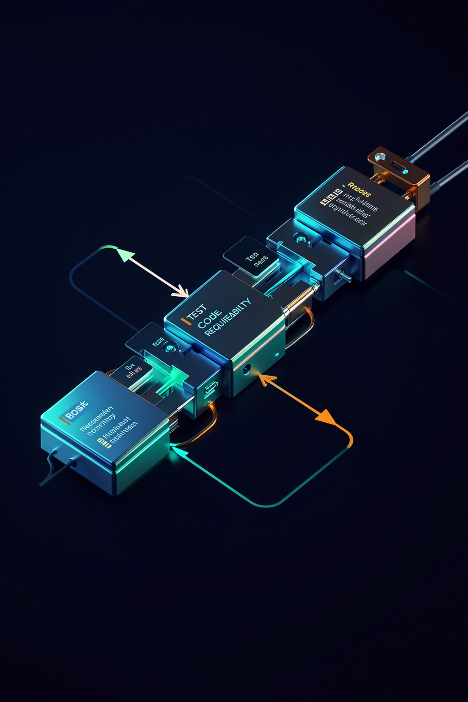
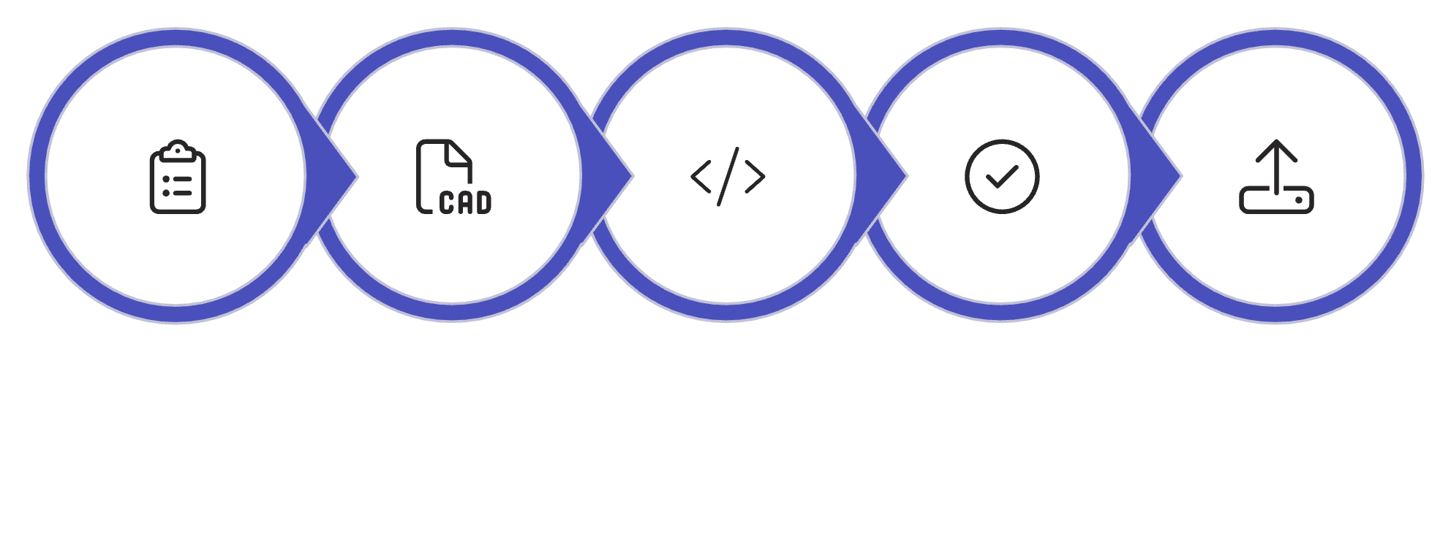
Traceability
Every requirement should connect to design, code, tests, release evidence, and operational monitoring.
Requirement
Design
Code
Tests
Release
Traceability makes it possible to answer: "Which tests cover this requirement?" and "Which requirements does this change affect?"

Slide 49

STLC
The Software Testing Life Cycle structures quality work from requirement analysis through test closure.

Slide 50






STLC phases
Analyze
Plan
Design tests
Prepare environment
Execute
Close

Slide 51

Shift left
Find ambiguity and risk before code is expensive to change.
The earliest useful test is a test of the requirement.
Reviewing requirements for clarity, completeness, and testability before design begins is the highest-leverage quality activity available to a team.

Slide 52




Application type changes the test strategy
Web
Mobile
API
Cross-browser, responsive, accessibility, and load testing
Device fragmentation, offline behavior, and battery impact
Contract testing, error codes, and rate limit behavior
Batch
Real-time
Volume, idempotency, and failure recovery
Latency, ordering, and backpressure handling
Web, mobile, API, batch, and real-time systems fail in different ways.

Slide 53

Environments protect customers
Changes gain confidence as they move through isolated environments toward production.

Slide 54

Local and Development
Fast feedback, synthetic data, verbose logs, and frequent change.
Optimized for learning—not customer traffic.
Local and development environments are designed for speed of iteration. Failures here are expected and cheap. The goal is rapid learning, not stability.

Slide 55

Test and Staging
Integrated services, realistic configuration, controlled test data, and release validation.
Test and staging environments mirror production as closely as possible. They are where integration failures, configuration errors, and performance issues are discovered before customers are affected.

Slide 56
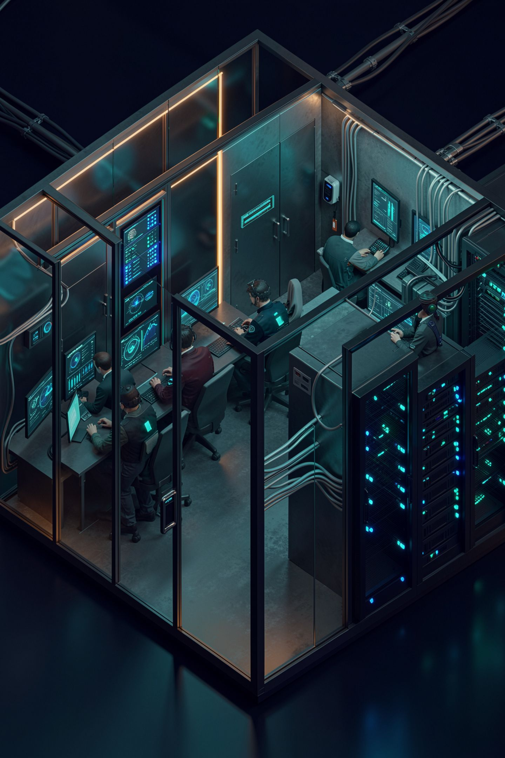
Production
Real users, protected data, strict access, monitoring, backups, and formal change control.

Slide 57
Environment parity
The principle
The practice
Keep environments similar enough that testing predicts production behavior.
Same artifact; environment-specific configuration.

Slide 58
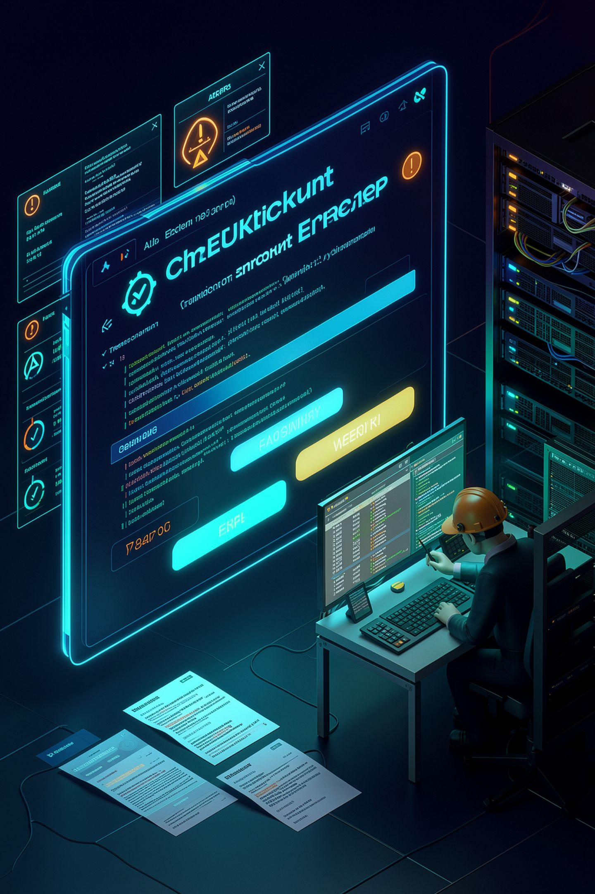
Production incident scenario
Checkout totals are wrong for discounted orders.
The team must diagnose, fix, verify, approve, deploy, monitor, and document the outcome.

Slide 59












The safe sustain loop
Observe
Triage
Verify → Learn
Analyze
Test → Approve → Deploy
Fix

Slide 60

Final takeaway
Speed is valuable only when the change remains understandable, testable, observable, and reversible.
Next: Jira and Confluence—turning the lifecycle into visible team execution.
Understandable
Testable
Observable
Reversible

