Slide 1

CMS
Conference Management system
Mini-Project Presentation
Deepak Nagda
Arpana Kumari
Kartik Chandra
Under the guidance of :
Prof. Anil Kumar Singh

Slide 2
Problem Statement
Managing academic conferences is often complex, requiring admins, authors, reviewers, and attendees to coordinate many tasks manually. Traditional methods for paper submission, reviewer assignment, and schedule creation can lead to inefficiencies, errors, and poor communication. Authors struggle to submit and track papers, while reviewers find managing reviews challenging. Attendees need easy access to conference information. The project aims to automate key processes, reduce manual effort, increase efficiency, and improve communication among all stakeholders involved in conference management.

Slide 3
Goals And Strategy
The goals of the CMS are to create conferences, automate key processes, and reduce manual tasks. It facilitates better communication among admins, authors, reviewers, and attendees. By providing a centralized platform, the project seeks to improve the quality of conference creation, conference management, and user experience.
The approach for the conference management system project is to build a centralized platform that automates essential conference management processes, including paper submission, reviewer allocation, and schedule management. The platform will feature role-based permissions to maintain security, with a user-friendly design to support smooth communication and cooperation among all participants.

Slide 4
Introduction
The conference management system is a centralized platform designed to create conferences. It automates key processes such as paper submission, reviewer assignment, and schedule management, reducing manual tasks and enhancing efficiency. The system supports admins, authors, reviewers, and attendees, allowing them to interact easily. Along with secure user authentication and a user-friendly interface, this platform aims to improve communication and collaboration, ultimately leading to better conference management.

Slide 5






Tech Stack

Slide 6
Implementation
Admin
Register
Login
Create Conference
Manage Papers, and Reviewers
Assign Papers
Update Schedule

Slide 7
Implementation
Author
Register
OTP Verification
Login
Upload Papers
Check Status

Slide 8
Implementation
Reviewer
Register
Login
Review Papers
Update Status

Slide 9
Implementation
Attendee
Register
OTP Verification
Login
View Schedule

Slide 10
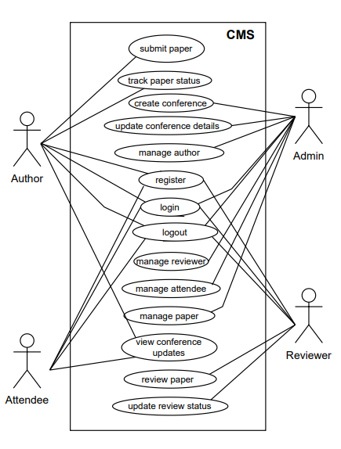
Use Case Diagram

Slide 11
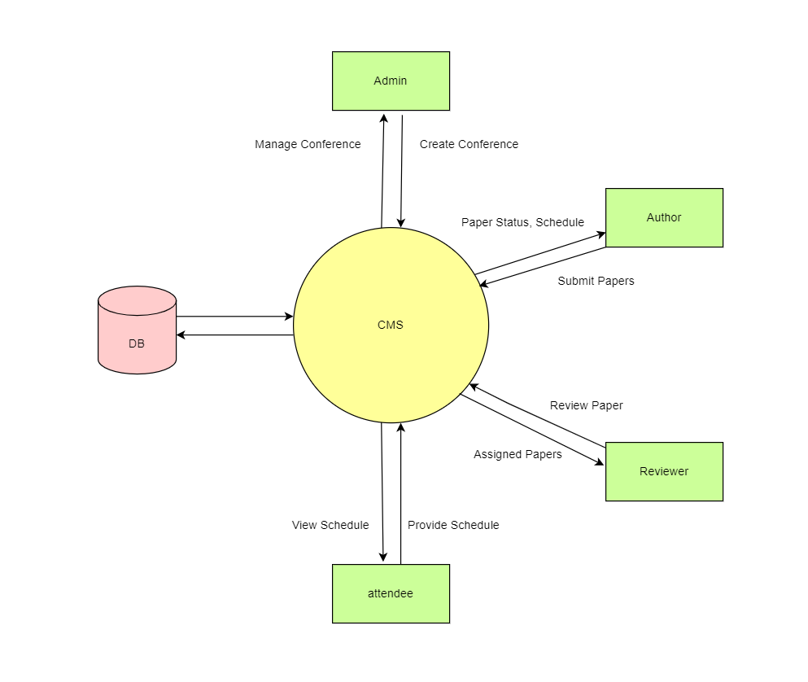
DFD Level – 0:

Slide 12
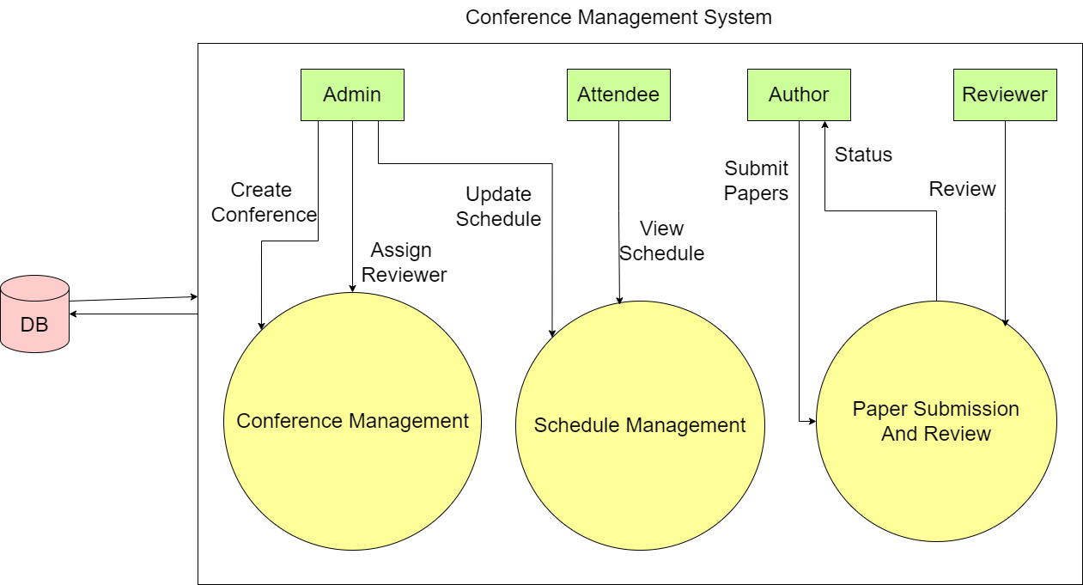
DFD Level -1

Slide 13
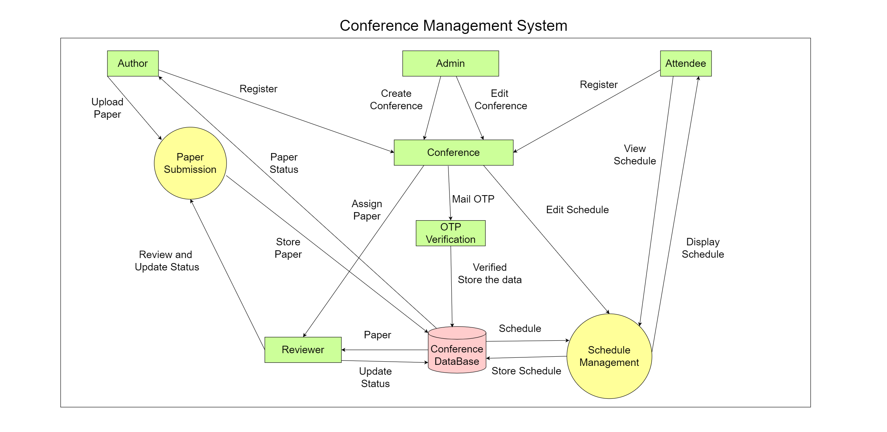
DFD Level-2

Slide 14
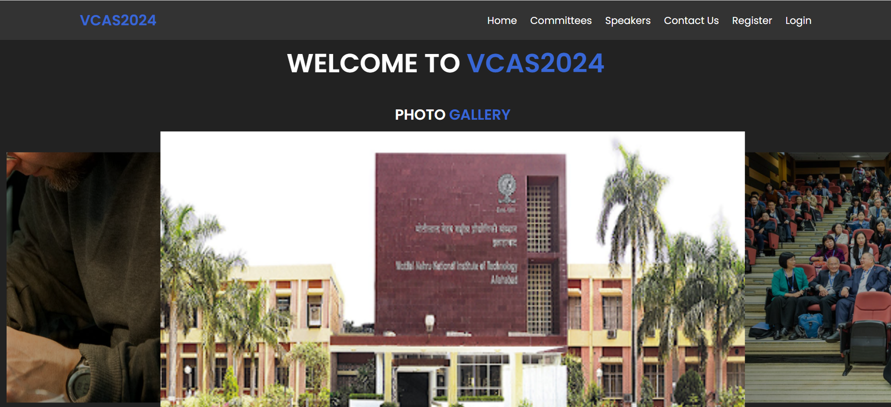
Screenshots
Home Page:

Slide 15
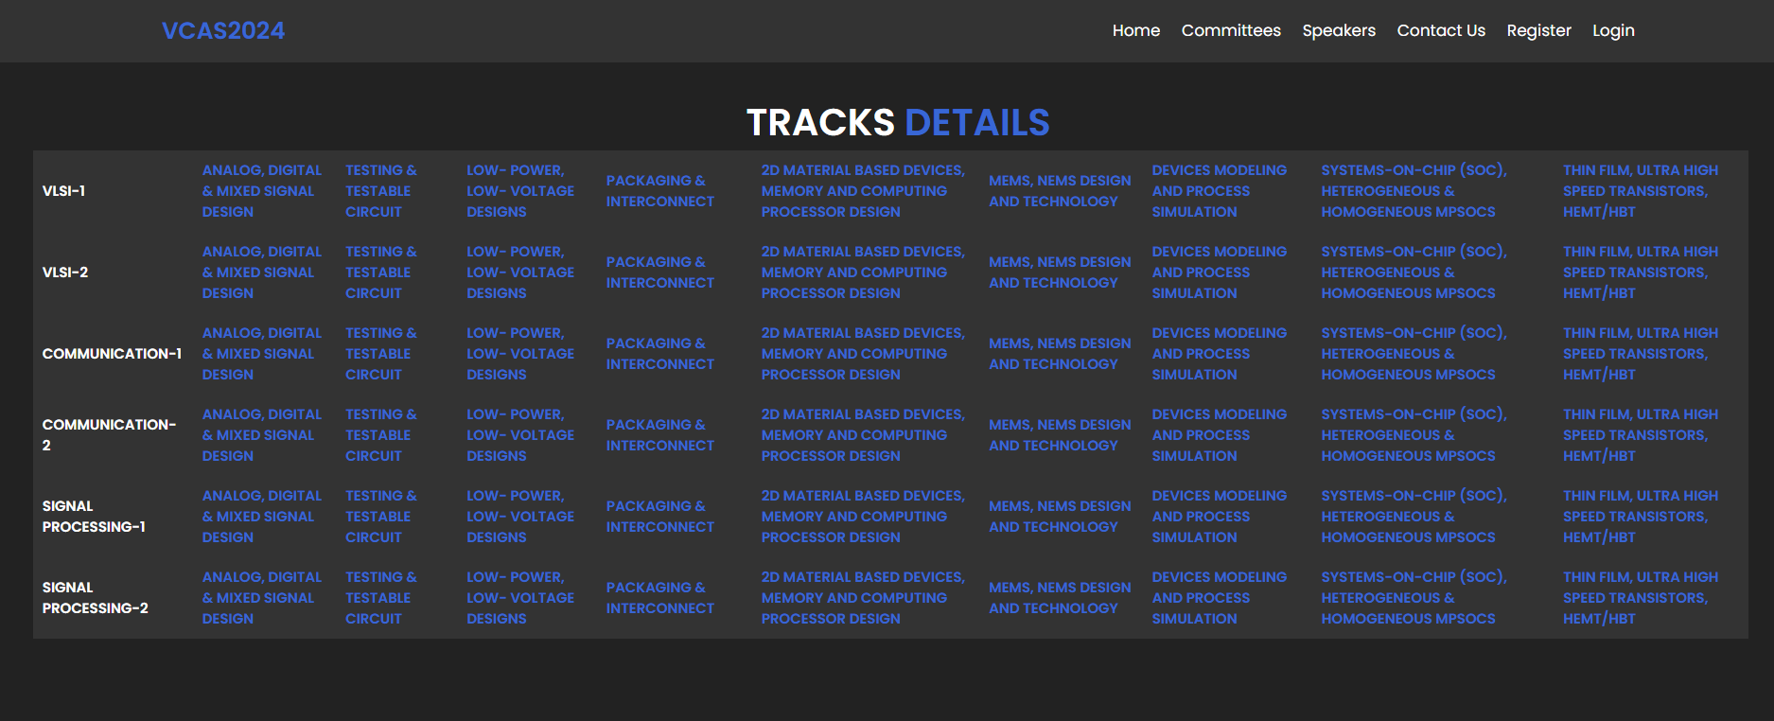
Screenshots
Home Page:

Slide 16
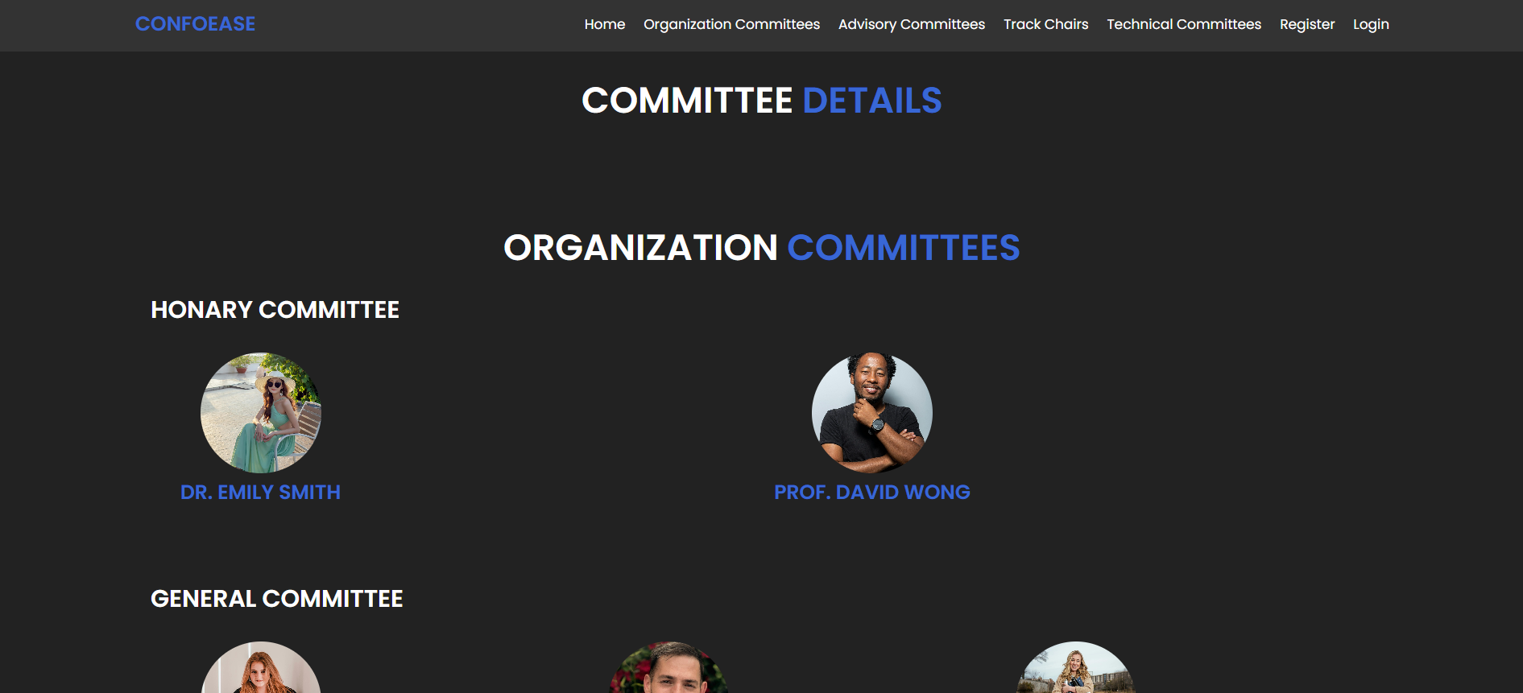
Screenshots
Committees:

Slide 17
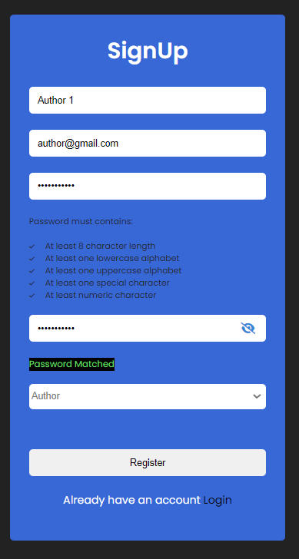
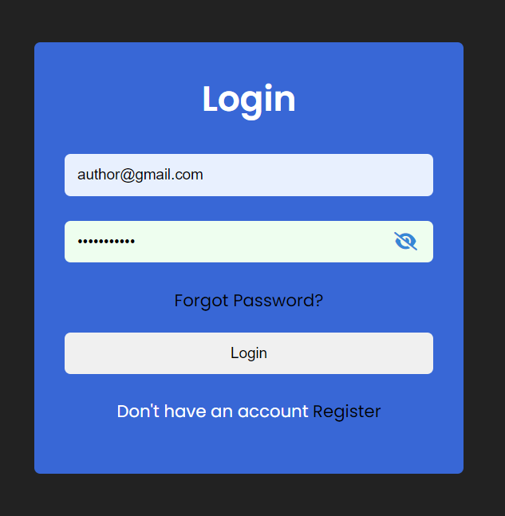
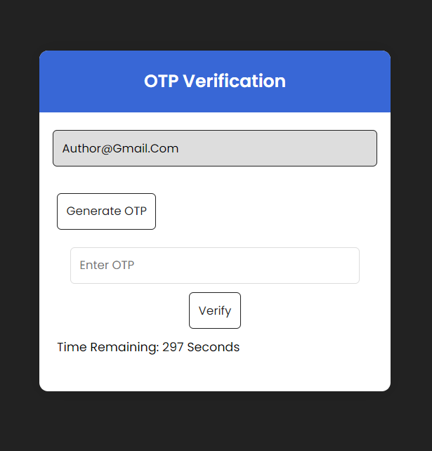
Screenshots
Registration and Login:

Slide 18
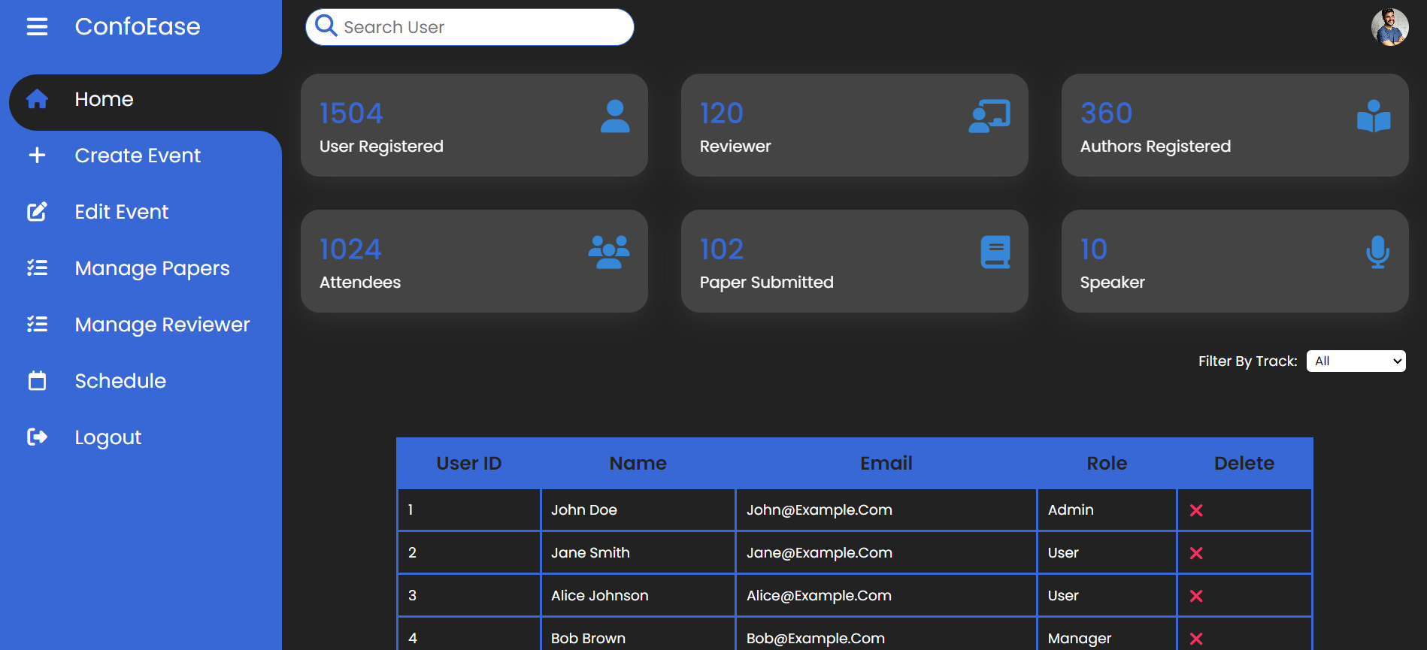
Screenshots
Admin Dashboard:

Slide 19
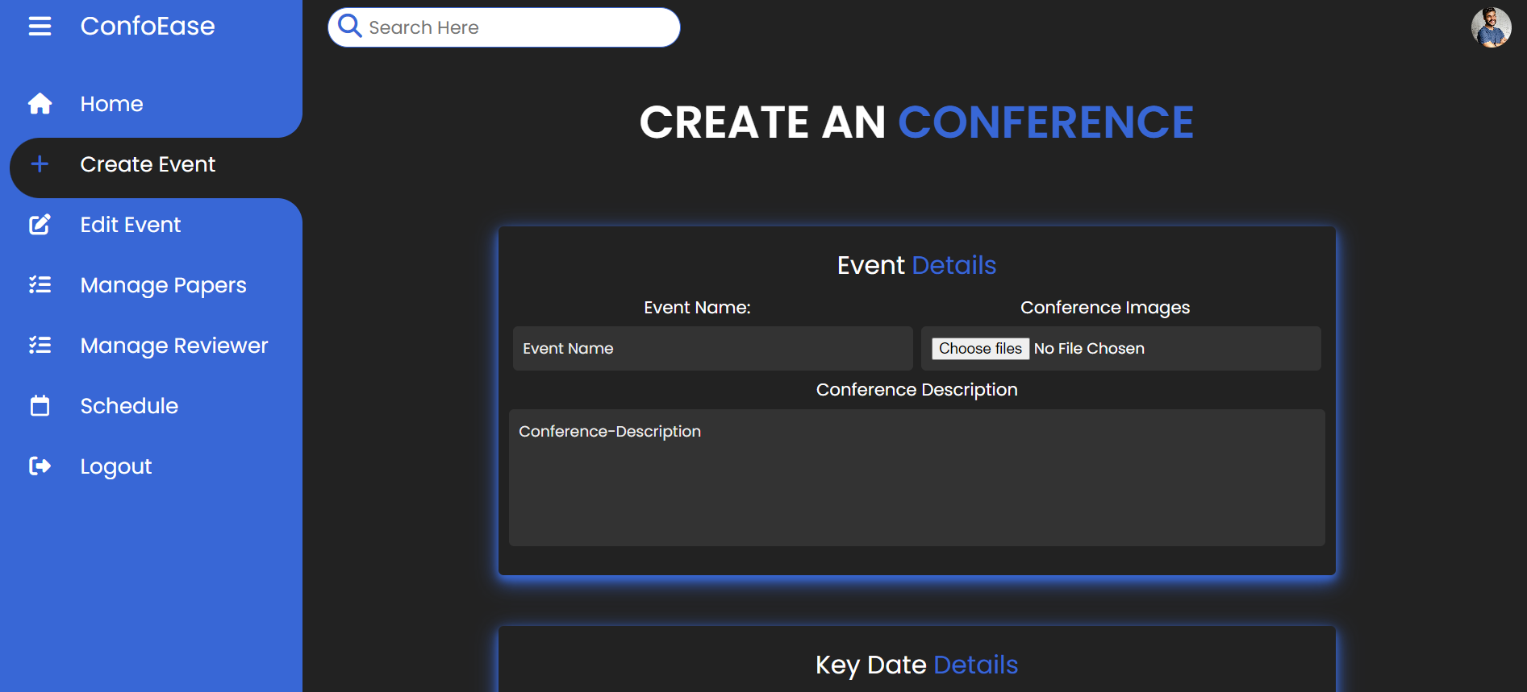
Screenshots
Create Event:

Slide 20
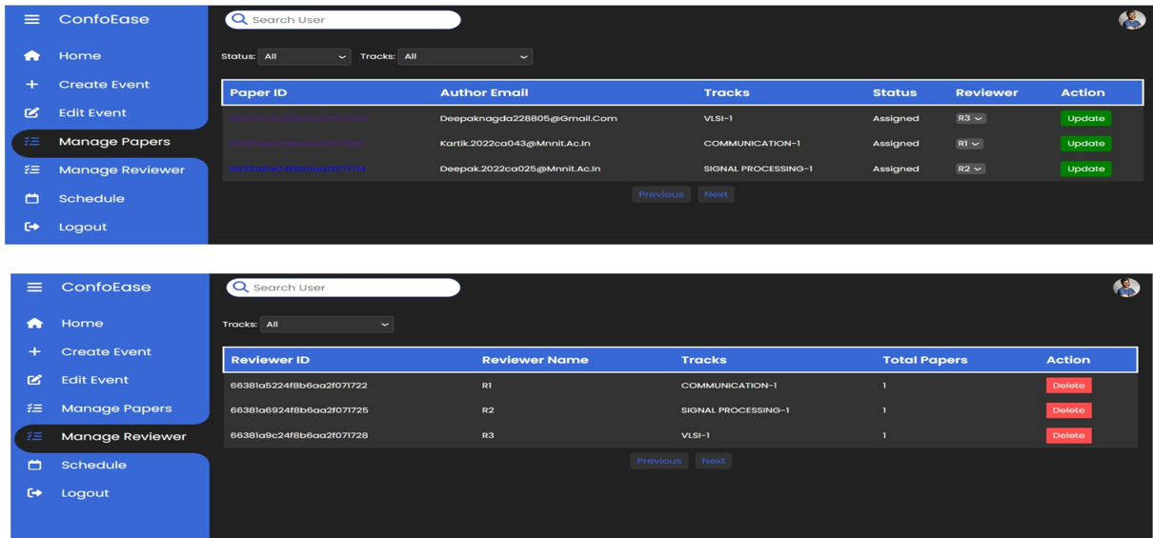
Screenshots
Assigning Papers and Managing Reviewers:

Slide 21
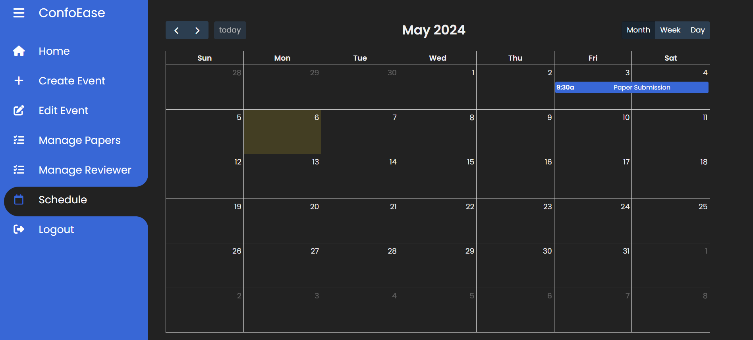
Screenshots
Schedule:

Slide 22
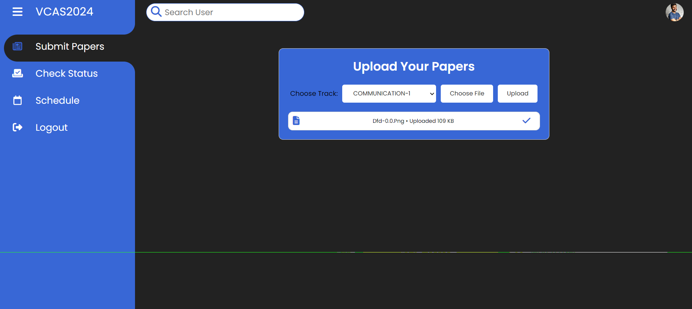
Screenshots
Upload Papers:

Slide 23
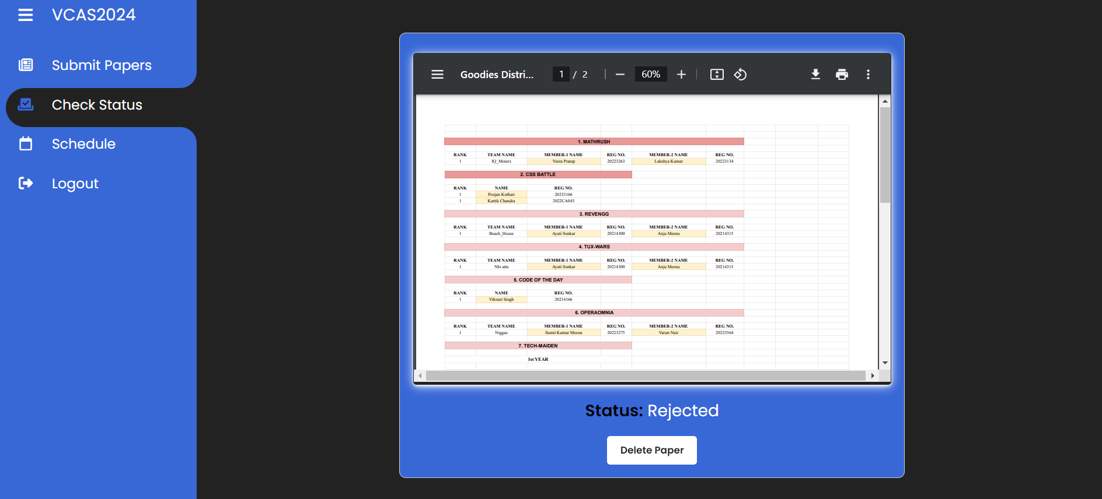
Screenshots
View Paper and check status:

Slide 24
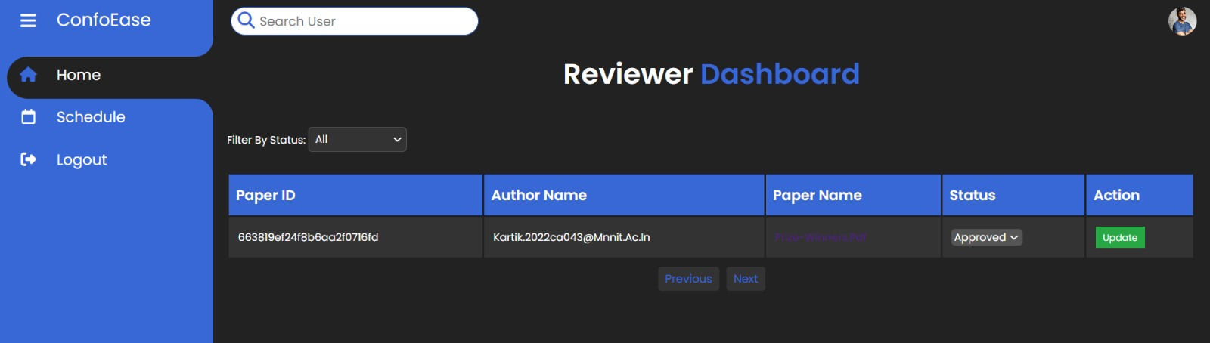
Screenshots
Reviewer Dashboard:

Slide 25
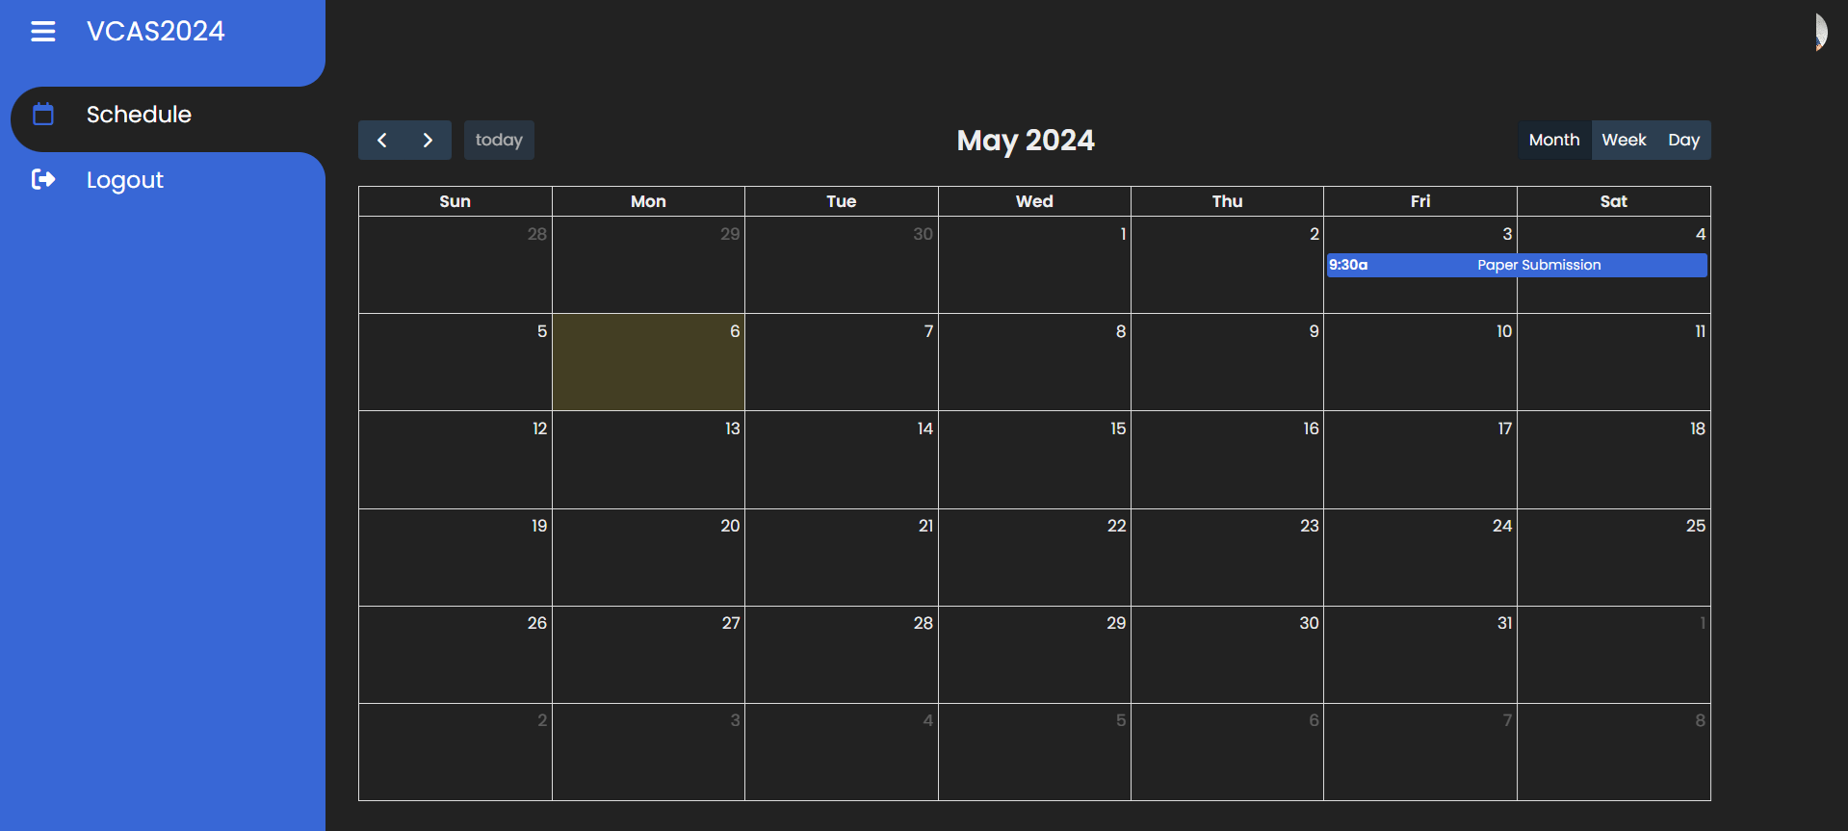
Screenshots
Attendee:

Slide 26
Future Scope
Real-Time Communication: Implement chat and video conferencing features for real-time interaction among users.
Virtual Conferences: Enable the system to support virtual conferences and remote participation.
Advanced Analytics: Provide detailed analytics and reporting tools to help admins track key metrics.
Third-Party Integrations: Integrate with other services like payment processors and academic databases for seamless functionality.
Mobile App: Develop a mobile application for convenient access from smartphones and tablets.
Scalability and Performance: Optimize the system for higher scalability and improved performance to accommodate more users and larger conferences.

Slide 27
Conclusion
Streamlined Processes: Automates key tasks such as paper submission, reviewer assignment, and schedule management, reducing manual effort.
Role-Based Interactions: Supports admins, authors, reviewers, and attendees with dedicated features for each role.
Secure and User-Friendly: Ensures secure user authentication and provides an intuitive user interface for easy use.
Improved Communication: Facilitates better collaboration among all stakeholders involved in the conference process.
Scalability and Flexibility: Designed to accommodate future growth and new features to meet evolving requirements.

Slide 28
References

Slide 29
Thank You

