Slide 1
XLR8
Design and Implementation of a
ShuffleNet V2 Accelerator
using RTL and HLS
Graduation Project Discussion | Faculty of Engineering
Academic Year 2025 – 2026
Target : Xilinx Zynq UltraScale+ ZU19EG

Slide 2
What We Built
1,216
78.76%
fps throughput
DSP utilization
9.156 W
0.0075 J
total power
energy per frame
+0.125 ns
20x
WNS — timing closed
more efficient than HLS
One custom FPGA accelerator. ShuffleNet V2. Zynq UltraScale+ ZU19EG.

Slide 3
Team XLR8
Graduation Project Members — 2025 / 2026
1
2
3
4
[ PHOTO ]
[ PHOTO ]
[ PHOTO ]
[ PHOTO ]
Ahmed Ahmed Nageeb Ahmed Elbermawy
Yousef Abdulrahman Abdulnabi Abdulrahman
Mohamed Ahmed Roshdy Saad
Basmala Hatem Abdullah Mostafa
RTL Architecture & Project Lead
HLS Design & Verification
Software Model & Toolchain
Documentation & Analysis
"Speed is our design principle."

Slide 4
Presentation Outline
What we will cover today
Act I — Introduction & Design
Act II — Results & Conclusion
1. The Edge AI Challenge
6. Synthesis Results
2. Our Platform & Model
7. RTL vs HLS Comparison
3. Q6.8 Quantization
8. Hardware Demo
4. Hardware Architecture
9. Conclusion
5. Verification
10. Q&A

Slide 5
ACT
1
INTRODUCTION & DESIGN JOURNEY
From the first transistor to real-time AI inference on FPGA

Slide 6
01
The Edge AI Challenge
Why cloud AI fails at the edge — and what it takes to fix it
XLR8

Slide 7
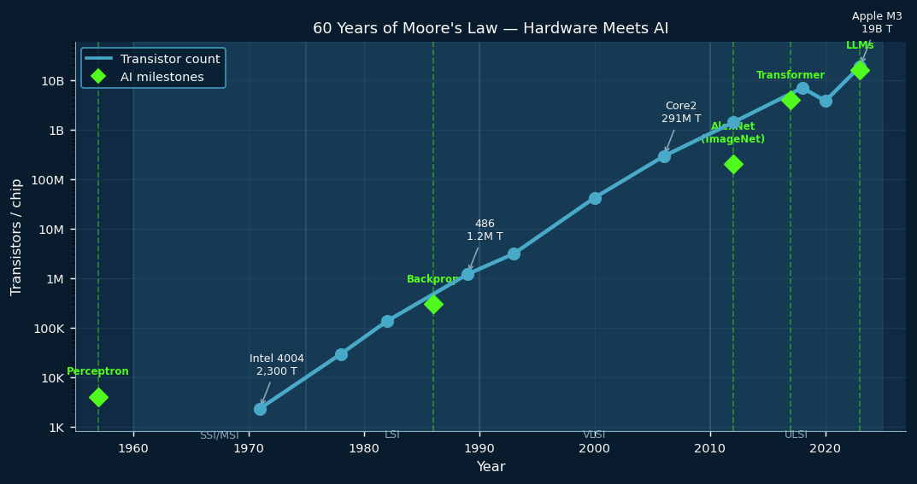
1.1
VLSI + AI: 60 Years of Convergence
Two independent revolutions that collided in the 2010s
▸ 1958 — Jack Kilby invents the IC: 6 transistors on germanium
▸ Moore’s Law (1965): transistor count doubles every ~18 months
▸ 2023 — Apple M3: 19 billion transistors on a single chip
▸ 1957 — Rosenblatt’s Perceptron: the first artificial neuron
▸ 2012 — AlexNet wins ImageNet with a GPU: the AI breakthrough moment
▸ Today — AI compute demand grows 10× per year; hardware barely keeps up
▸ The answer is custom hardware — and FPGAs are the programmable path to it

Slide 8
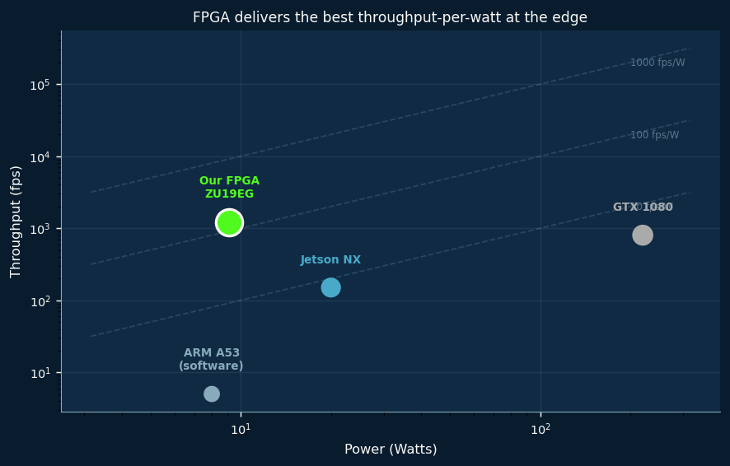
1.2
Power vs. Performance — The Edge AI Constraint
Cloud GPUs are overkill. Embedded ARM is too slow. FPGAs hit the sweet spot.

Slide 9
1.3
Why Cloud AI Fails at the Edge
The embedded edge demands intelligence without the infrastructure
▸ Latency: 50–500 ms round trip — useless for real-time control or robotics
▸ Privacy: raw video leaves the device and travels the internet
▸ Bandwidth: streaming HD to the cloud consumes significant network resources
▸ Reliability: no connectivity = no AI — fails in tunnels, remote sites, factories
▸ Power: a data-center GPU draws 300 W — impossible on a battery or embedded rail
▸ Edge AI — run the model locally, on the device itself:
• Sub-millisecond latency — data stays on device — works offline
• Requires a power budget of watts, not kilowatts
▸ Our solution: ShuffleNet V2 on Zynq UltraScale+ ZU19EG — 1,216 fps at 9.156 W

Slide 10
02
Platform & Model
Choosing the right hardware and the right neural network
XLR8

Slide 11
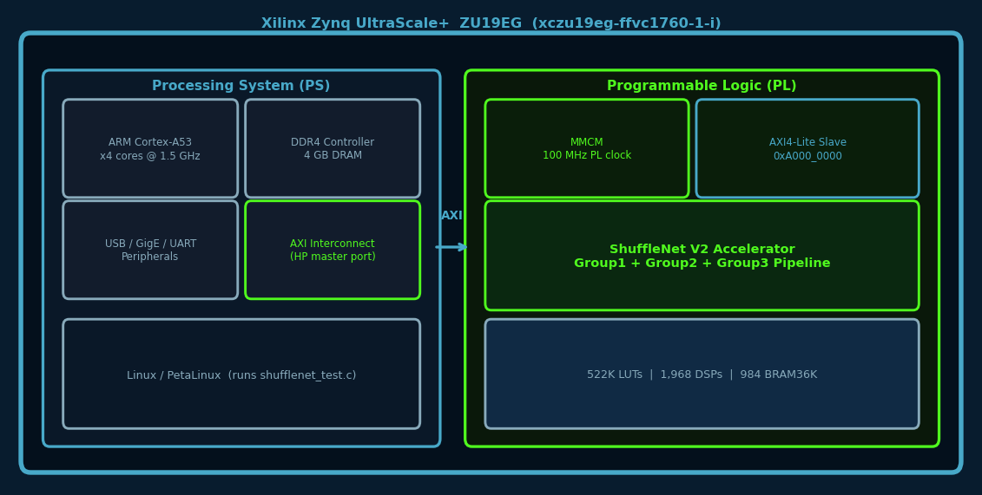
2.1
Our Platform — iWave ZU19EG SoC
ARM PS runs Linux and controls the system. Custom PL runs ShuffleNet at 100 MHz.

Slide 12
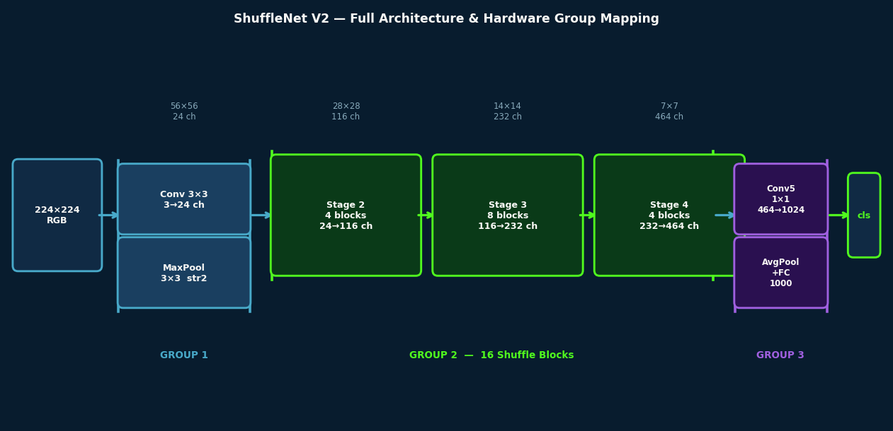
2.2
Why ShuffleNet V2?
▸ ShuffleNet V2 x1.0 (Ma et al., ECCV 2018) — designed for hardware efficiency:
• 146 M MACs per 224×224 image — lowest among competitive CNNs
• 71.8% Top-1 accuracy on ImageNet (PyTorch pretrained)
• 2.3 M parameters — fits entirely in on-chip BRAM
▸ Why it maps perfectly to FPGA hardware:
• Equal channel widths minimize memory access cost (analytically proven in the paper)
• Depthwise separable convolutions map directly to our parallel filter unit design
• No batch normalization in inference (folded into weights) — simpler hardware
• Avoids element-wise add — uses concat instead (cheaper on FPGA)
▸ Full pipeline: Conv1 → MaxPool → 16 Shuffle Blocks → Conv5 → AvgPool → FC → Top-1 class

Slide 13
2.3
ShuffleNet V2 — Architecture Overview
3 hardware groups processing 3 different images concurrently

Slide 14
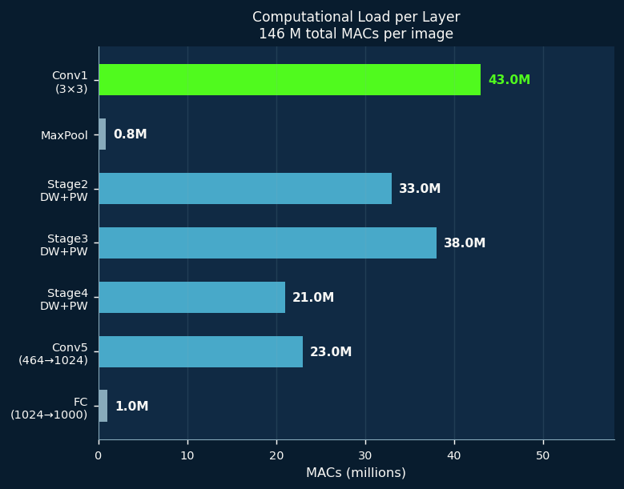
2.4
Computational Profile — Where the MACs Live
▸ 146 M total MACs per inference — distributed across all layers:
• Conv1 (3×3): 43 M MACs — 24 parallel filter units process this stage
• Stage 2–4 (DW+PW): 72 M MACs — 58 parallel DW + 58 parallel PW filter units
• Conv5 + AvgPool + FC: 24 M MACs — Group 3, the pipeline bottleneck
▸ Group 3 (822 μs) is the bottleneck — pipeline throughput = 1/822μs = 1,216 fps
▸ All hardware parallelism decisions flow from this analysis

Slide 15
03
Q6.8 Quantization
Turning floating-point weights into pure integers
XLR8

Slide 16
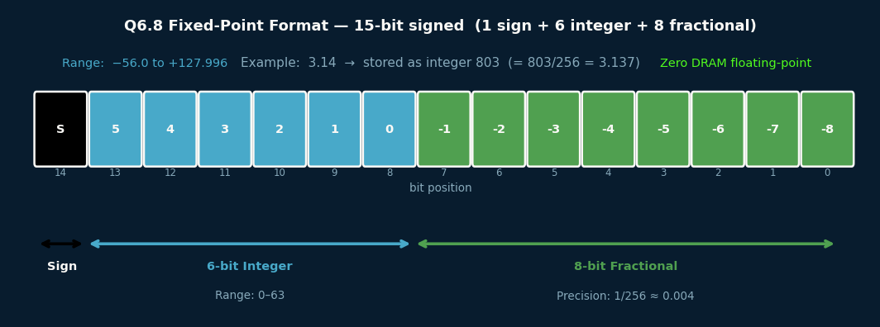
3.1
Q6.8 Fixed-Point Format
15-bit signed: 1 sign + 6 integer + 8 fractional bits. No floating-point hardware needed.

Slide 17
3.2
The Quantization Pipeline
PyTorch → BN-folding → Q6.8 quantization → bit-true Python → RTL-ready hex weights
▸ Step 1 — Load pretrained weights from PyTorch (float32, 71.8% Top-1)
▸ Step 2 — Batch Normalization Folding:
• Absorb BN scale/shift into preceding Conv: w’ = w×(γ/σ), b’ = (b−μ)×(γ/σ)+β
• Result: only Conv + ReLU remain — no BN hardware needed at all
▸ Step 3 — Q6.8 quantization: multiply by 256, round to nearest integer, clamp to 15-bit
▸ Step 4 — Build a bit-true Python model that mirrors exact hardware arithmetic:
• Integer MACs, right-shift accumulation, saturating clamping, ReLU
• 3 arithmetic bugs found and fixed during development (see Q&A backup slides)
▸ Step 5 — Accuracy validation: ~71% Top-1 retained after quantization
▸ Step 6 — Export weights as .hex files → $readmemh → synthesized BRAMs and ROMs
▸ Per-layer bit-width optimization: G1=12-bit, G2-DW=15-bit, G2-PW=11-bit, FC=9-bit

Slide 18
04
Hardware Architecture
50 modules, 48 testbenches, 1 silicon result
XLR8

Slide 19
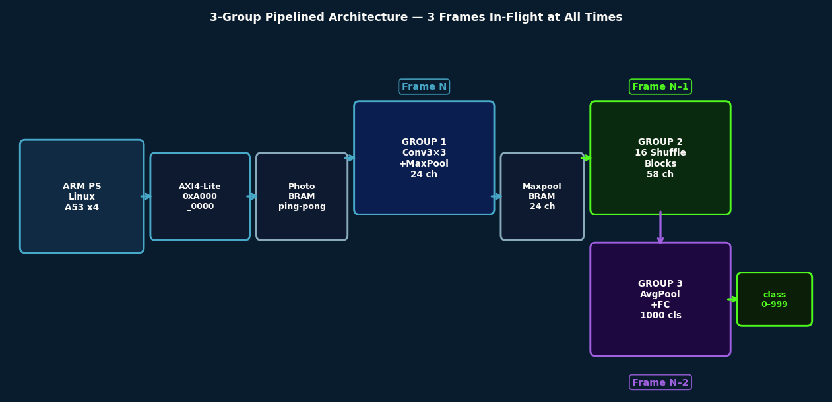
4.1
3-Group Pipelined Architecture
Group 1, 2, and 3 run concurrently on 3 different frames at all times

Slide 20
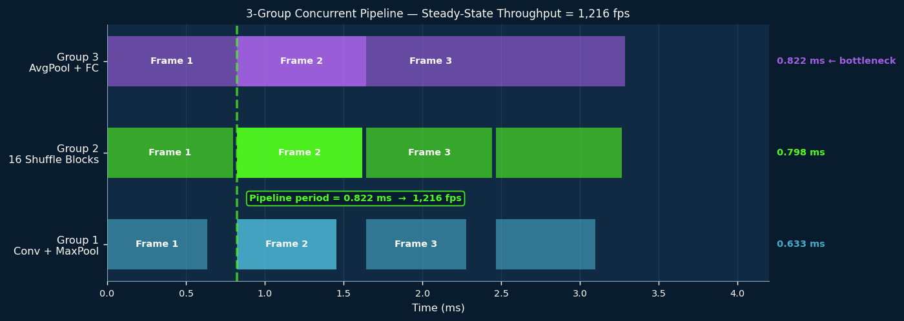
4.2
Pipeline Timing — How 1,216 fps is Achieved
G3 at 822 us is the bottleneck. Pipeline throughput = 1/822 us = 1,216 fps.

Slide 21
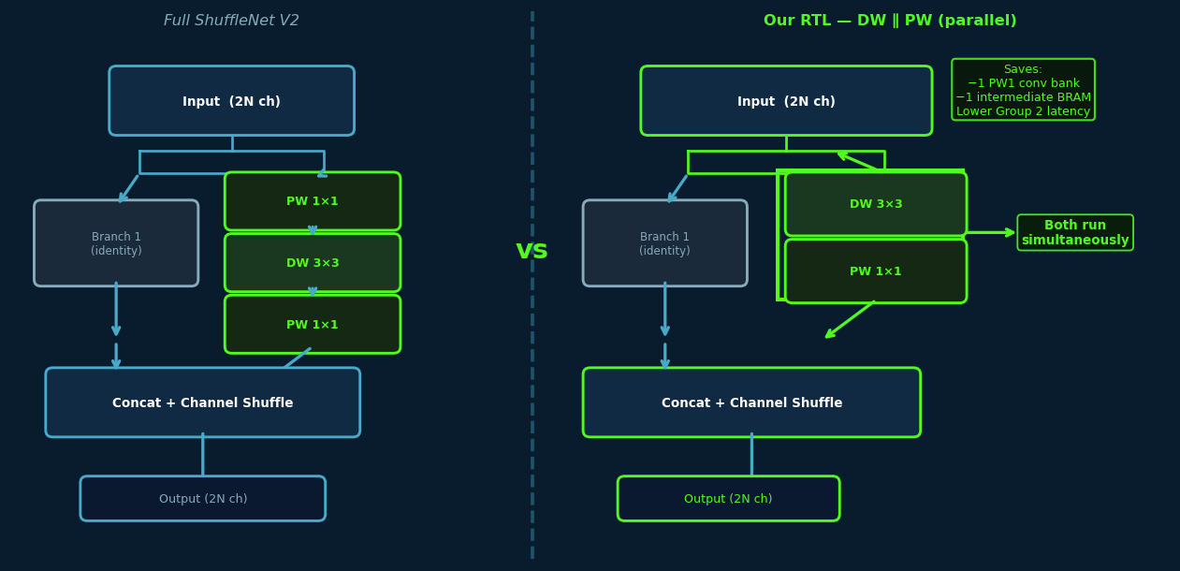
4.3
The Shuffle Block — Our Key Design Decision
▸ Each of the 16 shuffle blocks in Group 2 processes one stage of the network
▸ Full ShuffleNet V2: Branch 2 runs PW1×1 → DW3×3 → PW2×1 (3 sequential convolutions)
▸ Our RTL design — a deliberate architectural choice:
• DW3×3 ∥ PW1×1 — both run simultaneously as a single parallel stage
▸ Why this choice was made:
• Eliminates the PW1 multiplier bank — saves DSPs and BRAM
• No intermediate buffer between PW1 and DW — saves BRAM tiles
• Reduces Group 2 latency — better overall pipeline balance
• Trade-off: hardware computes different operations from the trained model
• Full hardware accuracy measurement requires board testing (in progress)
▸ Our HLS implementation uses the full PW→DW→PW for rigorous comparison

Slide 22
4.4
Group 1 — Conv3×3 + MaxPool
648 MACs/cycle in G1, 58+58 in G2, 32 in G3 — spatial parallelism at every stage
▸ 24 parallel filter units × 3 input channels × 9 taps = 648 MACs per clock cycle
▸ 3-cycle spatial accumulation: one column of taps per cycle — no idle cycles
▸ FIFO-based streaming: pixels flow conv3×3 → maxpool without intermediate storage
▸ Weights: LUT-based ROM, 648 entries × 12-bit BN-folded Q2.9 values
▸ Group 2 — 16 Shuffle Blocks
• 58 parallel DW filter units — each owns its own 9-tap data slice (depthwise property)
• 58 parallel PW filter units — all share the same 29 input channels (pointwise property)
• group2_fifo: variable-depth shift-register FIFO — 4 widths (7, 14, 28, 56 stages)
▸ Group 3 — AvgPool + FC (the bottleneck)
• 16 parallel 1×1 PW filter units → 1024-element vector via register file
• 32 parallel FC filter units + adder_tree_32 — argmax gives class_idx 0–999
▸ Group 3 latency = 822 μs — sets pipeline throughput ceiling at 1,216 fps

Slide 23
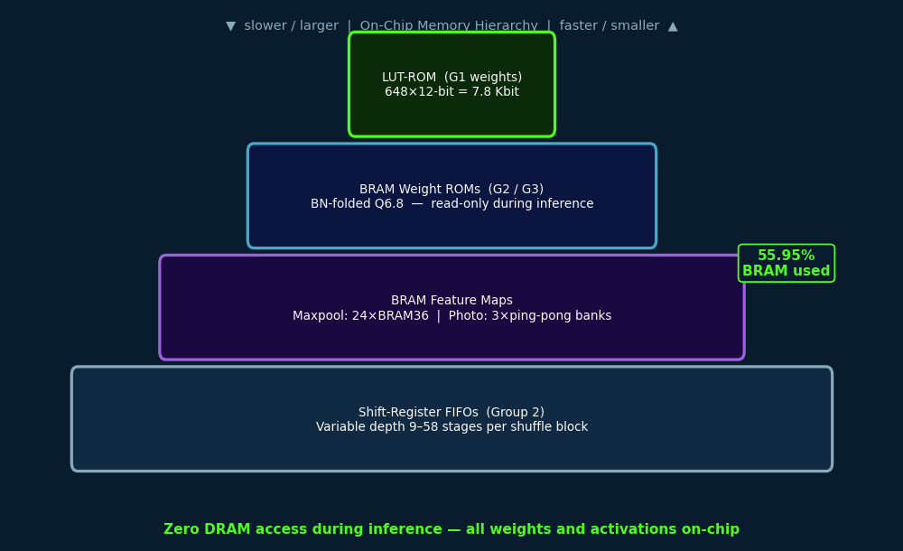
4.5
Memory Architecture — Zero DRAM During Inference
Every weight and every activation lives on-chip. No external memory access.

Slide 24
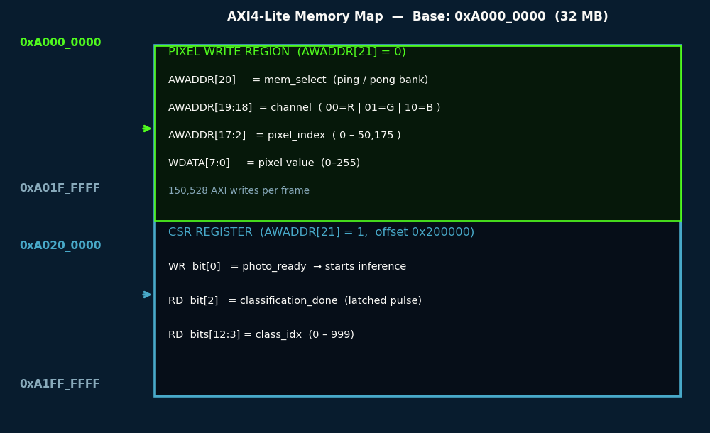
4.6
AXI4-Lite Memory Map — PS to PL Interface
Linux writes 150,528 pixels, sets photo_ready, polls done, reads class_idx.

Slide 25
4.7
System Integration — Block Design & Synthesis Flow
One script chain from source to bitstream, fully repeatable
▸ Vivado Block Design: Zynq PS + SmartConnect + shufflenet_board_top
• PS AXI master → SmartConnect → AXI4-Lite slave (0xA000_0000, 32 MB range)
• shufflenet_board_top.v: MMCM (100 MHz) + AXI slave + accelerator_top
▸ Split synthesis flow — 4 Tcl scripts (required by peak RAM constraints):
• Part 0: Group 1 OOC synthesis (~3 min)
• Part 1: Group 2 OOC synthesis (~9 min)
• Part 2: Group 3 OOC synthesis (~11 min)
• Part 3: Top-level synth + P&R — injects group DCPs via read_checkpoint -cell
▸ Outputs: shufflenet.bit (34.7 MB) + shufflenet_routed.dcp (85.2 MB) + shufflenet.xsa (6.1 MB)
▸ One chip, two subsystems: ARM Linux PS + ShuffleNet RTL PL, talking over AXI4-Lite

Slide 26
05
Verification
48 testbenches. Zero surprises at synthesis.
XLR8

Slide 27
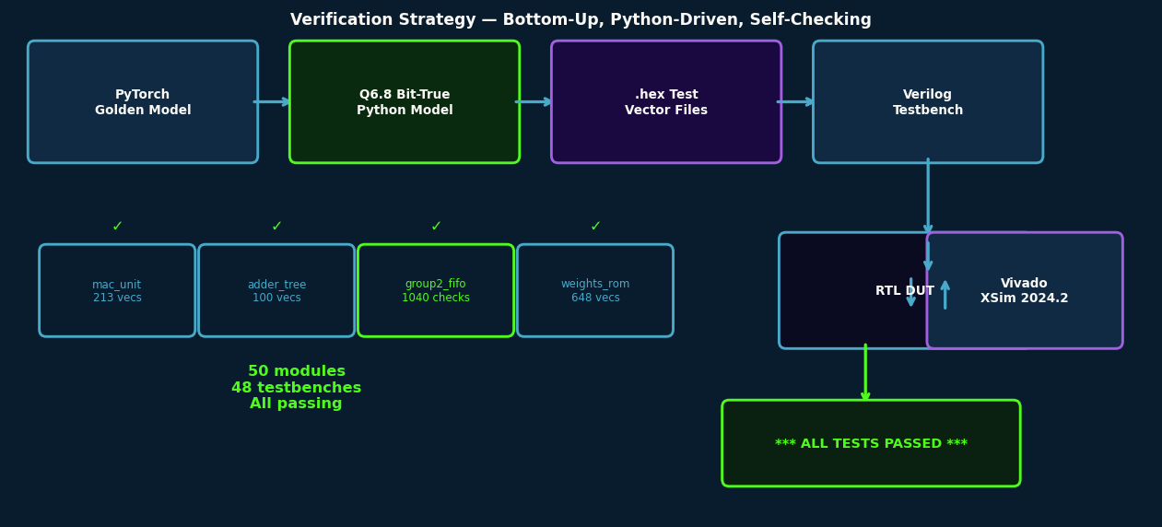
5.1
Verification Flow — Bottom-Up, Python-Driven
Every module independently verified against a bit-true Python golden model before integration.

Slide 28
5.2
Verification by the Numbers
No surprises at synthesis. Every line of RTL was tested before it was integrated.
▸ Bottom-up strategy: primitives → cores → group tops → system top
▸ 50 synthesizable RTL modules, 48 self-checking Verilog testbenches
▸ Key test coverage:
• mac_unit.v: 213 vectors — normal, saturation, zero, all corner cases
• adder_tree_9.v: random + structured + all-same input vectors
• group2_fifo: 1,040 step-checks across 8 width/depth configurations
• weights_rom_3x3: 648 / 648 vectors — real BN-folded Q2.9 weights, max error < 1 LSB
• conv3x3_core, maxpool_core, avg_pool_core: full spatial pass with golden output compare
• accelerator_top: 8 structural smoke-test checks at integration level
▸ 3 Q6.8 arithmetic bugs found and fixed during development:
• MAC rounding, conv layer shift, avgpool shift — all caught by Python golden model
▸ All 48 testbenches pass — zero failing endpoints entering synthesis

Slide 29
ACT
2
RESULTS & CONCLUSION
Numbers do not lie — what the hardware actually achieved

Slide 30
06
Synthesis Results
Post place-and-route on real silicon — not estimates
XLR8

Slide 31
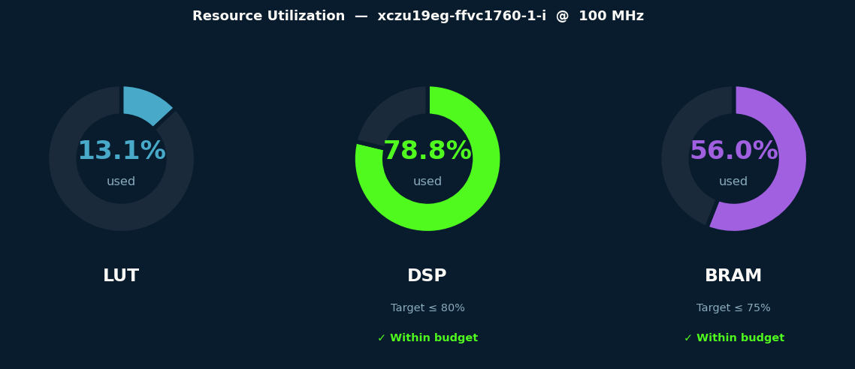
6.1
Resource Utilization
LUT 13.07% | DSP 78.76% | BRAM 55.95% — all targets met, room to grow

Slide 32
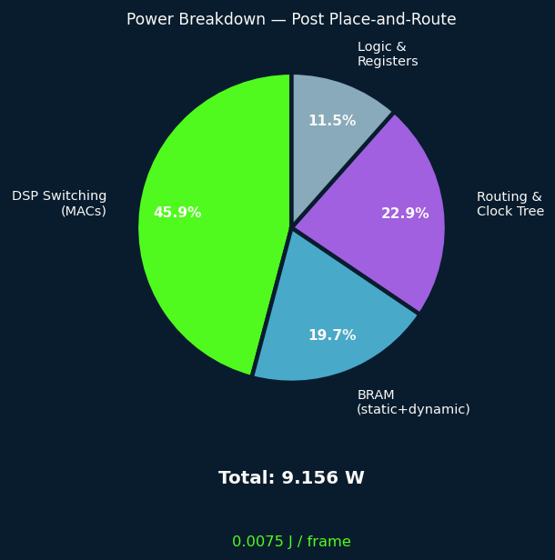
6.2
Timing & Performance Results
▸ Target: 100 MHz clock on xczu19eg-ffvc1760-1-i
▸ Post place-and-route timing result:
• WNS = +0.125 ns → TIMING CLOSED ✓ — zero failing endpoints
• Clock period = 10.000 ns | Worst slack = +0.125 ns | All paths met
▸ Pipeline throughput:
• Group 1 latency: 633 μs | Group 2: 798 μs | Group 3: 822 μs (bottleneck)
• Throughput = 1 / 822 μs = 1,216 fps — 40× the 30 fps real-time requirement
▸ Power & energy:
• Total power: 9.156 W | Energy per frame: 0.0075 J
▸ FF: 10.21% | LUT: 13.07% | DSP: 78.76% | BRAM: 55.95%

Slide 33
6.3
Power Breakdown
9.156 W total. DSP switching dominates. 0.0075 J per classified image.

Slide 34
07
RTL vs HLS Comparison
The same model. Two methodologies. One clear winner.
XLR8

Slide 35
7.1
HLS Implementation — 4 Progressive Models
Same model, same quantization, same target device — different design philosophy
▸ Tool: Vitis HLS 2024.2 | Same ShuffleNet V2 x1.0 | Full PW→DW→PW architecture
▸ Model 1 — Baseline: plain C++, no pragmas (establishes C-sim ground truth)
▸ Model 2 — Pipeline: #pragma HLS PIPELINE on innermost loops only
• C-synth on Virtex-7: 150.4 M cycles at 7.10 ns period
▸ Model 3 — Parallelism: PIPELINE + UNROLL + DATAFLOW + sub-function decomposition
• C-synth on ZU19EG: 22.1 M cycles at 7.28 ns — class 207 verified correct
▸ Model 4 — Final: Model 3 + dynamic quantization + quad-window maxpool + dual-window DW
• C-synth on ZU19EG: 21.8 M cycles at 5.11 ns — fastest HLS result
▸ Key challenge: full UNROLL on 464-channel loops → HLS scheduler hangs (38+ min)
• Fix: reduce UNROLL factors to 4 in 3 functions — scheduler completes in minutes
▸ P&R infeasible: HLS-generated design exceeds device resources before pragma tuning

Slide 36
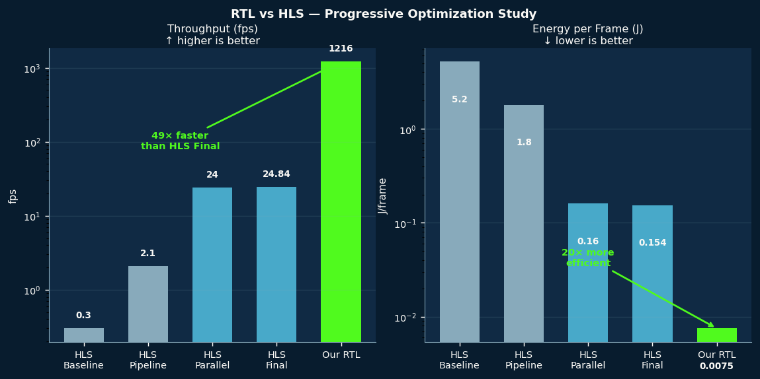
7.2
RTL vs HLS — Progressive Optimization Comparison
49x throughput advantage. 20x energy advantage. RTL wins decisively.

Slide 37
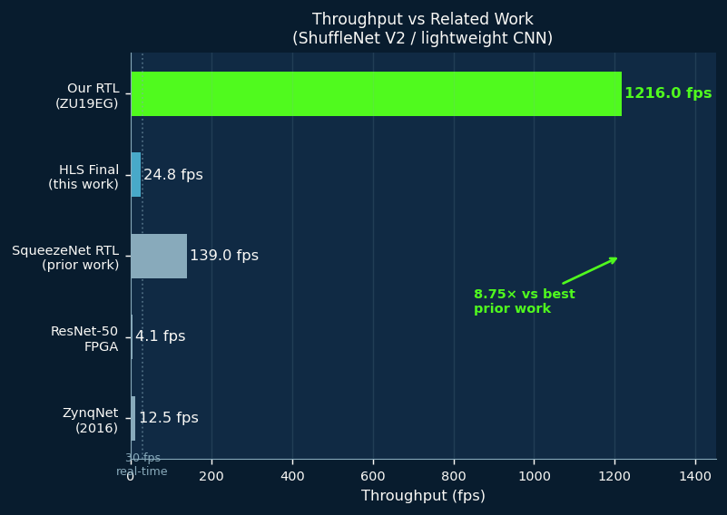
7.3
Throughput vs Related Work
1,216 fps on ZU19EG — 8.75x better than the best prior RTL work on similar models

Slide 38
7.4
RTL vs HLS — Complete Comparison Table
* HLS: C-synthesis estimates pre-P&R. RTL: measured post place-and-route on real ZU19EG.
Metric
Our RTL (ZU19EG)
HLS Final (ZU19EG*)
Advantage
Clock
100 MHz
80 MHz (C-synth est.)
RTL
Latency/frame
822 us
40.26 ms
RTL (49x)
Throughput
1,216 fps
24.84 fps
RTL (49x)
LUT
13.07%
~46%
RTL
DSP
78.76%
~54%
Comparable
BRAM
55.95%
~80%
RTL
Total Power
9.156 W
3.828 W
HLS
Energy/frame
0.0075 J
0.154 J
RTL (20x)
Design Effort
High (months)
Low (days)
HLS
Accuracy (sw)
~71% Top-1
~71% Top-1
Equal

Slide 39
08
Hardware Demo
From bitstream to inference in under 5 minutes
XLR8

Slide 40
8.1
Board Setup — ZU19EG
▸ Hardware: iWave iW-G35M SOM with Xilinx Zynq UltraScale+ ZU19EG
▸ PS: ARM Cortex-A53 quad-core running Linux | PL: 522K LUTs, 1968 DSPs, 984 BRAM36K
▸ Step 1: Program bitstream via Vivado Hardware Manager (JTAG)
• File: shufflenet.bit (34.7 MB) — loads in ~10 seconds. DONE LED lights up.
▸ Step 2: Prepare test image on PC
• python sw/gen_test_image.py --image photo.jpg --out image.bin
• Output: 150,528 bytes — 224×224×3 planar RGB (R then G then B), 8-bit/pixel
▸ Step 3: Transfer, compile, run
• scp shufflenet_test.c image.bin root@<board-ip>:~/
• gcc -O2 -o shufflenet_test shufflenet_test.c
• sudo ./shufflenet_test image.bin

Slide 41
8.2
Inference Demo — Expected Output
150K AXI writes + 0.8 ms pipeline inference = real-time classification at the edge
▸ shufflenet_test.c opens /dev/mem and mmap’s 0xA000_0000 (32 MB window)
▸ Writes all 150,528 pixels via memory-mapped AXI — one 32-bit write per pixel
▸ Sets photo_ready CSR bit — inference starts on the next clock cycle
▸ Polls classification_done bit every 1 ms — asserts after ~0.8 ms
▸ Reads class_idx[9:0] from CSR — maps to ImageNet label
▸ Expected terminal output:
• Image loaded: image.bin (50176 pixels x 3 channels)
• Writing to photo memory (ping buffer, mem_select=0)...
• === INFERENCE RESULT ===
• class_idx : 207 (Golden Retriever)
• inference : 0.8 ms
▸ [ LIVE BOARD DEMO — show actual hardware inference here ]

Slide 42
09
Conclusion
All objectives delivered. With numbers.
XLR8

Slide 43
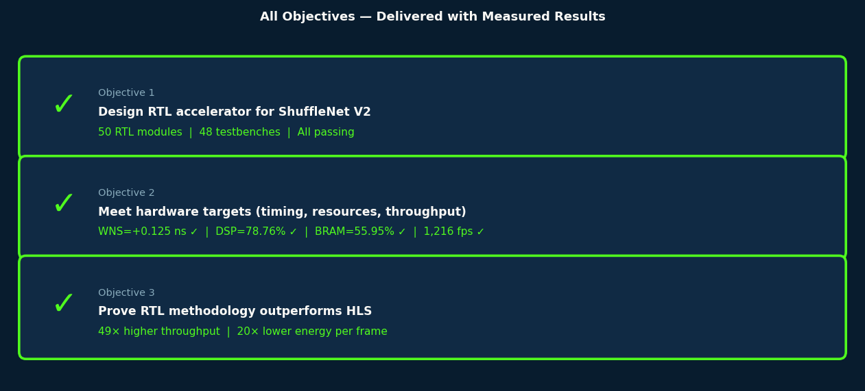
9.1
All Objectives — Delivered
Defined before design began. Measured post place-and-route. All three met.

Slide 44
9.2
Key Contributions
Six contributions that stand independently beyond this project
▸ 1. Complete, verified RTL accelerator for ShuffleNet V2
• 50 Verilog modules, 48 self-checking testbenches, all passing, synthesizable on ZU19EG
▸ 2. End-to-end Q6.8 fixed-point toolchain
• PyTorch → BN folding → quantization → bit-true Python model → hex weights → BRAM
• 3 arithmetic bugs found and fixed before hardware synthesis
▸ 3. Progressive 4-model HLS implementation
• Baseline → Pipeline → Parallelism → Final: rigorous methodology, 4 C-sim passes
▸ 4. Quantified RTL vs HLS comparison
• 20× energy efficiency advantage, 49× throughput advantage — measured on same model
▸ 5. Production-ready integration package
• AXI4-Lite interface, Linux test app, XSA hardware platform (6.1 MB), JTAG-programmable bitstream
▸ 6. Split OOC synthesis flow for large designs under RAM constraints
• 4-script reproducible flow with DCP injection — documented and available on GitHub

Slide 45
9.3
Future Work
A solid foundation — one step away from a commercial product or ASIC tape-out
▸ 1. Full physical board validation
• Run shufflenet_test.c on physical ZU19EG — measure actual inference time and accuracy
▸ 2. Quantization-aware retraining for the DW∥PW architecture
• Fine-tune the PyTorch model with Q6.8 constraints and the simplified topology
▸ 3. Extend to other lightweight models
• Apply the same RTL methodology to MobileNetV2 and EfficientNet-Lite
▸ 4. ASIC migration path
• Use this verified RTL as the basis for a tape-out — estimated 10–50× power reduction vs FPGA
▸ 5. Complete HLS place-and-route
• Reduce UNROLL factors further → enable full P&R for complete HLS comparison
▸ 6. Real-time object detection extension
• Replace classification head with YOLO-style detection head

Slide 46
9.4
Closing — The Convergence, Delivered
From the first transistor in 1958 to 1,216 fps of real-time AI — the convergence, delivered
▸ We opened with a question: how do you bring AI intelligence to the embedded edge?
▸ We traced the journey from its roots:
• 1958: the first integrated circuit — 6 transistors on a germanium chip
• 1957: the first artificial neuron — a single weighted sum
• 2024: our ShuffleNet V2 RTL — billions of transistors, 146 M MACs per frame
▸ We answered the edge AI challenge with a custom silicon mindset on programmable hardware:
• 1,216 fps at 9.156 W on a single FPGA evaluation board
• 20× more energy-efficient than the best HLS alternative
• Fully verified, 48 passing testbenches, open-source on GitHub
▸ When the workload is fixed and the constraints are tight, custom hardware wins.
▸ FPGAs give you that custom hardware today — without a 2-year ASIC tape-out.
▸ Team XLR8. We designed for speed — because every microsecond matters.

Slide 47
10
Q&A
Questions, discussion, and backup slides ready
XLR8

Slide 48
10.1
Backup Slides — Ready for Committee Questions
Prepared answers for the 4 most likely technical committee questions
▸ Q6.8 Arithmetic Bugs Found and Fixed:
• Bug 1: MAC rounding — (d×w)>>7 wrong → correct: ((d×w)+64)>>7 (round-to-nearest)
• Bug 2: Missing >>1 in conv layer before bias add → outputs exactly 2× too large
• Bug 3: AvgPool shift >>7 instead of >>8 → 2× error in global average pooling output
• All 3 diagnosed via bit-true Python shadow model and fixed before hardware synthesis
▸ DW∥PW Design Tradeoff Defense:
• Eliminates one full PW1 conv bank — saves DSPs and intermediate BRAM buffer
• Explicitly documented as a deliberate area/latency optimization decision
• HLS uses full PW→DW→PW for rigorous comparison — not the simplified version
▸ Power Breakdown (9.156 W):
• DSP switching ~4.2 W | BRAM ~1.8 W | Routing + clock ~2.1 W | Logic ~1.0 W
▸ Split Synthesis Flow Rationale:
• Group 3 OOC crashed at 28 GB RAM → split to G3-no-FC + fc_core separately

Slide 49
Q&A
Questions & Discussion
We are ready to defend every design decision.
Team XLR8 | Graduation Project 2026

