Slide 1
Research Strategy and Power Estimation
Joe Nagel
3/30/2026

Slide 2
Research Aims
Aim 1: Inflammation is Related to Declines in Cognition and Cortical Thickness
Hypothesis 1a: Baseline inflammation measures predict declines in memory consolidation and AD-signature cortical thickness
Hypothesis 1b: Increases in inflammation measures predict declines in memory consolidation and AD-signature cortical thickness
Aim 2: Inflammation and Amyloid Deposition Interact
Hypothesis 2: Declines in memory and AD‑signature cortical thickness are greatest when amyloid deposition and peripheral inflammation are both elevated

Slide 3
Data Overview
Sample Size
Target 175
Accounting for 10% attrition
Outcomes (Baseline – Year 1)
AD-Signature Cortial Thickness (continuous)
Cognitive measures (continuous)
Inflammation Measures
Cytokines: IL-6, TNF-alpha
Chemokines: MCP-1, eotaxin-1
Covariates
Demographics
Age, Sex
Cardiovascular risk markers
BMI, blood pressure, history of hypercholesterolemia
NSAID use
Immune-related health conditions
Crohn's disease, irritable bowel syndrome (IBS), and arthritis

Slide 4
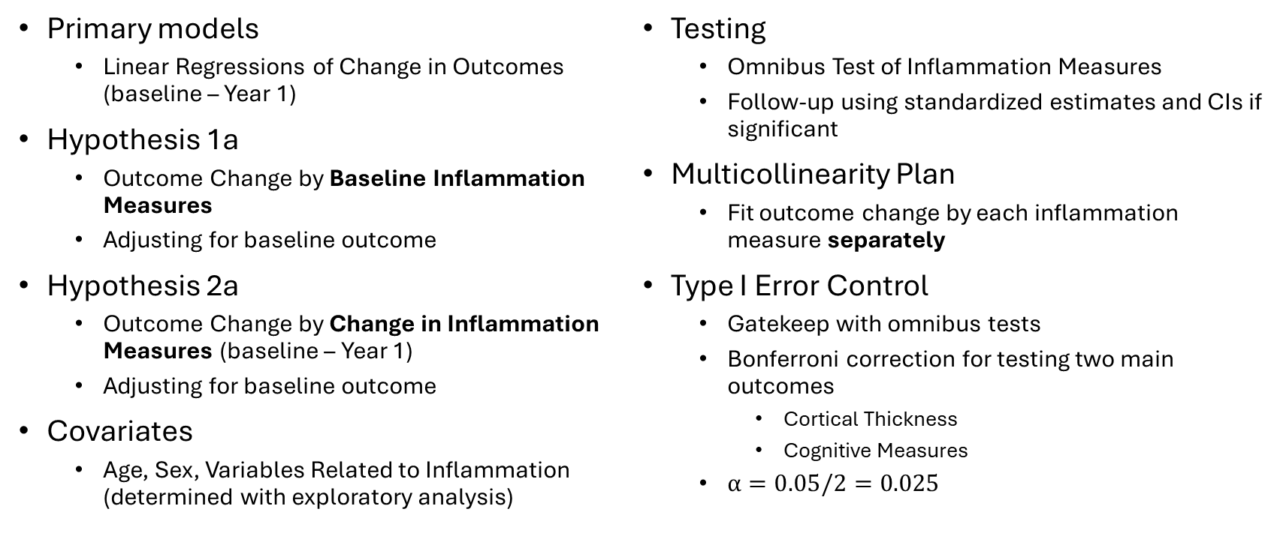
Aim 1 Analysis
Primary models
Linear Regressions of Change in Outcomes (baseline – Year 1)
Hypothesis 1a
Outcome Change by Baseline Inflammation Measures
Adjusting for baseline outcome
Hypothesis 2a
Outcome Change by Change in Inflammation Measures (baseline – Year 1)
Adjusting for baseline outcome
Covariates
Age, Sex, Variables Related to Inflammation (determined with exploratory analysis)
Testing
Omnibus Test of Inflammation Measures
Follow-up using standardized estimates and CIs if significant
Multicollinearity Plan
Fit outcome change by each inflammation measure separately
Type I Error Control
Gatekeep with omnibus tests
Bonferroni correction for testing two main outcomes
Cortical Thickness
Cognitive Measures
$α=0.05/2=0.025$

Slide 5
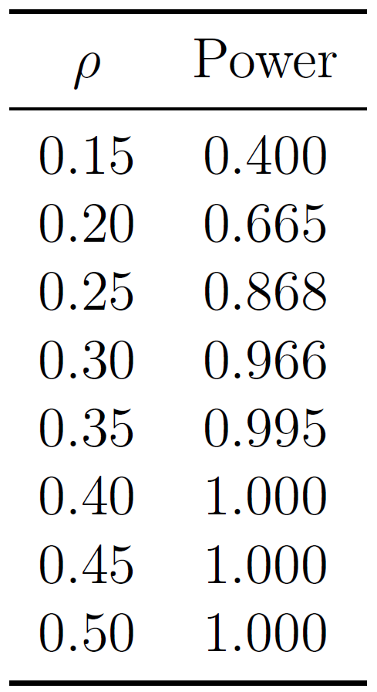
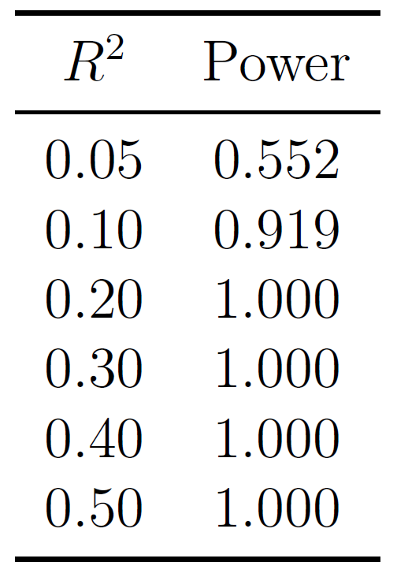
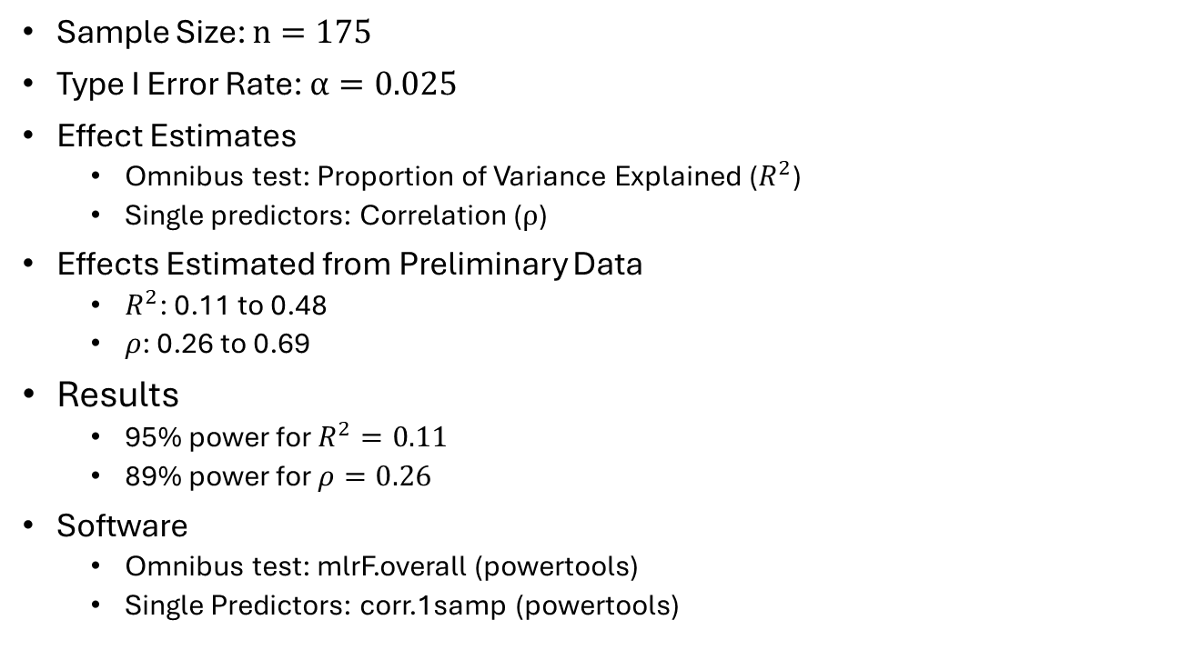
Aim 1 Power
Sample Size: $n=175$
Type I Error Rate: $α=0.025$
Effect Estimates
Omnibus test: Proportion of Variance Explained ($R^{2}$)
Single predictors: Correlation ($ρ$)
Effects Estimated from Preliminary Data
$R^{2}$: 0.11 to 0.48
$ρ$: 0.26 to 0.69
Results
95% power for $R^{2}=0.11$
89% power for $ρ=0.26$
Software
Omnibus test: mlrF.overall (powertools)
Single Predictors: corr.1samp (powertools)

Slide 6
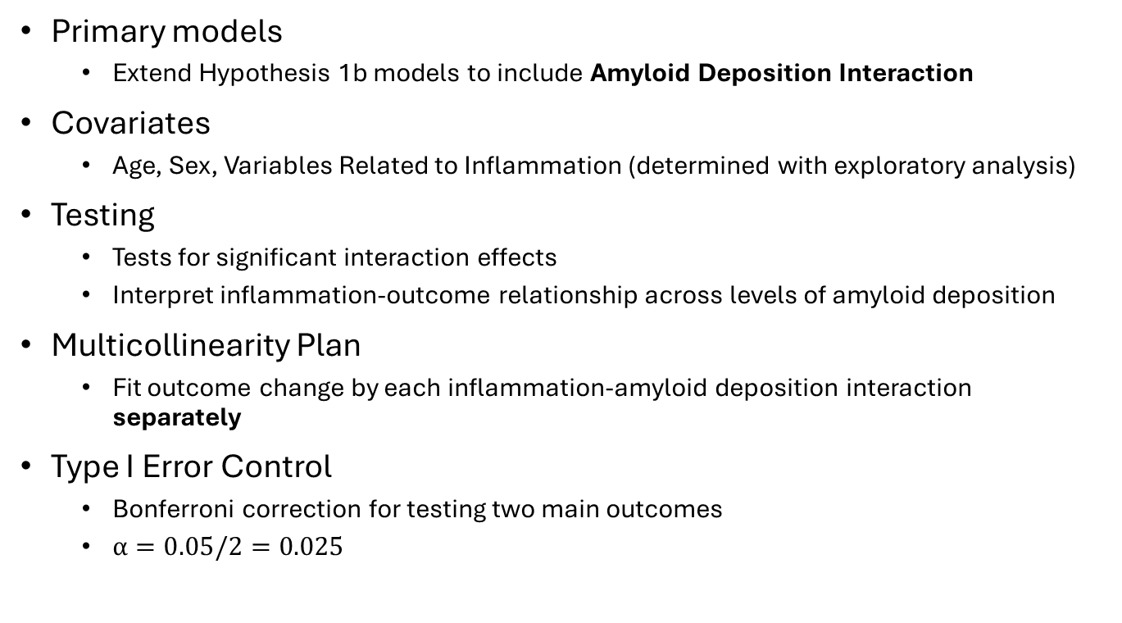
Aim 2 Analysis
Primary models
Extend Hypothesis 1b models to include Amyloid Deposition Interaction
Covariates
Age, Sex, Variables Related to Inflammation (determined with exploratory analysis)
Testing
Tests for significant interaction effects
Interpret inflammation-outcome relationship across levels of amyloid deposition
Multicollinearity Plan
Fit outcome change by each inflammation-amyloid deposition interaction separately
Type I Error Control
Bonferroni correction for testing two main outcomes
$α=0.05/2=0.025$

Slide 7
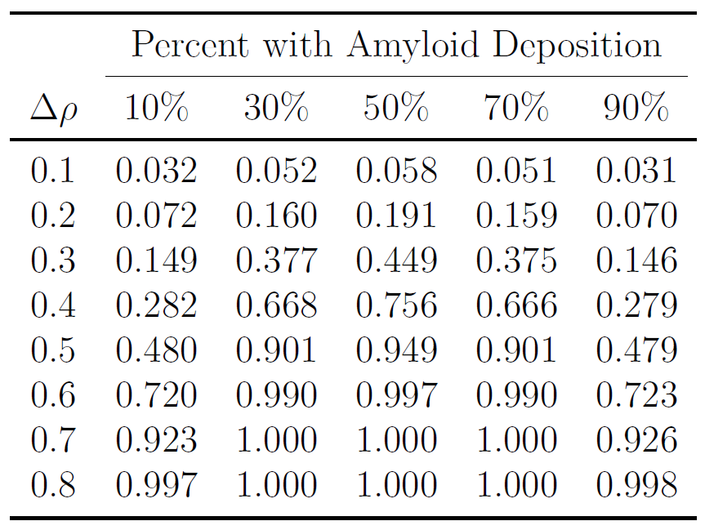
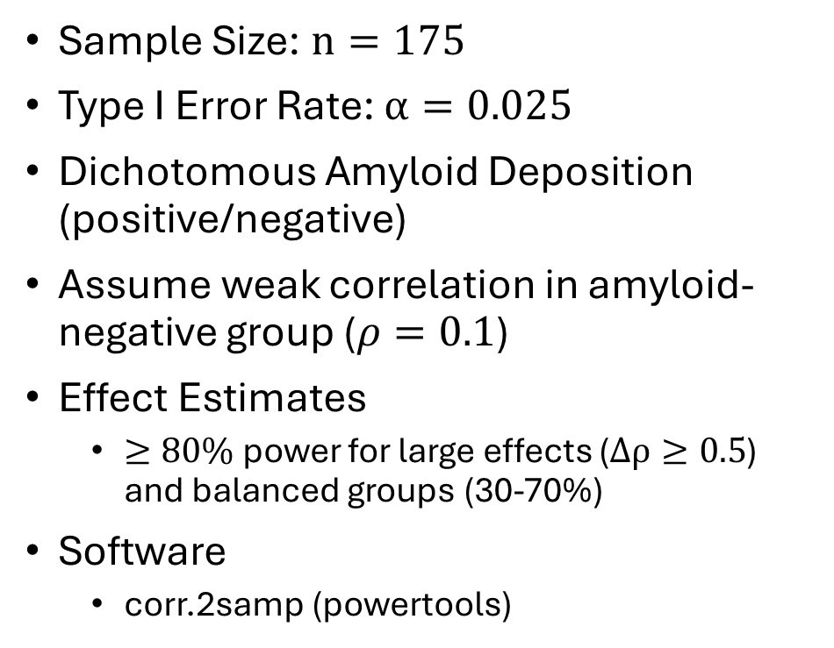
Aim 2 Power
Sample Size: $n=175$
Type I Error Rate: $α=0.025$
Dichotomous Amyloid Deposition (positive/negative)
Assume weak correlation in amyloid-negative group ($ρ=0.1$)
Effect Estimates
$≥80\%$ power for large effects ($Δρ≥0.5$) and balanced groups (30-70%)
Software
corr.2samp (powertools)

