Slide 1
Sex-Specific Risk Factor Analysis and Probability Estimation of Stroke
Joe Nagel
4/8/2026

Slide 2
Research Questions
What clinical risk factors are associated with stroke?
Coronary Heart Disease (CHD)
Use of Blood Pressure Medication
Smoking Status
Total Cholesterol
Body Mass Index (BMI)
What is the 10-year probability of stroke for specific risk profiles?
Age (40, 50, 60) and Sex
High Blood Pressure, Diabetes, Obesity

Slide 3
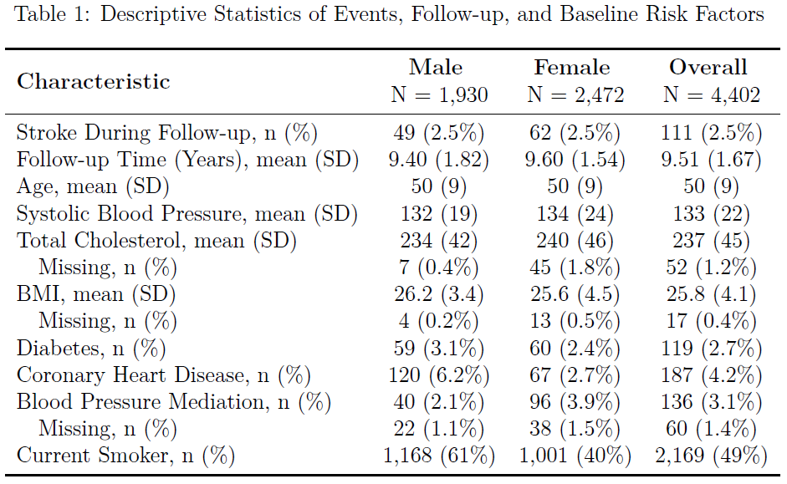
Data Overview
4434 Total Subjects
32 excluded (prevalent stroke)
111 Strokes During Follow-up
2.5% of all subjects
9.5 Years of Average Follow-up
Minimal Missingness
4275 Final Sample Size (127 w/ Missing)
Covariates
Age
Systolic Blood Pressure
Total Cholesterol
BMI
Diabetes
Coronary Heart Disease
Blood Pressure Medication Use
Smoking Status

Slide 4
Analysis Methods
Base Model
Cox Proportional Hazards Models for Males and Females
Risk of stroke by age, diabetes status, and systolic blood pressure
Identify Potential Risk Factors
CHD, blood pressure medication, smoking status, total cholesterol, BMI
Selected using AIC-based backwards selection
Estimate 10-year probability of stroke for specific profiles
Sex
Ages: 40, 50, 60
High Blood Pressure (BP=160), Diabetes, Obese (BMI=30)
Assess Proportional Hazards
Kaplan-Meier Survival Curves and Schoenfeld residuals test
Evaluate Impact of Time-Varying Covariates
Diabetes Status and Blood Pressure

