Slide 1
Impacts of Hard Drug Use on HAART Efficacy in HIV-Positive Men
Joe Nagel
3/2/2026

Slide 2
Research Questions
How is the treatment response after 2 years of HAART affected by hard drug use?
SF-36 Mental Component Summary (MCS) Score
SF-36 Physical Component Summary (PCS) Score
(log10) HIV viral load
CD4+ T cell count
Are any effects of hard drug use confounded or mediated by study protocol adherence?

Slide 3
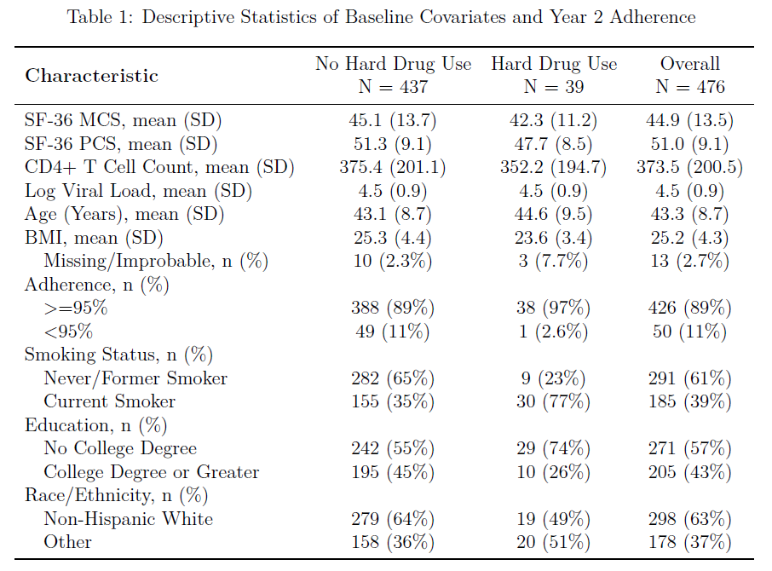
Data Overview
715 total subjects
467 subjects with all outcomes measured at Baseline and Year 2
41% missing for drug users
32% missing for non-users
Adherence
Higher among hard drug users (n=1 with <95%)

Slide 4
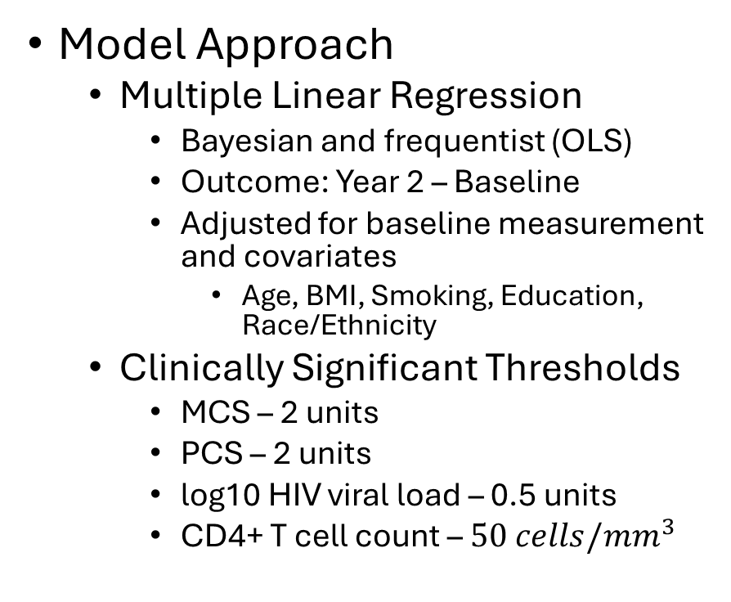
Analysis Methods
Model Approach
Multiple Linear Regression
Bayesian and frequentist (OLS)
Outcome: Year 2 – Baseline
Adjusted for baseline measurement and covariates
Age, BMI, Smoking, Education, Race/Ethnicity
Clinically Significant Thresholds
MCS – 2 units
PCS – 2 units
log10 HIV viral load – 0.5 units
CD4+ T cell count – $50 cells/mm^{3}$
Model Summaries
Frequentist
Point Estimates
95% Confidence Intervals (CI)
p-values
Bayesian
Point Estimates
95% Highest Density Intervals (HDI)
Posterior Probabilities (PP)
LOO-IC

Slide 5
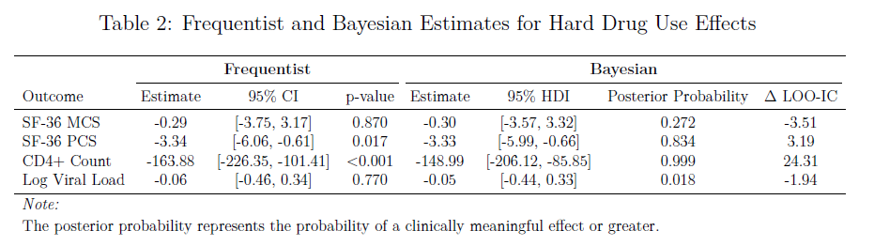
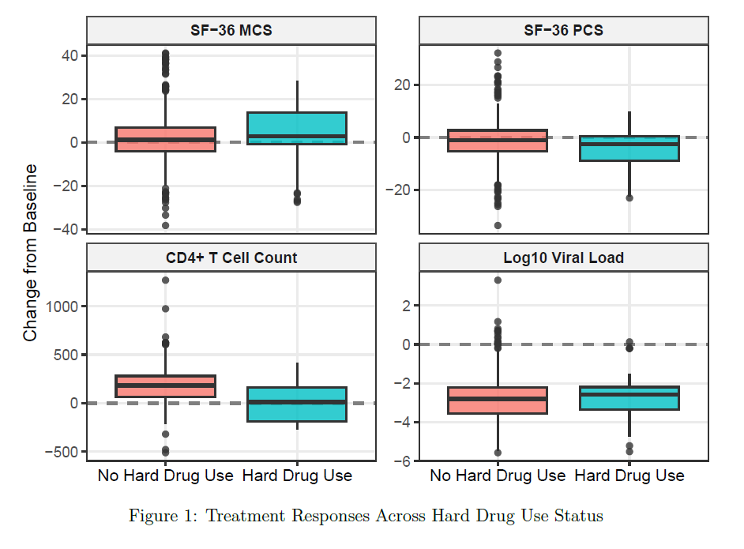
Results
CD4+ Counts
Hard drug users experienced a lower treatment response
Estimated difference: -148.99 cells/mm³; 95% HDI: [-206.12, -85.85]; PP: 0.999
PCS
Hard drug users had a lower treatment response
Estimated difference: -3.33 units; 95% HDI: [-5.99, -0.66]; PP: 0.834
MCS & Viral Load
No differences in treatment response between hard drug users and non-hard drug users

Slide 6
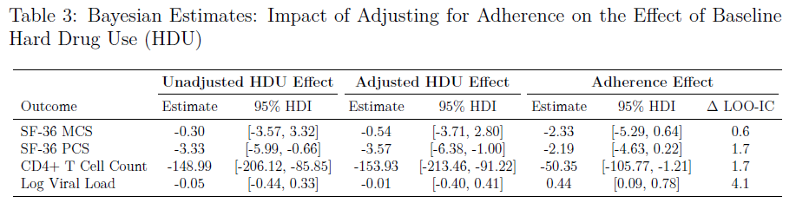
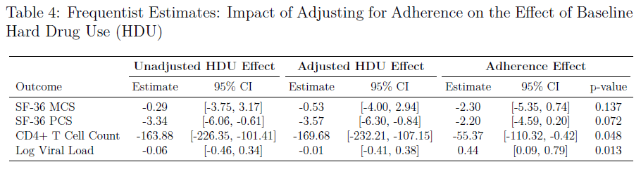
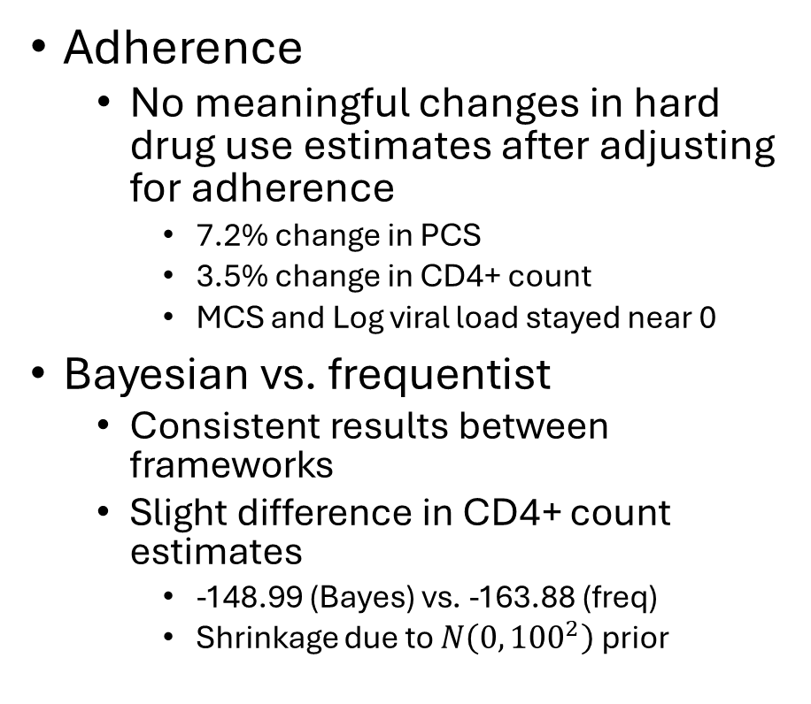
Results
Adherence
No meaningful changes in hard drug use estimates after adjusting for adherence
7.2% change in PCS
3.5% change in CD4+ count
MCS and Log viral load stayed near 0
Bayesian vs. frequentist
Consistent results between frameworks
Slight difference in CD4+ count estimates
-148.99 (Bayes) vs. -163.88 (freq)
Shrinkage due to $N\left(0,{100}^{2}\right)$ prior

Slide 7
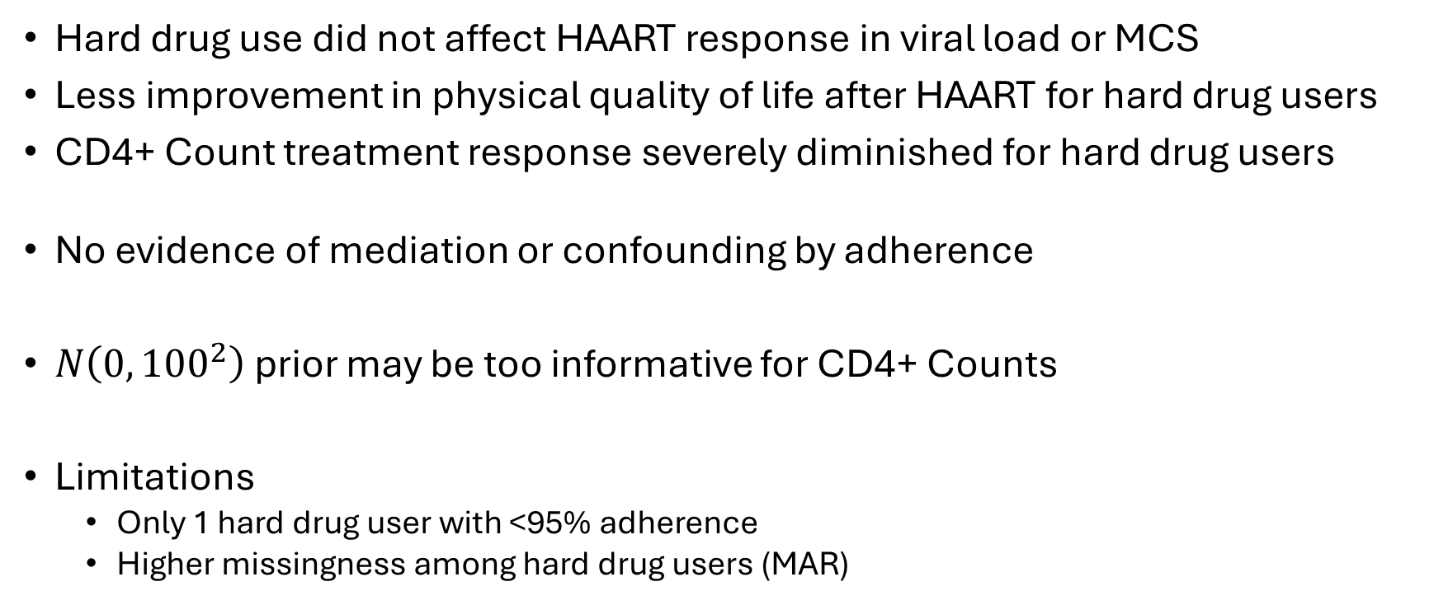
Discussion & Limitations
Hard drug use did not affect HAART response in viral load or MCS
Less improvement in physical quality of life after HAART for hard drug users
CD4+ Count treatment response severely diminished for hard drug users
No evidence of mediation or confounding by adherence
$N\left(0,{100}^{2}\right)$ prior may be too informative for CD4+ Counts
Limitations
Only 1 hard drug user with <95% adherence
Higher missingness among hard drug users (MAR)

