Slide 1
Evaluation of At-Home Sample Timing for Diurnal Hormone Level Characterization
Joe Nagel
2/4/2026

Slide 2
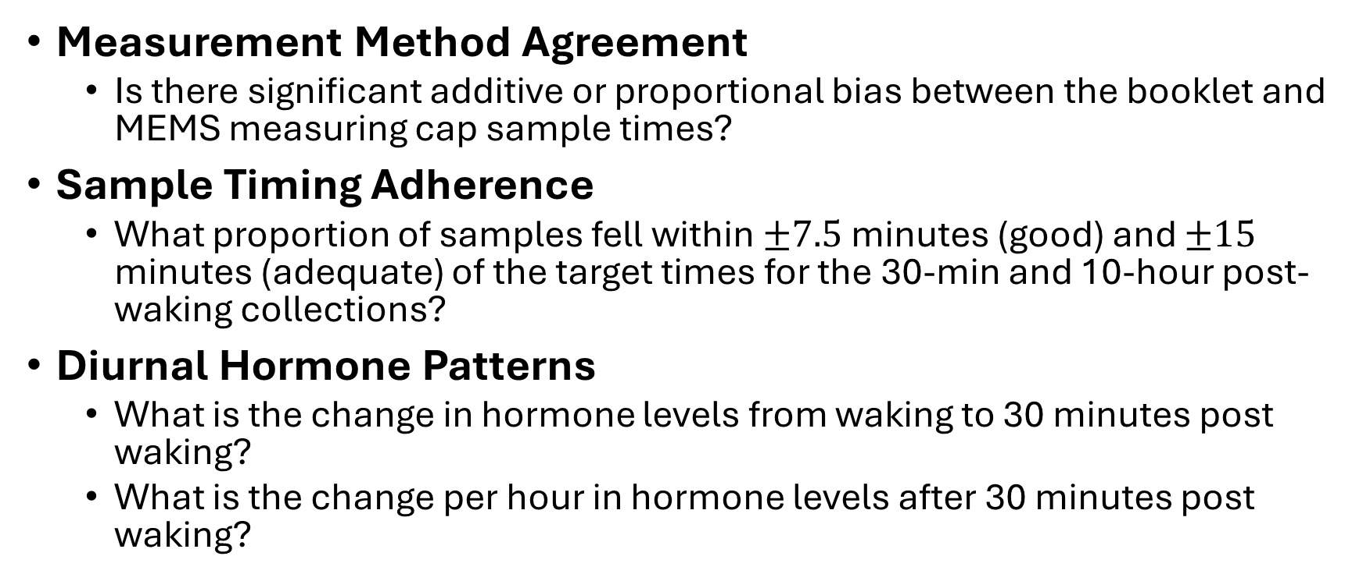
Research Questions
Measurement Method Agreement
  Is there significant additive or proportional bias between the booklet and MEMS measuring cap sample times?
Sample Timing Adherence
  What proportion of samples fell within $±7.5$ minutes (good) and $±15$ minutes (adequate) of the target times for the 30-min and 10-hour post-waking collections?
Diurnal Hormone Patterns
  What is the change in hormone levels from waking to 30 minutes post waking?
  What is the change per hour in hormone levels after 30 minutes post waking?

Slide 3
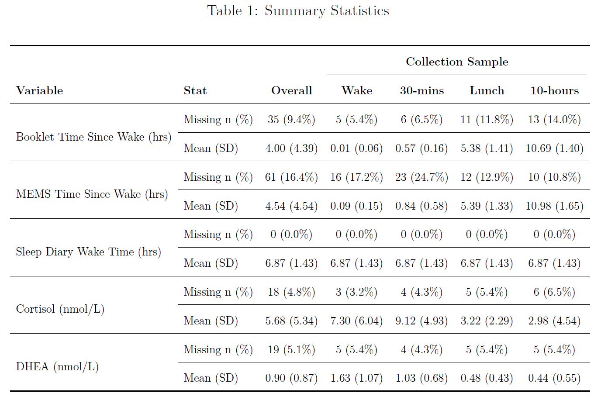

Data Overview
31 Subjects
  3 Days of Samples
  4 Samples/Day
Exclusions
  Cortisol $≥80$ nmol/L
  DHEA $≥$ 5.205 nmol/L
  Subject 3037 removed
    Multiple high DHEA readings
Missingness
  Booklet Times (9.4%)
  MEMS Times (16.4%)

Slide 4
Analysis Methods
Agreement Model
  Linear Mixed-Effect Model
  MEMS Cap Time by Booklet Time
  Tests
    Intercept = 0
    Slope = 1
Diurnal Hormone Pattern Models
  Piecewise Linear Mixed Effect Model
  Break at 30 Minutes
  Log Hormones by Booklet Time
  Tests
    Wake – 30 min Change
    After 30 min Change

Slide 5
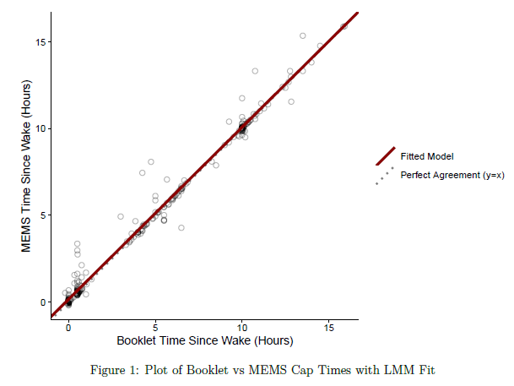
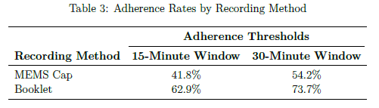
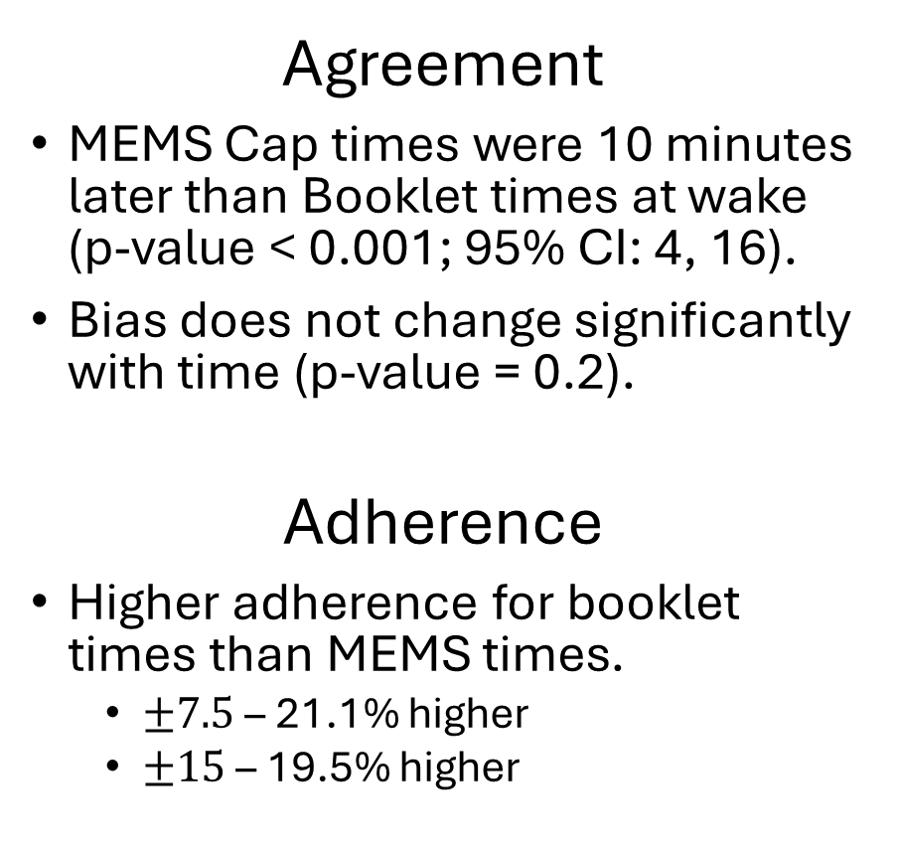
Results
Agreement
MEMS Cap times were 10 minutes later than Booklet times at wake (p-value < 0.001; 95% CI: 4, 16).
Bias does not change significantly with time (p-value = 0.2).
Adherence
Higher adherence for booklet times than MEMS times.
  $±7.5$ – 21.1% higher
  $±15$ – 19.5% higher

Slide 6
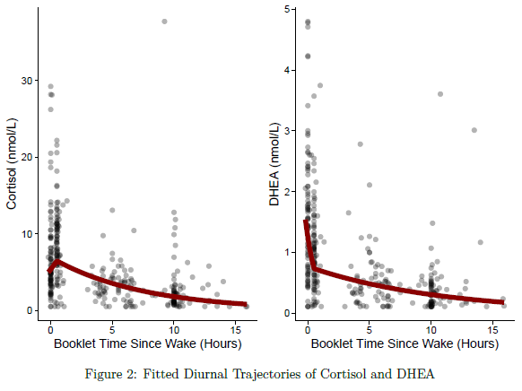
Results
Cortisol
From wake to 30 minutes, cortisol increased 20% on average (p-value = 0.09; 95% CI: -3, 59). Not Significant
After 30 minutes post waking, cortisol decreased 13% per hour on average (p-value < 0.001; 95% CI: 11, 14) .
DHEA
From wake to 30 minutes, DHEA decreased 41% on average (p-value < 0.001; 95% CI: 30, 51).
After 30 minutes post waking, DHEA decreased 9% per hour on average (p-value < 0.001; 95% CI: 7, 10).

Slide 7
Discussion & Limitations
Booklet MEMS Agreement
  Generally high a with some bias (MEMS later than Booklet)
Adherence
  ~20% higher for Booklet than MEMS
Diurnal Patterns
  Cortisol rose then fell (expected)
  DHEA fell rapidly then more slowly (unexpected)
Limitations
  Small sample size (31 subjects)
  Subjective sleep diary wake times

