Slide 1
To Stay or To Go: Predicting Customer Churn
Charter Data Scientist Interview
Joe Nagel

Slide 2
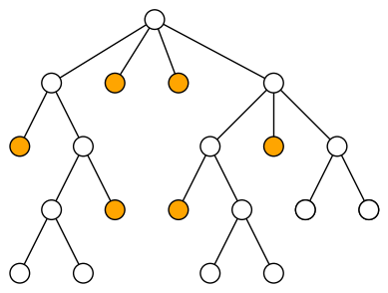
Feature engineering and modeling Considerations
Goal: Predict churn using customer activity
Data
Accounts (price and churn status)
Streams (timing and quality)
Customer Churn
41% overall
63% churn for inactive users
23% churn for active users
Feature Engineering
Volume
Recency
Quality
Value
Modeling Considerations
Binary Classification
Structural Missingness in Data

Slide 3
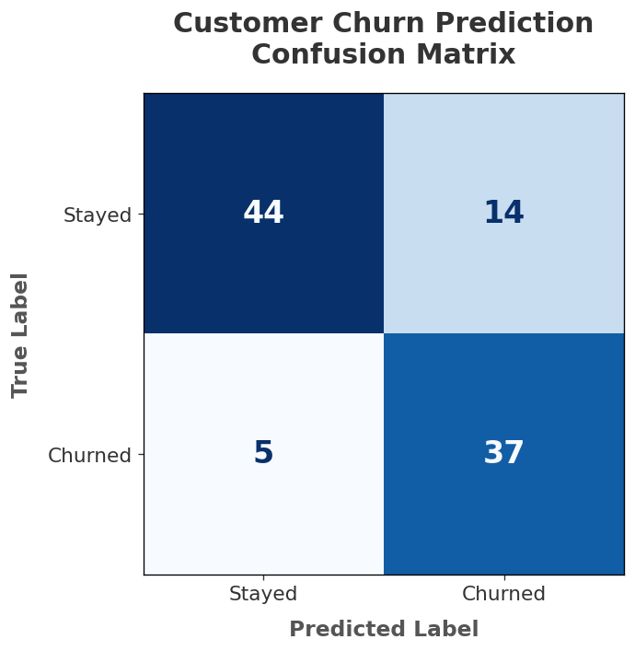
Model and prediction performance
XGBoost Classifier
Data Split: 80%/10%/10%
Stratified by churn status
Objective: Precision-Recall AUC
Randomized Hyperparameter Tuning
Validation Based Early Stopping
Performance
PR-AUC: 0.75
F1-Score: 0.80
Precision: 0.73
Recall: 0.88
Accuracy: 0.81
Feature Importance
Recency >>> Volume Quality Value
Future Work
Build separate models based on activity level
Measure changes in user behavior over time

Slide 4

AI usage and implementation
AI Usage
Coding
Double checking implementation
Troubleshooting errors
Modeling
Feature suggestion
Initial value selection
Communication
Presentation outline
Refining visualizations
Implemented in Python
Polars
XGBoost
scikit-learn
github.com/nageljo/CharterInterview

