Slide 1
Sales Data Analysis & Business Insights
ApexPlanet Internship – Task 4
Nagella Chinmaya Sai

Slide 2
Objective
To analyze sales data and extract meaningful insights for business decision-making.

Slide 3
Dataset
Dataset used: cleaned_sales.csv
Includes: Order ID, Category, Product, City, Payment Mode, Revenue

Slide 4
Key Performance Indicators
Total Revenue: 308799
Total Orders: 9
Average Order Value: 34311
Top Category: Electronics

Slide 5
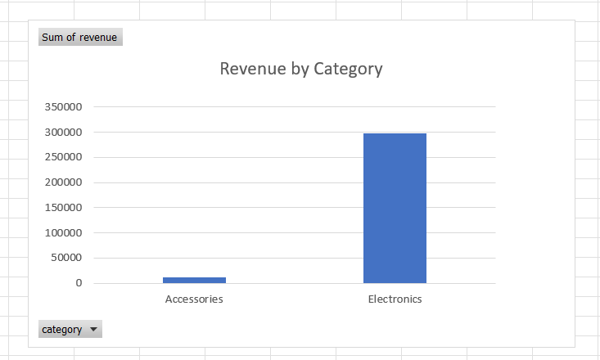
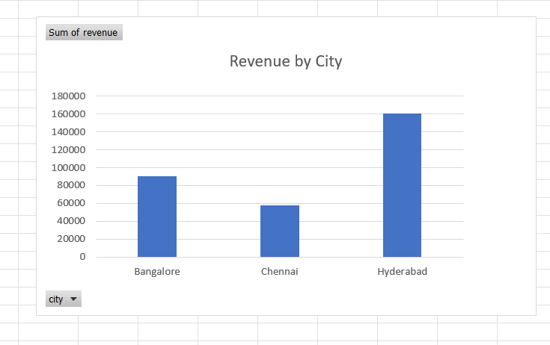
Visual Analysis
Revenue by Category
Revenue by City
Payment Mode Distribution
Product-wise Revenue

Slide 6
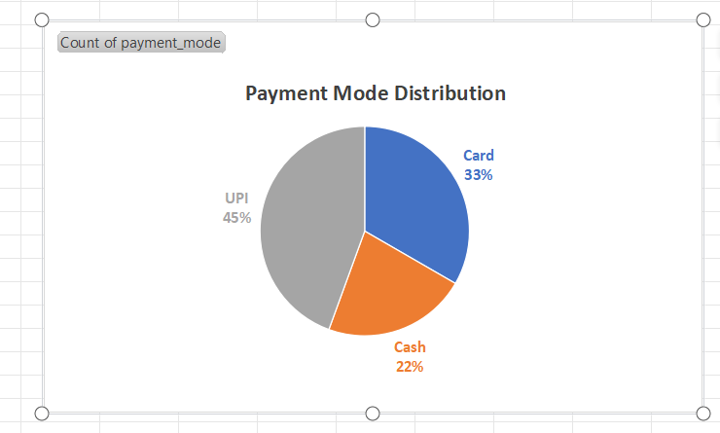
Key Insights
Electronics generates highest revenue
Hyderabad leads in sales
UPI is most used payment mode

Slide 7
Hypothesis
UPI is the most preferred payment method among customers.

Slide 8
Validation
Data analysis shows UPI transactions are highest, supporting the hypothesis.

Slide 9
Conclusion
The analysis helps understand business performance and customer behavior for better decisions.

Slide 10
Thank You

