Slide 1

Project 2 - Group 5
Justin, Michelle, Nagender, Nidhi, Roman, Ryan

Slide 2
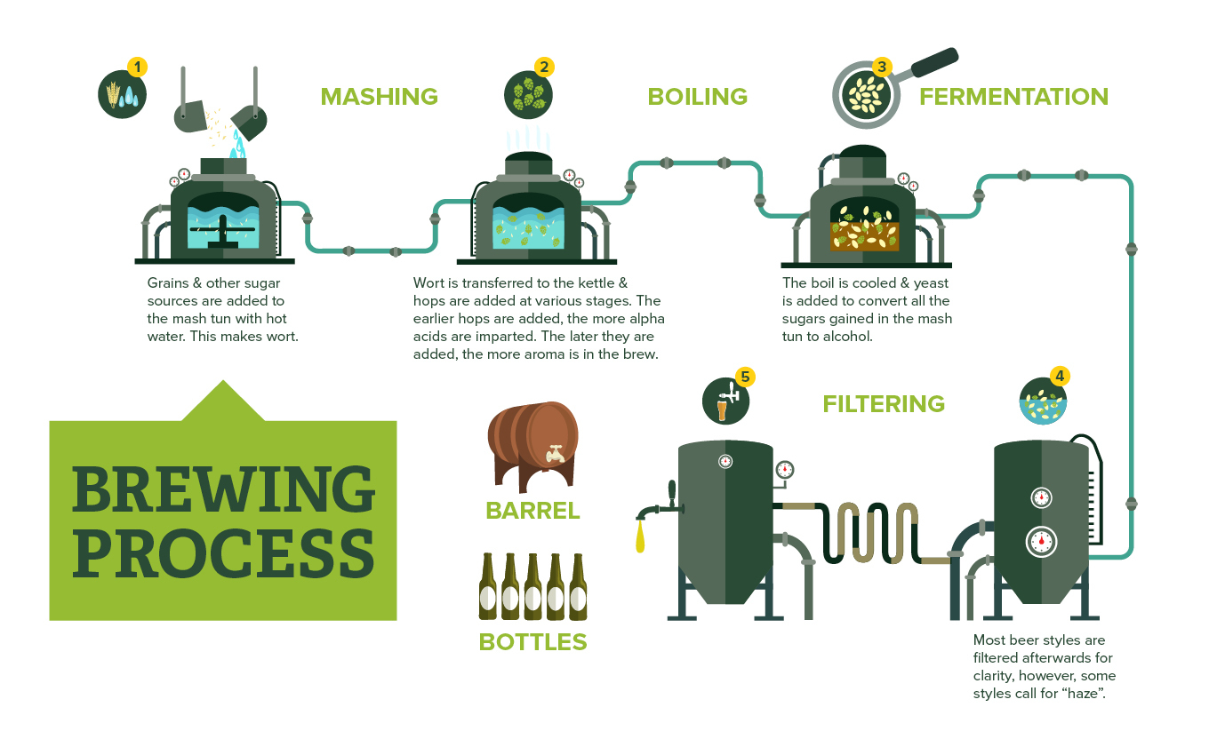
Microbreweries

Slide 3
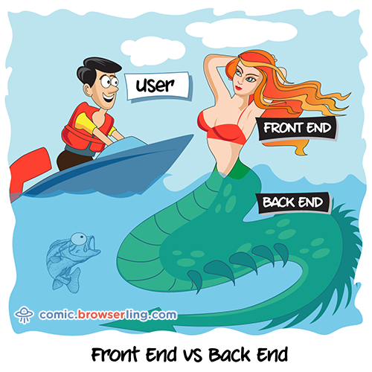
Data and Flask
Data: Open Brewery DB
Map: Longitude and Latitude
CSV -> DBeaver -> SQLite
File structure:
app.py
/templates
Incorrectly rendered data
Python (Plotly Express)
Javascript (AnyChart,
Anime.js {Figma})

