Slide 1

GNANEX AI
AI-Powered Interview Preparation
Team Dream Hackers . AB Talks Vibe Code
PROBLEM STATEMENT: AI PRODUCTIVITY & LIFE-SAVER COMPANION

Slide 2

The Problem: Interview Preparation Is Broken
The hackathon challenge asked us to build an intelligent assistant that helps users with deadlines, bills, or interview preparation. We chose interview simulation — a domain where existing tools fall critically short.
Generic Questions
Most platforms offer static question banks with no role-specific context or personalisation.
No Realistic Practice
Without a live interviewer, candidates cannot practise under realistic conversational pressure.
No Adaptive Follow-ups
Existing tools do not ask follow-up questions based on the candidate's actual answers.
No Structured Feedback
Candidates receive no meaningful evaluation of their responses, strengths, or areas to improve.

Slide 3
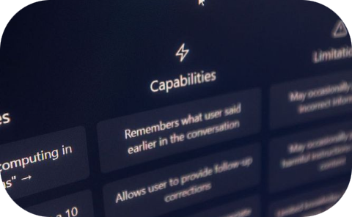
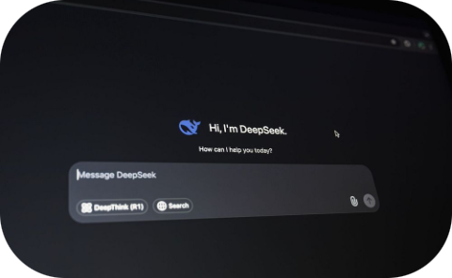


Our Solution: GNANEX AI
GNANEX AI is an AI-powered technical interview simulator that creates a realistic, role-specific interview experience using Google Gemini. Candidates select a profile, engage in an adaptive conversation, and receive structured feedback at the end.
Candidate Profile Selection
Adaptive AI Follow-ups
Session-Based Feedback
Choose from predefined technical roles. The AI tailors questions to the selected domain and seniority level.
Google Gemini generates dynamic follow-up questions based on each candidate's specific answers — just like a real interviewer.
At the end of each session, the AI provides structured evaluation covering strengths, weaknesses, and improvement areas.
User Journey: Candidate → Start Interview → AI Questions → Candidate Answers → Adaptive Follow-ups → Evaluation → Feedback

Slide 4
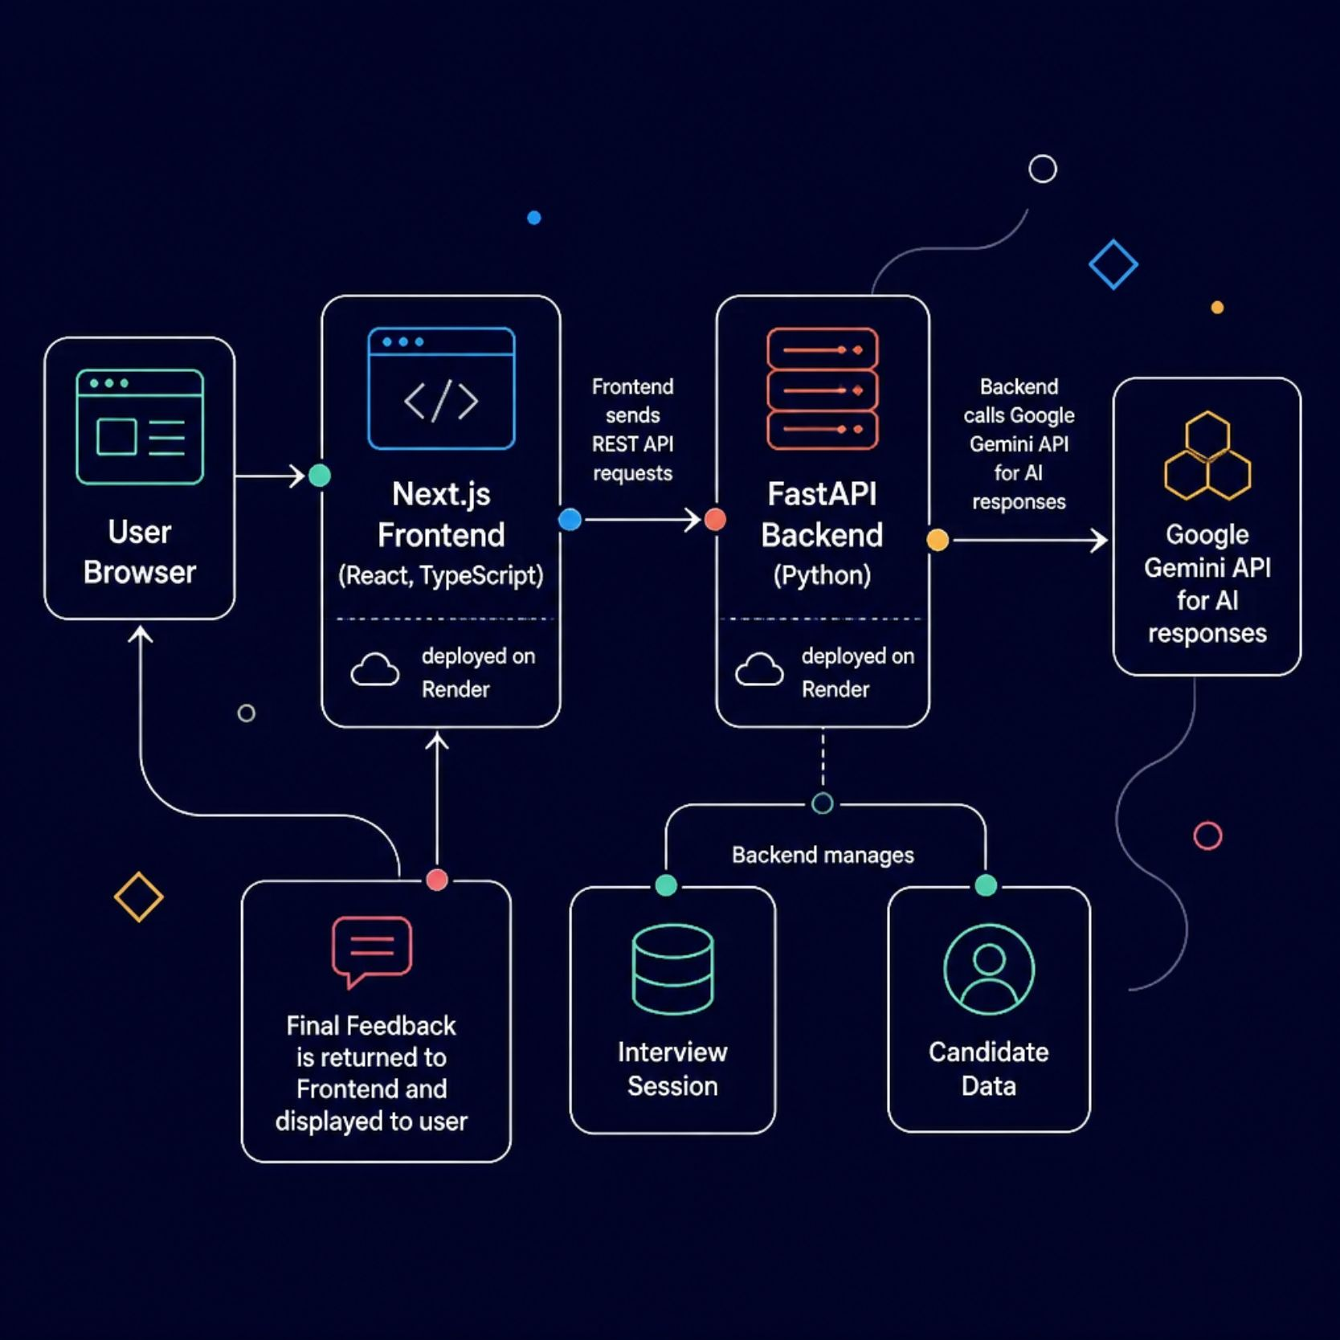
System Architecture
GNANEX AI uses a decoupled frontend-backend architecture deployed on Render. The Next.js frontend communicates with a FastAPI backend via REST API, which orchestrates the interview flow using Google Gemini.
Technology Stack
Frontend: Next.js, React, TypeScript
Backend: FastAPI, Python
AI: Google Gemini (google-genai SDK)
API: REST API
Version Control: GitHub
Deployment: Render (separate frontend & backend services)

Slide 5
Development Journey
Building GNANEX AI was a step-by-step engineering process — from initial repository setup to a fully deployed production application. Each phase built on the previous one.
Repository Setup
Initialised GitHub repo with frontend and backend directory structure.
Backend Foundation
Built FastAPI server with core routes and project scaffolding.
Candidate & Session APIs
Implemented /api/candidates and /api/interview endpoints for profile and session management.
Gemini Integration
Connected Google Gemini API to generate AI interviewer responses and follow-ups.
Frontend Interface
Built the Next.js interview UI with candidate selection and chat interface.
Production Deployment
Deployed both services to Render, resolved CORS, and validated end-to-end.

Slide 6
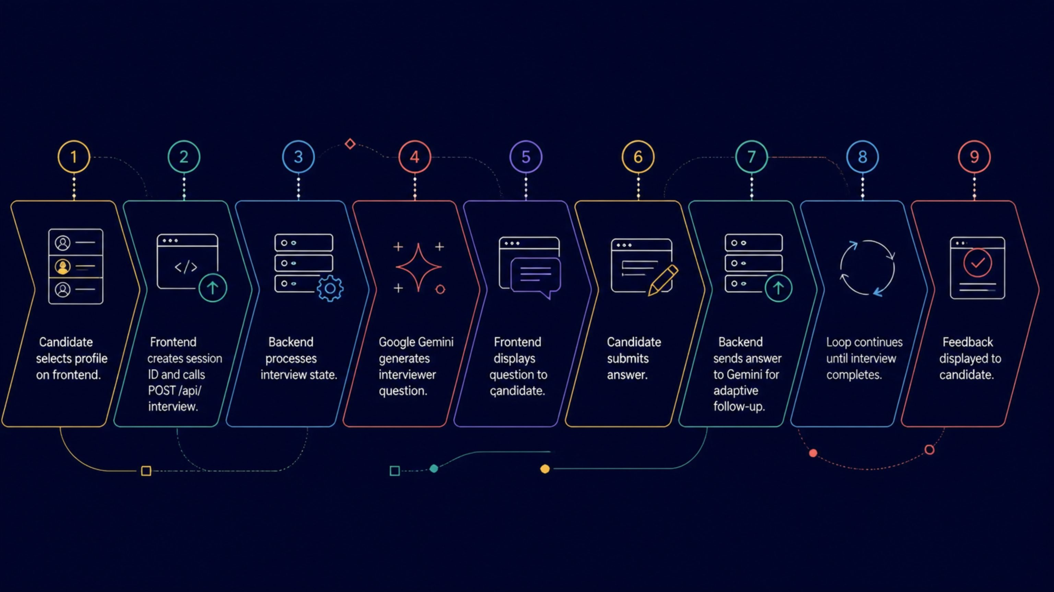
How the AI Interview Flow Works
The interview flow is a continuous loop between the frontend and the Gemini-powered backend. The AI generates questions, evaluates answers, and adapts in real time. The frontend also suppresses acknowledgement-only AI responses (e.g., "yes", "okay", "continue") to keep the conversation clean and focused.
Key Design Decision
Session Management
The frontend filters out filler AI responses like "yes", "okay", and "continue" so the candidate only sees meaningful interviewer questions and feedback.
Each interview runs in an isolated session with a unique ID. The backend tracks conversation state across multiple turns, ensuring Gemini has full context for adaptive follow-ups.

Slide 7




Debugging & Problems We Faced
Real engineering is messy. Here are the actual problems we hit — and how we solved them.
🐛 Python Dependency Conflict
🐛 Python Syntax Validation
Problem: protobuf versions conflicted with google-ai-generativelanguage. Initial requirements.txt had incompatible pinned versions.
Fix: Simplified to: fastapi, uvicorn, google-genai, python-dotenv. Verified in an isolated virtual environment.
Problem: Needed to verify backend files before deployment.
Fix: Ran python -m py_compile on key backend files to catch syntax errors early.
🐛 Frontend Production Build
🐛 Production API Routing
Problem: Ensuring the Next.js app compiled without errors.
Fix: Ran npm --prefix frontend run build. The production build completed successfully.
Problem: Frontend used localhost/127.0.0.1 development routing in production.
Fix: Removed obsolete Next.js rewrite config and used the production backend URL via frontend environment configuration.

Slide 8
The CORS Error — And How We Fixed It
This was the final blocker before the frontend and backend could communicate in production. Both services were live on Render, but the browser blocked all API requests.
❌ The Error
✅ The Fix
Frontend: https://dreamhackers-gnanex-ai.onrender.com
Backend: https://dreamhackers-gnanex-ai-1.onrender.com
Browser console reported:
Access to fetch at ... has been blocked by CORS policy: No 'Access-Control-Allow-Origin' header is present.
Added CORSMiddleware to the FastAPI backend
Allowed the production frontend origin explicitly
Allowed required HTTP methods and headers
Committed the change and pushed to GitHub
Render automatically redeployed the backend service
This single change resolved the final connection problem between our frontend and backend.

Slide 9

Testing, Validation & Deployment
After debugging, we ran a complete end-to-end validation before final submission.
Before Debugging
Debugging Process
After — Production Ready
CORS errors blocking all API calls
Localhost routing in production build
Dependency conflicts preventing deployment
Frontend and backend not communicating
Isolated virtual environment testing
Simplified requirements.txt
Fixed CORS middleware configuration
Updated production API routing
Backend endpoints tested and working
/api/candidates returned candidate data
Frontend production build succeeded
Interview flow and AI responses working
Production Deployment Architecture
GitHub Repo
Render Frontend
Public source of truth
Next.js app deployed
Render Backend
Production Live
FastAPI service deployed
Public URLs serving traffic
The project was deployed as separate frontend and backend services on Render. A key lesson: localhost success does not guarantee production success — CORS, environment variables, API URLs, routing, and dependency resolution must all be validated in the real environment.

Slide 10
Submission & What We Learned
📦 Hackathon Submission
💡 Engineering Lessons Learned
GitHub Repo: github.com/nagendra-dev5/dreamhackers-gnanex-ai
Live Frontend: dreamhackers-gnanex-ai.onrender.com
Live Backend: dreamhackers-gnanex-ai-1.onrender.com
PROMPTS.md: View on GitHub
README: Full documentation included in repository
AI integration is only one part of building a real application
Dependency management matters — pinned versions can break builds
Local success does not guarantee production success
CORS must be handled correctly from the start
Frontend and backend must be deployed and configured separately
Terminal commands (py_compile, npm run build) are invaluable for debugging
Git commits provide essential checkpoints during rapid development
Production testing is non-negotiable
AI-assisted coding still requires human debugging and verification
"From idea → code → debugging → deployment → successful submission."
— Team Dream Hackers

