Slide 1

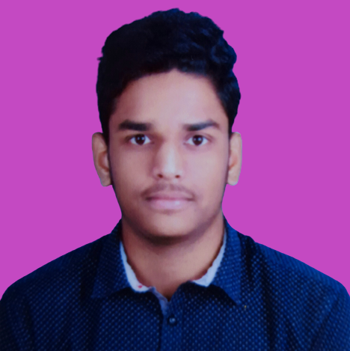
“This is Nagendra Nainala and I am passionate about Software Development”

