Slide 1
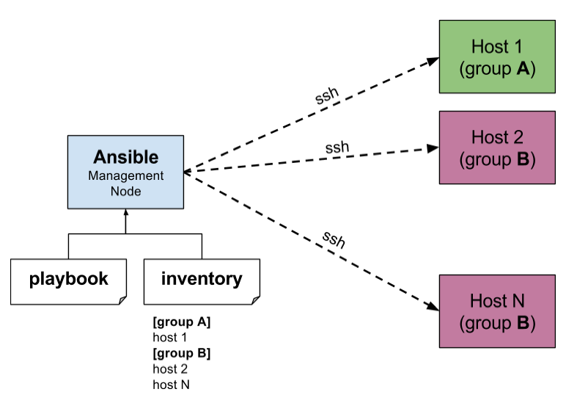
Ansible
Ansible is open source automation platform. Ansible can help you with Configuration management, application deployment,task automation and also IT orchestration.
Ansible is an automation tool for server provisioning, configuration, and management.
It is very simple to setup,effieient and more powerful.

Slide 2
Orchestration:
Cloud orchestration is arranging and coordinating of automated tasks, which ultimately results in a single process of workflow.
Orchestration describes automated arrangement, coordination, and management of complex computer systems, and services.
Connecting and automating of work flows when applicable to deliver a defined service.
Advantages:
Ansible is free and opensource.
Agentless. ansible doesn't require a master client model.which means, no agent to be installed at the client.
Ansible uses SSH for the operations on the existing network.
Devloped in python.
lightweight and quick deployment.
Ansible uses YAML Syntax in configuration files.

Slide 3
It allows you to organize your server inventory into groups, describe how those groups should be configured or what actions should be taken on them, and issue all of these commands from a central location.
All Ansible commands are run from a control machine, which can be either a local computer or ec2 instance.
Ansible uses SSH to execute commands remotely on nodes.
Ansible ships with a large collection of modules that you can run as tasks or via commands as needed.

