Slide 1
GIT
Git is an open source, distributed version control system (VCS).
It’s commonly used for source code management (SCM).
Git is a free and open source distributed version control system designed to handle projects with speed and efficiency.
Git is system for version control primarily used by programmers and others who writs code.
It runs at the command line on your local machine.
It allows you to keep track of your files and modifications to those files in something called a repository (repo).
To track last five changes to the rep :#git log -5
you can use it with a team of people who are working on the same project.
It's useful in team env because everyone can work independently on those files.
Git HUb is website that allows you to upload your Git repositories online.
It gives GUI for navigating your repos.
It gives other peoples navigate your repos.

Slide 2
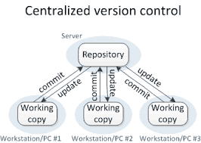
Version Control is the management of changes to documents, computer programs, large websites and other collection of information.
There are two types of VCS:
Centralized Version Control System (CVCS)
Distributed Version Control System (DVCS)
Centralized VCS

Slide 3
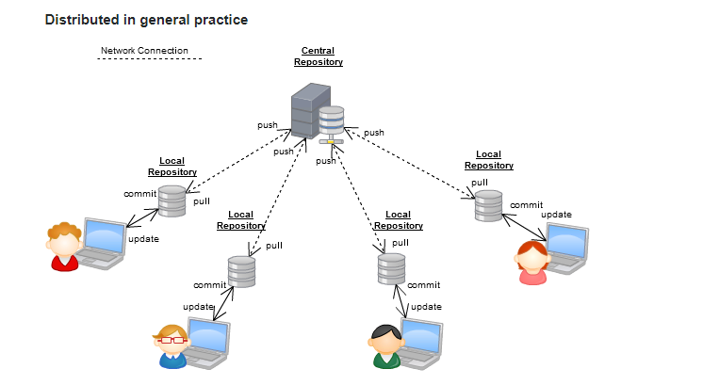
It is not locally available; meaning you always need to be connected to a network to perform any action
Since everything is centralized, in any case of the central server getting crashed or corrupted will result in losing the entire data of the project.
Distributed VCS
In Distributed VCS, every contributor has a local copy or “clone” of the main repository i.e. everyone maintains a local repository of their own which contains all the files and metadata present in the main repository.

Slide 4
All operations (except push & pull) are very fast because the tool only needs to access the hard drive, not a remote server. Hence, you do not always need an internet connection.
Committing new change-sets can be done locally without manipulating the data on the main repository. Once you have a group of change-sets ready, you can push them all at once.
Git is a DVCS
Some of the basic operations in Git are:
Initialize
Add
Commit
Pull
Push
Some advanced Git operations are:
Branching
Merging
Rebasing

Slide 5
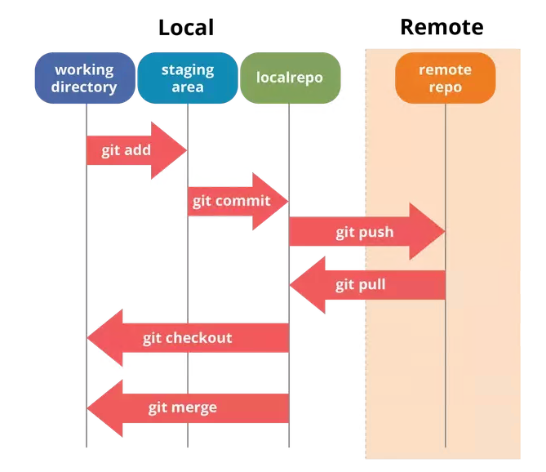

Slide 6
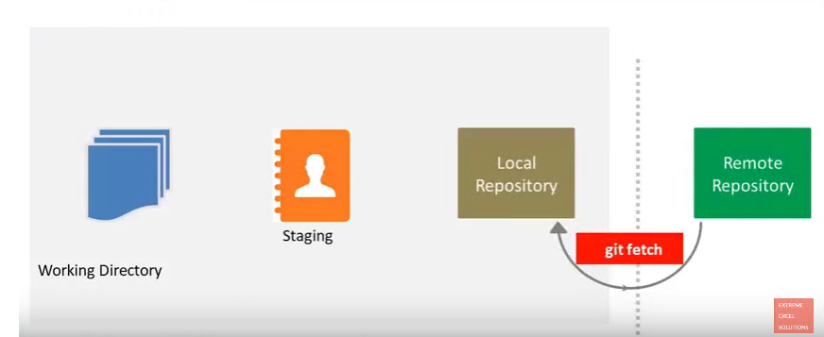
Git Fetch: is the command that says "bring my local copy of the remote repository up to date."
Git Fetch: when you do a git fetch, it gets all the changes from the remote repository, stores the changes in a separate branch in your local repository and if you want to reflect those changes in your corresponding branches, use a git merge to do that.

Slide 7
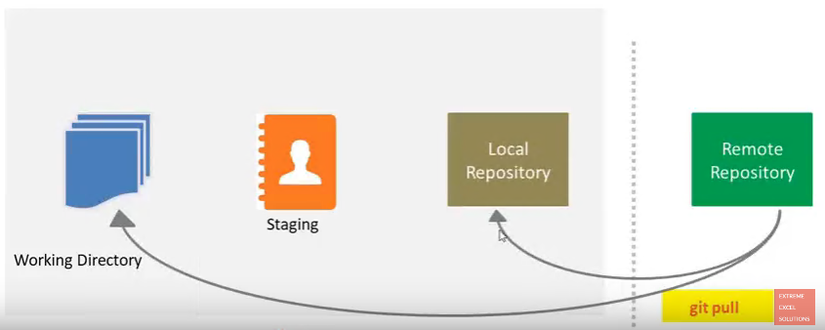
Git pull: says "bring the changes in the remote repository where I keep my own code."
Git pull: when you do a git pull, it gets all the changes from the remote or central repository and attaches it to your corresponding branch in your local repository.

Slide 8
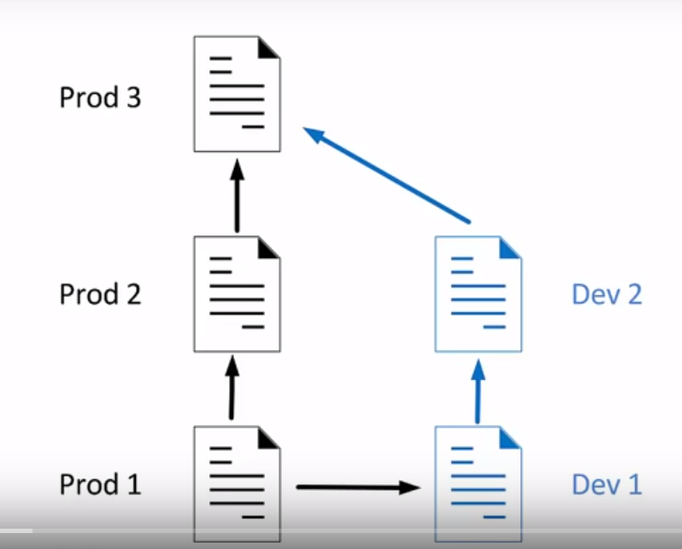
GIT Branch
Allows to working with the different versions of the same file as parallel. branch's are independed we have create diff branches like dev and prod to work on diff versions.
HEAD: is a ref (reference point) to the currently checked out commit.some times call symbolic pointer HEAD tell out terminal what we have checkout.

Slide 9
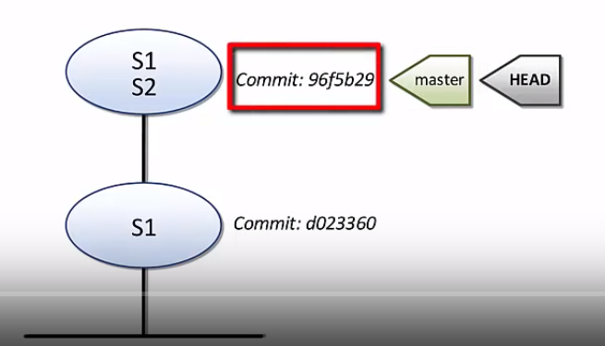
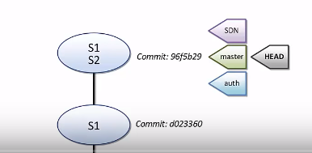
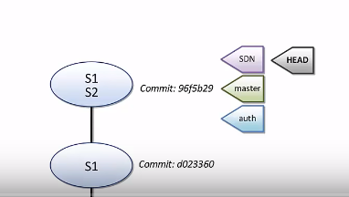
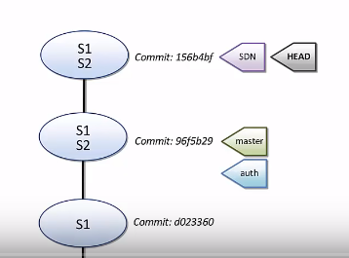
How is Branch implemented :

Slide 10
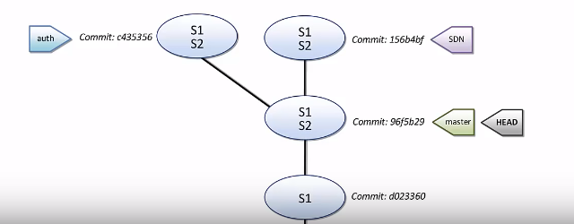
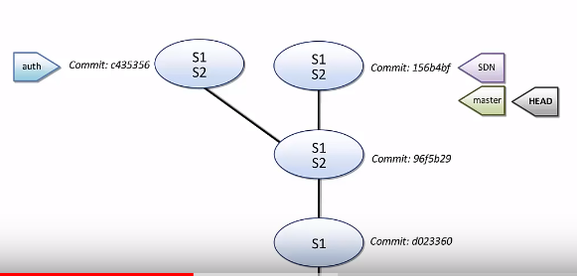
GIT Merge
Fast-Forward-merge: Move branch directly to the master branch.

Slide 11
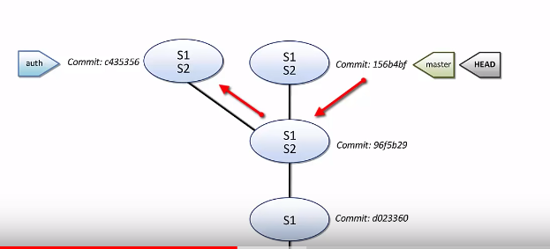
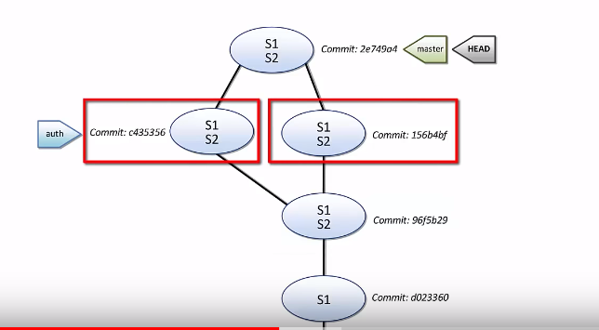
3-way merge: not a direct path to merge master branch to merge branch.

Slide 12
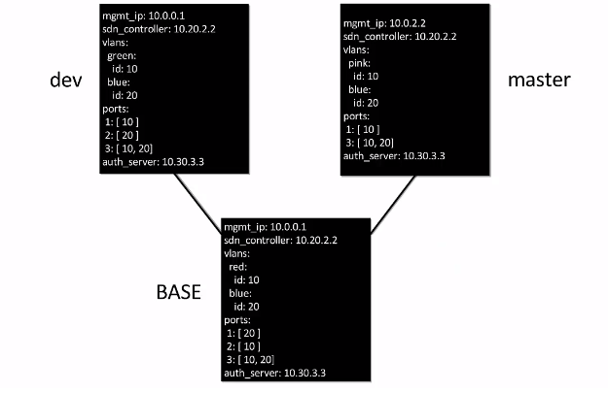
Merge conflicts
checking the both branches modified files what are the changes updated and remove those conflicts related data.

