Slide 1
Jenkins
Jenkins is a Continuous Integration server.
Jenkins is an open source automation tool written in Java with plugins built for Continuous Integration purpose.
Jenkins is used to build and test your software projects continuously making it easier for developers to integrate changes to the project.
It also allows you to continuously deliver your software by integrating with a large number of testing and deployment technologies.
plugins:
Jenkins achieves Continuous Integration with the help of plugins.
Plugins allows the integration of Various DevOps stages.
If you want to integrate a particular tool, you need to install the plugins for that tool.
example: Git, Maven 2 project, Amazon EC2, HTML publisher etc.
Advantages of Jenkins include:
It is an open source tool with great community support.
It is easy to install.
It has 1000+ plugins to ease your work. If a plugin does not exist, you can code it and share with the community.
It is free of cost.
It is built with Java and hence, it is portable to all the major platforms.

Slide 2
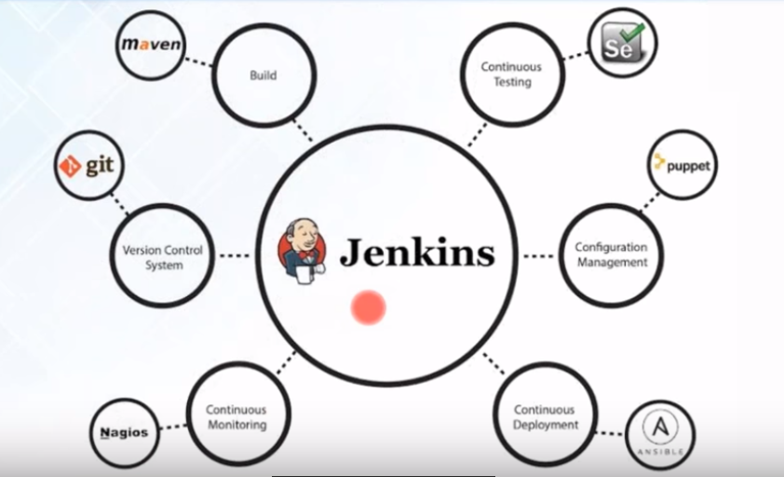

Slide 3
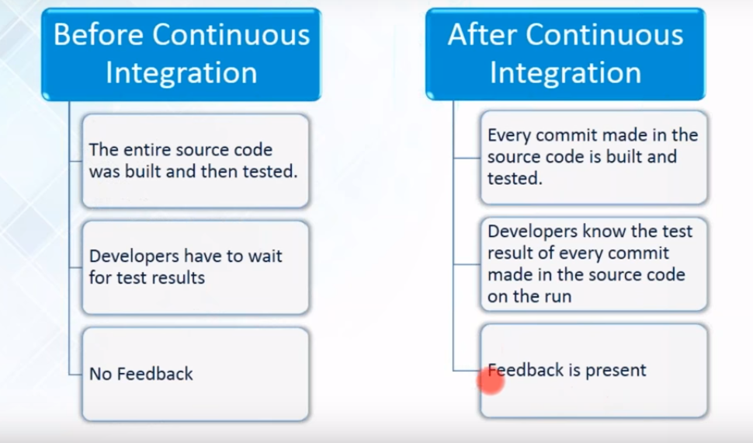

Slide 4
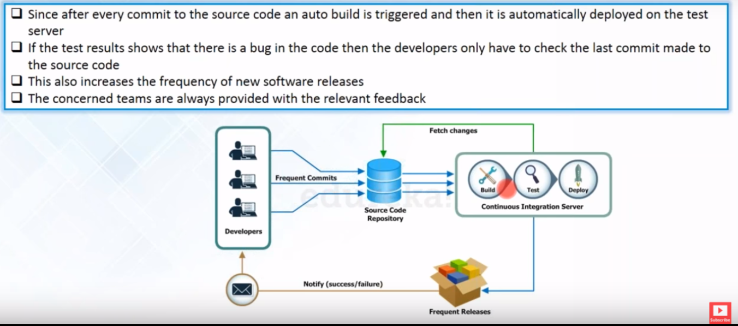

Slide 5
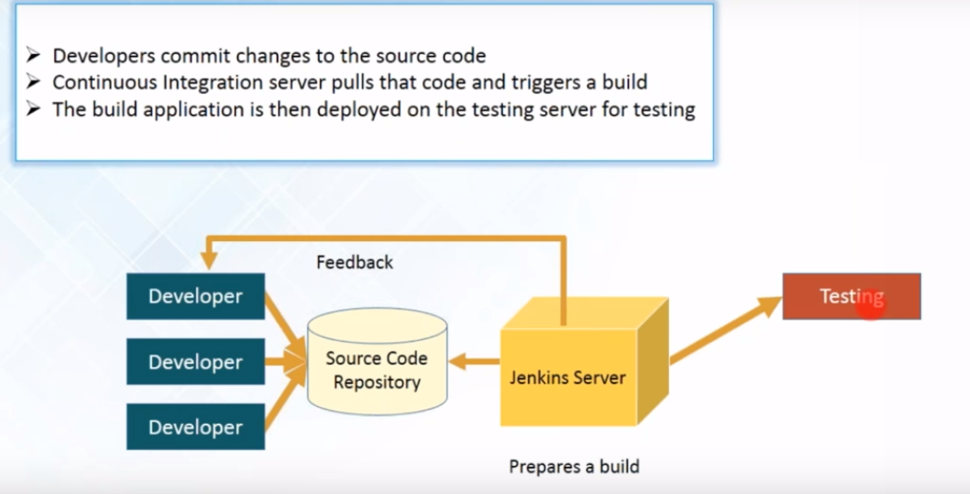

Slide 6
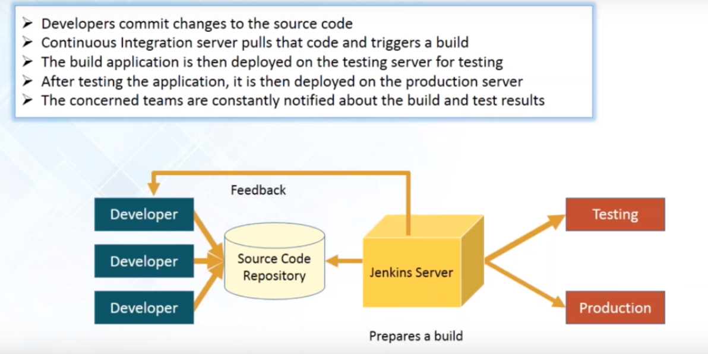

Slide 7
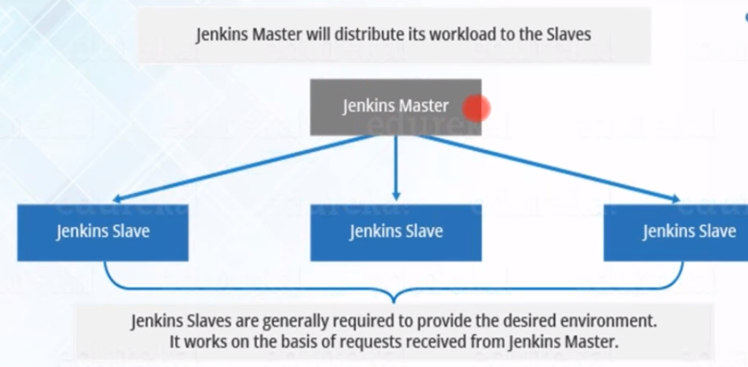
Jenkins master and slave nodes:
A Master represents basic installation of Jenkins and handles all tasks for the build system.
A Slave is a system that is set up to reduce the burden of build projects from the master but delegation behavior depends on the configuration of each project.
Labels: which is used while configure in the job.

Slide 8
jenkins usermanagement & Manage user roles:
Jenkins doesn't have any database but it is having config.xml file it will store the all configurations.
Choose jenkins data base automatically create the users.
Legacy mode: user's have read permissions only.
Create and Manage user roles - we need to install Role Strategy Plugin

Slide 9
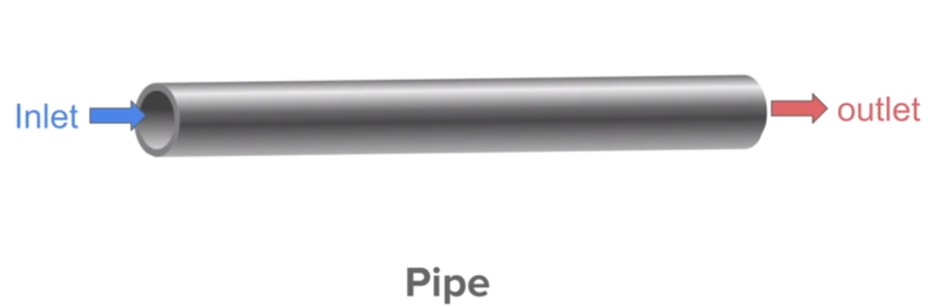
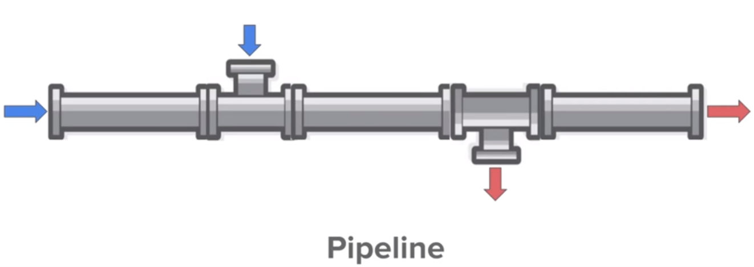
Pipeline in Jenkins
Pipe line is work flow with group of events or jobs that are chained and integrated with each other in sequence which are interlinked with one another in a sequence.
Every job in a pipeline has some dependency on one or more other jobs.
Jenkins Pipeline is a combination of plugins that support the integration and implementation of continuous delivery pipelines using Jenkins.
A pipeline has an extensible automation server for creating simple or complex delivery pipelines "as code," via pipeline DSL (Domain-specific Language).

Slide 10
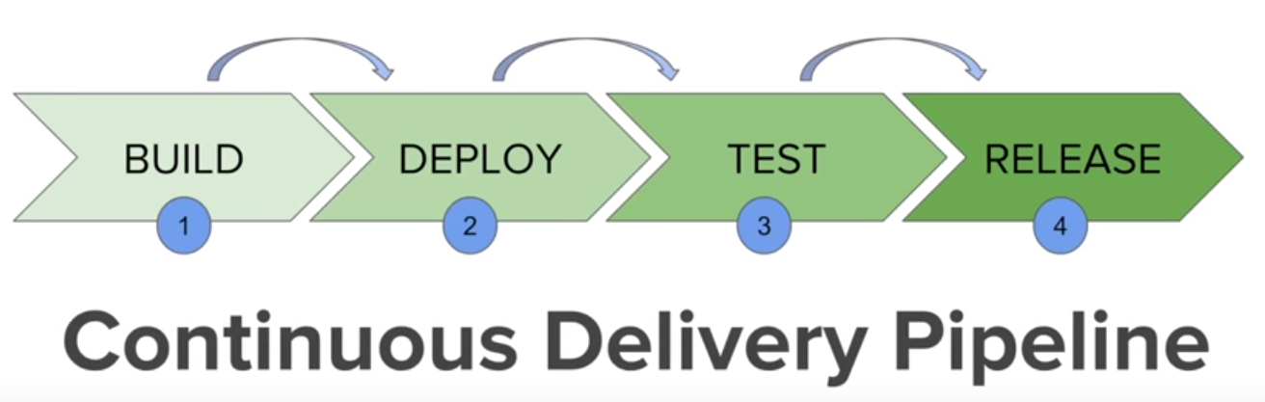
The picture above represents a continuous delivery pipeline in Jenkins.
It contains a group of states called build, deploy, test and release.
These events are interlinked with each other. Every state has its events, which work in a sequence called a continuous delivery pipeline.
Setup DELIVERY PIPELINE in Jenkins:
Chain required jobs in sequence: Add upstream/downstage jobs.
Install Delivery pipeline plugin.
Delivery pipe line view: configure the pipe line view.
Run and Validate.

Slide 11
JenkinsFile
Jenkins pipelines can be defined using a text file called JenkinsFile.
You can implement pipeline as code using JenkinsFile, and this can be defined by using a domain specific language (DSL).
JenkinsFile can be defined by either Web UI or with a JenkinsFile.
The benefits of using JenkinsFile are:
You can create pipelines automatically for all branches and execute pull requests with just one JenkinsFile.
You can review your code on the pipeline
You can audit your Jenkins pipeline
This is the singular source for your pipeline and can be modified by multiple users.
There are two types of syntax used for defining your JenkinsFile.
Declarative
Scripted

Slide 12
Declarative:
Declarative pipeline syntax offers an easy way to create pipelines.
It contains a predefined hierarchy to create Jenkins pipelines.
It gives you the ability to control all aspects of a pipeline execution in a simple, straight-forward manner.
Scripted:
Scripted Jenkins pipeline runs on the Jenkins master with the help of a lightweight executor.
Why Use Jenkin's Pipeline?
Jenkins is an open continuous integration server which has the ability to support the automation of software development processes.
You can create multiple automation jobs with the help of use cases, and run them as a Jenkins pipeline.

Slide 13
Here are the reasons why you use should use Jenkins pipeline:
Jenkins pipeline is implemented as a code which allows multiple users to edit and execute the pipeline process.
Jenkins Pipelines support big projects. You can run multiple jobs, and even use pipelines in a loop.
Jenkins Pipeline Concepts
Term Description
Pipeline The pipeline is a set of instructions given in the form of code for continuous delivery and consists of instructions needed for the entire build process. With pipeline, you can build, test, and deliver the application.
Node The machine on which Jenkins runs is called a node. A node block is mainly used in scripted pipeline syntax.
Stage A stage block contains a series of steps in a pipeline. That is, the build, test, and deploy processes all come together in a stage. Generally, a stage block is used to visualize the Jenkins pipeline process.
Step A step is nothing but a single task that executes a specific process at a defined time. A pipeline involves a series of steps.

