Slide 1
Direct Simulation Monte Carlo Method for Fluid Flows
Nagendra Krishnamurthy

Slide 2
Overview
Introduction
Motivation
The scheme
Results
Summary and future work

Slide 3
Overview
Introduction

Slide 4
Introduction
Molecular dynamics simulations
Particle-based approach
Using Newton’s laws compute every particle trajectory
Limited to simple hydrodynamic flows
Enormous computational resources requires for realistic simulations
1 mm³ of air at STP would require 10¹⁶ molecules.
A cubic domain with 1 million particles

Slide 5
Introduction
Direct Simulation Monte Carlo
Simplified molecular dynamics
Solve the non-linear Boltzmann equation
Use only a small fraction of the actual number of particles
Stochastically model the collisions, scattering and post-collision velocity distributions
A cubic domain with 1000 representative particles

Slide 6
Overview
Introduction
Motivation

Slide 7
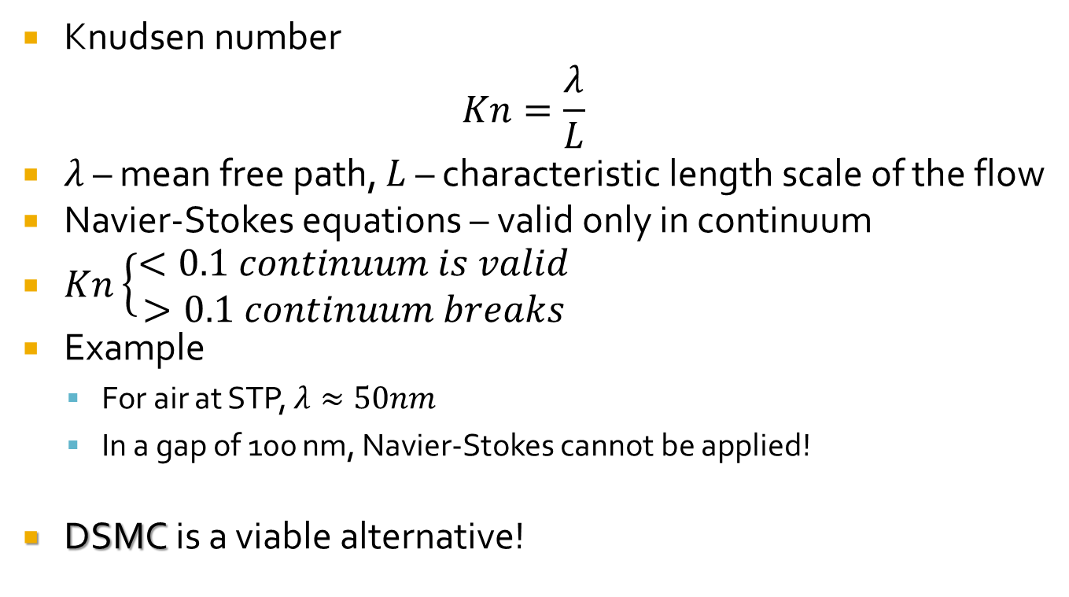
Motivation
Knudsen number
$$Kn=\frac{λ}{L}$$
$λ$ – mean free path, $L$ – characteristic length scale of the flow
Navier-Stokes equations – valid only in continuum
$Kn\left\{\begin{aligned}<0.1 continuum is valid \\ >0.1 continuum breaks\end{aligned}\right.$
Example
For air at STP, $λ≈50nm$
In a gap of 100 nm, Navier-Stokes cannot be applied!
DSMC is a viable alternative!

Slide 8
Overview
Introduction
Motivation
The scheme

Slide 9
The scheme*
Initialization
Randomly distribute N representative particles with uniform density
Advection
Compute new particle locations
Handle particles crossing the boundary
Collision
Rules based on kinetic theory
Average cell properties
Summation over all particles
* Based on Alexander and Garcia [1].

Slide 10

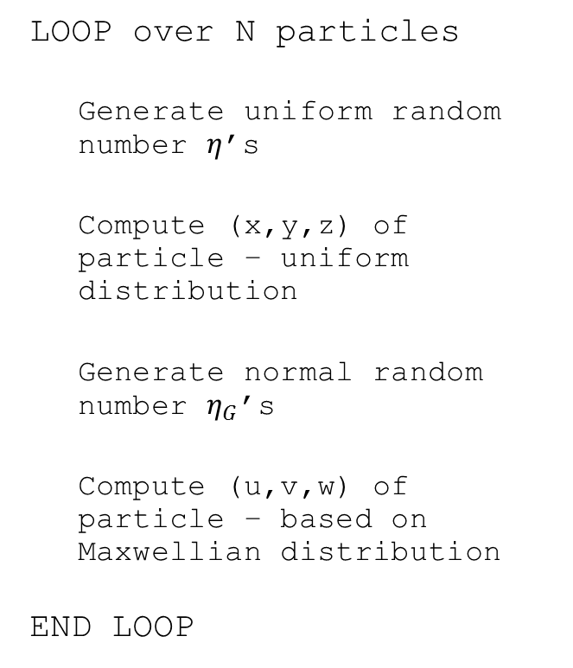
Initialization
LOOP over N particles
Generate uniform random number $η$’s
Compute (x,y,z) of particle – uniform distribution
Generate normal random number $η_{G}$’s
Compute (u,v,w) of particle – based on Maxwellian distribution
END LOOP
$$x_{i}=x_{min}+Δx_{i}η_{i}$$
$$u_{i}=\sqrt{\frac{k_{B}T_{w}}{m}}{η_{G}}_{i}$$

Slide 11

Advection
LOOP over N particles
Compute new particle location (x,y,z)
IF (x,y,z) out of bounds
Periodic boundaries
Specular walls
Diffuse walls
END LOOP
$$x_{i}=x_{i}+u_{i}Δt$$
$$x_{i}=x_{i}+Δx_{per}$$
$$u_{i}=−u_{i}$$
$$u_{t}=\sqrt{\frac{k_{B}T_{w}}{m}}η_{G};u_{n}=\sqrt{−\frac{2k_{B}T_{w}}{m}\ln\left(η\right)}$$

Slide 12
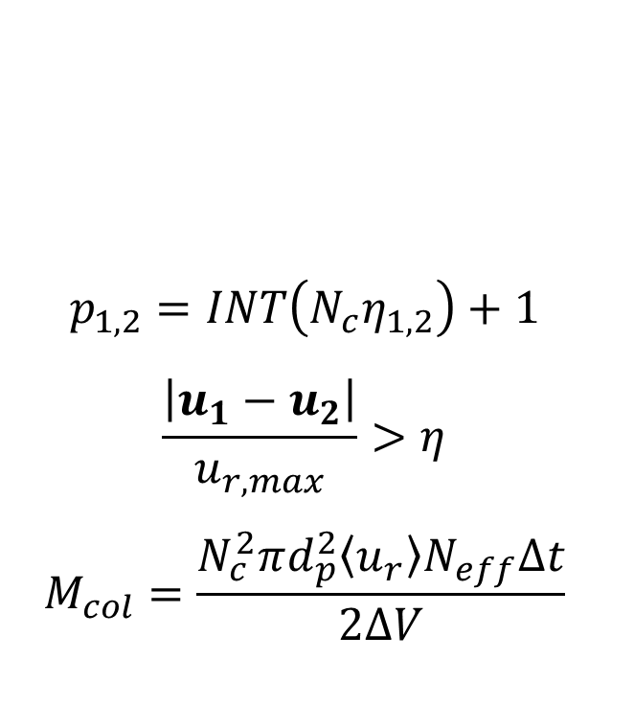
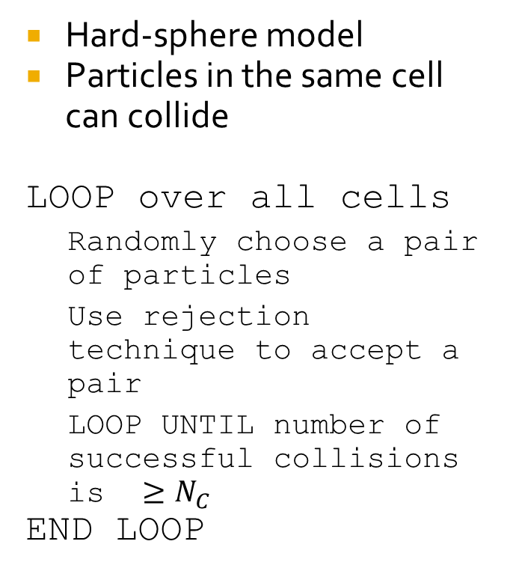
Collision
Hard-sphere model
Particles in the same cell can collide
LOOP over all cells
Randomly choose a pair of particles
Use rejection technique to accept a pair
LOOP UNTIL number of successful collisions is $≥N_{C}$
END LOOP
$$p_{1,2}=INT\left(N_{c}η_{1,2}\right)+1$$
$$\frac{\left|u_{1}−u_{2}\right|}{u_{r,max}}>η$$
$$M_{col}=\frac{N_{c}^{2}πd_{p}^{2}\left\langle u_{r}\right\rangle N_{eff}Δt}{2ΔV}$$

Slide 13

Collision
IF successful collision pair found
Preserve relative velocities
Preserve center of mass
Isotropic scattering
Compute new particle velocities (same positions)
END IF
$$u_{r}=\left|u_{1}−u_{2}\right|=\left|u_{1}^{′}−u_{2}^{′}\right|$$
$$u_{cm}=\frac{1}{2}\left(u_{1}+u_{2}\right)=\frac{1}{2}\left(u_{1}^{′}+u_{2}^{′}\right)$$
$u_{r}^{′}=u_{r}\left[\left(sinθcosφ\right)i+\left(sinθsinφ\right)j+cosθk\right]$
$$u_{1,2}^{′}=u_{cm}±\frac{1}{2}u_{r}^{′}$$

Slide 14

Averaging
LOOP over all cells
Density
Momentum density
Energy density
Velocity
Temperature
END LOOP
$$ρ=\frac{1}{V_{s}}\sum_{i}{m_{i}}$$
$$p=\frac{1}{V_{s}}\sum_{i}{m_{i}u_{i}}$$
$$e_{j}=\frac{1}{V_{s}}\sum_{i}{\frac{1}{2}m_{i}{\left|u_{i}\right|}^{2}}$$
$$u_{c}=\frac{p}{ρ}$$
$$T=\frac{2m_{i}}{3k_{B}}\left[\frac{e}{ρ}−\frac{1}{2}{\left|u_{c}\right|}^{2}\right]$$

Slide 15
Check points
At least 30 particles in each cell
Time-step chosen should be a fraction of the mean free time
Cell dimensions should be smaller than mean free path
Simple monatomic gas
Dilute gas assumption

Slide 16
Overview
Introduction
Motivation
The scheme
Results

Slide 17
Results
Problem description
Preliminary check
Shearing flow
Rayleigh problem

Slide 18
Problem description
1-D problem
Walls in the z-direction
Periodicity – x- and y-directions
Fluid – air at STP

Slide 19
Preliminary check
Both walls stationary and diffuse
Thermodynamic equilibrium
Maxwellian velocity distribution expected at walls
Data from particle-wall collisions

Slide 20
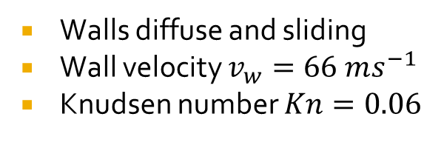
Shearing flow
Walls diffuse and sliding
Wall velocity $v_{w}=66 ms^{−1}$
Knudsen number $Kn=0.06$
No slip expected at walls
Constant temperature throughout

Slide 21
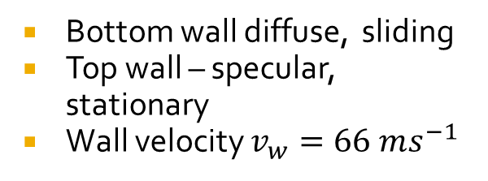
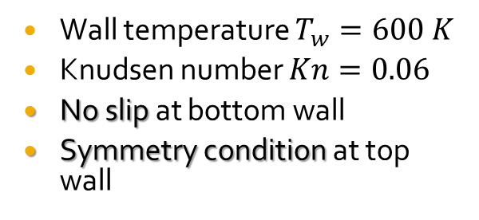
Raleigh flow
Bottom wall diffuse, sliding
Top wall – specular, stationary
Wall velocity $v_{w}=66 ms^{−1}$
Wall temperature $T_{w}=600 K$
Knudsen number $Kn=0.06$
No slip at bottom wall
Symmetry condition at top wall

Slide 22
Overview
Introduction
Motivation
The scheme
Results
Summary and future work

Slide 23
Summary and future work
3-D working code developed (tested for 1-D only)
Simple hard-sphere model for collisions
Sample test problems
Improvements
Variance reduction to improve efficiency
Other boundary conditions
Inlet/outlet
Pressure boundary
Better collision model
Extension to moderately dense flows
Coupling with conventional CFD solvers for multi-scale problems

Slide 24
Thank you
Questions?

Slide 25
Bibliography
Alexander, F.J., and Garcia, A.L., The direct simulation Monte Carlo method, Computer simulations. Vol 11(6), p. 588-592, 1997.
Oran, E.S., Oh, C.K., and Cybyk, B.Z., Direct simulation Monte Carlo: Recent advances and applications, Annual Review of Fluid Mechanics. Vol 30, p. 403-441, 1998.
Bird, G.A., Molecular gas dynamics. Clarendon, Oxford, 1976.
Bird, G.A., Molecular gas dynamics and the direct simulation of gas flows. Calrendon, Oxford, 1994.

Slide 26

Appendix
Reflection off the walls
Specular wall
Only normal component gets reversed
Assumed as perfectly elastic collision
Diffuse thermal wall
All three components reset as per a biased Maxwellian distribution
Normal component
Tangential component
$$P_{n}\left(u_{n}\right)=\frac{m}{k_{B}T_{w}}u_{n}e^{−\frac{mu_{n}^{2}}{2k_{B}T_{w}}}$$
$$P_{t}\left(u_{t}\right)=\sqrt{\frac{m}{2{πk}_{B}T_{w}}}e^{−\frac{mu_{t}^{2}}{2k_{B}T_{w}}}$$

Slide 27

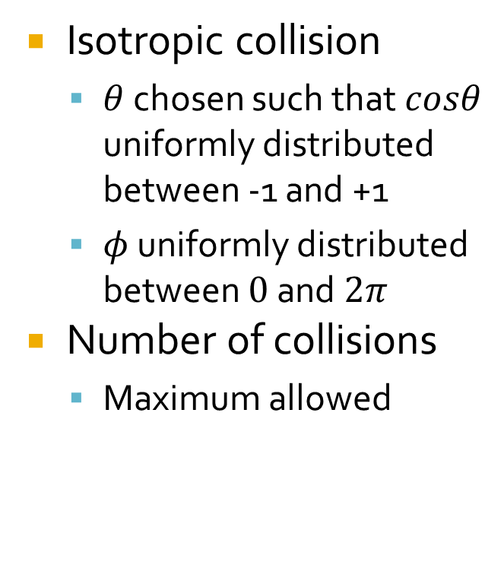
Appendix
Isotropic collision
$θ$ chosen such that $cosθ$ uniformly distributed between -1 and +1
$φ$ uniformly distributed between $0$ and $2π$
Number of collisions
Maximum allowed
$$cosθ=2η−1$$
$$sinθ=\sqrt{1−\cos^{2}{θ}}$$
$$φ=2πη$$
$$M_{col}=\frac{N_{c}^{2}πd_{p}^{2}\left\langle u_{r}\right\rangle N_{eff}Δt}{2ΔV}$$

Slide 28
Appendix
Procedure for time-accurate calculations
Perform multiple realizations
Perform averaging over every cell in every time-step
Perform ensemble averaging over the different realizations

