Slide 1
Topic Modeling on News Articles
- Nagendra K P
[24ETCS126011]

Slide 2
Introduction
Topic Modeling is an unsupervised NLP technique used to uncover hidden thematic structures in text data.
It helps in organizing, summarizing, understanding massive textual datasets.
Applied in news categorization, recommendation systems, summarization, and more.

Slide 3
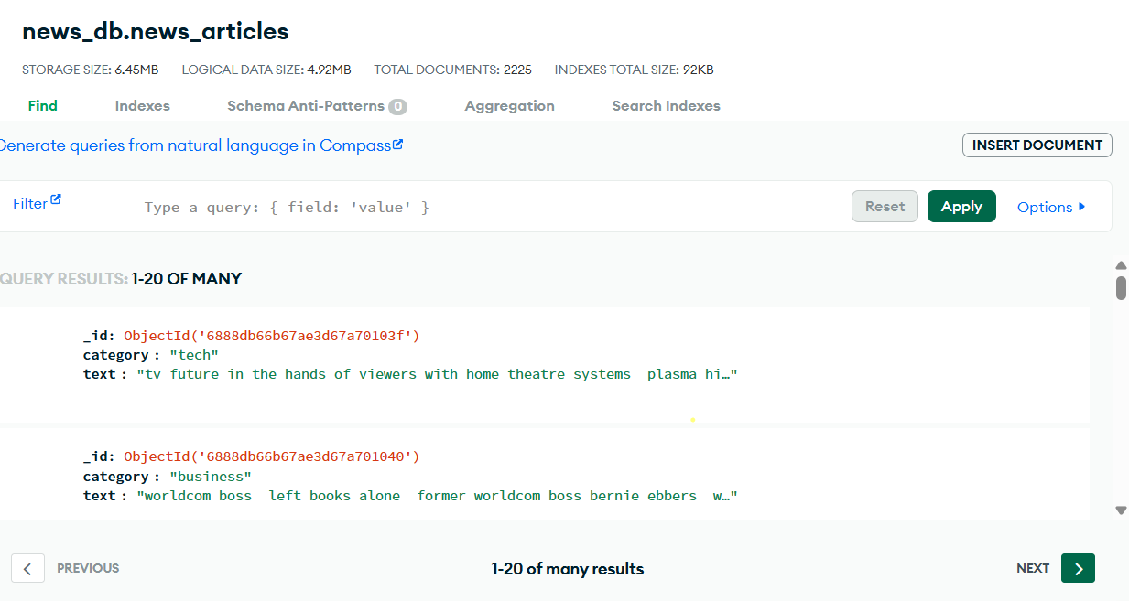
Dataset Description
Total of 2,256 news articles collected from MongoDB, covering multiple categories like Politics, Sports, Technology, etc.
Dataset includes two main features:
text: The main content of the news article.
category: The article's label/category (used only for validation, not supervised training).

Slide 4
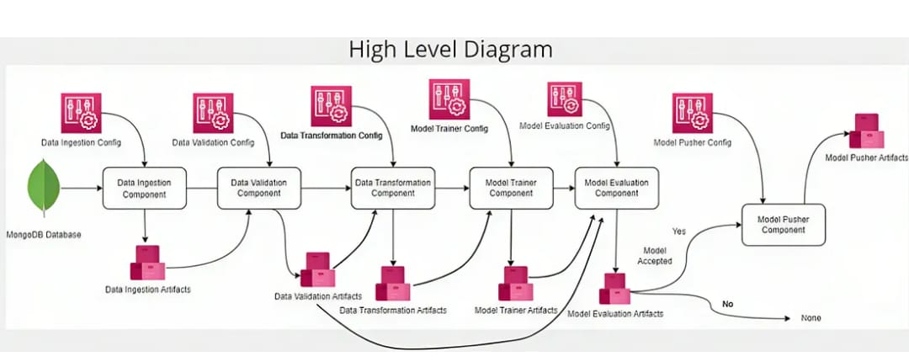
Architecture

Slide 5
Methodology
Data Ingestion: Fetch news articles from MongoDB.
Data Validation: Schema validation and anomaly checks.
Data Transformation: Preprocessing (Tokenization, Stopword removal, Lemmatization).
Model Training: Build LDA & LSA models.
Model Evaluation: Coherence score computation to select best model.

Slide 6
Text Preprocessing
Steps: Lowercasing, removing stopwords, punctuation, and digits.
Lemmatization using spaCy.
Tokenization: Splitting corpus into meaningful words.

Slide 7
Algorithms Used
1. Latent Dirichlet Allocation (LDA)
Probabilistic model where documents are mixtures of topics.
Widely used for unsupervised topic discovery.
2. Latent Semantic Analysis (LSA)
Dimensionality reduction using SVD.
Captures relationships between terms and documents in reduced latent space.

Slide 8
Model Evaluation
Coherence Score:
Measures the semantic similarity between high-scoring words in a topic.
Higher coherence → More interpretable topics.
Metric is computed for both LDA and LSA models to select the better-performing model.

Slide 9
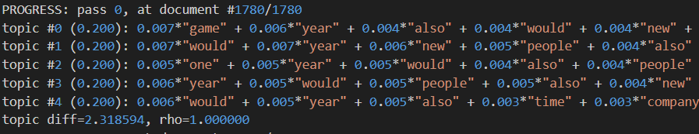
Output

Slide 10
Applications of Topic Modeling
News categorization
Customer feedback analysis
Recommendation systems
Trend analysis in social media or business

