Slide 1
BLUESTOCK
Mutual Fund Analytics Platform
End-to-end data pipeline, performance analytics & investor insights
Project Presentation · August 2026
01

Slide 2
THE CHALLENGE
Problem & Objective
Problem
Objective
Mutual fund data in India is fragmented across scheme masters, daily NAVs, investor transactions, and benchmark indices — making it hard to answer simple questions like “which funds are actually worth holding, on a risk-adjusted basis?”
1
Build a clean, warehoused view of scheme, NAV, and transaction data
2
Quantify risk-adjusted performance (Sharpe, Sortino, alpha, beta, drawdown)
3
Rank funds with a transparent, weighted composite scorecard
4
Deliver the results as an interactive, filterable Power BI dashboard
02

Slide 3
FOUNDATIONS
Data Sources
1,522
46,000
32,778
40
Schemes in the industry-wide fund master
Daily NAV records
Investor transactions
Schemes with full performance instrumentation
10 fund houses tracked
Jan 2022 – May 2026, 40 schemes
₹352.16 Cr, Jan 2024 – May 2025
Sharpe, Sortino, alpha, beta, drawdown
Two layers: broad industry reference data (scheme master, AUM, SIP inflows, folios) for market-level trends, and a curated 40-scheme analytical sample for deep performance analytics.
03

Slide 4
HOW IT'S BUILT
Architecture
Raw Data
Clean & Validate
SQLite Warehouse
Analytics
Power BI
10 CSV extracts:
scheme master, NAV,
transactions, benchmarks
→
Python scripts:
null/dup checks,
referential integrity
→
Star schema:
dim_fund + 3 fact
tables (bluestock_mf.db)
→
Jupyter notebooks:
EDA + performance
metrics & scorecard
→
5-page interactive
dashboard, filters
& drill-through
Every stage is a standalone, re-runnable Python script — favouring transparency and auditability over premature automation.
Reference: schema.sql (star schema) · queries.sql (10 canonical queries) · database_load.py (SQLAlchemy loader)
04

Slide 5
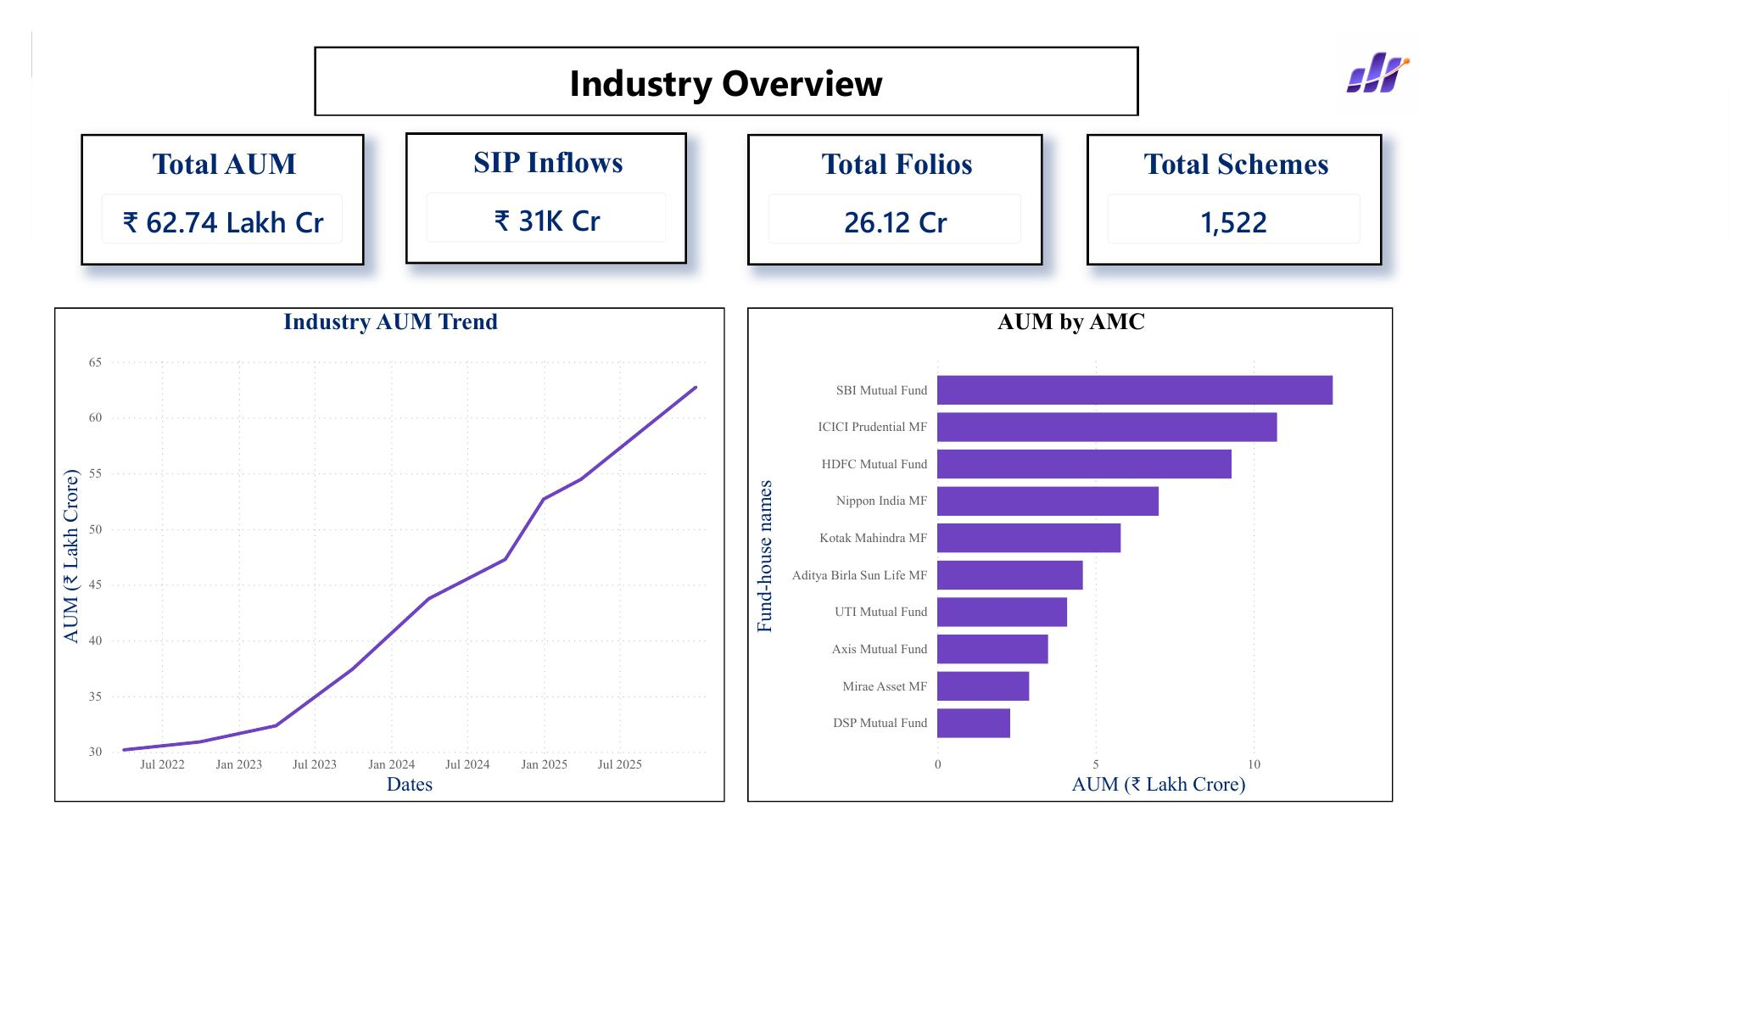
EXPLORATORY ANALYSIS · PART 1 OF 2
Market-Level Trends
₹62.74L Cr
Total industry AUM — more than doubled since mid-2022
₹31,002 Cr
All-time-high monthly SIP inflow
26.12 Cr
Total investor folios, growing steadily since 2022
SBI MF
Industry Overview — Power BI
Largest AUM among the 10 fund houses tracked
05

Slide 6
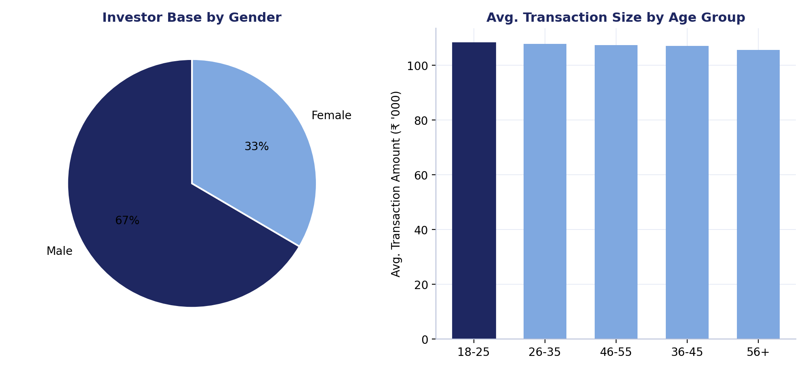
EXPLORATORY ANALYSIS · PART 2 OF 2
Investor Base & Behaviour
Liquid funds
Largest monthly category inflow (₹32–42K Cr) — used as cash management, not growth
T30 cities
66.3% of transaction volume vs. 33.7% from B30 cities
KYC
91.9% fully verified; 8.1% pending follow-up
Payment mix
UPI, Net Banking, Cheque, Mandate each ~24–25%
06

Slide 7
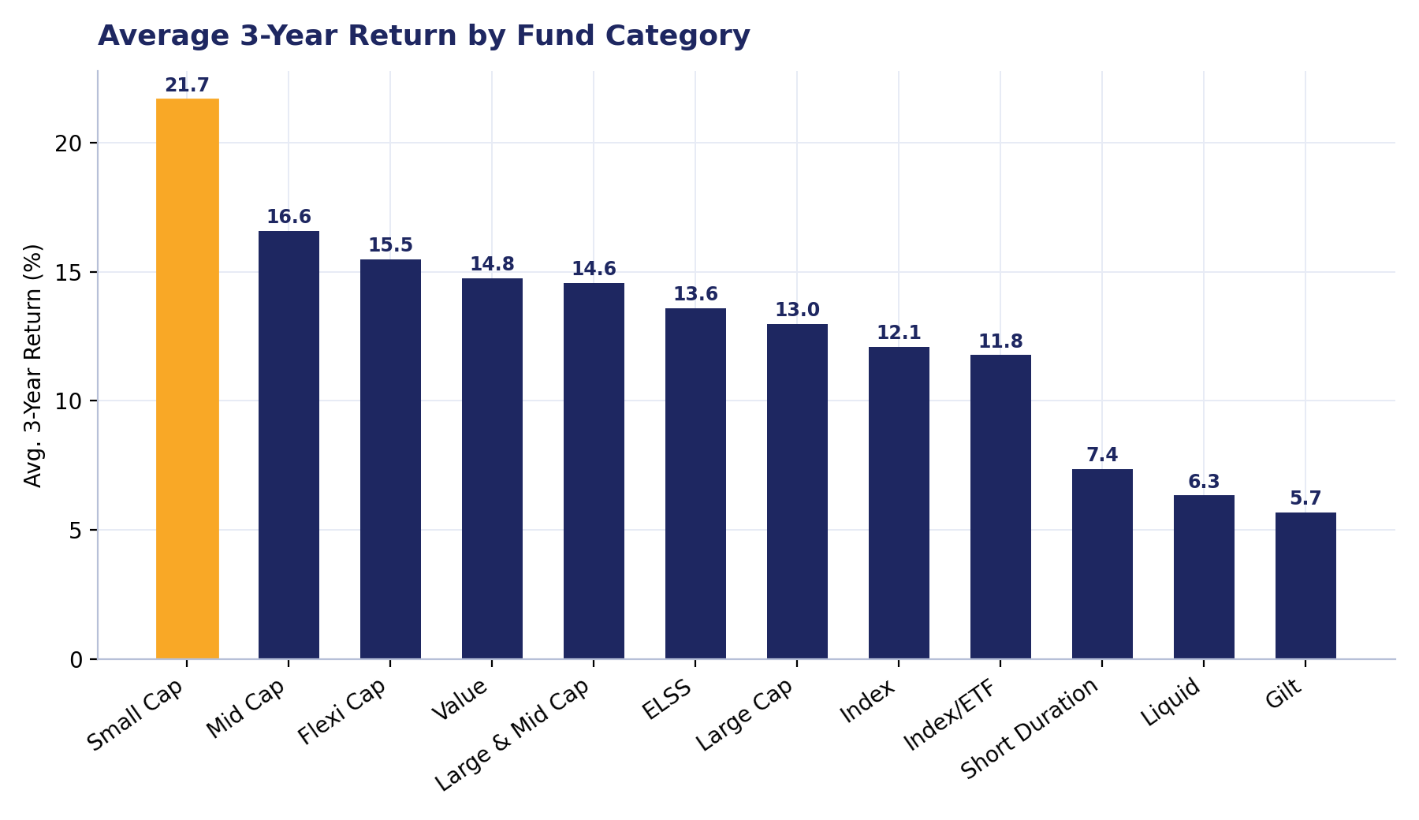
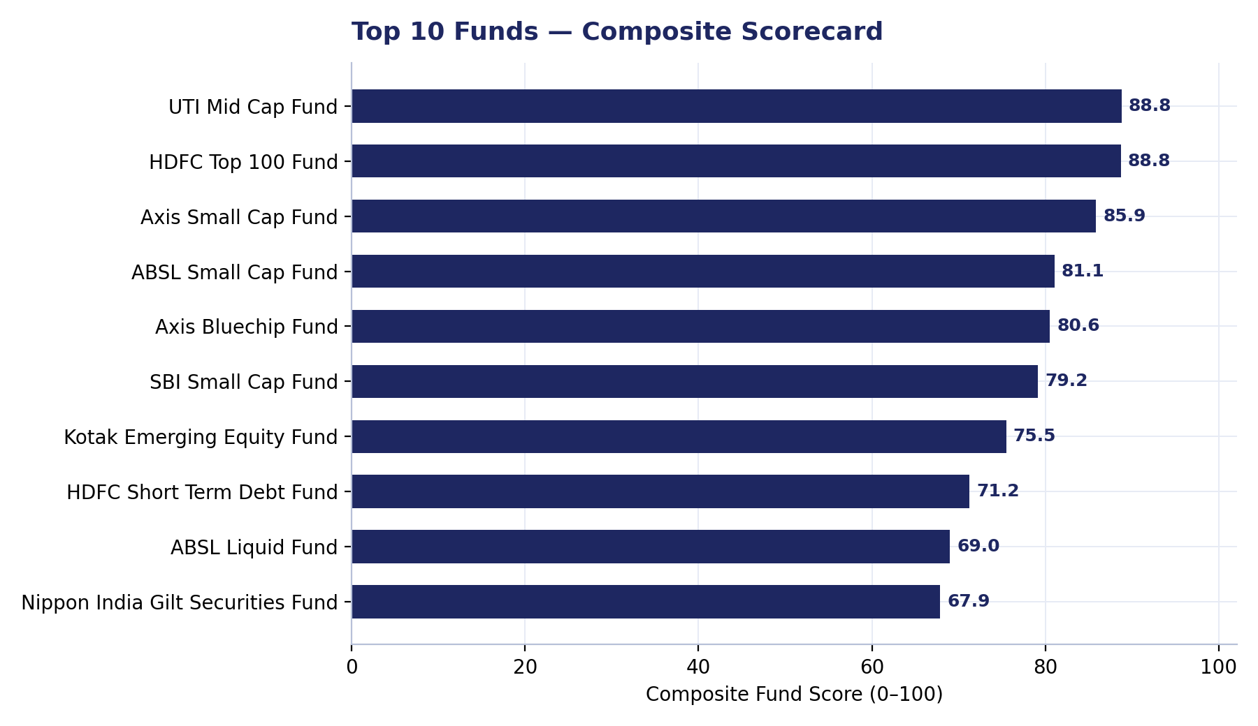
PERFORMANCE ANALYTICS · PART 1 OF 2
Risk, Return & the Fund Scorecard
Small Cap leads on 3-yr return (21.7%) but carries the highest risk; Gilt/Liquid anchor the low end. UTI Mid Cap Fund and HDFC Top 100 Fund top the composite scorecard at 88.8/100, blending CAGR, Sharpe, alpha, cost, and drawdown.
07

Slide 8
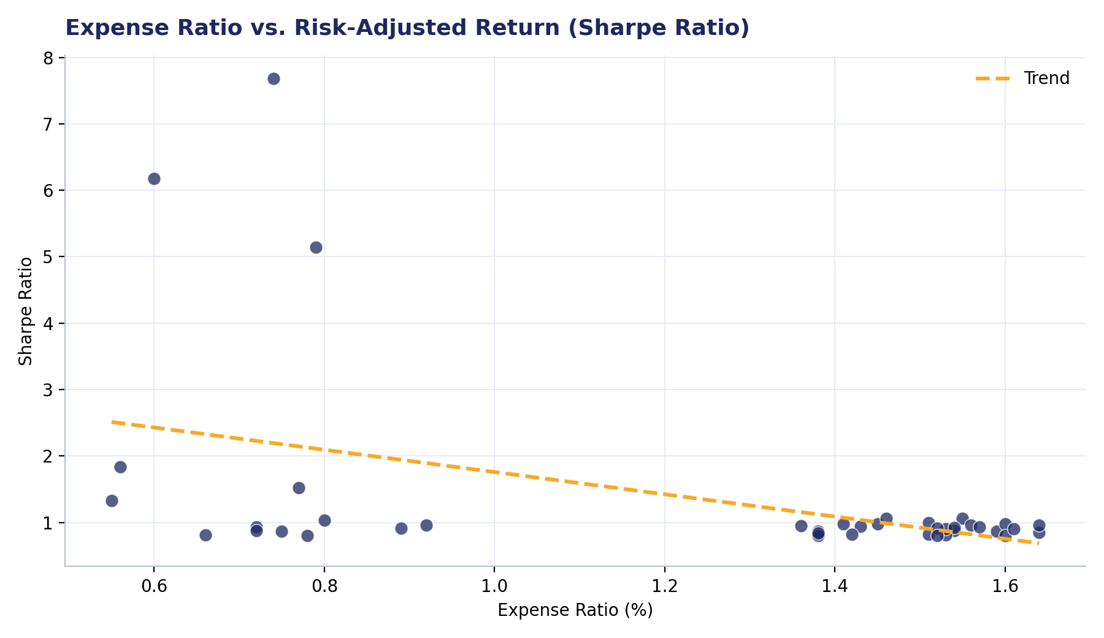
PERFORMANCE ANALYTICS · PART 2 OF 2
Cost Efficiency & Key Correlations
Correlation Snapshot
Beta ↔ 3-yr Return
+0.73
Market sensitivity is the strongest single driver of realised return
Expense Ratio ↔ Sharpe
−0.44
Confounded by asset mix — debt funds are both cheaper and lower-vol
Expense Ratio ↔ 3-yr Return
+0.51
Not causal — reflects equity funds costing more than debt funds
08

Slide 9
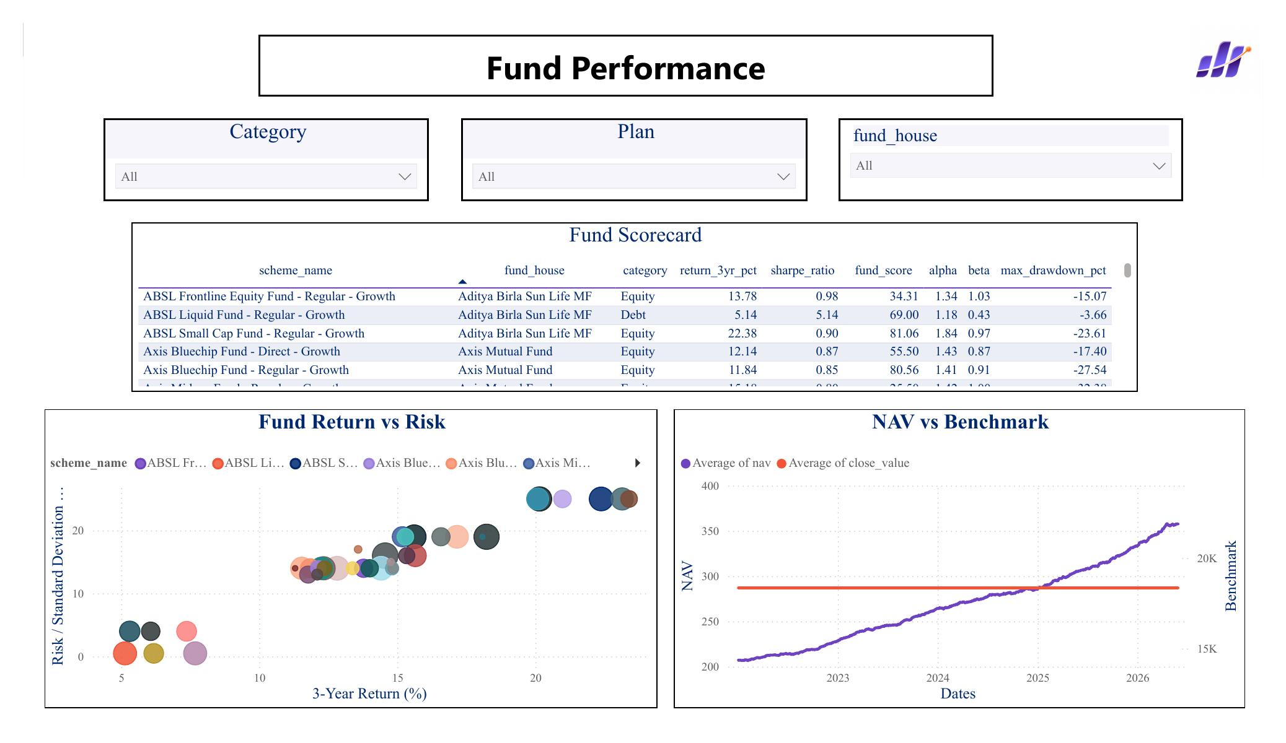
THE DELIVERABLE · PART 1 OF 2
Dashboard — Overview & Fund Performance
Industry Overview
Fund Performance
09

Slide 10
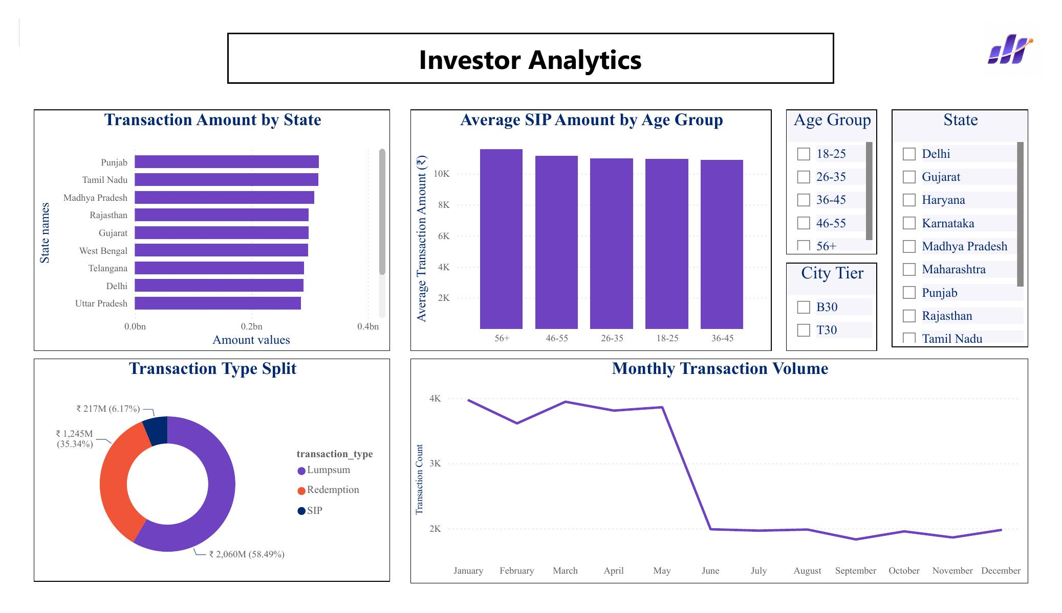
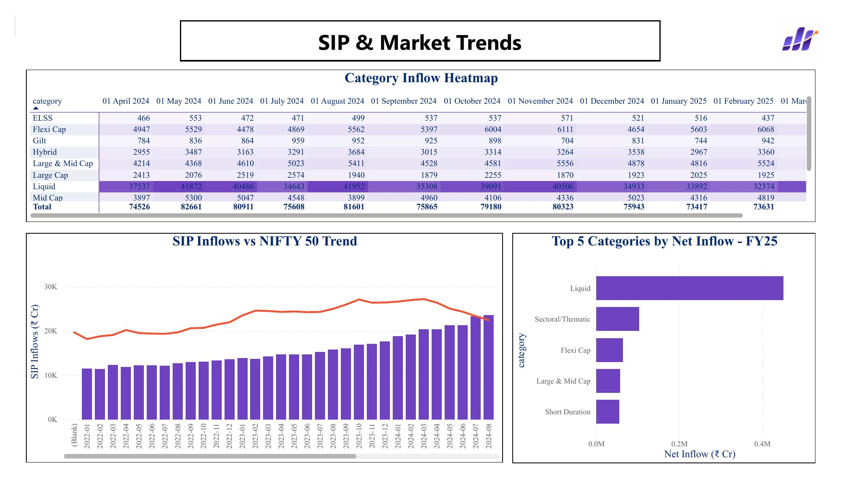
THE DELIVERABLE · PART 2 OF 2
Dashboard — Investor Analytics & SIP Trends
Investor Analytics
SIP & Market Trends
10

Slide 11
BRINGING IT TOGETHER
Key Findings
1
AUM more than doubled since 2022, with SIP inflows at an all-time high — the retail growth story is intact.
2
Return closely tracks risk: beta explains most of the return spread across the 40-scheme sample (corr. +0.73).
3
UTI Mid Cap and HDFC Top 100 lead the composite scorecard, balancing return, risk, cost, and drawdown — not just chasing raw CAGR.
4
Investor base still skews male and T30-city, with SIP dominant by count but lumpsum dominant by value.
5
The 40-scheme analytical sample is a strong proof of concept but should not be read as representative of the full 1,522-scheme market.
11

Slide 12
Thank You
Bluestock Mutual Fund Analytics · Questions & Discussion
12

