Slide 1
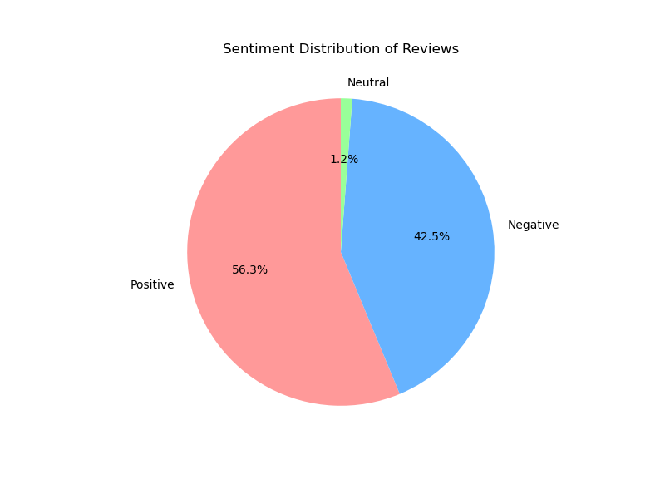
Sentiment Distribution of Reviews

Slide 2
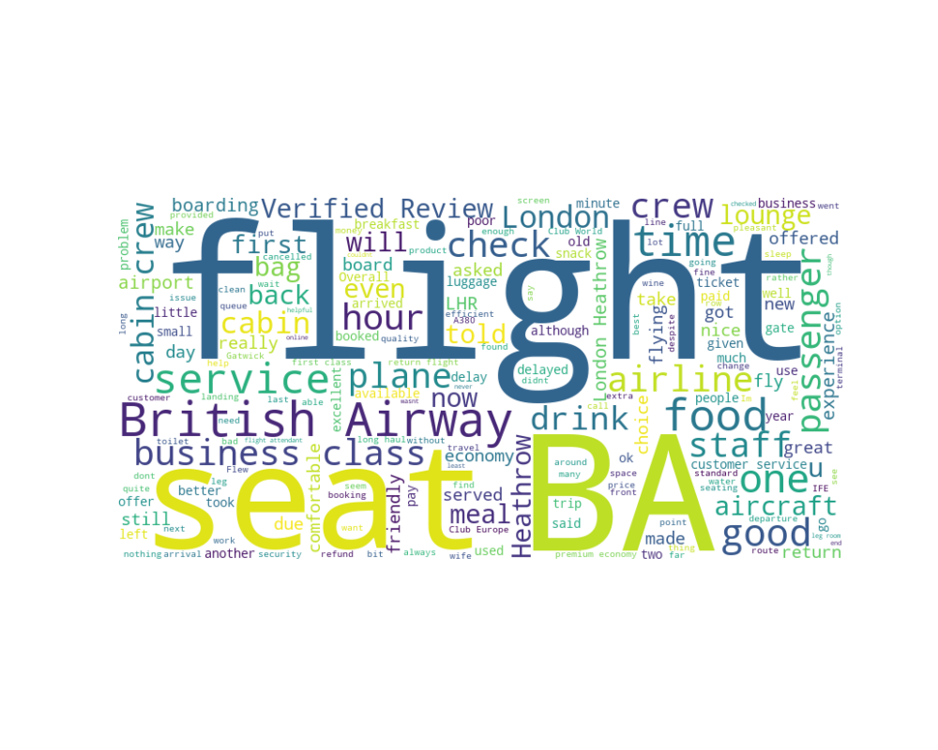
Frequent Terms in Reviews

Slide 3
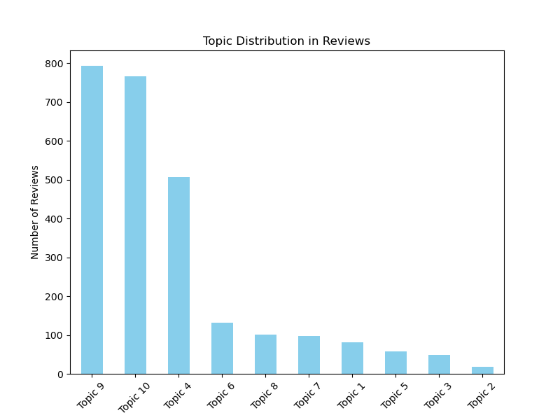
Topic Distribution in Reviews

Slide 4
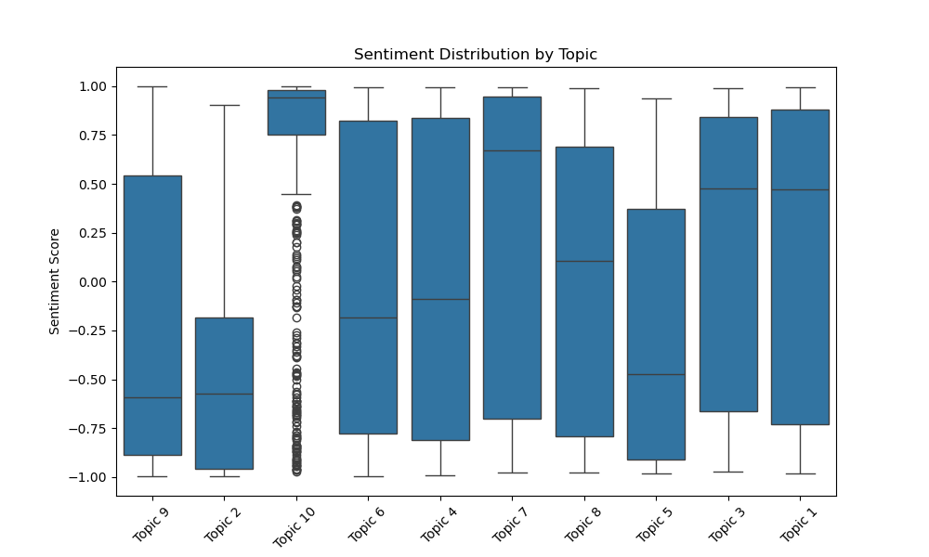
Sentiment vs. Topics

Slide 5
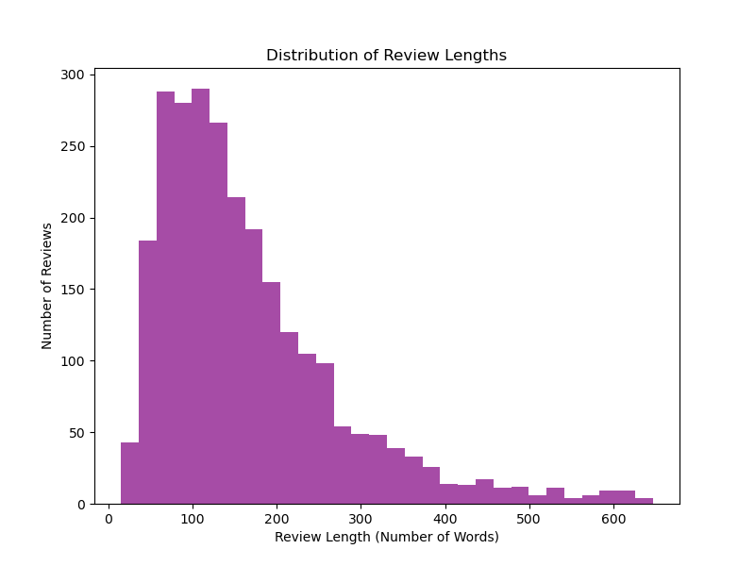
Distribution of Review Lengths

Slide 6
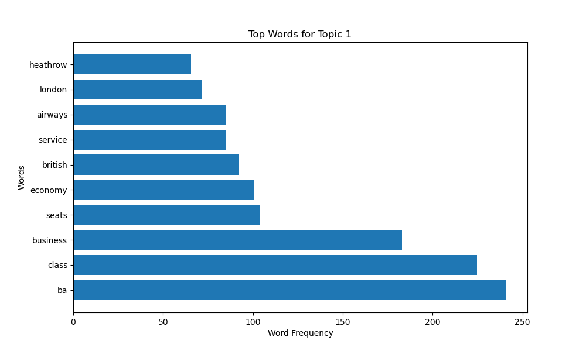
Top Words for Topic 1

Slide 7
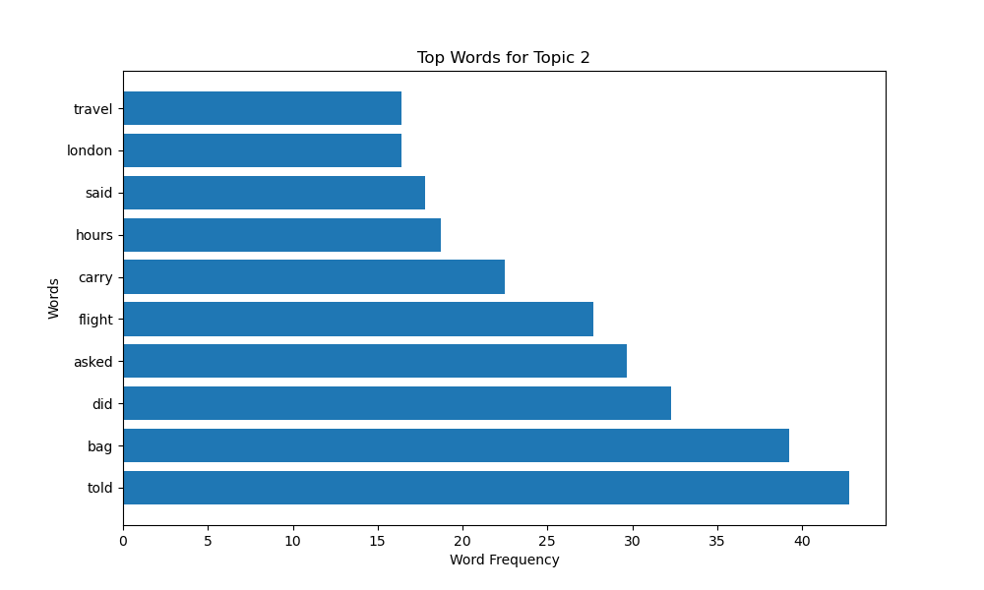
Top Words for Topic 2

Slide 8
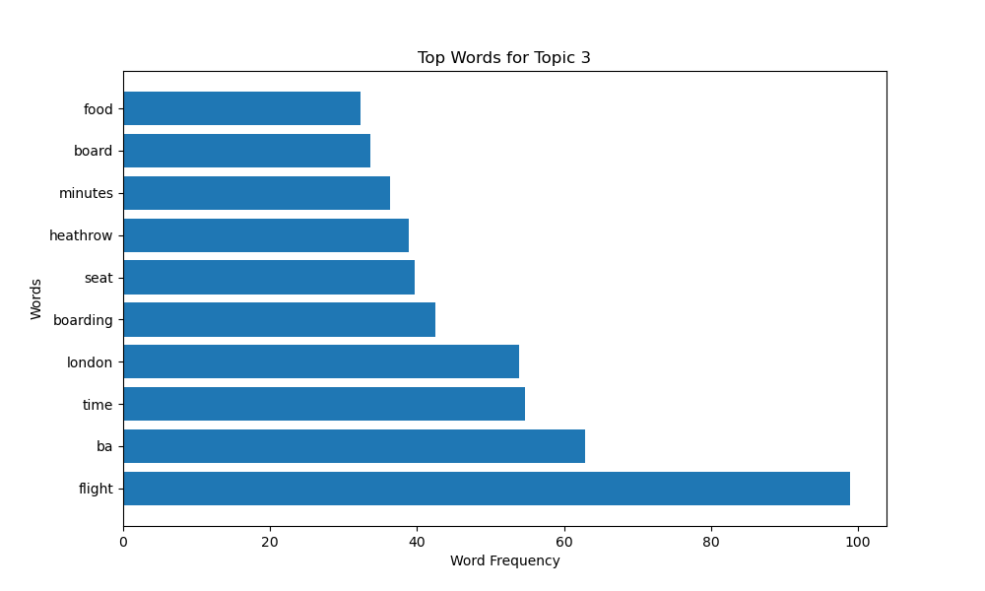
Top Words for Topic 3

Slide 9
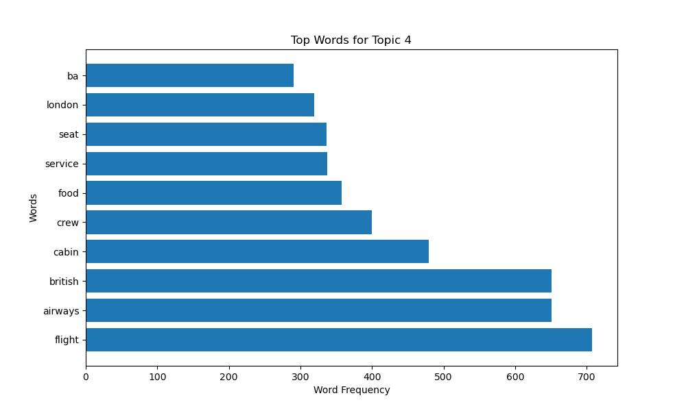
Top Words for Topic 4

Slide 10
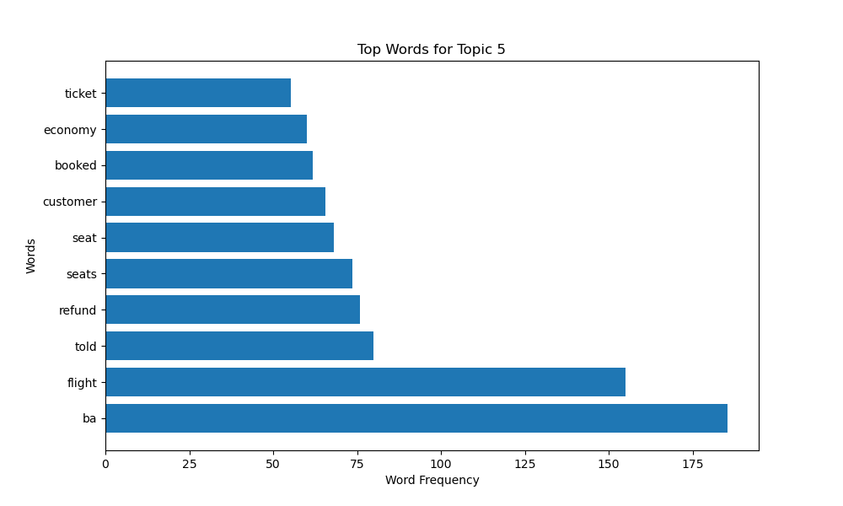
Top Words for Topic 5

Slide 11
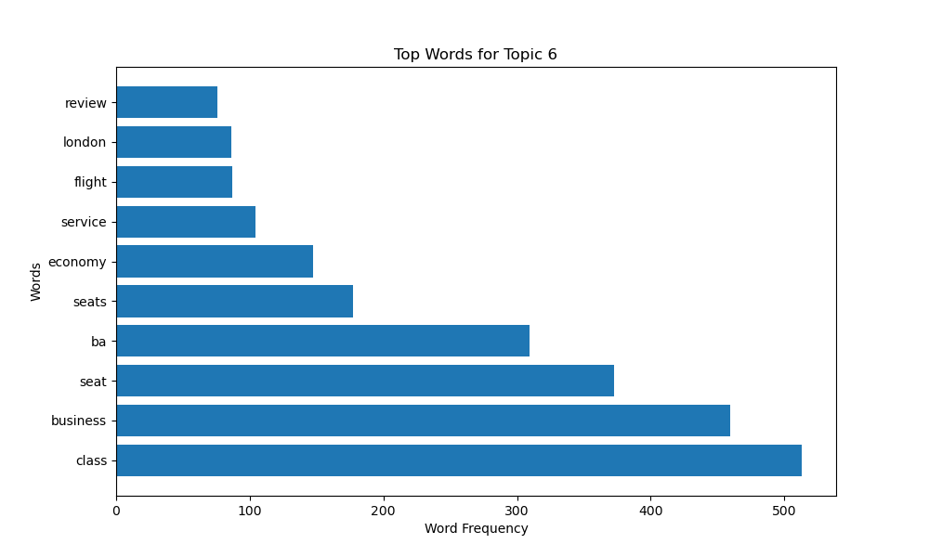
Top Words for Topic 6

Slide 12
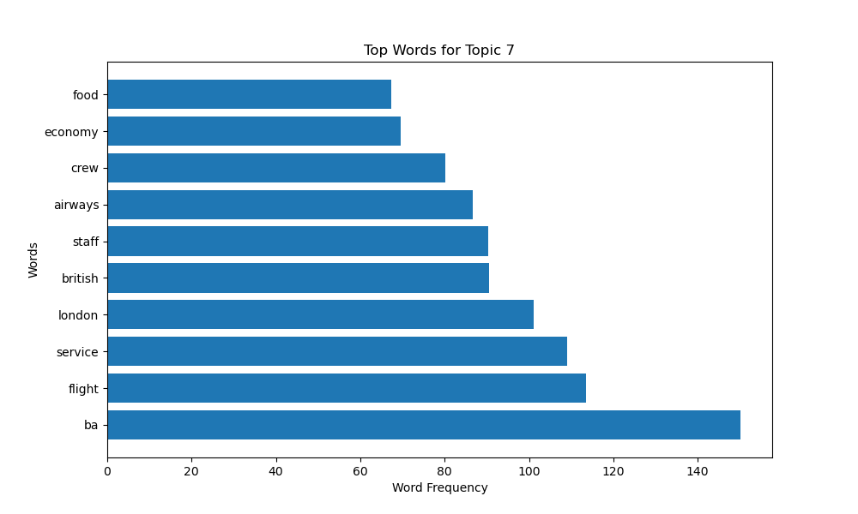
Top Words for Topic 7

Slide 13
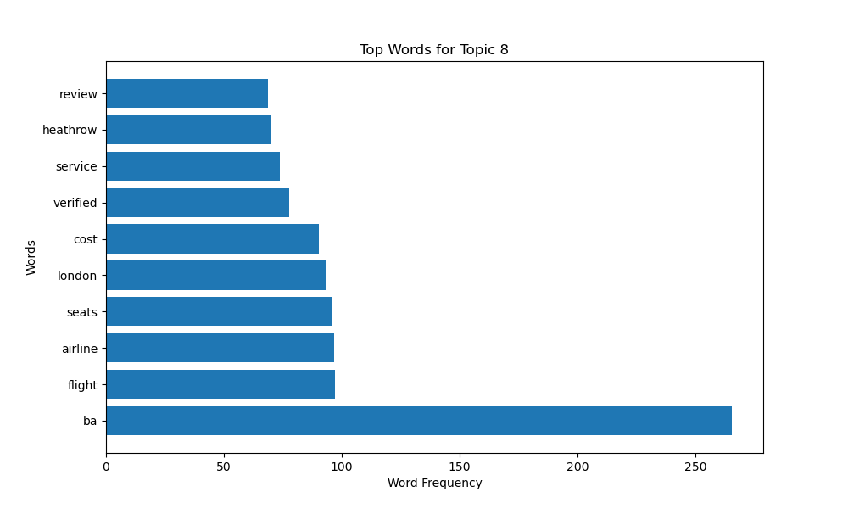
Top Words for Topic 8

Slide 14
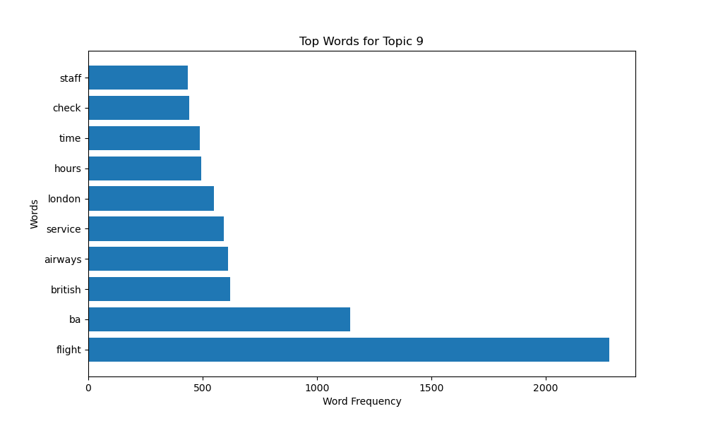
Top Words for Topic 9

Slide 15
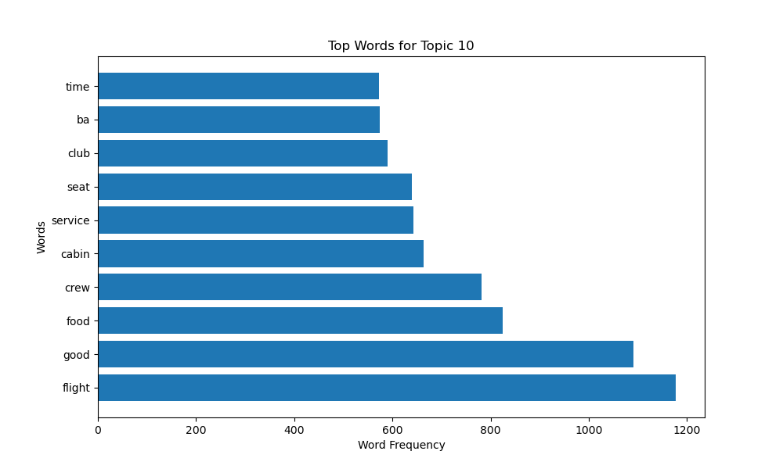
Top Words for Topic 10

