Slide 1
Predictive Modeling for Customer Booking Completion
Summary of Model Performance and Feature Importance

Slide 2
Model Performance
Model Evaluation Metrics:
- Accuracy: 0.8561
- Cross-validation scores: [0.8504, 0.7873, 0.7267, 0.5566, 0.771]
- Average CV score: 0.7384
- Precision (No Booking): 0.87
- Recall (No Booking): 0.98
- F1-Score (No Booking): 0.92
- Precision (Booking): 0.57
- Recall (Booking): 0.12
- F1-Score (Booking): 0.19
- Macro Average F1-Score: 0.56

Slide 3
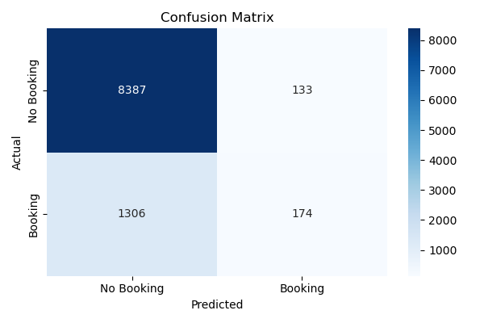
Confusion Matrix

Slide 4
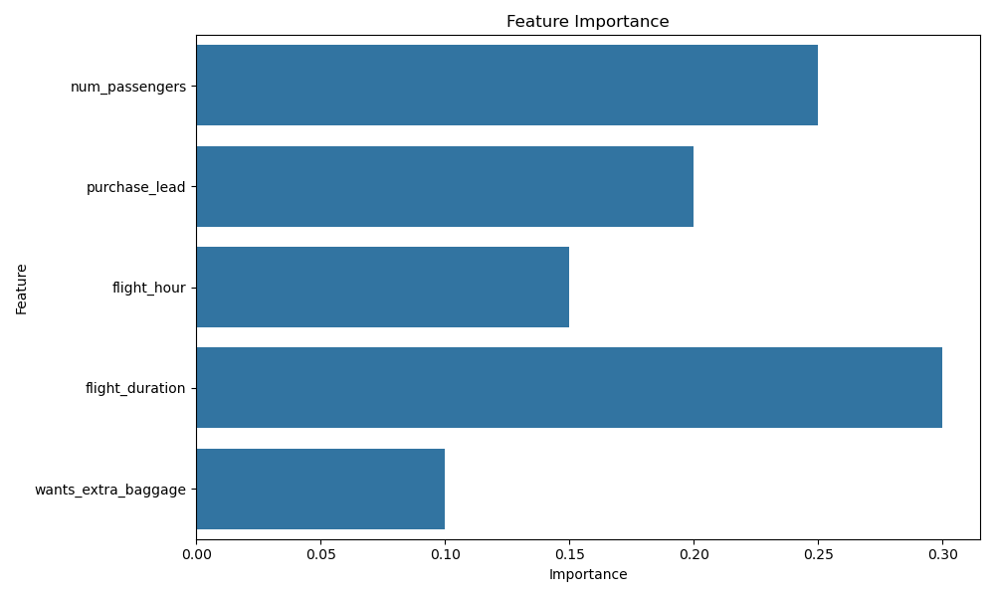
Feature Importance

